Slide 1

Department of Electrical & Electronic Engineering
Bangladesh University of Engineering and Technology
Dhaka, Bangladesh
EEE 6608: Machine Learning & Pattern Recognition
Speech Emotion Recognition Using 1D CNN
Name: Md. Intikhab Shahriar Hasan
Roll No.: 0424062503
Session: April 2024

Slide 2









Speech Emotion Recognition (SER)
What’s Emotion Recognition?
Emotion Recognition is the ability to precisely infer human emotions
Utilizing facial expressions, body language, speech patterns, and text.
Why it’s important?
Human-Computer Interaction (HCI) & Robotics
→ More intuitive and responsive to user emotions
Mental Health and Well-being
Detecting signs of stress, anxiety, or depression, enabling timely interventions
Security & Surveillance
Unusual or aggressive behaviors from emotional cues
Marketing and Customer Experience
→Gauge consumer reactions to products, services,
Emotion Recognition using speech signals

Slide 3
Speech Emotion Recognition (SER)
Advantages of Emotion Recognition from speech signals:
Non-Intrusive and Privacy-Friendly
→ Only audio input is required
→ Cameras capture visual data, intruding on privacy
Effective in Low-Visibility Conditions
→ Works in low-light, dark, or visually obstructed environments
Suitable for phone calls or virtual meetings without video
Unobstructed by Physical Appearance or Expression Limitations
Can detect emotions even if a person’s face is obscured, hidden, or masked, eg. in online meetings or while wearing face masks
Can detect emotions that are not strongly expressed in facial features, eg. sounds angry but the facial expression is neutral
Works in Unstructured and Natural Conversations
Text-based approaches struggles with sarcasm, irony, or subtle emotions that aren’t conveyed in words
SER works while emotions are conveyed through tone, pitch, and vocal intonation, even if the words themselves are neutral.
Emotion Recognition using speech signals

Slide 4
Emotional Speech Dataset
Toronto Emotional Speech Set (TESS)
→ 2800 speech samples
→ 2 actors, 1400 samples per speaker
7 different emotion classes
400 sample audios for each of the classes
Prior Works
References & Year | Features Extracted | Architecture Used | Performance
[6], 2024 | Multiple Time & Freq domain Features | Ensembling A (CNNs), B (BiLSTM-FCN), C (BiLSTM-FCN with transformer) Networks | 99.857 %
[7], 2023 | MFCC Spectrogram | CNN+LSTM+Attention | 99.81 %
[6] Mengsheng Wang, Hongbin Ma, Yingli Wang, Xianhe Sun, Design of smart home system speech emotion recognition model based on ensemble deep learning and feature fusion. https://doi.org/10.1016/j.apacoust.2024.109886
[7] Singh J, Saheer LB, Faust O. Speech Emotion Recognition Using Attention Model. International Journal of Environmental Research and Public Health. 2023; 20(6):5140. https://doi.org/10.3390/ijerph20065140

Slide 5





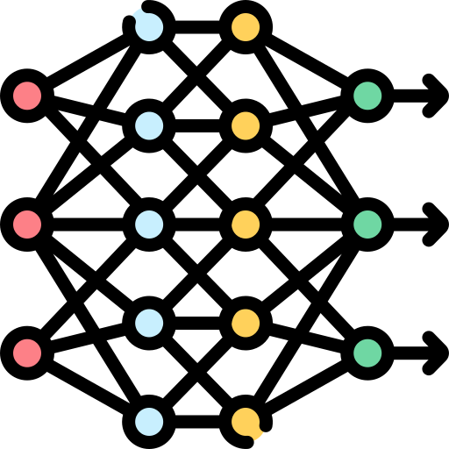




Proposed Approach
Capturing Speech Signal
Pre-processing
Feature Vector
Feature Extraction
Mel-Frequency Cepstral Coefficients
Flattening
Setting Offset & Clipping Duration/ Zero Padding
Human Subject
Emotion Recognition
Angry
Train Classifiers e.g., 1-D CNN
Disgust
Fear
Happy
Neutral
Sad
Surprise

Slide 6
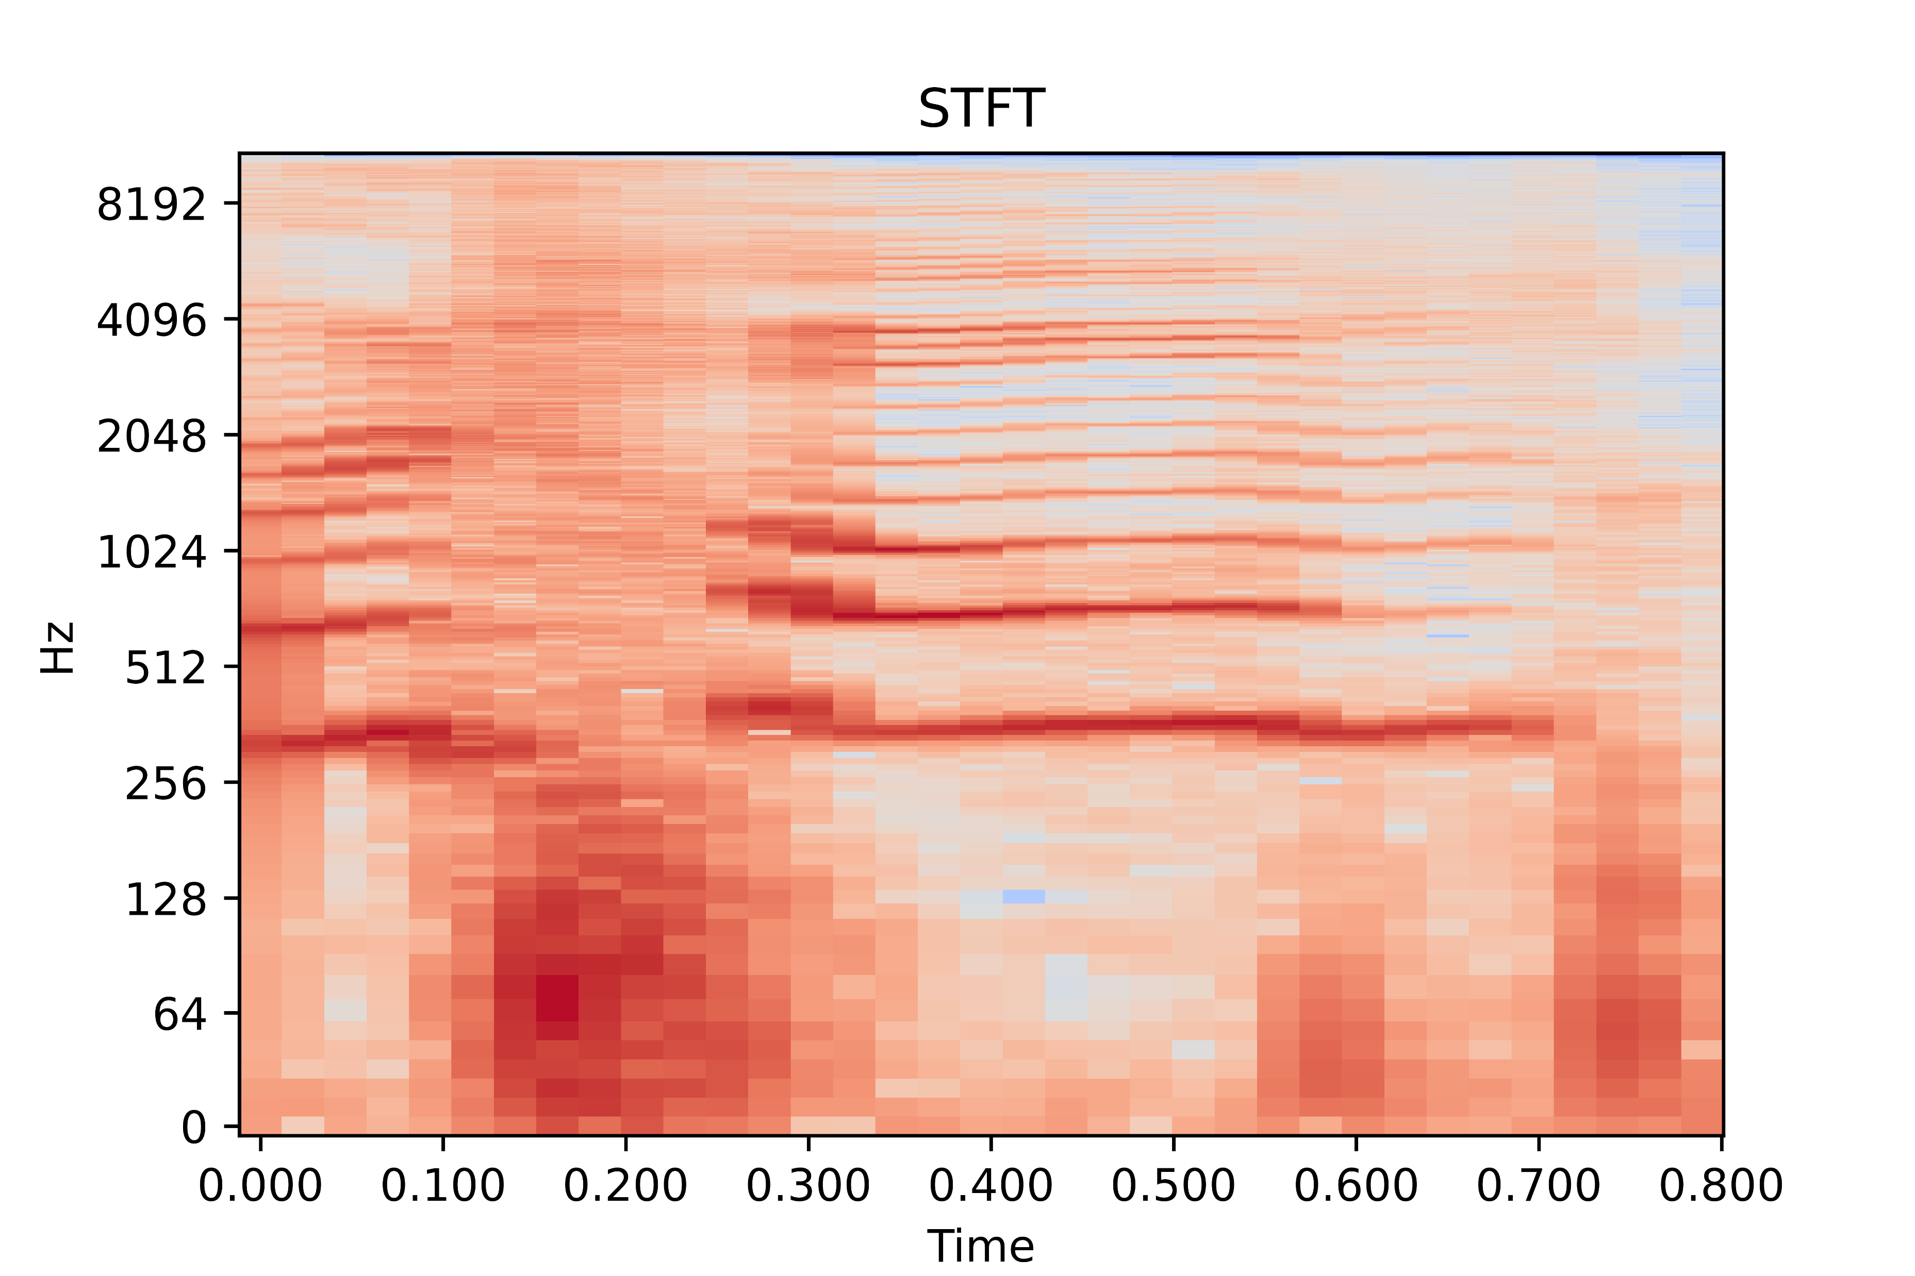
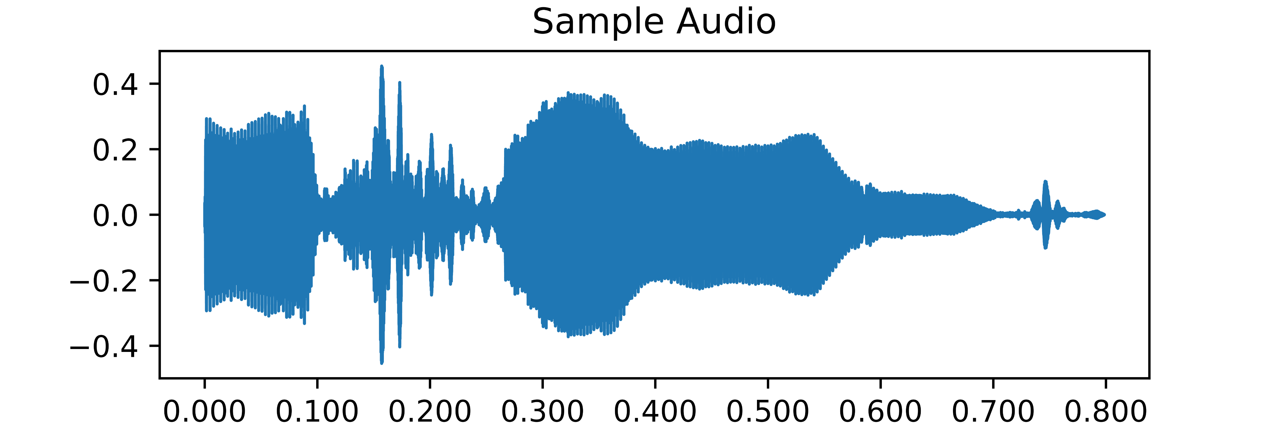
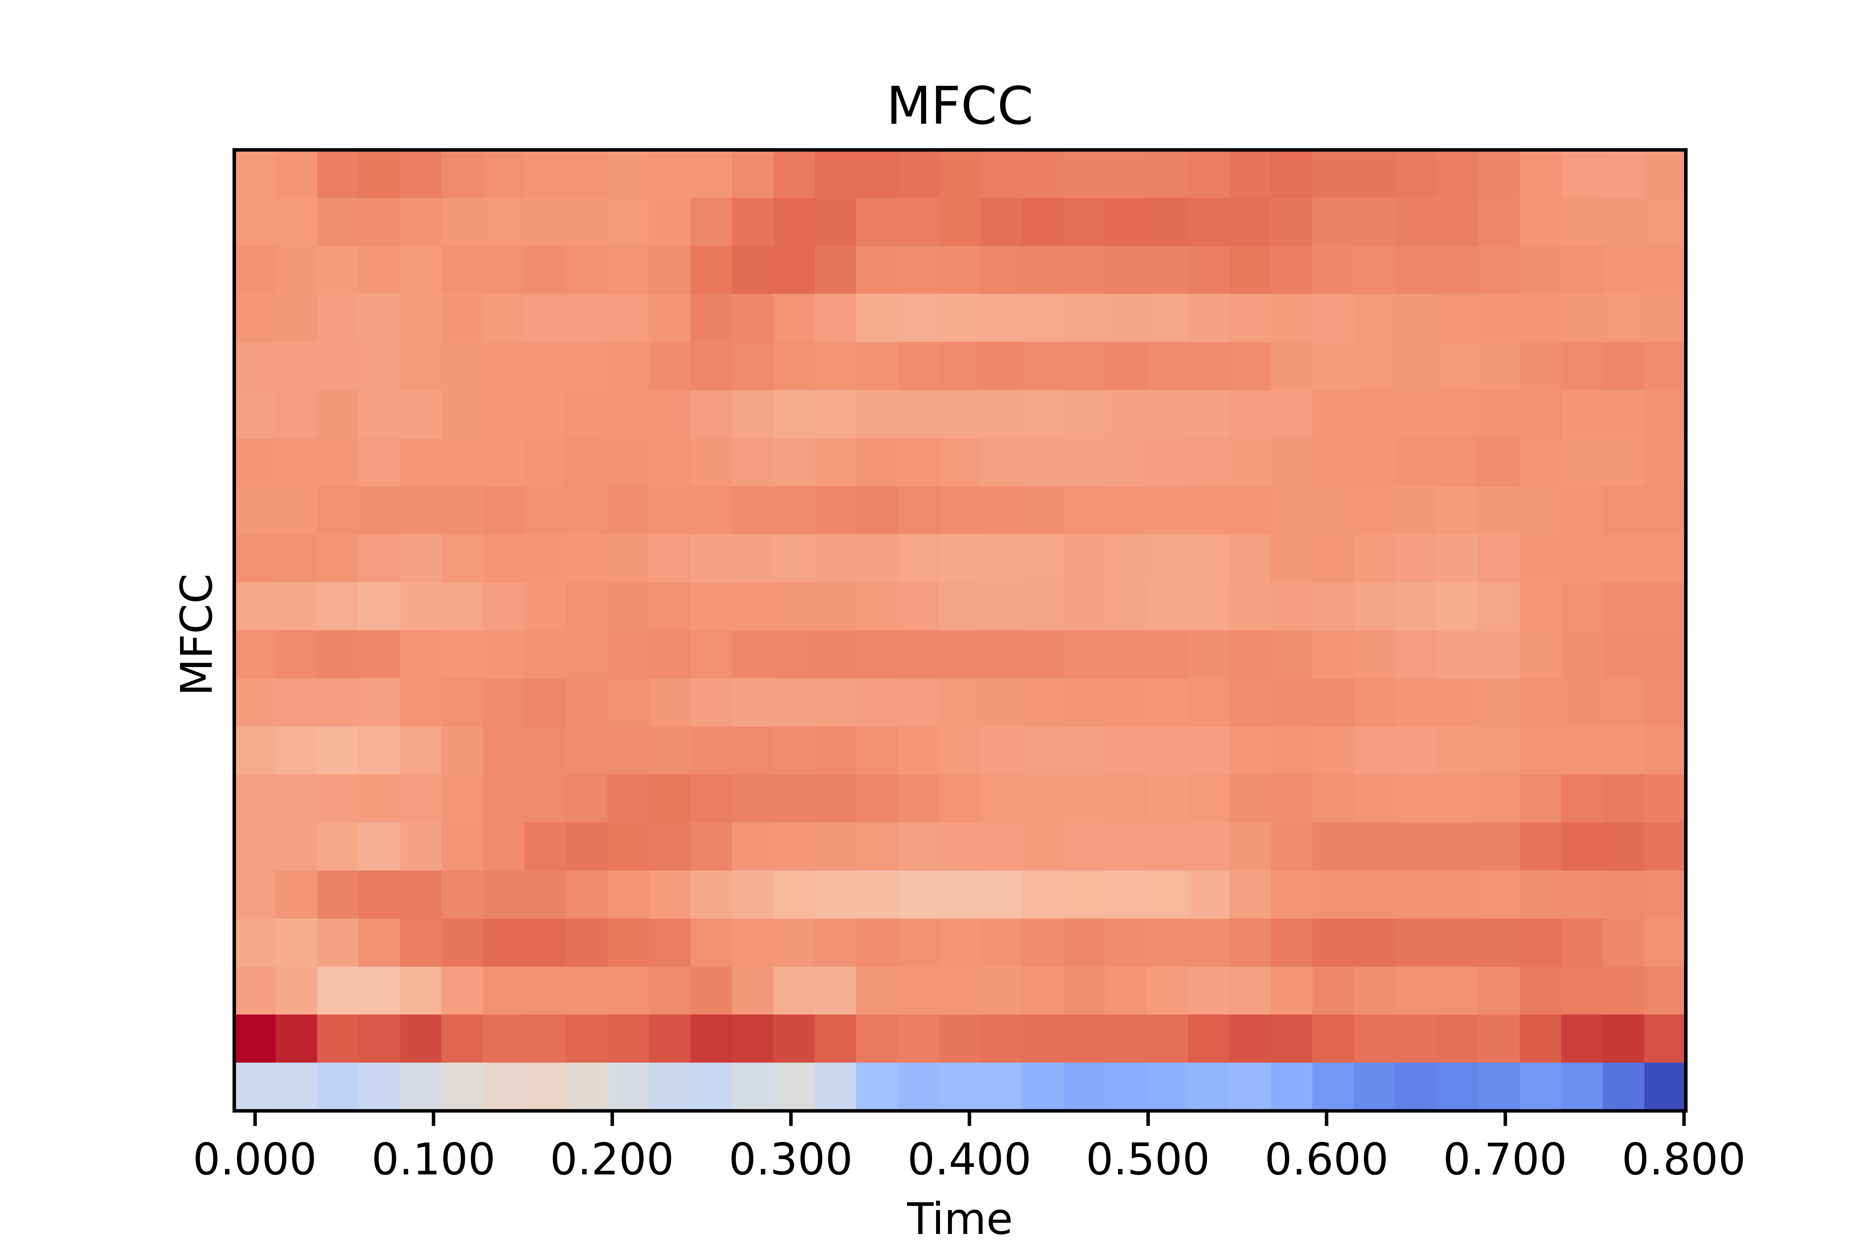
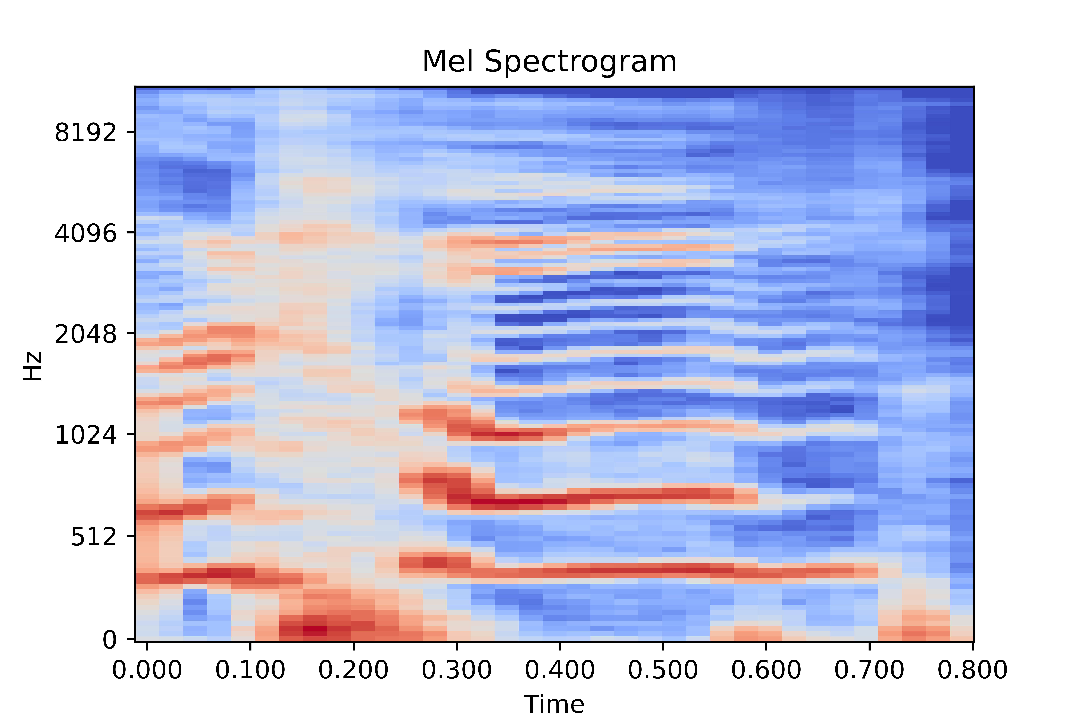
Feature Extraction
Capturing Speech Signal
STFT
Human Subject
Mel Scale
Feature Vector
Flattening
DCT

Slide 7
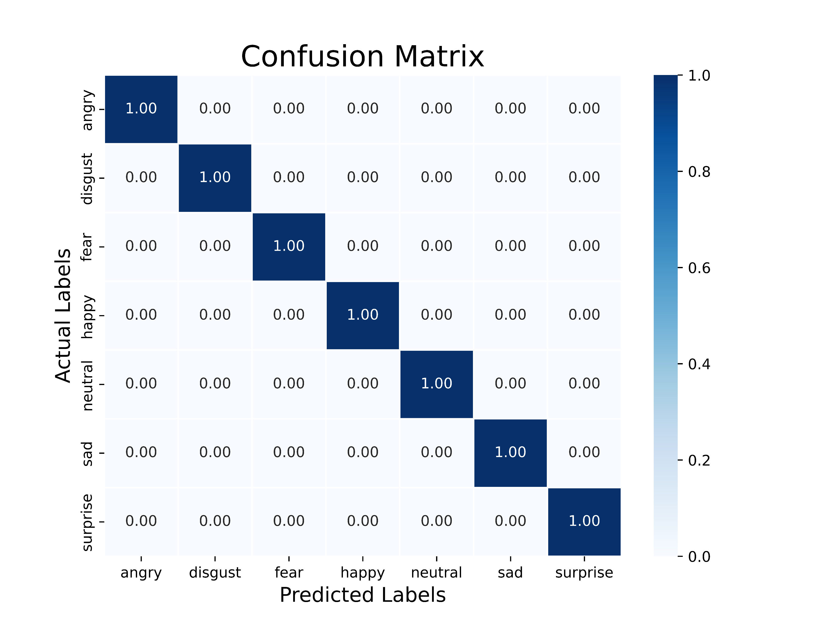
Performance Analysis
Classifier | Result (%)
Decision Tree | 78.39
Random Forest | 97.68
SVM | 98.21
XGBoost | 96.96
1D CNN | 100
Results obtained using 1D CNN

Slide 8
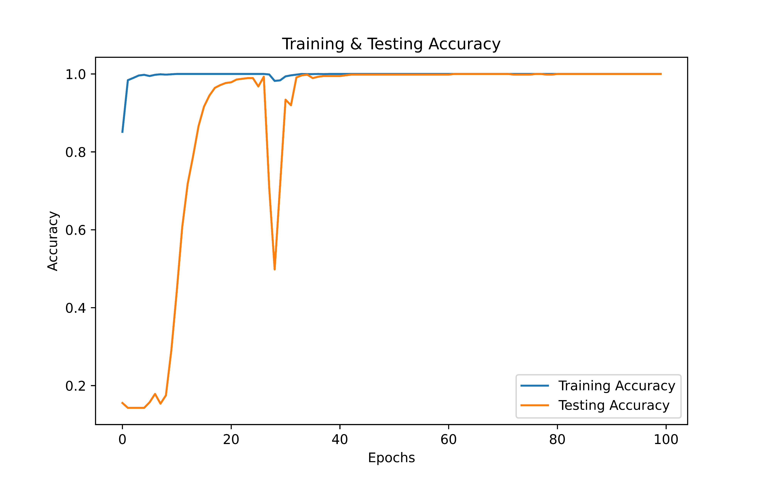
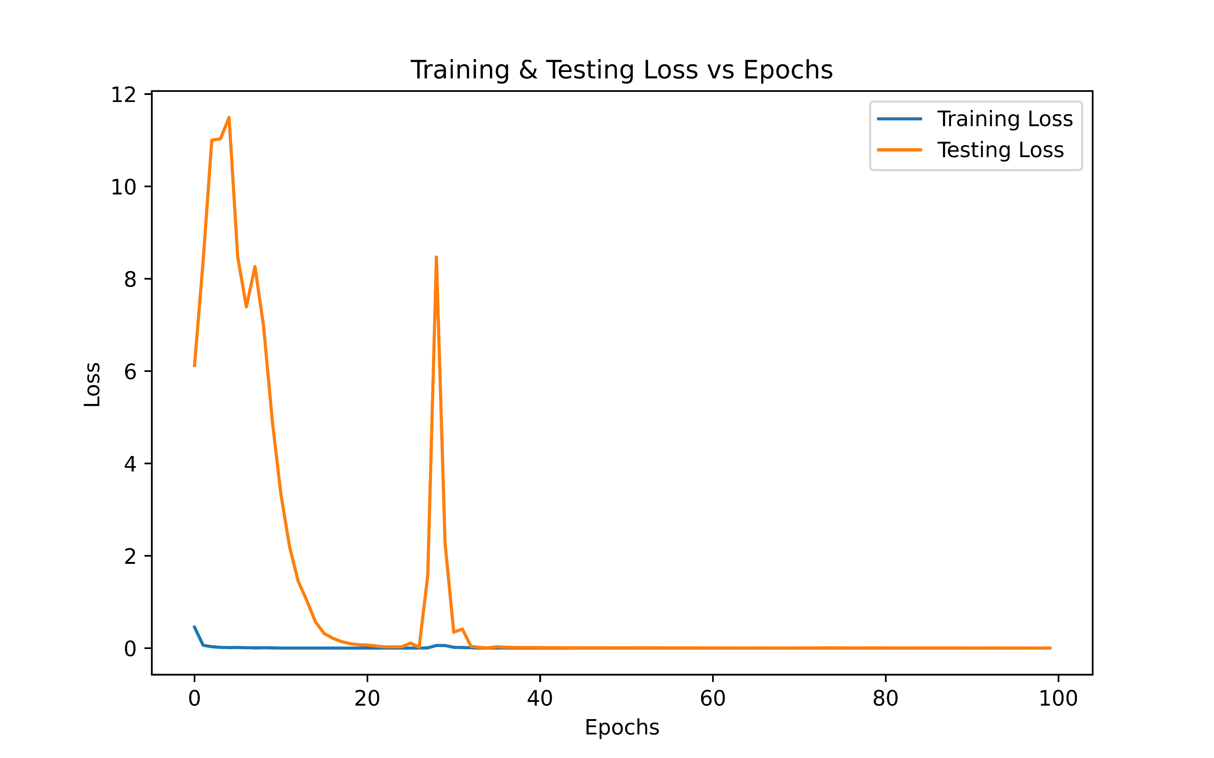
Performance Analysis
Training & Testing Accuracy vs Epochs
Training & Testing Loss vs Epochs

Slide 9
Performance Analysis
References & Year | Features Extracted | Architecture Used | Performance
[6], 2024 | Multiple Time & Freq domain Features | Ensembling A (CNNs), B (BiLSTM-FCN), C (BiLSTM-FCN with transformer) | 99.857 %
[7], 2023 | MFCC Spectrogram | CNN+LSTM+Attention | 99.81 %
This Work | MFCC (Flattened) | 1D CNN | 100 %
1D CNN
Conv1d (filters=128, kernel_size=5)
BN, Relu, MaxPool
Conv1d (filters=128, kernel_size=5)
BN, Relu, MaxPool, Dropout (0.2)
Conv1d (filters=256, kernel_size=5)
BN, Relu, MaxPool
Conv1d (filters=256, kernel_size=3)
BN, Relu, MaxPool, Dropout (0.2)
Conv1d (filters=256, kernel_size=3)
BN, Relu, MaxPool
Conv1d (filters=512, kernel_size=3)
BN, Relu, MaxPool, Dropout (0.2)
Flatten, Dense (256), BN, Dense (7, softmax)
1D CNN Architecture

