Slide 1
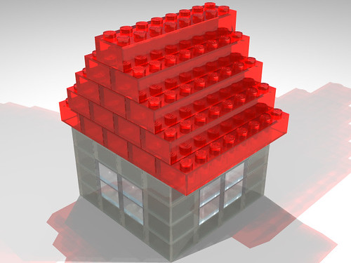
Funktionen
Aus kleineren Bausteinen grössere bauen
"LEGO house" by Atsushi Tadokoro is licensed under CC BY 2.0

Slide 2
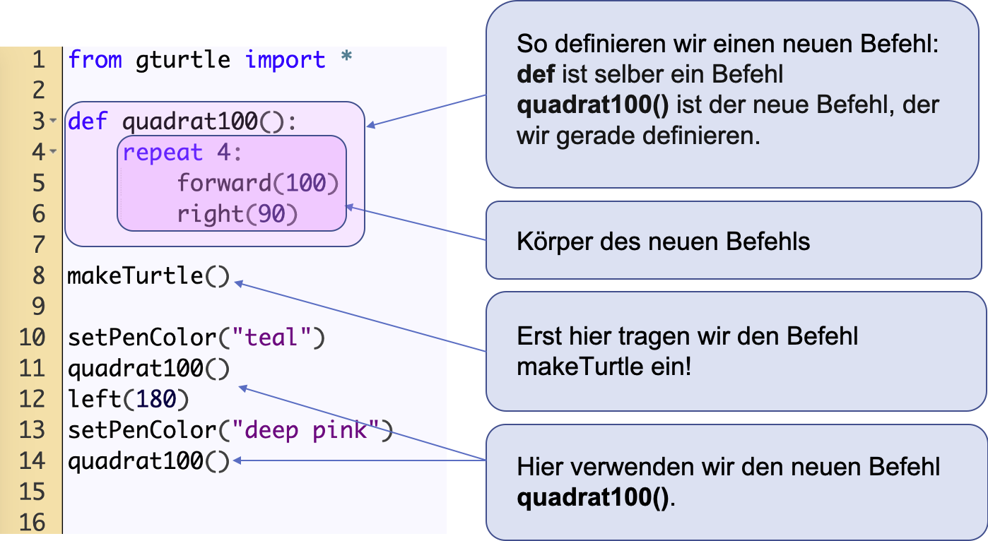

Slide 3
