Slide 1
“ Smart HandWash System to overcome SSI Problem”

Slide 2
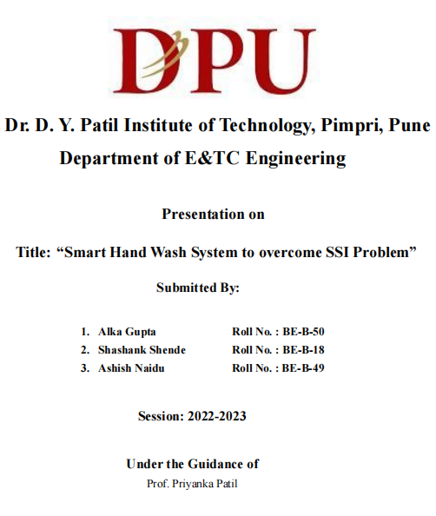

Slide 3
Introduction:
Hand hygiene compliance by workers is extremely important in healthcare settings like hospitals and clinics. The quality of each episode of hand washes is also important, therefore World Health Organization has given some standard guidelines for proper hand wash. According to the guidelines, proper hand washing procedure comprises of different ways of rubbing the hands to ensure that no area of the hands is missing. In hospitals, before operation a staff present with doctors does not follow proper handwash guidelines, hence every year millions of lives are threatened by Surgical Site Infections (SSI). These infections would contribute to the spread of antibiotic resistance. We build an automated smart handwash system to avoid the Surgical Site Infections and reduce the lives threaten infections by monitoring the different handwash techniques provided by the World Health Organization. By maintaining the proper database it will be easy for Hospital Infection Control Committee to monitor the individual person.

Slide 4
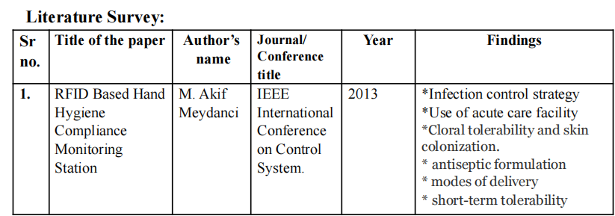
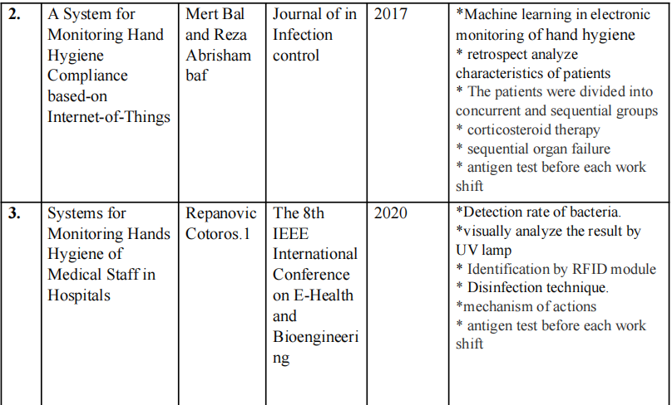

Slide 5
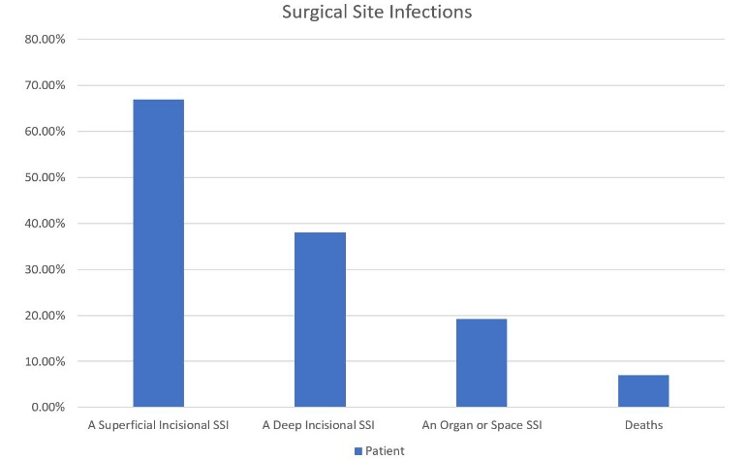
Problem statement:
Every year, millions of lives are threatened by surgical site infections (SSI). These infections would contribute to the spread of antibiotic resistance. Acc. To World Health Organization (W. H. O.) minimum 3 minutes are necessary to wash the hands properly to avoid the S. S. I.
In rural areas and in government hospitals due to lack of facilities doctors and staff ignores the hand hygiene which leads to the increase in the S. S. I.

Slide 6
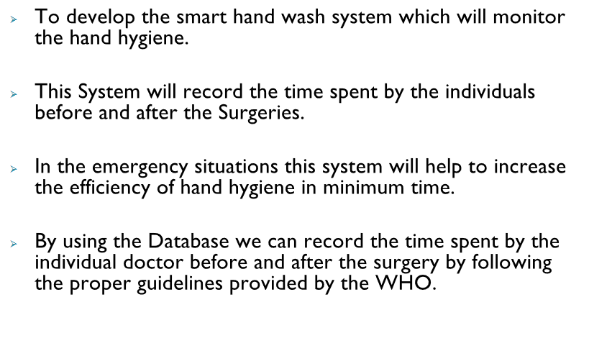
Objective
“
,,

Slide 7
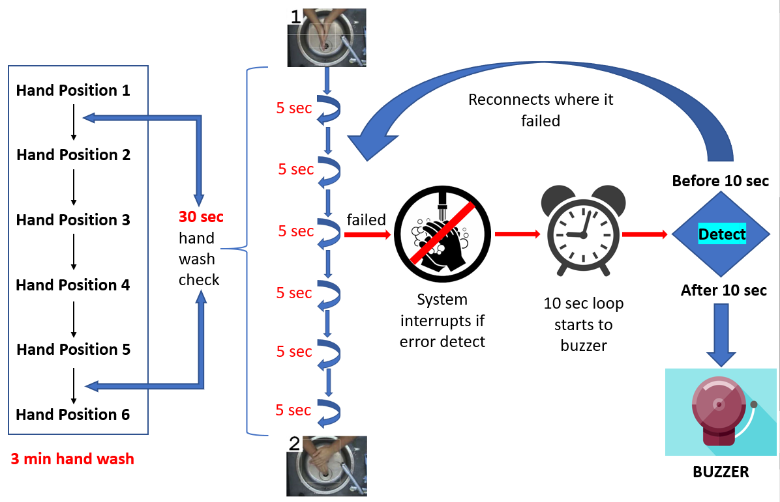
System Overview :

Slide 8
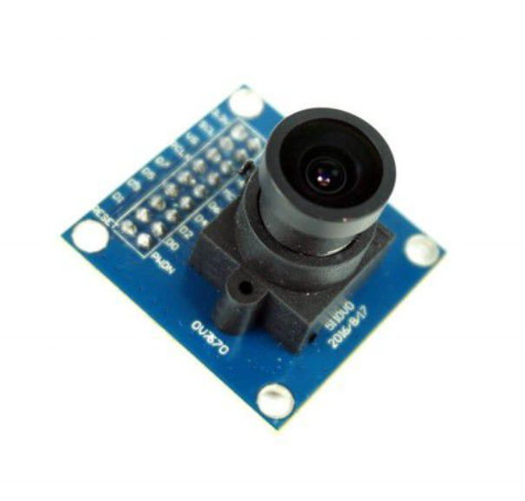
HARDWARE SPECiFICATIONS
Camera Module:
Display(Inch) | IPS Panel ST7789/1.3 Inch
USB to TTL | CP2104
Working Voltage | 2.3~3.6V
Working Current(mA) | 160mA
Power Supply | USB 5V/1A
charging current(A) | 1 A
Battery required | 3.7V lithium battery
Frequency range(GHz) | 2.4~2.5GHz
Transmit Power | 22dBm
Communication Distance | 300m
Bluetooth protocol | bluetooth v4.2BR/EDR
Working Temperature Range (°C) | 40 to 85

Slide 9

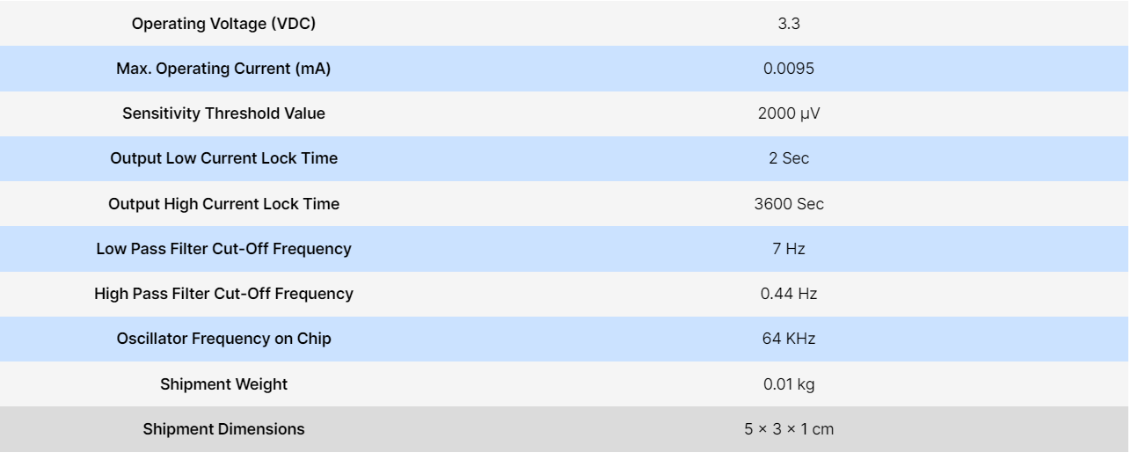
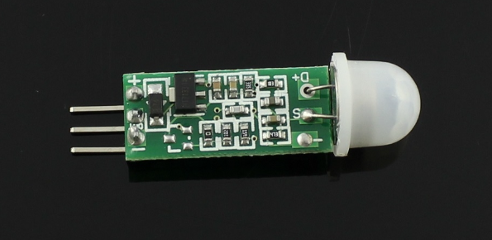
Buzzer:
Operating Voltage : 1.5 ~ 15V DC
Working Current: Less than 25mA
Tone Generation Range : 1.5 ~ 2.5kHz
Dimensions (LxWxH): 26 x 15 x 11 mm
PIR Sensor :

Slide 10
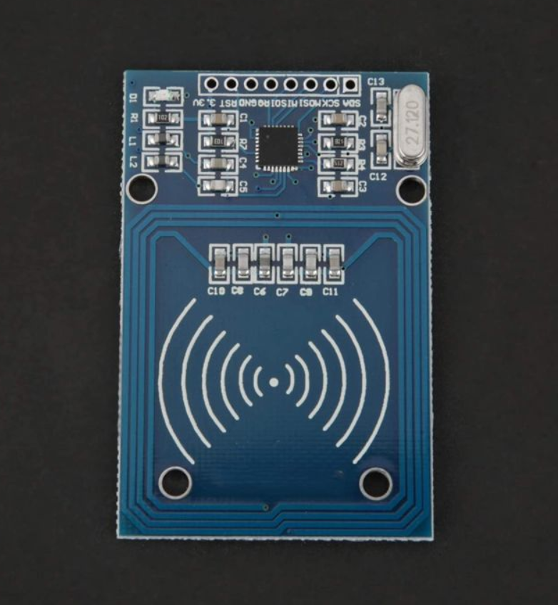
RFID Sensor :
Input Supply voltage (V) | 3.3V (Do not use 5V supply)
Operating Current (mA) | 13 ~ 26
Operating Frequency (MHz) | 13.56
SPI data rate (Mbit/s) | 10
operating distance in reading/Write mode (mm) | 50
Length (mm) | 60
Width (mm) | 39.5
Height (mm) | 5
Weight (gm) | 20

Slide 11
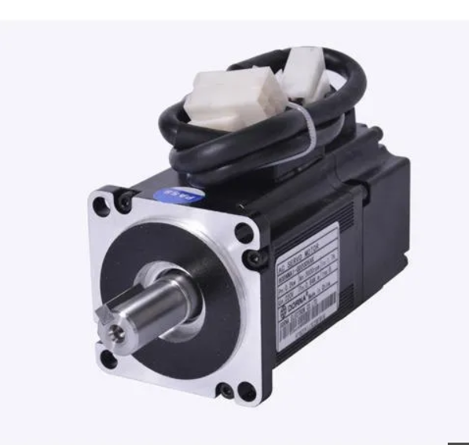
Servo Motor:
Operating Voltage (VDC) | 4.8 ~ 6.6
Temperature Range | 0- 55℃
Stall Torque @ 4.8V (Kg-Cm) | 9.40
Stall Torque @6.6V (Kg-Cm) | 11
Operating Speed @4.8V | 0.19sec/60°
Operating Speed @6.6V | 0.15sec/60°
Dead Bandwidth | 1uS
Gear Type | Semi-Metal
No. of teeth | 25

Slide 12
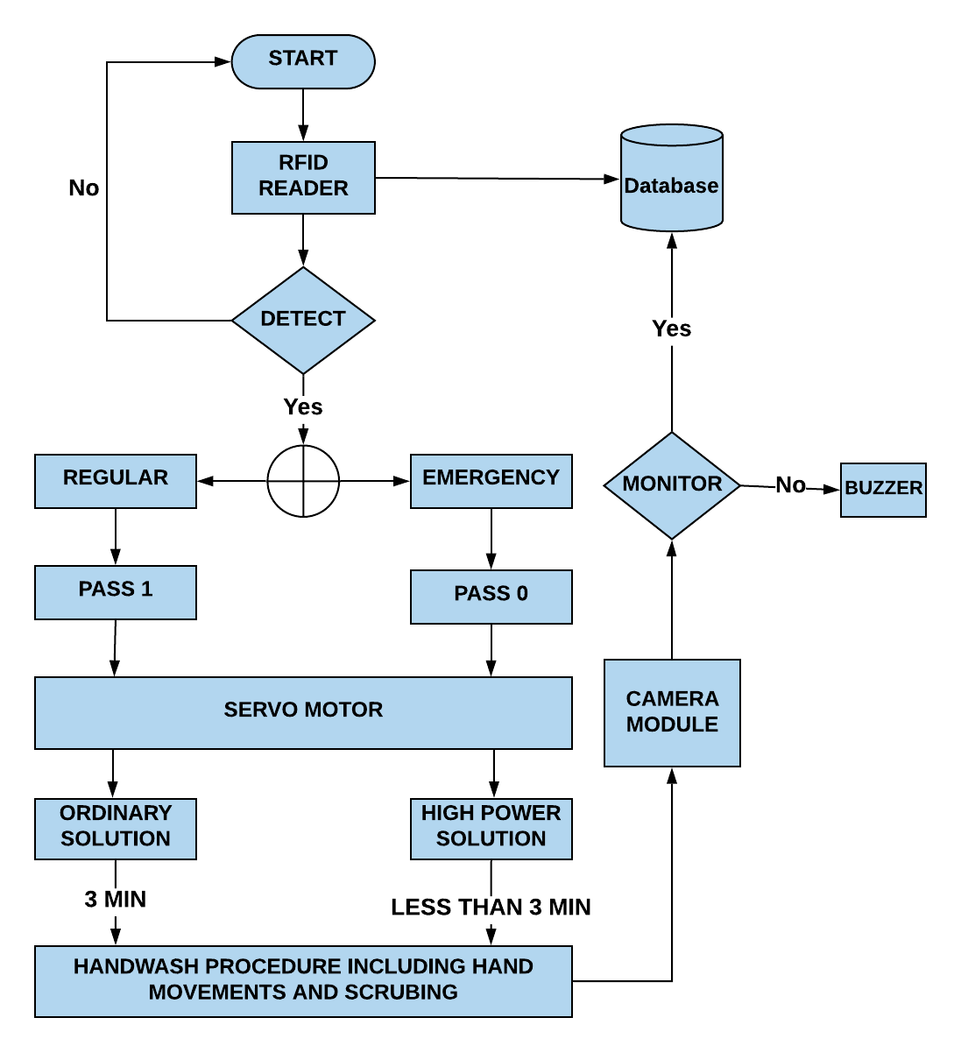
Flowchart :

Slide 13
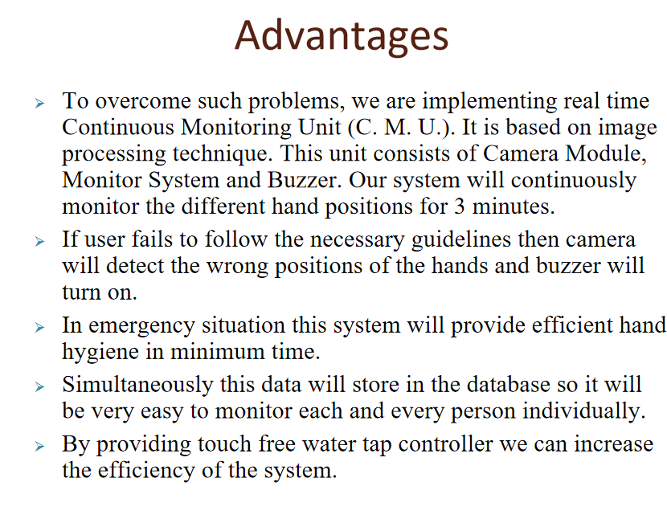
OBJECTIVES :

Slide 14
Sr.no | Activity | Tentative Date
1 | topic finalization | 3rd August 2022
2 | Literature review | 18th August 2022
3 | Finalization of aim and Objectives | 29th August 2022
4 | Block Diagram | 7th September 2022
5 | Finalization of specifications | 20th September 2022
6 | Finalization of methodology | 4th October 2022
7 | Implementation various ML algorithm for prediction | 24th October 2022
8 | Implementation of LSTM model | 12th NOvember 2022

Slide 15
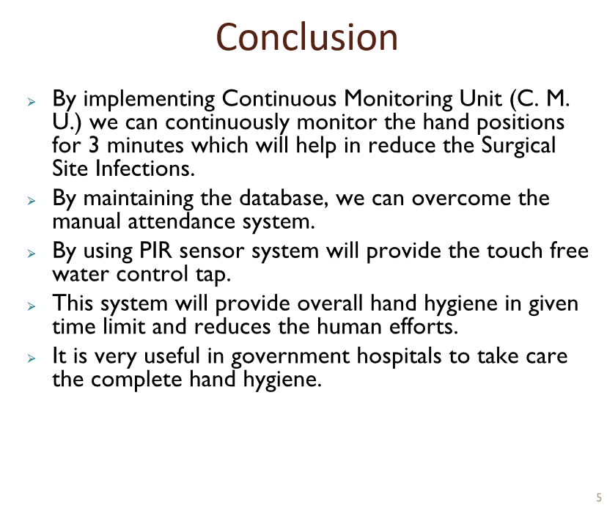
SUMMARY
At Contoso, we believe in giving 110%. By using our next-generation data architecture, we help organizations virtually manage agile workflows. We thrive because of our market knowledge and great team behind our product. As our CEO says, "Efficiencies will come from proactively transforming how we do business."

Slide 16


Slide 17
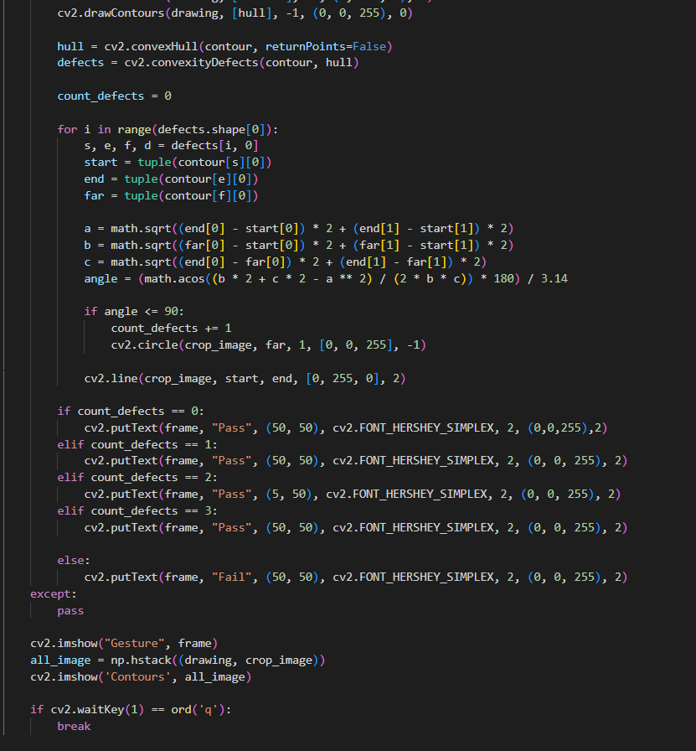

Slide 18
THANK YOU

