Slide 1

K.D.K College Of Engineering Nagpur
Department of Information Technology
Sixth Semester
Mini Project
Topic On:- ”Virtual Assistant using Python “
Rupali Mamale 9
Tina kshirsagar 12
Pranay Lohbhare 45 5.
Shashank Mankar 6
Presented by:-
Sr.no Name of members Roll No
Ashvini Khobragade 1
Rupali Mamale 9
Tina Kshirsagar 12
Pranay Lohbare 45
Shashank Mankar 60
Guide Name
Priyanaka Dewalkar Mam

Slide 2
Content
Abstract
Introduction
Literature Review
Methodology
Block Diagram
Conclusion
Reference

Slide 3
Abstract
With the advancement of technology in this digital world, daily life has become smarter and easier. This also includes virtual assistants who can help with many simple tasks by teaching them to do it. Here the command is given as input, The output is the result of the work in the form of speech or displayed on the screen and sometimes on the screen. Input is provided by the microphone (Bluetooth cable already installed).
There are many famous virtual assistants such as Amazon - Alexa, Apple – Siri, Microsoft - Cortana, Samsung - Bixby. Used by humans and some. Although it supports many languages. A virtual assistant is a combination of speech recognition. (convert text to speech), command and various functions time, extra time, alarm clock, etc. The virtual assistant can chat with people (chatbot), daily schedule, reminders, notes, calculator, jokes, web content, alarm clock, open and close applications and documents, etc. It also connects to the Internet to provide results for user queries.

Slide 4
Introduction
In recent years, there has been an increase in the use of virtual assistants (VA) to perform various tasks for users. VA is designed to assist users with tasks like scheduling appointments, setting reminders, sending messages, and more.
The AI-powered virtual assistant is designed using Python extension files and provides advanced algorithms to analyze user commands and provide accurate and instant responses. Programmers aim to learn and adapt to user behavior over time; Therefore, the more users interact with it, the better the user learns about their likes and personas.
AI-powered virtual assistant is a powerful tool that helps programmers save time and increase productivity in their daily lives.
It follows the user's needs, making it versatile and useful for anyone who wants to simplify their daily work. Most voice assistants like Siri, Ok Google, and Cortana were created in 2016. So I created my new virtual assistant called "JARVIS”.

Slide 5
Literature Review
Voice assistant has participated in many major competitions over the years and has a long history. Voice assistants for speaking, searching, and commands are becoming the norm on smartphones and wearables.
In order to provide general information (thoughts and opinions) about voice control, virtual assistants, application areas and other topics, this study is based on an incomplete information analysis.
There are now many smart programs on the market that can fulfill natural language in many roles in daily life. Bell Laboratories created the first speech recognition system, Audrey, in 1952[9]. Audrey is illiterate and has a limited ability to understand only ten numbers spoken by some people (Pieraccini, 2012.
The Shoebox Machine only recognizes and responds to 16 words spoken in English by the speaker, including the ten digits "0" through "9". [4]These limitations later became problematic and raised questions about language skills. Hidden Markov Models (HMM) were introduced in the 1970s. (Rabiner, 1989).

Slide 6
Methodology
Speech recognition is the technology used by virtual assistants to convert voice input into commands. All audio signals converted into executable commands or digital files that software can execute when the user wants to help complete a task.
The next step is to find the responses received and compare the information with the software documentation. You can use your own commands to operate the machine from Virtual Assistant. Speech recognition, Wikipedia, web browsers, pysttx3 etc. We use many Python installation packages such as. to create virtual help.
You can convert audio to text using speech recognition. Next this to find an acceptable response, data are compared with software data. Machines can be operated using your own commands by using a virtual assistant.
We employ a variety of Python installer packages, such as Speech recognition, Wikipedia, web browser, pysttx3, etc., to create virtual assistants. Using speech recognition, audio can be turned into text.

Slide 7
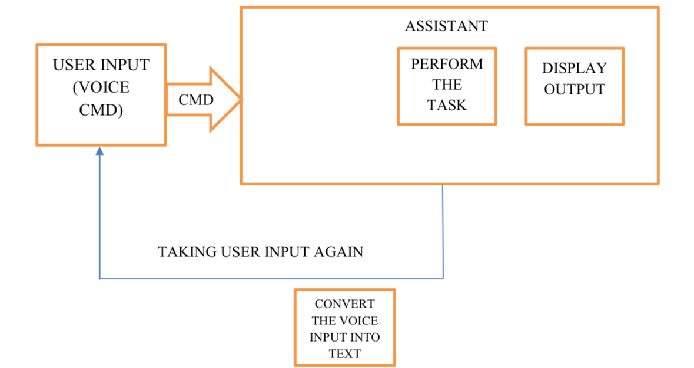
Block Diagram

Slide 8
Conclusion
A virtual personal assistant is a great way to organize your plans. There are now many smart personal assistants on the market for different platforms. These new software applications work better than PDA devices because they provide everything from a smartphone.
VPAs are also more reliable than personal assistants because VPAs are portable and you can use them whenever you want. Because they are connected to the Internet, they have more information than other assistants. In this article, we talk about creating a personal virtual assistant for Windows using Python. Virtual assistants make people's lives easier. Have the freedom to hire virtual assistants to provide the services they need.

Slide 9
References
M. Bapat, H. Gune, and P. Bhattacharyya, “A paradigm-based finite state morphological analyzer for marathi,” in Proceedings of the 1st Workshop on South and Southeast Asian Natural Language Processing (WSSANLP), pp. 26–34, 2010.
B. S. Atal and L. R. Rabiner, “A pattern recognition approach to voiced unvoiced-silence classification with applications to speech recognition,” Acoustics, Speech and Signal Processing, IEEE Transactions on, vol. 24, no. 3,pp. 201–212, 1976.
V.Radha and C. Vimala, “A review on speech recognition challenges and approaches,” doaj. org, vol. 2, no. 1, pp. 1–7, 2012.
T. Schultz and A. Waibel, “Language- independent and language adaptive acoustic modeling for speech recognition”, SpeechCommunication, vol. 35, no. 1, pp. 31–51, 2001.
V.Radha and C. Vimala, “A review on speech recognition challenges and approaches,” doaj. org, vol. 2, no. 1, pp. 1–7, 2012.
T. Schultz and A. Waibel, “Language- independent and language adaptive acoustic modeling for speech recognition”, SpeechCommunication, vol. 35, no. 1, pp. 31–51, 2001.
Excellent style manual for science writers is “Speech recognition with flat direct models,” IEEE Journal of Selected Topics in Signal Processing, 2010.

Slide 10
Thank You

