Slide 1



K.D.K COLLEGE OF ENGINEERING NAGPUR
Department of Information Technology
Seventh Semester
Project
Topic on:-“Virtual Assistant for Desktop”
Presented by:-
Sr.no Name of Members Roll No
1 Ashvini Khobragade 1
2 Rupali Mamale 9
Pranay Lohabare 37
Shashank Mankar 52
Guide Name:-
Prof.S.S.Ganorkar
AK

Slide 2

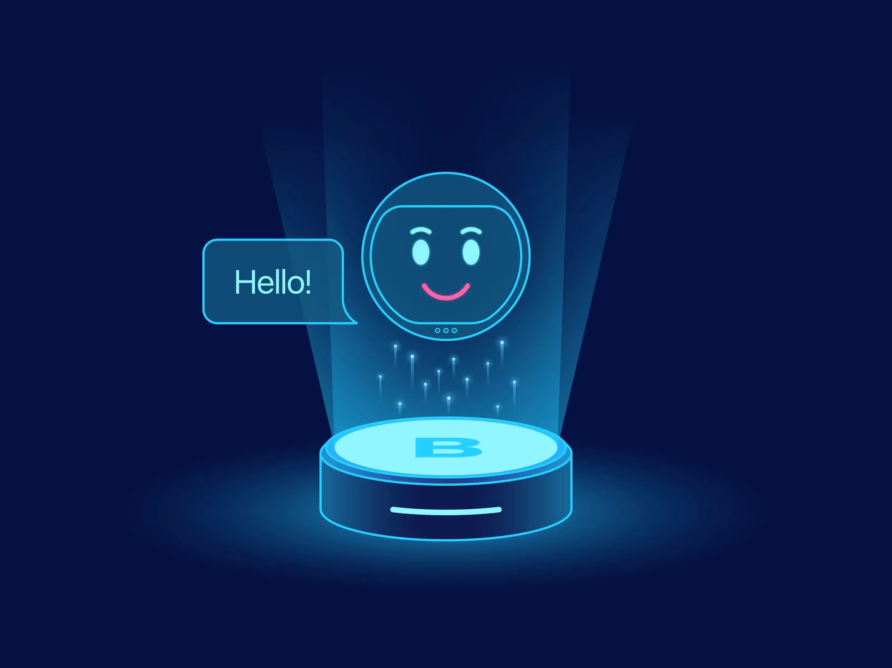
CONTENT
Introduction
Literature Review
Methodology
Features of virtual Assistant
Problem Statement
Building a Virtual assistant with python
Conclusion

Slide 3

INTRODUCTION TO VIRTUAL ASSISTANTS
Virtual assistants (VAs) are software programs that can understand and respond to human language. VAs are designed to automate tasks and provide information. They're becoming increasingly popular in a variety of industries.
In recent years, there has been an increase in the use of virtual assistants (VA) to perform various tasks for users. VA is designed to assist users with tasks like scheduling appointments, setting reminders, sending messages, and more.
APIs (Application Programming Interfaces) are essential for extending the capabilities of a virtual assistant.
They allow the assistant to access external services and data, such as weather information, news updates, or even controlling smart home devices.

Slide 4
.
.
.
.
LITERATURE REVIEW
Authors: C. L. Hudlicka and R. A. M. De Jong | Authors: K. S. Rao, M. S. Devi and A. Ramakrishnan | Authors: J. A. Perez-Marin and I. Pascual-Nieto | Authors: H. L. Nguyen, T. D. Nguyen, and Q. V. Tran
Year: 2015 | Year: 2019 | Year: 2020 | Year: 2021
Summary: Examines the integration of personality and emotional responses in chatbots to make them more human-like. | Summary: Reviews the role and advancements of NLP in the functionality of virtual assistants. | Summary: Chronicles the development of virtual assistants, tracing their progression from early implementations like ELIZA to modern assistants like Alexa. | Summary: This paper surveys the use of deep neural networks in enhancing chatbot functionalities within the customer service industry
.

Slide 5
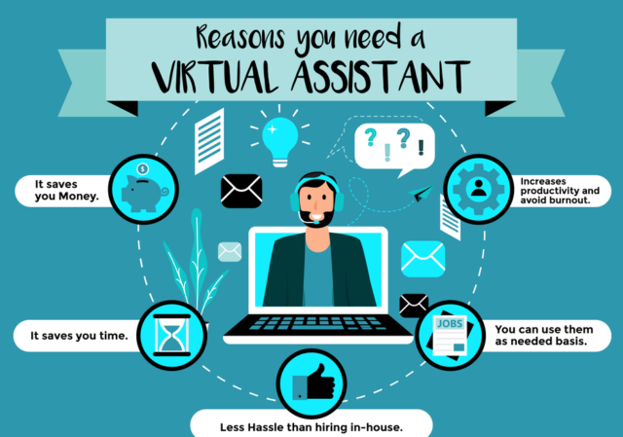
METHODOLOGY
For making virtual assistant we use some python installer packages like Speech recognition, gTTS, pipwin, etc. Speech recognition is the process of converting audio into text. This is commonly used in voice assistants like Alexa, Siri, etc.
Virtual assistants use natural language processing (NLP) to match user text or voice input to executable commands. Some continually learn using artificial intelligence techniques including machine learning and ambient intelligence. To activate a virtual assistant using the voice, a wake word might be used.
Speech recognition is the technology used by virtual assistants to convert voice input into commands.
All audio signals converted into executable commands or digital files that software can execute when the user wants to help complete a task.
.

Slide 6







FEATURES OF VIRTUAL ASSISTANT
GREET ME FUNCTION
1
2
CONVERSATIONS FUNCTION
.
3
NEWS FUNCTION
4
WHATAPP FUNCTION

Slide 7
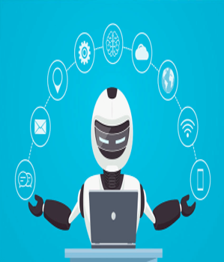
PROBLEM STATEMENT
Task Management
Communication
Efficiency
Personalization
.
Information Access
User Interaction
Integration
User-Experience

Slide 8
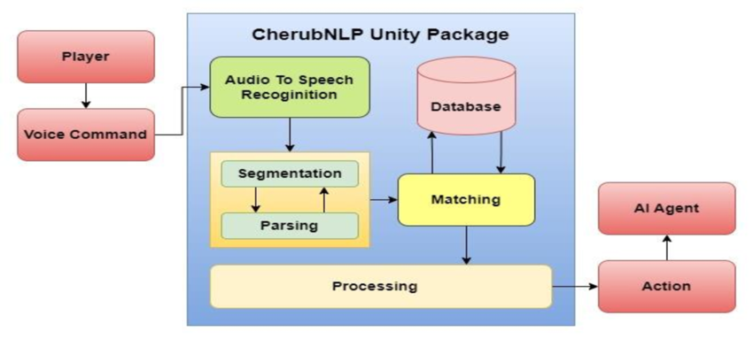
BUILDING A VIRTUAL ASSISTANT
1
Choose a Framework
Speech Recognition - Algorithm : Hidden Markov Models (HMM), Deep Neural Networks (DNNs), or Recurrent Neural Networks (RNNs). Library : SpeechRecognition, pyaudio, google-cloud-speech.
2
Define Intents and Entities
Identify the user's potential intents, such as booking a flight or getting weather updates, and define the relevant entities, like flight dates or city names.
3
Create a Dialogue Model
Design the conversational flow using dialogue models, defining the responses for different intents and entities, including actions and responses.
4
Train and Evaluate the Model
Train the VA on a dataset of conversations and evaluate its performance to ensure accuracy and responsiveness.

Slide 9
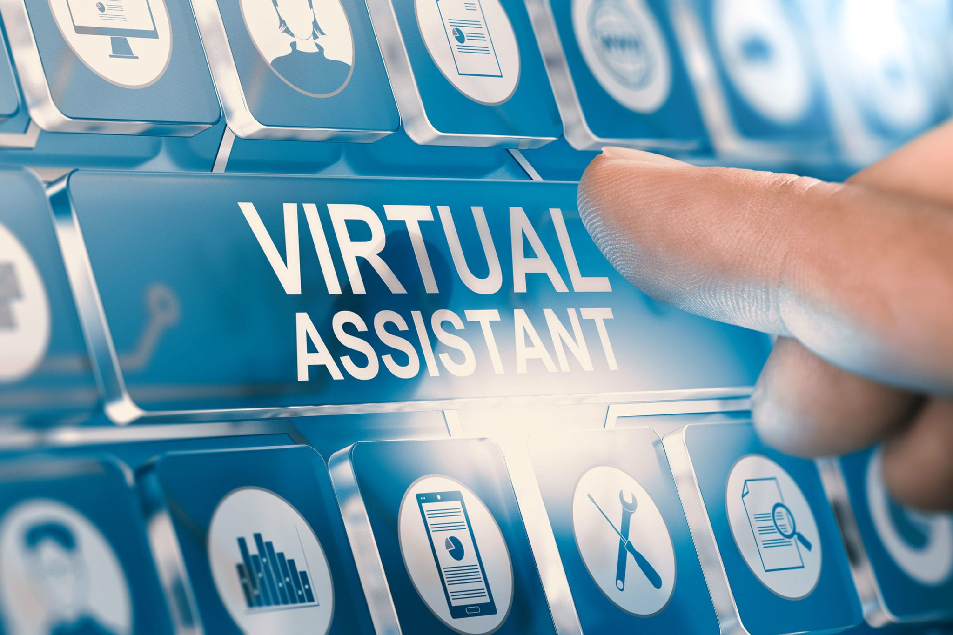




CONCLUSION
Advanced NLP
Machine Learning
Multimodal Interactions
Integration with Smart Home Devices
Implement more sophisticated NLP techniques to improve the VA's understanding of complex language and nuances.
Utilize machine learning algorithms to enable the VA to learn from user interactions and improve its performance over time.
Enable the VA to handle multimodal inputs, such as voice, text, and images, for richer and more engaging interactions.
Integrate the VA with smart home devices to control appliances, lighting, and other home automation features.

