Slide 1

Review-2-rec
Group Members
Manikanta Allanki (G42549699)
Shashank Bopanna (G33584567)
Shrishail Ravi Terni (G28972385)

Slide 2

introduction
Review2Rec is a Recommendation system Leveraging textual reviews to provide the product recommendations for the Amazon Reviews. Our Approach was to find the similarities based on the metric from vector embedding of the reviews. The Project includes doing the text Analysis on text reviews, data pre-processing, and then building the recommendation engine based on the processed text reviews. Where each review is transformed to a embedding vector using pre trained model/transformers, and then searching the users with similar vectors and building the recommendation engine.

Slide 3

Process Diagram
Database hosting
We hosted our database on Docker container
Pulling the pgvector image from docker hub which is an extension of Postgres.
Filtering DB
Filtering based on helpfulness
Filtering based on frequency of items and users reviewed
SQL DB
Processing & Normalization
Exploratory Data Analysis
Json file
Embeddings to existing table
Recommendation Engine
Recommendation query using the vector embedding to find the similar users.
Giving the recommendation of those books which similar users liked and user didn’t read
Analysis
Doing some analysis based on the review text which is the most liked book.
And the books which are slow read
Vector Embeddings
Creating a vector embeddings.
Altering the reviews table by registering the vector embedding

Slide 4
DATASET DESCRIPTION
asin :- ID of the product, like B000FA64PK
overall :- rating of the product.
Review Text :- text of the review (heading).
Review Time :- time of the review (raw).
Reviewer ID :- ID of the reviewer, like A3SPTOKDG7WBLN
reviewerName :- name of the reviewer.
summary :- summary of the review (description).
Unix Review Time :- unix timestamp.
Helpful: - helpfulness rating of the review - example: [2,3].

Slide 5

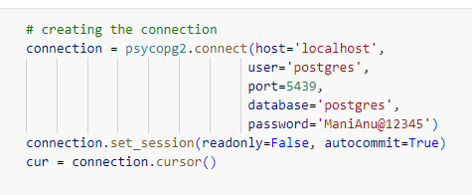
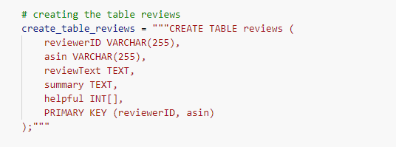
Database translation
JSON dictionary to SQL Database

Slide 6
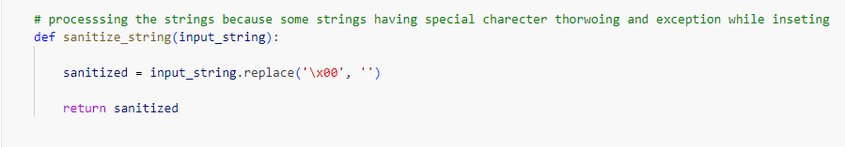
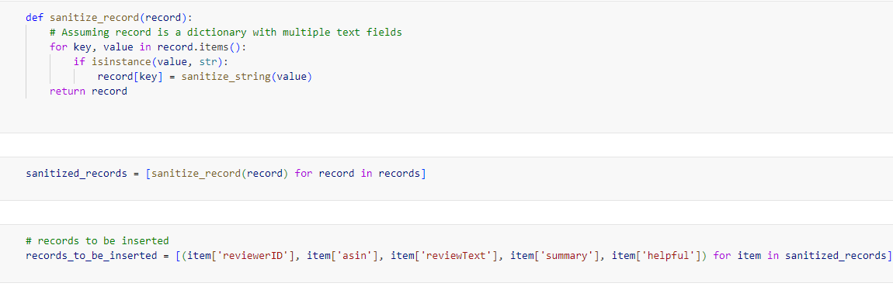
Database translation
Sanitizing the input and inserting records

Slide 7
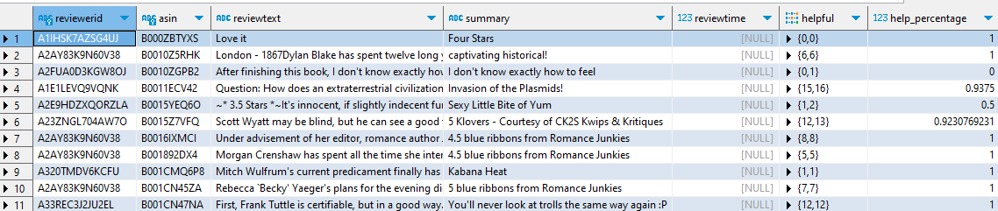
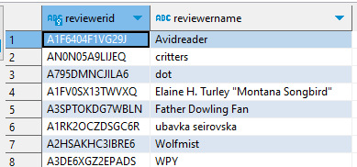
Database translation
Normalization of Tables
We divided the data into 2 tables :-
Table which only contains reviews
Table which only contains reviewers

Slide 8

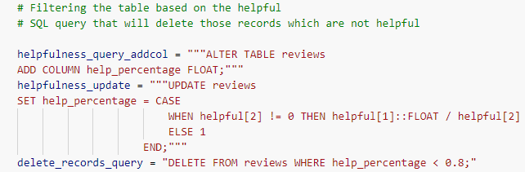
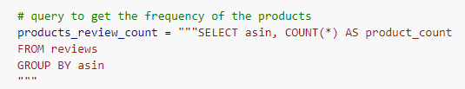
Exploratory data analysis
Filtering the rows based on helpfulness
Query to get the frequency of product count

Slide 9
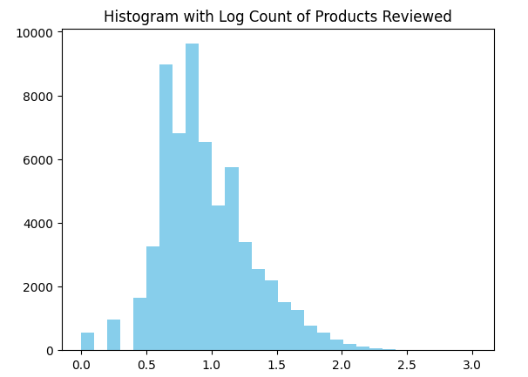
Exploratory data analysis

Slide 10
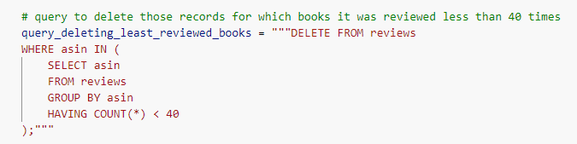
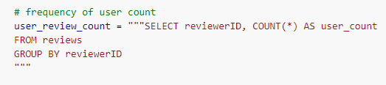
Exploratory data analysis
Filtering the rows based on the number of times reviewed
Query to get the log count of the users

Slide 11
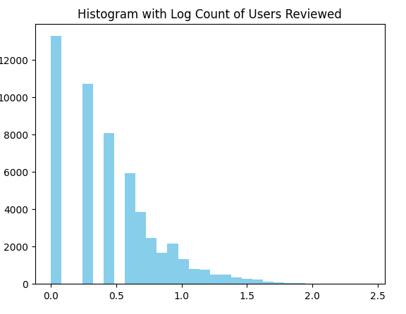
Exploratory data analysis

Slide 12

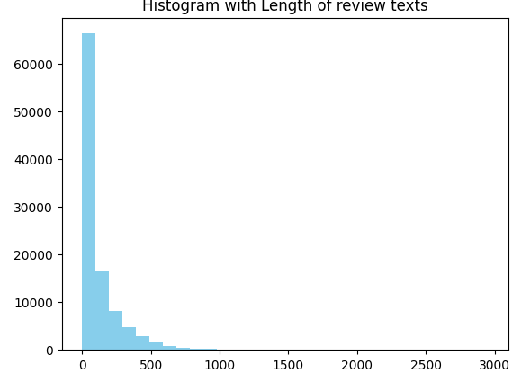
Embeddings
Histogram of the length of review texts

Slide 13

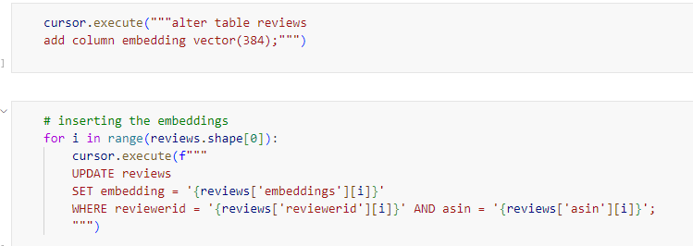
Embeddings
Used a sentence transformer to generate embeddings of the review texts

Slide 14
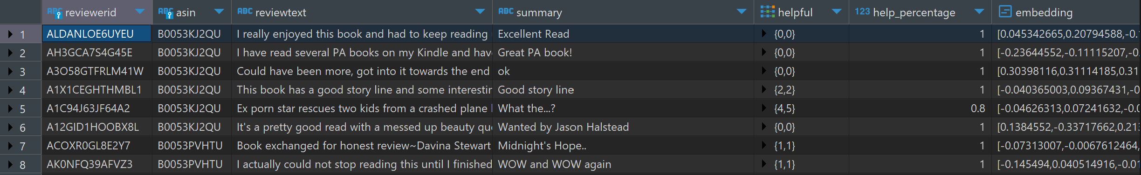
Embeddings

Slide 15
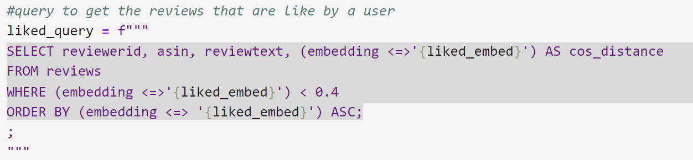
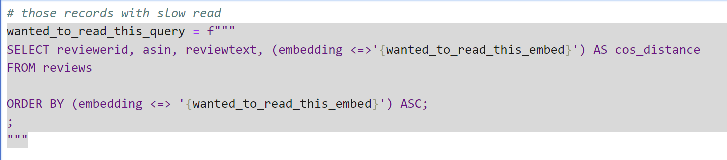
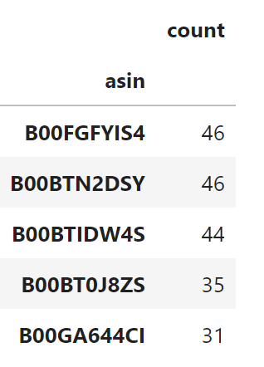
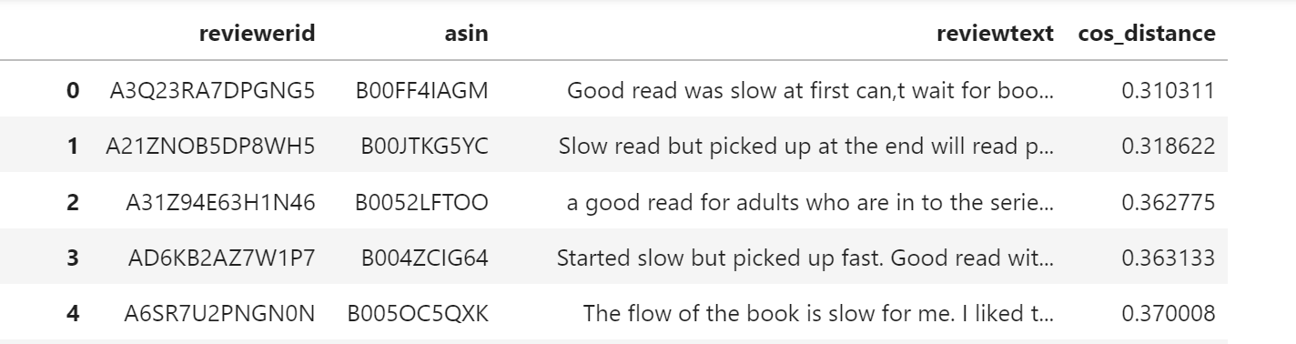
Leveraging Embeddings
Query to find the Most Liked book
Query to find the slow read book

Slide 16
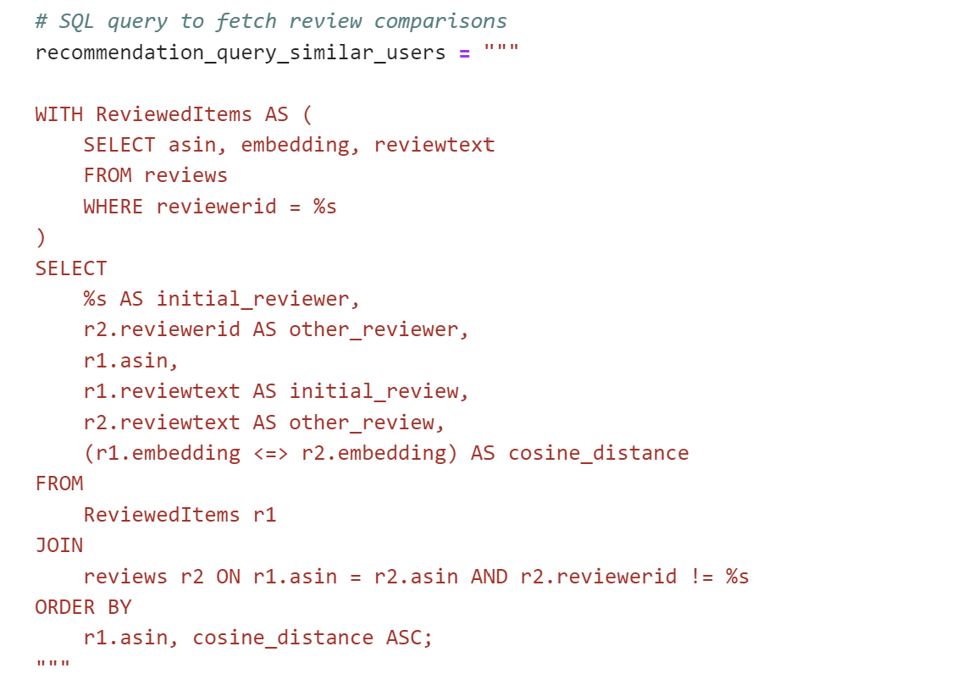
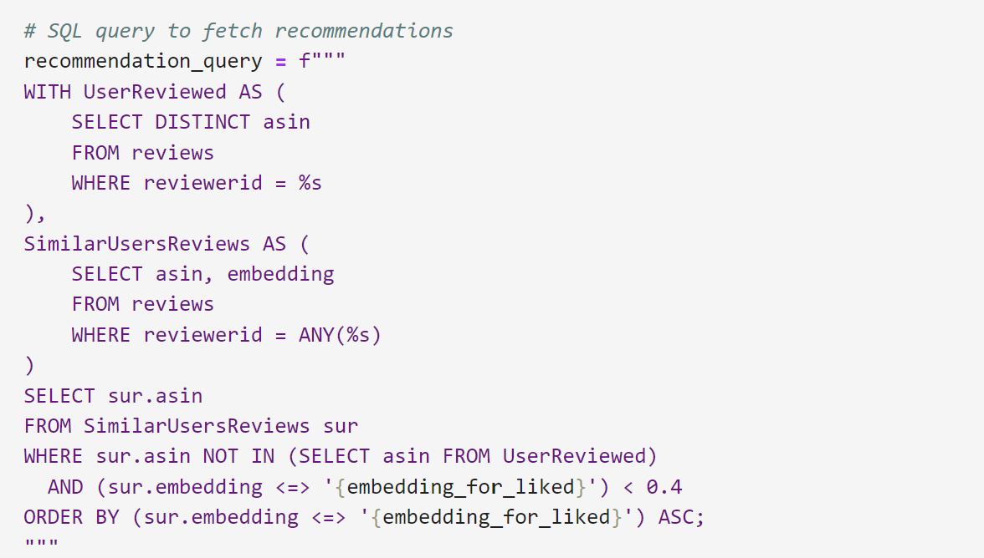
Recommendation Engine Algorithm
Query to find similar users
Query to find Recommendation

Slide 17

THANK YOU
- Team Review-2-Rec

