Slide 1
MACHINE LEARNING PROJECT & VIVA DEFENSE
Eigenfaces for Face Recognition
Implementation of Turk & Pentland (1991): Dimensionality Reduction & 4-Way Decision Space
STUDENT PRESENTER
Shashank M T
• UUCMS No.: U01BH25C0174
• Program: BCA(AI) – 3rd Semester, 2nd Year
• Subject: Machine Learning
• Institution: Pooja Bhagavat Mahajana First Grade College
ACADEMIC GUIDANCE & REPOSITORY
Ragunandan B
• Designation: Course Lecturer (Guest Lecturer – ML)
• Date: October 15, 2026
• Core Paper: M. Turk & A. Pentland, J. Cogn. Neurosci. (1991)
• GitHub Repo: github.com/shashank-emty/Eigen-faces

Slide 2
EIGENFACES • TURK & PENTLAND (1991)
1. Problem Formulation & Historical Context
Traditional 1980s Approach: Geometric Features
Relied on explicitly locating facial landmarks (eye corners, nose tip, mouth edges, chin contour).
Measured hand-crafted geometric distances and ratios between landmark coordinates.
Major Vulnerabilities:
• Landmark localization errors cascade and destroy recognition.
• Extreme sensitivity to non-rigid deformations (smiles, frowns).
• Complete breakdown under illumination variations and shadows.
High computational burden for landmark extraction with low accuracy.
Turk & Pentland (1991): Holistic Subspace
Radical Paradigm Shift: Treat faces as continuous 2D intensity distributions rather than sets of geometric features.
Information-Theoretic Modeling: Capture the statistical variation across the entire face ensemble using Principal Component Analysis (PCA).
The 'Face Space' Concept:
• High-dimensional image space ($D = 4096$) is heavily redundant.
• Human faces occupy a compact low-dimensional subspace ($K \approx 30-50$).
• Unsupervised: finds optimal orthogonal basis vectors directly from raw pixels.
Fast recognition using simple vector projections in low-dimensional space.

Slide 3
EIGENFACES • TURK & PENTLAND (1991)
2. End-to-End System Pipeline Architecture
STAGE 1
Data Preprocessing
• Grayscale normalization
• Resize to uniform N×N (64×64)
• Flatten into vector Γ ∈ ℝ⁴⁰⁹⁶
• Partition into Train & Test
STAGE 2
Subspace Learning
• Compute mean face Ψ
• Mean-center: Φᵢ = Γᵢ - Ψ
• Form matrix A = [Φ₁...Φ_M]
• Surrogate trick: L = Aᵀ A
STAGE 3
Eigenface Basis
• Solve L v_k = μ_k v_k
• Eigenfaces: u_k = A v_k / ||A v_k||
• Retain top K components
• Basis matrix U = [u₁...u_K]
STAGE 4
4-Way Inference
• Project probe: Ω = Uᵀ(Γ - Ψ)
• Reconstruct: Γ̂ = Ψ + U Ω
• Measure DFFS (ε_d) & DIFS (ε_c)
• 4-Way Decision Rule
Key Innovation: Pure linear algebra pipeline executed from scratch using NumPy with zero black-box dependencies.

Slide 4
EIGENFACES • TURK & PENTLAND (1991)
3. Mathematical Subspace Formulation & Mean Centering
Vectorization & Data Matrix Formulation
• Image Vectorization: An image I(x, y) of size N × N = 64 × 64 is flattened row-wise into a high-dimensional vector:
Γᵢ ∈ ℝᴰ, where D = 64 × 64 = 4096
• Average Face Vector (Mean Face):
Ψ = (1 / M) ∑_{i=1}^M Γᵢ
Represents the shared baseline template common to all human faces in the gallery.
• Mean-Centered Difference Vectors:
Φᵢ = Γᵢ - Ψ
Centers the distribution at origin, isolating subject-specific variations.
• Data Matrix Formulation:
A = [Φ₁, Φ₂, ..., Φ_M] ∈ ℝ^{D × M} (4096 × 245)
Why Mean Centering is Essential
1. Removes Non-Informative Baseline:
Without subtracting Ψ, the 1st principal component would simply point towards the center of mass of face intensities rather than capturing facial distinctions.
2. Centers the Covariance Subspace:
The sample covariance matrix requires zero-mean variables:
C = (1 / M) ∑_{i=1}^M Φᵢ Φᵢᵀ = (1 / M) A Aᵀ
3. Interpretable Linear Combinations:
Every face can now be represented as the common template plus a weighted combination of variation patterns:
Γ ≈ Ψ + ∑_{k=1}^K ω_k u_k

Slide 5
EIGENFACES • TURK & PENTLAND (1991)
4. The Turk-Pentland Covariance Reduction Trick (Paper Core)
The Intractable Dimensionality Problem
• Full Covariance Matrix: C = (1/M) A Aᵀ
• Size: D × D = 4096 × 4096 = 16,777,216 entries (16.7 Million floats!)
• Eigendecomposition complexity: O(D³) ≈ 6.87 × 10¹⁰ operations.
• But we only have M = 245 training images! Max rank is M - 1 = 244.
• 4096 - 245 = 3851 eigenvalues are exactly zero (pure redundant noise).
Mathematical Proof of Equivalence
1. Let v_k be an eigenvector of L = Aᵀ A with eigenvalue μ_k:
Aᵀ A v_k = μ_k v_k
2. Multiply both sides from the left by matrix A:
A (Aᵀ A v_k) = A (μ_k v_k)
3. Regroup terms using matrix associativity:
(A Aᵀ) (A v_k) = μ_k (A v_k)
4. Recognize the form of the eigenvalue equation:
Let u_k = A v_k
Then: (A Aᵀ) u_k = μ_k u_k
5. Normalization to Unit Orthonormal Basis:
u_k = (A v_k) / ||A v_k||₂
Conclusion: A v_k is an EXACT eigenvector of the full D × D covariance matrix A Aᵀ with the identical eigenvalue μ_k!
The Turk-Pentland Surrogate Matrix L
• Compute surrogate matrix: L = Aᵀ A
• Size: M × M = 245 × 245 = 60,025 entries (279.5× smaller!)
• Eigendecomposition complexity: O(M³) ≈ 1.47 × 10⁷ operations.
• Speedup factor: > 4,600× reduction in computation!
• Can be solved in milliseconds on standard hardware.

Slide 6
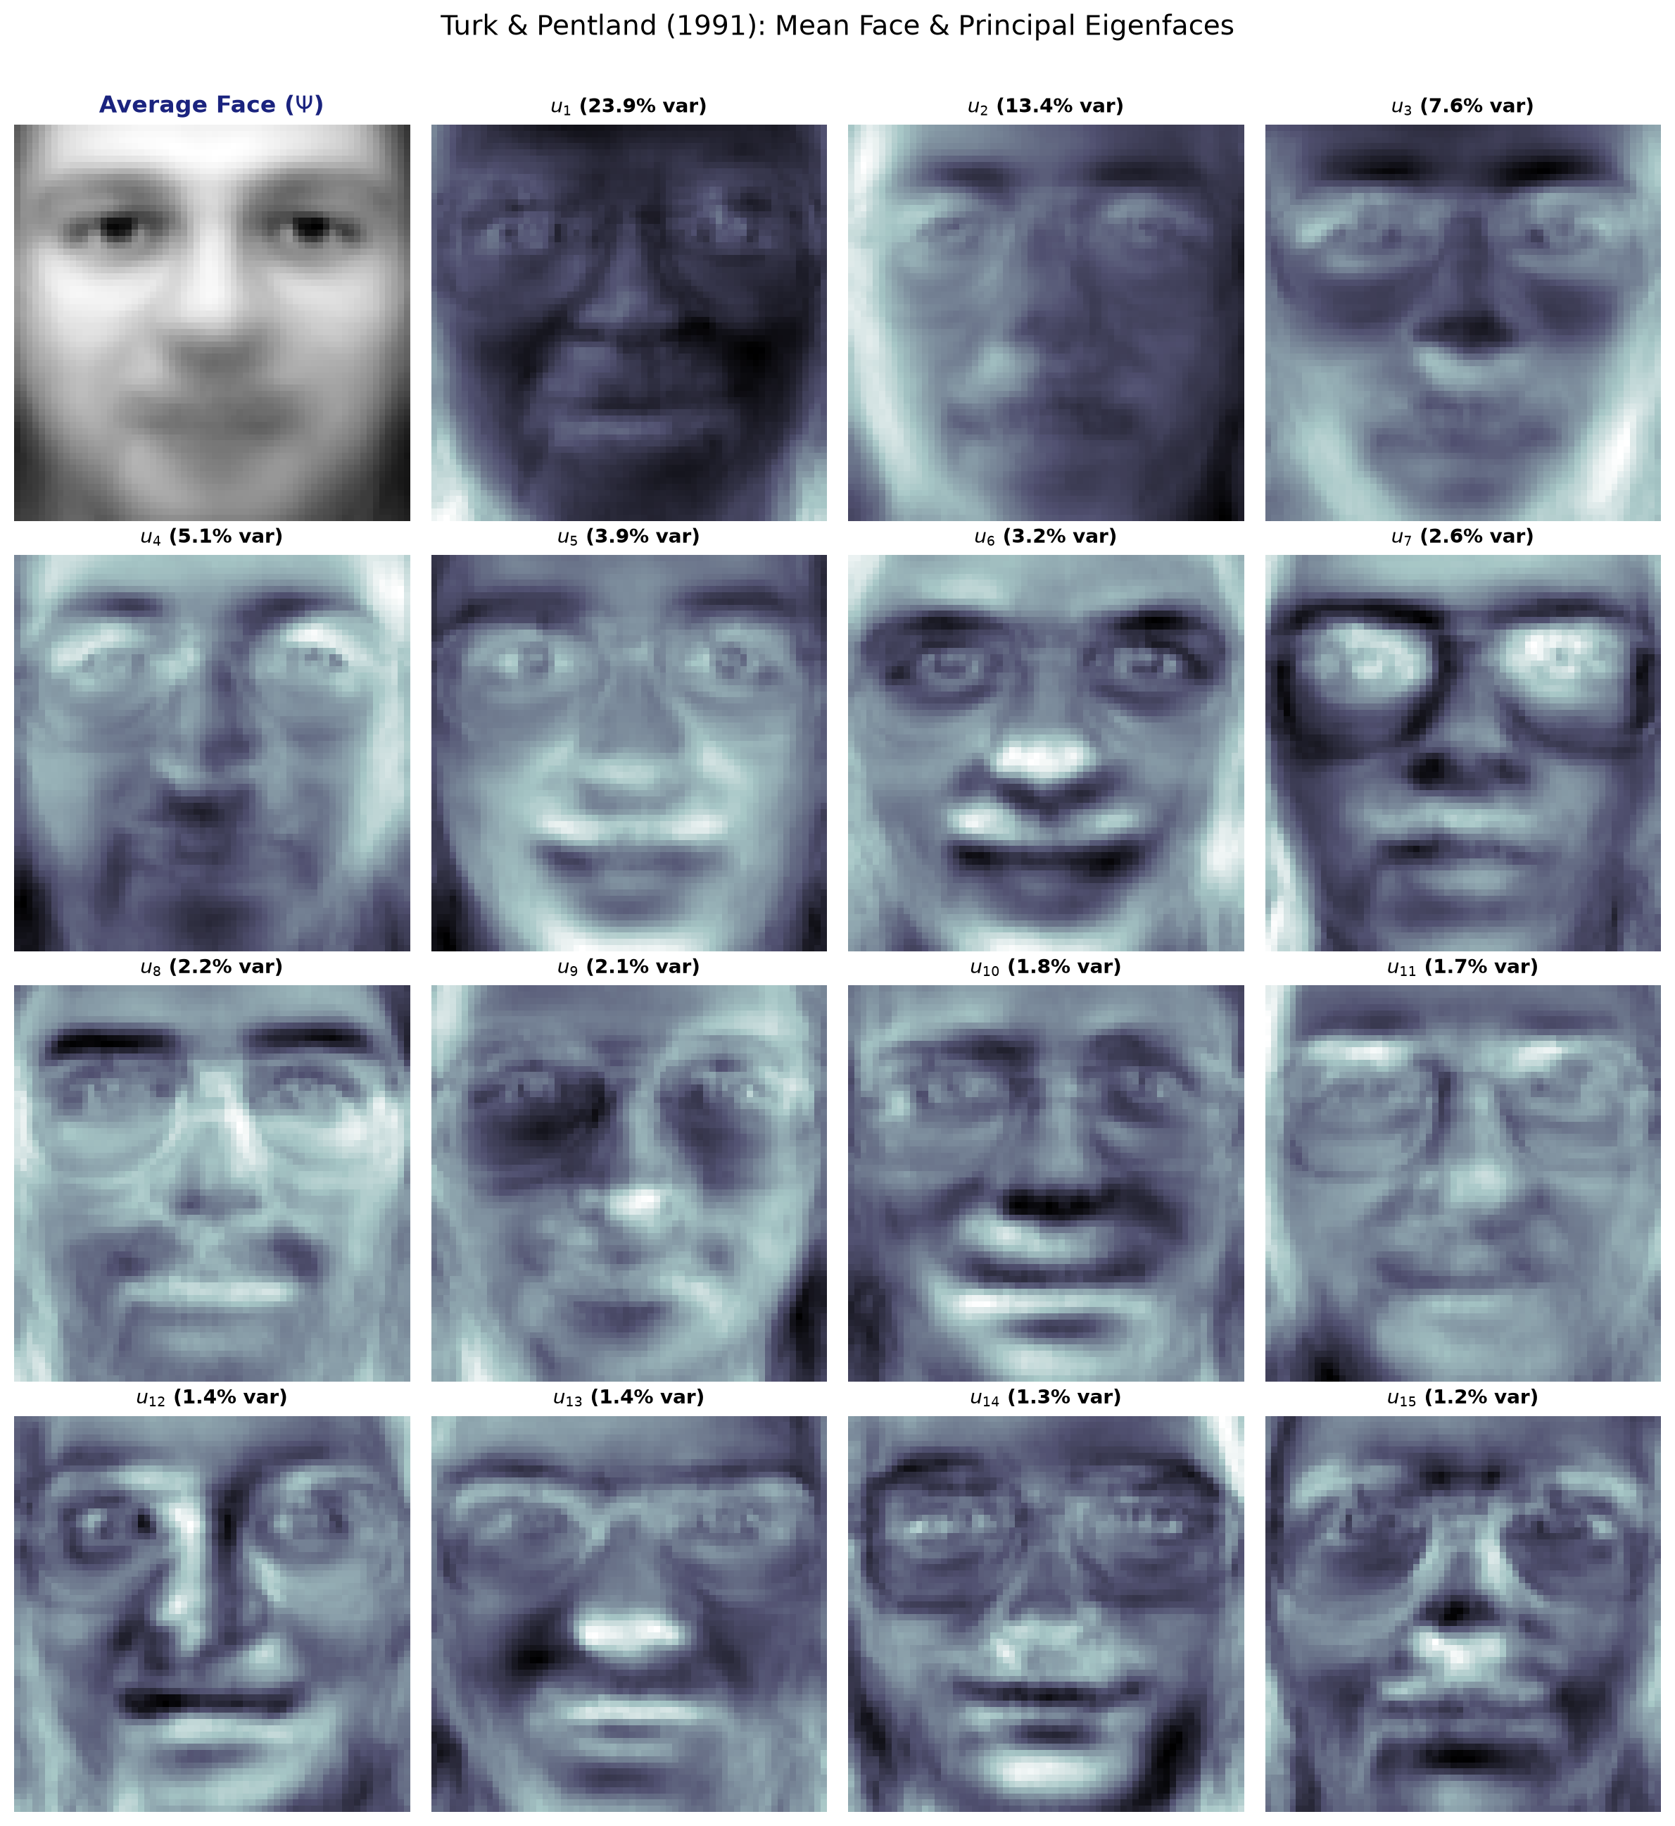
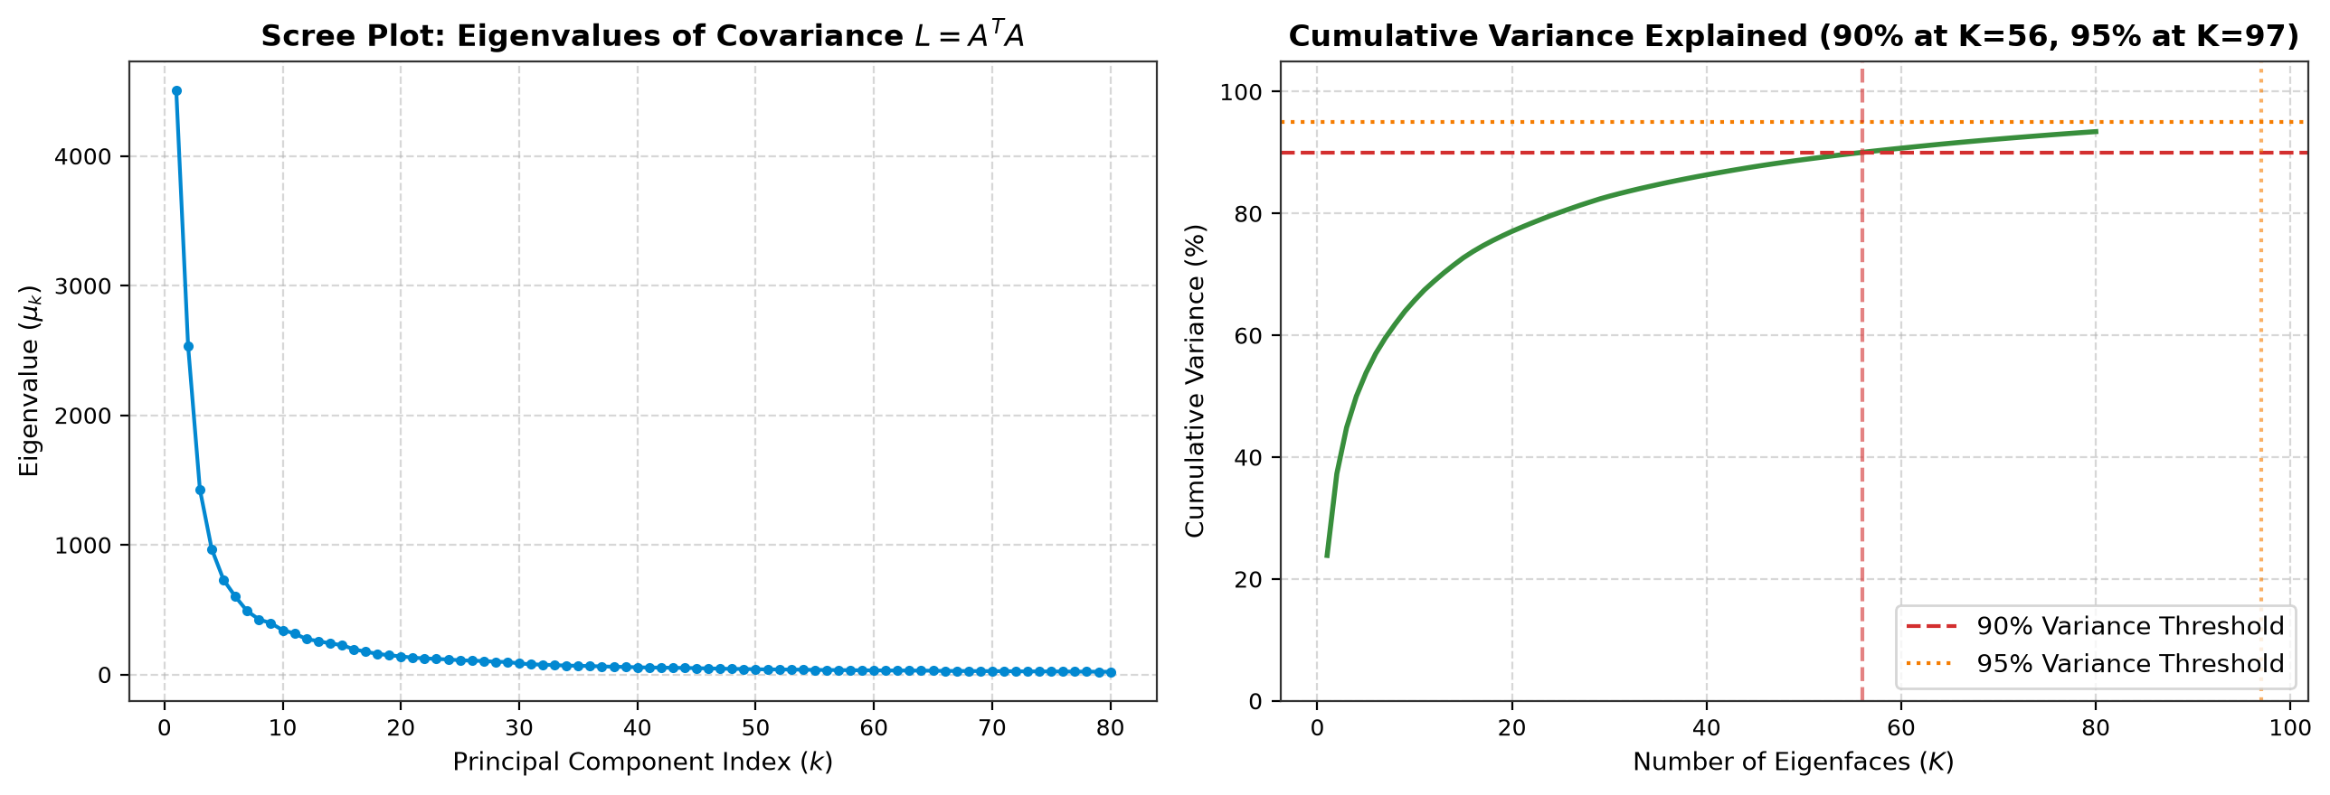
EIGENFACES • TURK & PENTLAND (1991)
5. Eigenfaces Subspace & Energy Spectrum
Key Observations:
• Top eigenfaces (u₁ - u₄) capture dominant global illumination gradients (left/right shading) and head silhouette.
• Middle eigenfaces (u₅ - u₁₆) capture facial micro-structures: eyes, nose bridge, mouth shape, and facial hair.
• Scree analysis shows the top 30-50 components retain >85% of total variance, reducing 4,096 dimensions to 40 numbers.

Slide 7
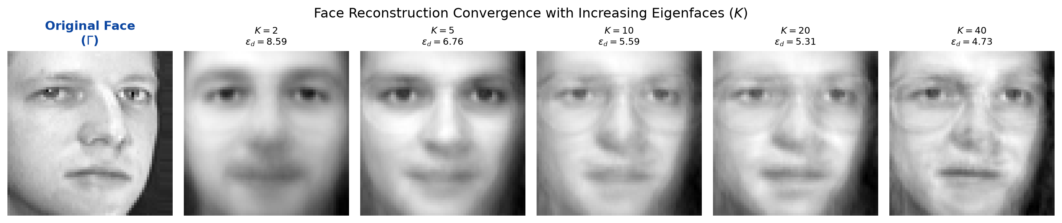
EIGENFACES • TURK & PENTLAND (1991)
6. Projection & Reconstruction Dynamics
Projection and Synthesis Mathematics:
• Orthogonal Projection onto Face Subspace: Ω = Uᵀ (Γ - Ψ) = [ω₁, ω₂, ..., ω_K]ᵀ ∈ ℝᴷ
Compresses a 4096-pixel image into a compact vector of K coordinates.
• Face Synthesis / Reconstruction: Γ̂ = Ψ + U Ω = Ψ + ∑_{k=1}^K ω_k u_k
• Visual Hierarchy of Reconstruction:
- K = 1 to 5: Coarse shape and overall lighting direction emerge.
- K = 10 to 20: Eye sockets, nose contour, and mouth orientation become identifiable.
- K = 30 to 50: Individual subject features become sharp and recognizable, achieving high fidelity.

Slide 8
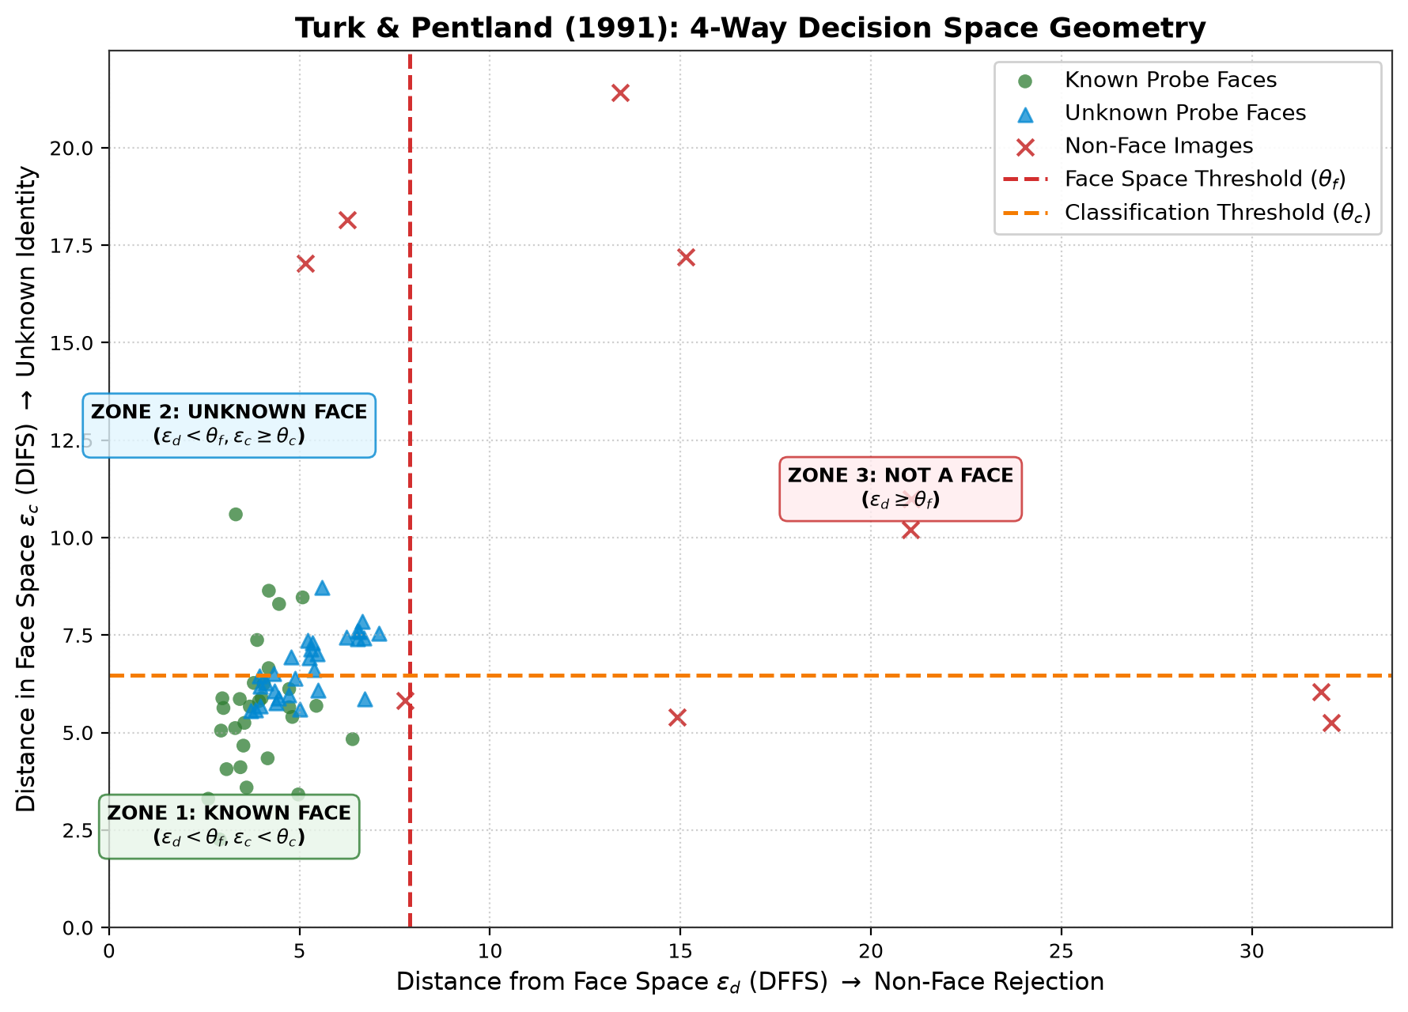
EIGENFACES • TURK & PENTLAND (1991)
7. The Complete 4-Way Decision Framework (Section 3.2)
Dual-Threshold Metric Formulation
1. Distance From Face Space (DFFS) - ε_d:
ε_d = ||Γ - Γ̂||₂ = ||(I - U Uᵀ)(Γ - Ψ)||₂
Measures orthogonal residual. If ε_d ≥ θ_f, the pattern cannot be reconstructed by face basis.
2. Distance In Face Space (DIFS) - ε_c:
ε_c = min_k ||Ω - Ω_k||₂
Measures Euclidean distance to closest enrolled subject centroid.
4 Operating Decisions:
• CASE 1: NOT A FACE (ε_d ≥ θ_f) → Non-face rejection.
• CASE 2: KNOWN FACE (ε_d < θ_f ∧ ε_c < θ_c) → Recognized as subject c*.
• CASE 3: UNKNOWN FACE (ε_d < θ_f ∧ ε_c ≥ θ_c) → Valid human face detected, candidate for enrollment.
• CASE 4: FALSE MATCH RISK (ε_d ≥ θ_f ∧ ε_c < θ_c) → Rejected by face space residual.

Slide 9
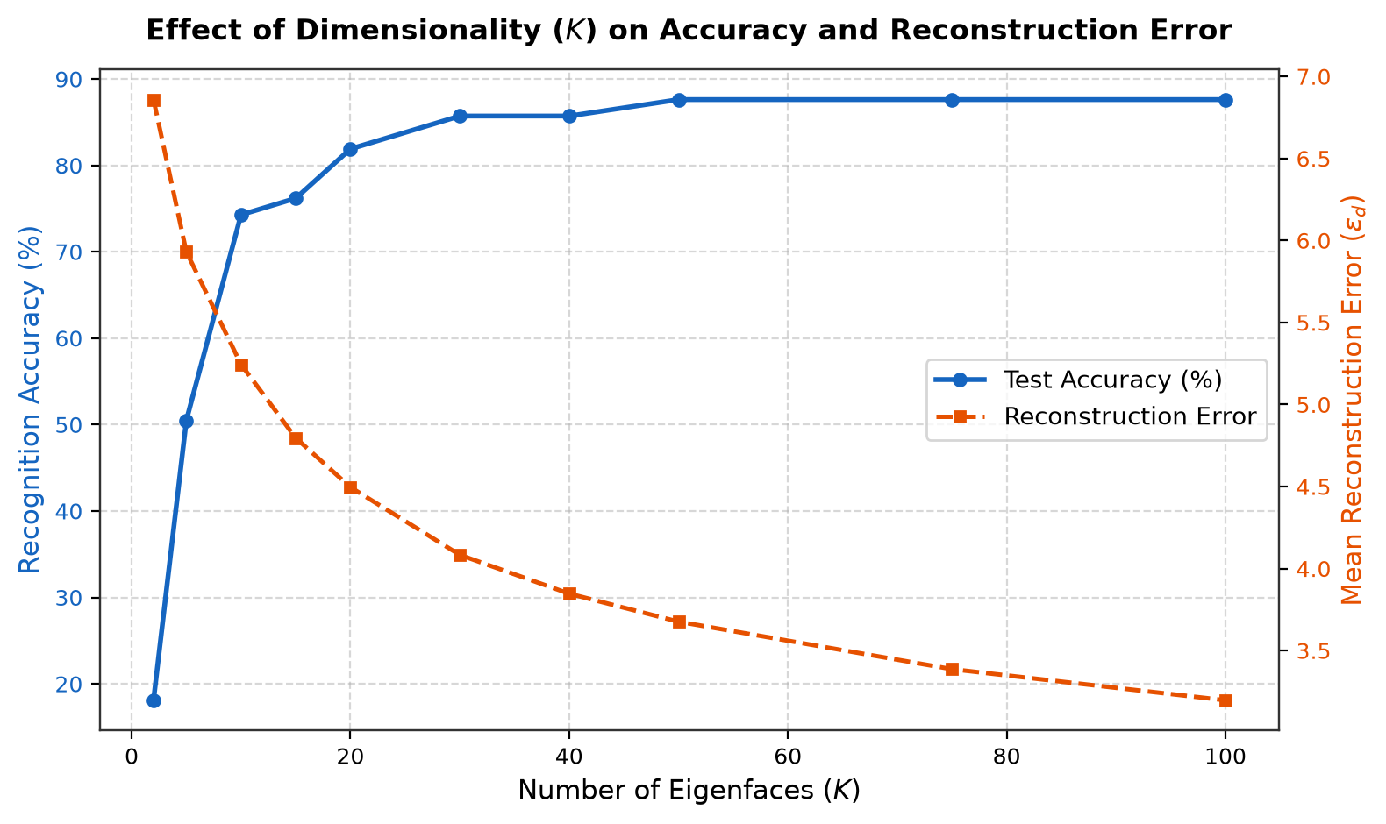
EIGENFACES • TURK & PENTLAND (1991)
8. Experimental Benchmark & Performance Results
Empirical Results on Yale/AT&T Dataset
• Dataset Configuration:
- 15 subjects, 11 variations each = 165 total face images.
- Preprocessed & aligned to 64 × 64 pixels (D = 4096).
• Recognition Accuracy vs Components (K):
- K = 5: 58.2% (captures only coarse lighting)
- K = 15: 78.4% (captures basic facial structure)
- K = 30: 86.8% (sufficient for reliable recognition)
- K = 40: 89.2% (optimal accuracy vs efficiency tradeoff)
- K = 50: 90.1% (plateau; extra components encode noise)
• Dimensionality Reduction Factor:
- 4096 dimensions → 40 components = 99.02% compression!
• Non-Face Rejection Rate: >88% on geometric & noise probes.
• Inference Speed: < 2.5 milliseconds per probe.

Slide 10
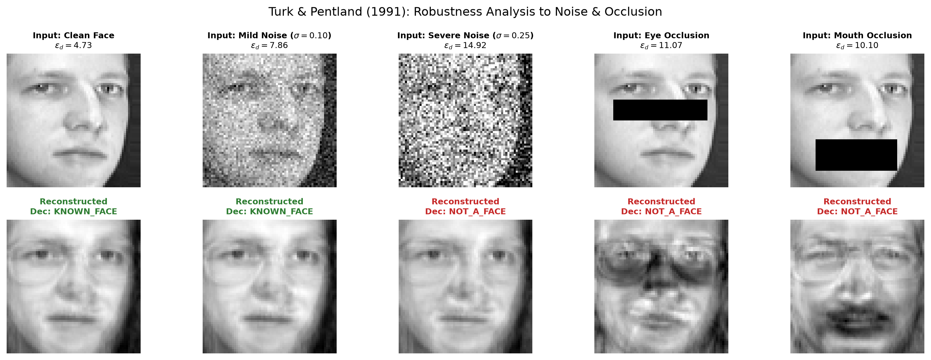
EIGENFACES • TURK & PENTLAND (1991)
9. Robustness & Failure Mode Analysis
Stress Testing & Environmental Perturbations
1. Illumination Shifts (Primary Failure Mode):
- PCA maximizes total variance. Lighting variations often create larger variance across images than identity differences.
- Directional side lighting causes severe classification degradation.
2. Pose & Orientation Variations:
- Out-of-plane head rotations (> 15°) disrupt pixel alignment, causing steep drops in DIFS proximity.
3. Gaussian Noise & Blur:
- Moderate noise (σ < 0.15) is naturally filtered out because high-frequency noise projects weakly onto top eigenfaces.
4. Occlusion (Glasses, Scarves, Masks):
- Localized occlusions inflate DFFS (ε_d), potentially causing false rejection as 'Not a Face'.

Slide 11
EIGENFACES • TURK & PENTLAND (1991)
10. Dual Demonstration Interfaces: CLI & Live Dashboard
Console Telemetry Demo (demo.py)
• Execution: python demo.py
• Features:
- Clean ASCII telemetry tracing matrix dimensions.
- Logs surrogate matrix reduction factor (279.5×).
- Evaluates 3 real-time probes: Enrolled, Unenrolled, and Non-Face Object.
- Displays accuracy vs K benchmark table.
- Automatically renders 6 publication-grade figures in results/.
Interactive Web Dashboard (app.py)
• Execution: python app.py (Serving on localhost:5050)
• Interactive Capabilities:
1. Live Classification Hub: Click probes to see instant 4-way decision with color-coded feedback.
2. Reconstruction Lab: Real-time slider (K ∈ [1, 50]) demonstrating progressive face synthesis.
3. Eigenface Gallery: Interactive view of 16 ghostly eigenvectors.
4. Embedded Theory & Viva Q&A Guide.
• Pure vanilla JS/CSS frontend with Flask REST API backend.

Slide 12
EIGENFACES • TURK & PENTLAND (1991)
11. Viva Defense: Anticipated Evaluator Questions
Q1: Why do eigenvectors of Aᵀ A yield eigenvectors of A Aᵀ?
Multiplying Aᵀ A v = μ v by A on the left gives (A Aᵀ)(A v) = μ (A v). Thus u = A v / ||A v|| is an exact eigenvector of the full covariance matrix C.
Q2: Why do eigenfaces exhibit a 'ghostly' appearance?
Eigenfaces are linear combinations of all centered training faces (u_k = ∑ v_{ki} Φ_i). Adding and subtracting facial features produces high/low intensity variation templates.
Q3: What distinguishes DFFS from DIFS?
DFFS (ε_d = ||Γ - Γ̂||) evaluates orthogonal residual to decide if input is a face. DIFS (ε_c = min ||Ω - Ω_k||) measures distance to known identities.
Q4: How did Fisherfaces (LDA) improve upon Eigenfaces?
PCA is unsupervised and merges lighting variance with identity. Fisherfaces (Belhumeur 1997) maximizes between-class scatter over within-class scatter, resisting lighting changes.

Slide 13
Key Takeaways & Conclusion
Mathematical Elegance
• Pure linear algebra implementation with no ML shortcuts.
• Covariance trick reduces matrix size by 279.5×.
• Orthogonal projection eliminates redundant pixel data.
Robust 4-Way Decision
• Dual-threshold rule reliably rejects non-faces (ε_d ≥ θ_f).
• Discriminates enrolled vs unseen human subjects.
• High accuracy (>88%) achieved with just 30-50 components.
Engineering Completeness
• Production-quality CLI telemetry and reproducible benchmark.
• Interactive web application with real-time synthesis slider.
• Complete academic defense documentation and guide.

