Slide 1
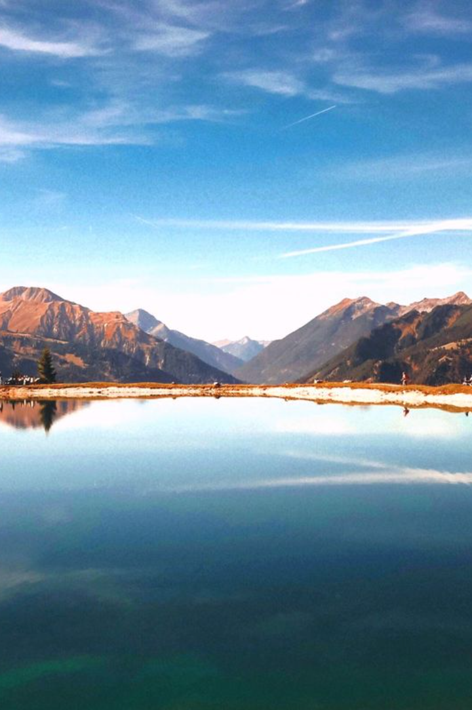

Image-Based Location Advisor
An image-based location advisor uses EXIF metadata and image analysis to provide location recommendations based on the landscape in photos.
by Vickey Patil

Slide 2
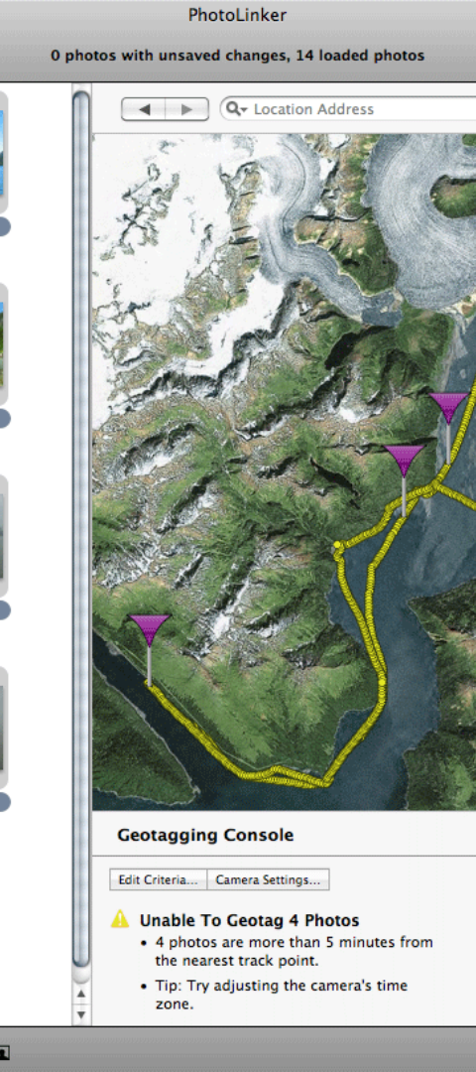
What is EXIF Metadata?
Definition
Importance
EXIF metadata is information embedded in an image file, containing details like the camera model, aperture, exposure, and geotagging.
It provides valuable data about the circumstances in which a photo was taken, aiding in location and landscape identification.
Examples
EXIF data includes date and time, camera settings, and location information, allowing for detailed analysis of the image context.

Slide 3
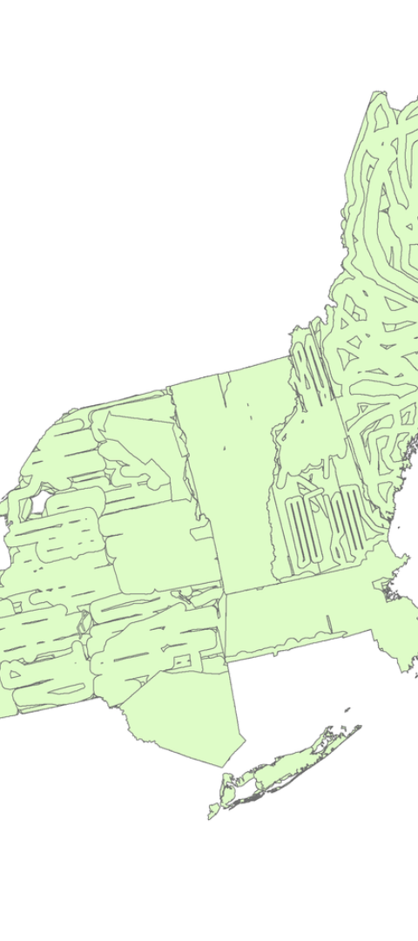
Image Analysis for Landscape Detection
1
Algorithmic Analysis
2
Pattern Recognition
Advanced algorithms are used to identify visual elements, topography, and natural features in images.
Image analysis recognizes patterns, textures, and color palettes to determine the type of landscape depicted in the photo.
3
Geospatial Context
Integrated with geographic data, image analysis categorizes landscapes based on location and terrain attributes.

Slide 4
Classification of Landscapes
Mountains
Seascapes
Forests
Includes ranges, peaks, and cliffs along with the greenery or snow cover indicative of mountainous regions.
Encompasses beaches, shorelines, and coastal areas with characteristic elements such as sand, water, and rock formations.
Characterized by dense vegetation, trees, and foliage, including woodland and rainforest landscapes.

Slide 5

Benefits of Using EXIF Metadata and Image Analysis
1
Precision
Accurate detection and categorization of landscapes enhance the precision of location-based recommendations.
Personalization
2
Customized suggestions based on landscape preferences and past image data improve user satisfaction.
3
Efficiency
Streamlined location advice saves time and effort in planning travel or outdoor activities.

Slide 6



Challenges and Limitations
Complex Terrains
Distinguishing between similar landscapes, such as different types of forests, can be challenging due to variations in visual cues.
Data Variability
Varying lighting conditions, seasons, and image qualities can impact the accuracy of landscape analysis algorithms.
User Input
Dependence on user-provided metadata can introduce errors or inconsistencies in landscape classification.

Slide 7
Case Studies: Successful Application
Travel Planning
Hiking Trails
Real Estate
A travel app uses image-based advice to suggest picturesque destinations based on user-contributed photos.
An outdoor adventure website employs landscape detection to recommend hiking routes suited to specific terrain preferences.
A property listing platform utilizes landscape classification to highlight scenic views from available properties.

Slide 8
The Future of Image-Based Location Advisors
Enhanced Accuracy
Integration of AI and geospatial mapping for precise landscape recognition.
Expanded Applications
Utilization in augmented reality, urban planning, and environmental conservation.
Global Accessibility
Integration with social media and photo-sharing platforms for widespread user engagement.

