Slide 1
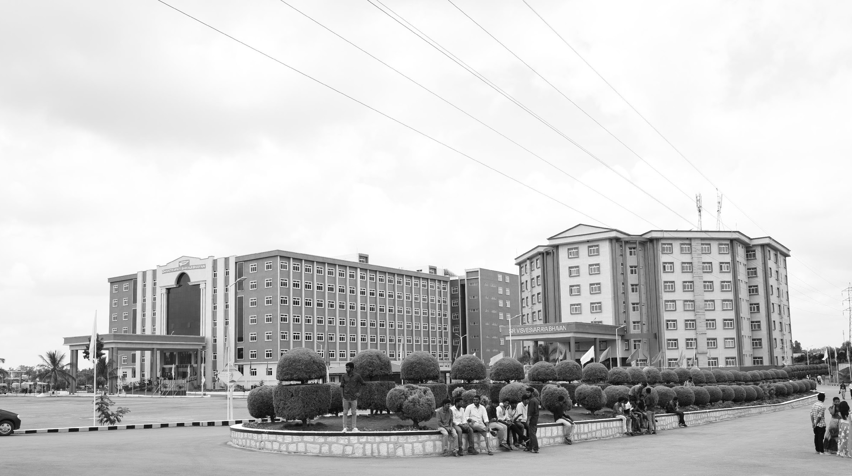
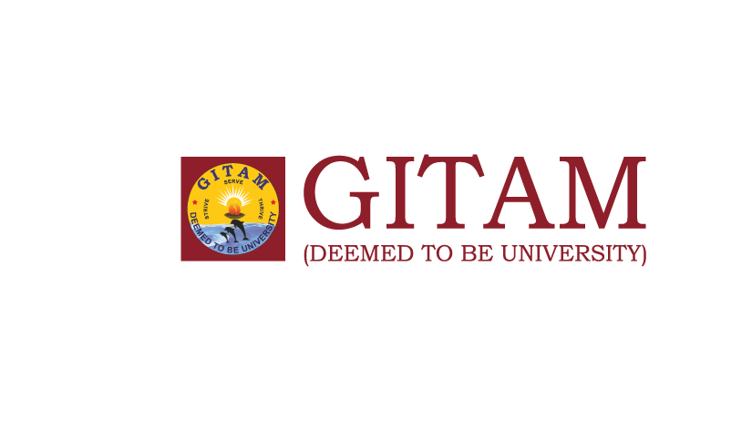
DEEP LEARNING FOR IMAGE FUSION
AY 2021-25
GITAM UNIVERSITY
Major Project
Project ID: CS7
A University should be a place of light, of liberty, and of learning.
Department of Electrical Electronics and Communication Engineering
Project Team:
Shashank Kumar Aradhya – BU21EECE0100551
Project Mentor:
Dr Koshy George
www.gitamedu.com

Slide 2

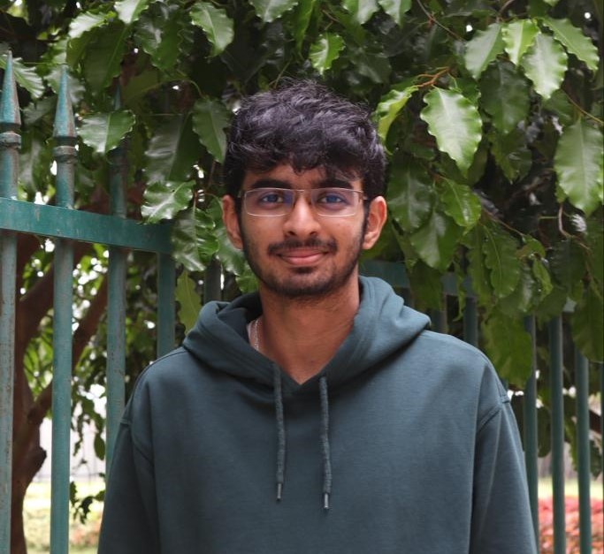
Project Group – Details
Photo
Track
Roll No
Name
EECE
BU21EECE0100551
Shashank Kumar Aradhya

Slide 3
Abstract
Image fusion combines information from multiple images into one fused image which is more informative than any single source image. In applications such as surveillance, fusing infrared (IR) and visible images, aids human vision perception in decision making. IR images capture thermal information, invaluable in low-light or night-time conditions, while visible images provide rich detail and colour information. IR images are illumination-independent, offering robust information regardless of lighting conditions. Traditional methods, like wavelet transforms or principal component analysis, often fail to fully leverage the complementary nature of IR and visible images, resulting in suboptimal results.
Deep learning has revolutionized fields by enabling computers to learn and make decisions from large amounts of data. In image processing, deep learning methods form the state-of-the-art techniques in image classification, object detection, and more. This versatility and effectiveness make deep learning ideal for image fusion. Its applications extend to medical imaging, remote sensing, and autonomous driving, handling complex image processing tasks. This makes deep learning particularly suitable for fusing IR and visible images.
In this project, we explore advanced deep learning approaches to improve IR and visible image fusion. We are investigating techniques like Generative Adversarial Networks (GANs) and diffusion models. GANs generate high-quality images by creating realistic details through adversarial training. Diffusion models refine images by gradually reducing noise, enhancing detail and coherence in the fused image.
Our approach involves training these models on paired IR and visible images to learn the best feature combination. We aim to identify the most effective method for preserving features suitable for human vision perception, in the fused image.
To implement this, we deploy the chosen model on the NVIDIA Jetson Nano, a compact embedded system with powerful processing capabilities. This ensures our solution is effective and efficient for real-time applications. Our project highlights the potential of deep learning in achieving high-quality image fusion, providing practical solutions for real-world applications.

Slide 4
Objective and Goals
Objective
Enhance the fusion of infrared (IR) and visible images using advanced deep learning techniques for real-time applications.
Combine thermal information from IR images with the rich detail and color of visible images to create a more comprehensive and informative output.
Leverage deep learning models like Generative Adversarial Networks (GANs) and diffusion models to achieve superior image fusion.
Focus on preserving key features from both IR and visible sources.
Deploy the final solution on the NVIDIA Jetson Nano for high efficiency and real-time processing.
Target applications include surveillance, medical imaging, and autonomous systems.
Goals
Main Goals:
Develop a deep learning-based model that effectively fuses IR and visible images to produce high-quality outputs.
Evaluate and compare different deep learning techniques, such as GANs and diffusion models, for image fusion.
Optimize the fused image to retain critical features from both IR and visible images, enhancing human vision perception.
Implement the chosen model on the NVIDIA Jetson Nano for real-time image fusion processing.
Additional Goals:
Ensure scalability of the model to handle different image resolutions and types for diverse applications.
Improve model robustness to handle various environmental conditions, such as lighting and noise.
Validate the model’s performance through testing against standard benchmarks and real-world datasets.

Slide 5
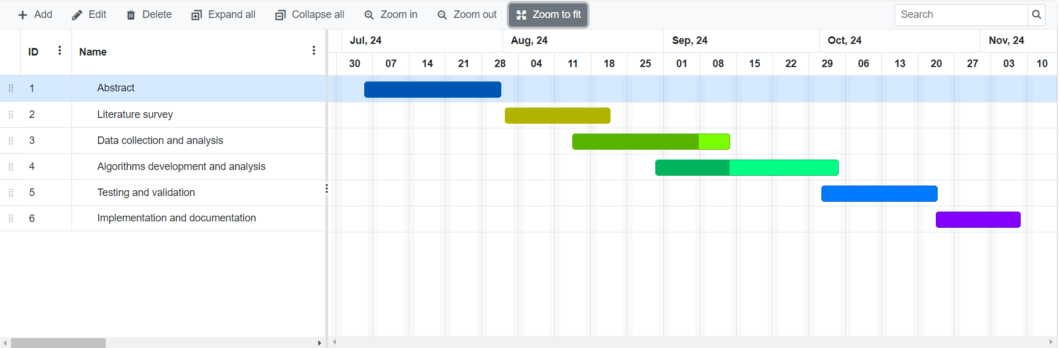
Project Plan
Gant Chart - Milestones and Activities

Slide 6
Literature Survey
Sl.No | Title of the Paper | Year | Author | Key findings | Research gap
1. | A review of image fusion: Methods, applications and performance metrics Publication: Digital Signal Processing 137 (2023) 104020 | 2023 | Simrandeep Singh, Harbinder Singh, Gloria Oscar Deniz , Sartajvir Singh, Himanshu Monga, P.N. Hrisheekes, Anibal Pedraza | Approach: The papers review various image fusion methods, from traditional wavelet transforms to modern deep learning techniques like CNNs. Techniques: Wavelet Transform: H. Li et al. (1995) enhanced multisensor image quality. Contrast Pyramid: H. Jin and Y. Wang (2014) improved detail in visible and infrared image fusion. Deep Learning: Y. Liu et al. (2018) showcased CNNs for pixel-level fusion. Guided Filtering: H. Singh et al. (2014) preserved details in exposure fusion. Results: Significant improvements in visual quality and detail. Deep learning methods outperform traditional techniques but need large datasets. Contrast pyramid enhances detail visibility across spectral sources. | There is a need for more extensive exploration of real-time applications and the integration of deep learning techniques with traditional methods. Many methods lack scalability and robustness in dynamic environments, which limits their practical applicability. Further research is required to validate the effectiveness of deep learning approaches in real-world scenarios and varying conditions, particularly in terms of lighting and scene dynamics.

Slide 7
Literature Survey
Sl.No | Title of the Paper | Year | Author | Key findings | Research gap
2. | A review of multimodal image matching: Methods and applications Publication: Information Fusion 76 (2021) 323–336 | 2021 | Hao Zhang, Han Xu, Xin Tian, Junjun Jiang , Jiayi Ma | Approach: Categories of Image Fusion: Digital Photography Image Fusion Multi-modal Image Fusion Sharpening Fusion Technique: The survey highlights various deep learning techniques used in image fusion, including: End-to-end CNN-based methods: Such as PMGI, which uses proportional maintenance loss for generating fused images. Generative Adversarial Networks (GANs): For example, FusionGAN, which enhances texture details through adversarial training. Autoencoders (AEs): Employed for feature extraction and reconstruction in a unified manner. Results: Deep learning methods significantly outperform traditional methods in feature extraction, fusion, and image reconstruction, resulting in higher quality fused images. | The authors note that existing surveys primarily focus on specific fusion tasks and do not comprehensively review the latest technologies across multiple image fusion scenarios. Additionally, there is a lack of thorough exploration of deep learning-based methods, particularly GAN-based and AE-based approaches, which have emerged recently. This gap indicates a need for a more holistic review that encompasses the advancements in deep learning for various image fusion applications.

Slide 8
Literature Survey
Sl.No | Title of the Paper | Year | Author | Key findings | Research gap
3. | DDFM Denoising Diffusion Model for Multi-Modality Image Fusion Publication: IEEE/CVF International Conference on Computer Vision (ICCV), 2023, pp. 8082-8093 | 2023 | Zixiang Zhao, Haowen Bai, Yuanzhi Zhu, Jiangshe Zhang, Shuang Xu, Yulun Zhang, Kai Zhang, Deyu Meng, Radu Timofte, Luc Van Gool | Approach: The proposed approach leverages the denoising diffusion probabilistic model (DDPM) to address the challenges of multi-modality image fusion. It formulates the fusion task as a conditional generation problem and utilizes a hierarchical Bayesian model with latent variables to generate high-quality fused images. Technique: The technique involves splitting the generation problem into an unconditional DDPM to leverage image generative priors and a conditional diffusion sampling module to better fit different data distributions. The approach aims to retain intricate textures while emphasizing structural information in the fused images. Results: The results demonstrate the effectiveness of the DDFM approach in generating images that adhere to human visual perception while preserving the integrity of the source image information. The proposed method shows remarkable performance across both visual and numerical metrics in infrared-visible image fusion and medical image fusion tasks. | Research gaps could include the need for further exploration of the generalizability of the proposed approach to other types of multi-modality image fusion tasks and the scalability of the method to larger datasets or real-time applications.

Slide 9
Literature Survey
Sl.No | Title of the Paper | Year | Author | Key findings | Research gap
4. | Visible and Infrared Image Fusion Benchmark (VIFB) Publication: IEEE/CVF International Conference on Computer Vision (ICCV), 2020 | 2023 | Xingchen Zhang, Ping Ye, Gang Xiao | Approach: The paper introduces the Visible and Infrared Image Fusion Benchmark (VIFB), aimed at standardizing the evaluation of image fusion algorithms. It provides a consistent dataset and evaluation framework for better comparisons among various methods. Technique: VIFB includes 21 image pairs of visible and infrared images, tested with 20 fusion algorithms across different categories. It employs 13 evaluation metrics that cover various aspects of image quality, ensuring a comprehensive assessment of algorithm performance. Results: Results show no single algorithm consistently outperforms others across all metrics, with traditional algorithms often outperforming deep learning methods. This indicates a need for further advancements in deep learning techniques for image fusion. | The study highlights a lack of standardized datasets for visible and infrared image fusion, making performance comparisons challenging. It also points to the need for improved computational efficiency in fusion algorithms for real-time applications.

Slide 10
Literature Survey
Sl.No | Title of the Paper | Year | Author | Key findings | Research gap
5. | Dif-Fusion: Toward High Color Fidelity Publication: IEEE TRANSACTIONS ON IMAGE PROCESSING, VOL. 32, 2023 | 2024 | Jun Yue , Leyuan Fang, Shaobo Xia , Yue Deng, and Jiayi Ma | Approach: The proposed diffusion-based image fusion method effectively combines multi-channel data, achieving notable improvements in color fidelity and visual quality. Technique: The method employs six statistical metrics for evaluation: Mutual Information (MI), Visual Information Fidelity (VIF), Spatial Frequency (SF), Qabf, Standard Deviation (SD), and Delta E, with MI and VIF being particularly emphasized for their high values. Results: The method ranks first in MI, VIF, SF, and SD on the M3FD dataset, with MI values exceeding 0.5807 and Qabf values consistently higher than 0.4798, outperforming TarDAL and other generative models | The study highlights the need for further investigation into the impact of data diversity on diffusion-based image fusion models. Significant differences in dataset properties can adversely affect performance, suggesting a need for adaptive methods that handle varied data distributions. Additionally, optimizing time-step selections in diffusion processes and improving computational efficiency are critical areas for future research to enhance practicality and effectiveness.

Slide 11
Analysis - SWOT
Strengths
Weaknesses
Limited by embedded system processing power.
High complexity in model training and tuning.
Dependent on large, high-quality datasets.
Innovative use of GANs and diffusion models.
Real-time processing on NVIDIA Jetson Nano.
High applicability in surveillance and healthcare.
Focus on preserving critical image features.
Threats
Opportunities
Rapid advancements in AI may outpace the approach.
Hardware limitations affecting scalability.
Data security concerns in sensitive applications.
Expanding to other fields like agriculture and automation.
Commercialization potential in various industries.
Opportunities for research collaborations.

Slide 12
Analysis – 4W1H
Why: To improve decision-making in applications like surveillance by fusing complementary information from IR and visible images.
What: Use deep learning models (GANs, diffusion models) to create high-quality, fused images from IR and visible image data.
Where: Applicable in real-time environments such as surveillance systems, healthcare, autonomous vehicles, and low-light conditions.
When: During real-time operations where thermal and visible information are critical for enhanced situational awareness.
How: Implement the chosen deep learning model on the NVIDIA Jetson Nano to fuse IR and visible images efficiently in real time.
Refined Objective: To develop a real-time deep learning-based image fusion system that combines IR and visible images to enhance human vision perception in critical applications.

Slide 13
Requirements
Software Requirements:
Operating System:
Jetson Nano: Ubuntu 18.04-based JetPack 4.x.
Development Machine: Ubuntu 18.04 or later, or Windows with WSL2.
Deep Learning Frameworks:
TensorFlow: Version compatible with JetPack, typically TensorFlow 2.x.
PyTorch: Version compatible with JetPack, typically PyTorch 1.x or later.
Image Processing Libraries:
OpenCV: Version 4.x or later.
Development Environment:
Python: Version 3.6 or later.
Jupyter Notebook: Version compatible with Python 3.x.
Tools for Deployment:
JetPack SDK: Includes L4T (Linux for Tegra), libraries, and development tools for Jetson Nano.
Hardware Requirements:
NVIDIA Jetson Nano:
Storage: microSD card with at least 32GB capacity (UHS-1 recommended).
RAM: 4GB LPDDR4.
Power Supply: 5V/4A USB-C power supply.
Camera Modules:
IR Camera: Compatible with Jetson Nano (e.g., FLIR Lepton).
Visible Light Camera: Compatible with Jetson Nano (e.g., Raspberry Pi Camera Module).
PC or Laptop:
CPU: Modern multi-core processor (e.g., Intel i5/i7 or AMD Ryzen).
RAM: Minimum 8GB, 16GB recommended.
GPU: NVIDIA GPU (e.g., GTX 1060 or higher) if available for accelerated training.

Slide 14
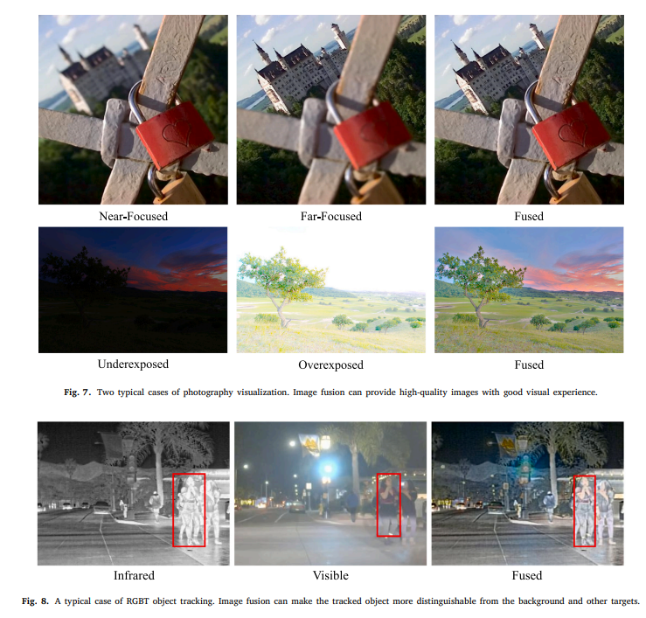
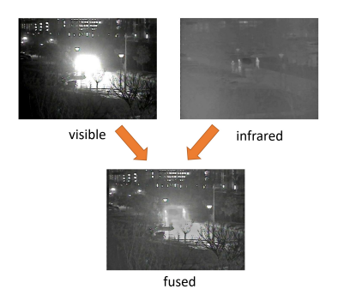
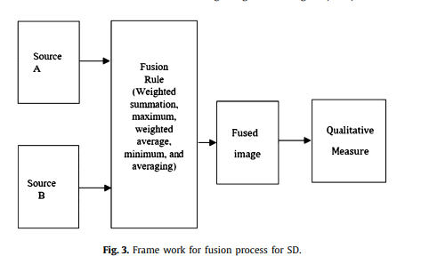
Architecture

Slide 15
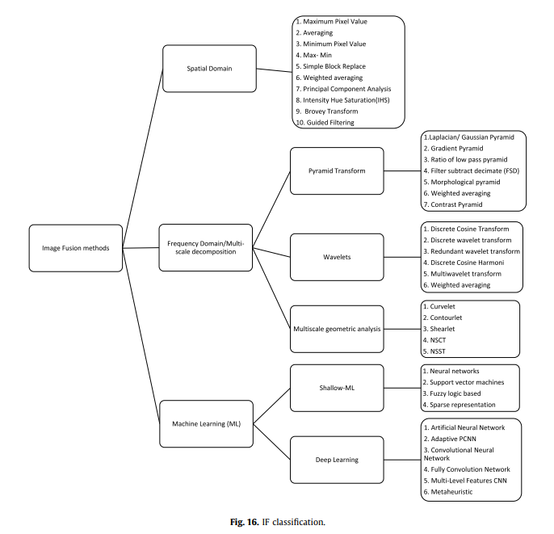

Slide 16
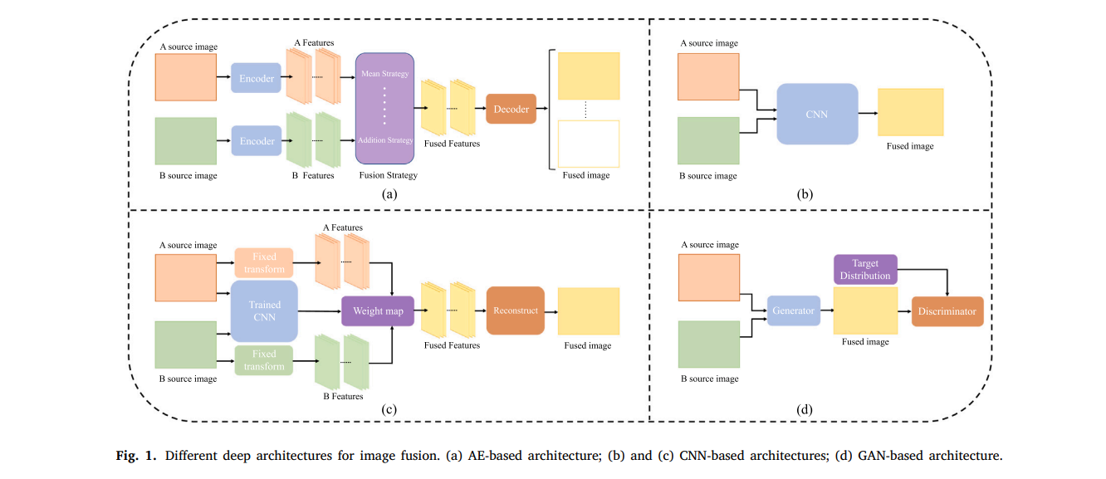

Slide 17
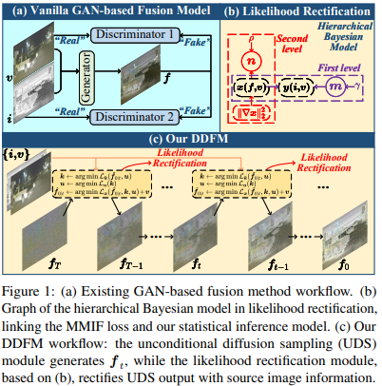

Slide 18
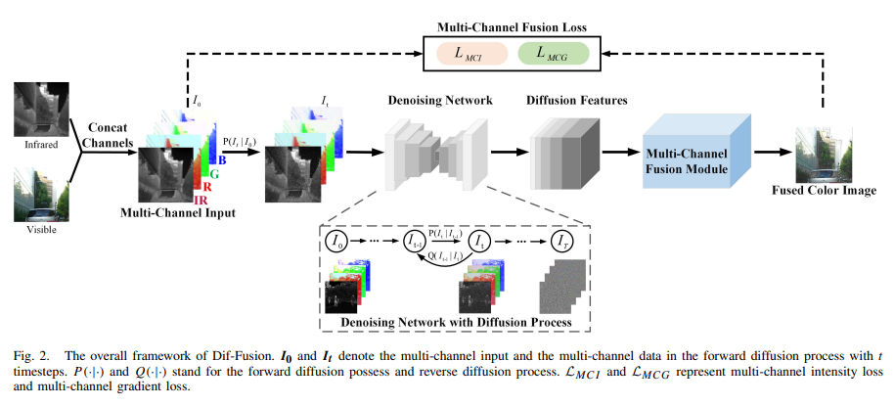

Slide 19
Progress Report
1. Abstract
Status: Completed
Details: The abstract is finalized and covers approximately 500 words, detailing the project’s objectives, methodology, and expected outcomes.
2. Literature Survey
Status: Completed
Details: Completed a comprehensive literature review. Reviewed 15-20 research papers and articles on image fusion techniques, deep learning models, and specific applications to IR and visible image fusion.
3. Data Collection and Analysis
Status: Halfway through
Details:
Data Collection: Collected 1000+ pairs of IR and visible images.
Data Storage: Approximately 10GB of data.
Analysis: Initial data preprocessing is 50% complete. Includes normalization, resizing, and augmentation of images.
Next Steps: Complete data preprocessing, perform exploratory data analysis, and organize datasets for model training.
4. Algorithms Development and Analysis
Status: In Progress
Details:
Model Exploration: Evaluating 3-4 different deep learning models including GANs and diffusion-based Laplacian models.
Channel Learning: Investigating the learning of different color channels:
YCbCr and RGB: Analyzing which color space conversions (e.g., YCbCr vs. RGB) better capture and fuse features.
Color Space Conversion: Comparing performance of models using different color channels and conversions.
Initial Analysis: Comparing model performance based on metrics such as PSNR (Peak Signal-to-Noise Ratio) and SSIM (Structural Similarity Index).
Preliminary Findings: Initial results suggest diffusion-based Laplacian models may offer better image fusion quality compared to traditional methods.
Current Focus: Fine-tuning model parameters, learning color channels, and conducting deeper analysis on model performance.

Slide 20
Progress Report
5.Testing and Validation
Status: Not Started
Details:
Plan: Testing will involve validating model performance with a test dataset comprising 200-300 images.
Metrics: Evaluate models using metrics like PSNR, SSIM, and visual quality assessment.
Schedule: Testing and validation are scheduled to begin after finalizing the algorithm development, expected to start in 3-4 weeks.
6. Implementation and Documentation
Status: Not Started
Details:
Implementation: Deploying the selected model on the NVIDIA Jetson Nano, including system setup and optimization.
Documentation: Preparing project documentation, including methodology, results, and user manuals. Documentation will begin after testing and validation are completed.
Timeline: Expected to start implementation and documentation in approximately 6-8 weeks, following successful testing.
20

Slide 21
Summary, Conclusion and Future
Summary:
Completed: Abstract, Literature Survey.
In Progress: Data Collection (50% complete), Algorithm Development (including channel learning and color space conversions).
Upcoming: Data Analysis, Testing and Validation, Implementation, and Documentation.
Conclusion:
The project has made substantial progress, with key milestones including the completion of the abstract and literature survey. Data collection is halfway done, and algorithm development is actively progressing. The upcoming phases involve rigorous testing and validation of models to ensure accuracy and performance. Following this, the project will focus on implementing the model on the NVIDIA Jetson Nano and preparing comprehensive documentation.
Future Report:
Completion of Data Analysis: Detailed findings from data preprocessing and exploratory analysis.
Testing and Validation: Results from evaluating model performance using the test dataset, including metrics like PSNR and SSIM, and qualitative assessments.
Implementation: Progress on deploying the model on the NVIDIA Jetson Nano, including system setup and real-time optimization.
Documentation: Development of comprehensive documentation covering methodology, results, and user instructions.

Slide 22
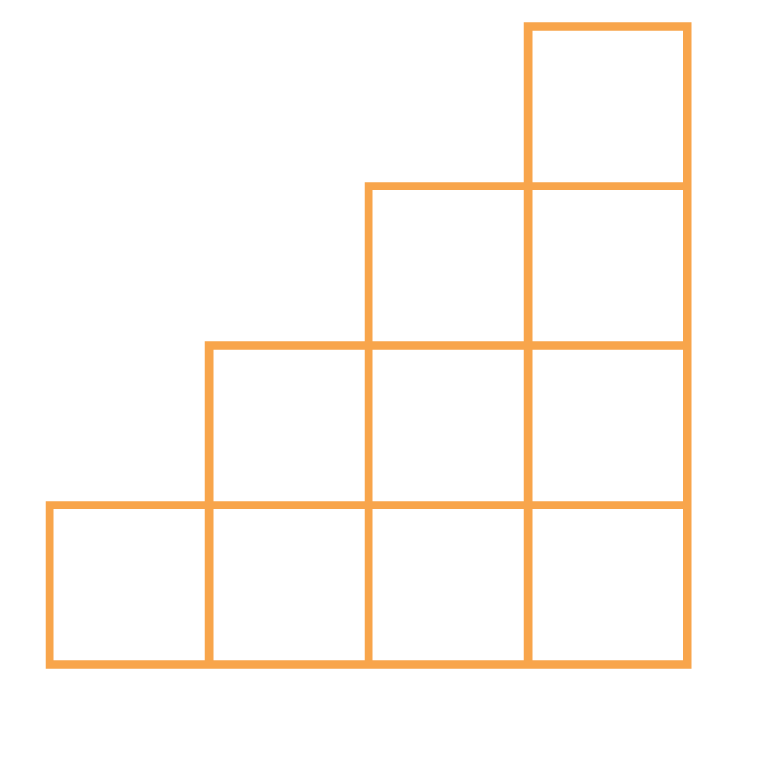
THANK YOU

