Slide 1
Online Self-Supervised Deep Learning for Intrusion Detection Systems
Research paper analysis · critical assessment · SSID+ improvements · experimental validation
Paper: M. Nakıp & E. Gelenbe, IEEE Transactions on Information Forensics and Security, vol. 19, pp. 5668–5683, 2024
Team: <Member 1> · <Member 2> · <Member 3> · <Member 4>
Notes:
Introduce the team and the paper. Say who covers which part (problem, method, critique, implementation).

Slide 2
Roadmap
1
Problem & motivation
Colour code
Botnets, IoT, why online learning is hard
Amber tags: content summarised from the original authors.
Teal tags: the team's own analysis, proposals and results.
2
SSID methodology
AADRNN, trust Γ, packet selection, phases
3
Paper's evaluation
Kitsune & Bot-IoT setup and reported results
4
Critical assessment
Assumptions, errors, gaps, self-poisoning
5
SSID+ & experiments
Our 5 fixes, implementation, results
Notes:
Walk through the five parts of the talk.

Slide 3
1 · Problem & Motivation
Why does an IoT IDS need to learn online, without labels?
Notes:
Member 1 starts here.

Slide 4
Botnets turn cheap IoT devices into DDoS weapons
AUTHORS' CONTRIBUTION
27.7%
≈52%
2 tasks
of global web traffic in 2021 came from malicious bots
of IoT connections go to low-cost, low-maintenance devices
detect malicious traffic · identify compromised devices
Anomaly-based IDSs catch zero-day attacks, but they depend on a model of normal traffic, and normal traffic drifts.
Notes:
Mirai-type malware compromises IoT devices, which then launch DDoS, leak data and spread malware. Two tasks: detect malicious traffic (reactive) and identify compromised devices (preventive).

Slide 5
Two obstacles to online learning
AUTHORS' CONTRIBUTION
1 · No labelled data
2 · When to update?
Each network needs its own collected and labelled traffic, which is rarely available.
Human labelling is slow, costly and error-prone.
Frequent updates burn scarce IoT compute for little gain.
Rare updates leave the model stale and false alarms rise after drift (e.g. new devices).
Notes:
Obstacle 1: no labelled data per deployment. Obstacle 2: choosing when to retrain. Frequent retraining wastes compute; rare retraining leaves the model stale.

Slide 6
Existing self-supervised IDSs still need offline data
AUTHORS' CONTRIBUTION
Work | Mechanism | Offline data | Extra model | Online
Song & Kim | LSTM pseudo-normal data | Yes | Yes | No
Wang et al. | BYOL contrastive | Yes | Yes | No
Zhang et al. | Bidirectional GAN | Yes | Yes | No
Caville et al. | GNN contrastive | Yes | Yes | No
Abououf et al. | LSTM-AE (cloud) | Yes | No | Partly
SSID (this paper) | Own decisions × trust Γ | No | No | Yes
Team note
KitNET, Kitsune's own detector, is an online unsupervised autoencoder IDS on the same dataset, and it is not compared.
Notes:
Summarise Table I of the paper. Point out that SSID is the only one that is fully online. Then the team's note: KitNET, which is online and unsupervised, is missing from the comparison.

Slide 7
What the paper contributes
AUTHORS' CONTRIBUTION
1
SSID framework
Fully online, label-free training for any IDS with learnable parameters
2
Trust coefficient Γ
Γ = C_rep · C_gen measures online how far the IDS can be trusted
3
Self-supervised selection
Packets labelled with probabilities Γ(1−y) / Γy / 1−Γ
4
Trust-triggered updates
Retrain only when Γ < Θ and no attack is in progress
5
Evaluation
Kitsune + Bot-IoT, AADRNN & MLP backbones, two tasks
Notes:
Read out the contributions.

Slide 8
2 · SSID Methodology
System model, AADRNN, trust coefficient, phases
Notes:
Member 2 starts here.

Slide 9
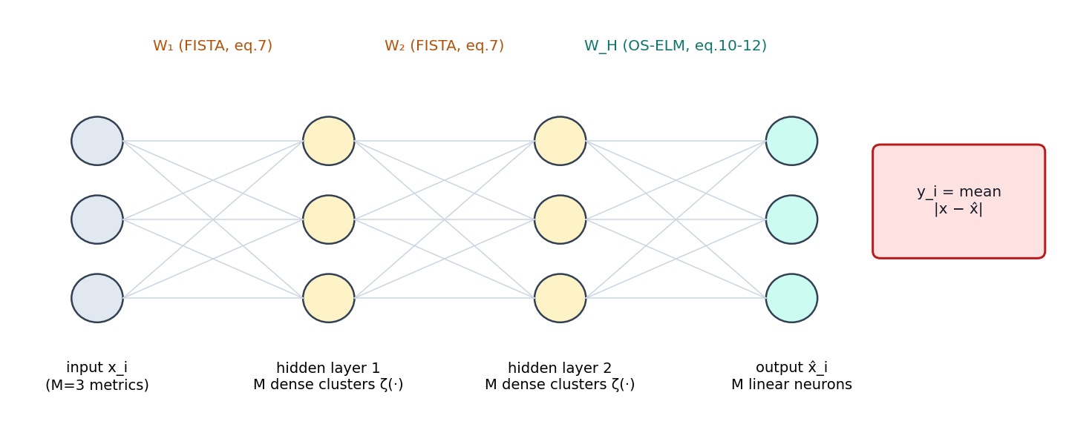
The IDS: an auto-associative Deep Random Neural Network
AUTHORS' CONTRIBUTION
Inputs (header only)
Traffic detection, M = 3:
• total size of last 500 pkts
• mean inter-arrival of last 500
• # pkts in last 100 s
Device identification, M = 6, over 10-s windows
y_i = (1/M) Σ |x_mi − x̂_mi| · alarm if mean(y, I = 10) > γ
Notes:
AADRNN reconstructs the benign metrics it expects. y is the mean absolute deviation (eq. 5); device identification uses the max (eq. 6). Inputs are header-only metrics.

Slide 10
Learning the AADRNN
AUTHORS' CONTRIBUTION
Initial learning (l = 0): hidden layers by FISTA
W_h = argmin_{W ≥ 0} ‖ [adj(ζ(X_{h−1} W_R)), 1] W − X_{h−1} ‖² + ‖W‖₁ (7)
Online learning (l ≥ 1): output layer only, by OS-ELM
O_l = O_{l−1} − O_{l−1}Xᵀ(I + X O_{l−1} Xᵀ)⁻¹ X O_{l−1} W_H ← W_H + O_l Xᵀ(X₀ − X W_H) (11–12)
ζ(·) is the DRNN dense-cluster activation (eq. 4). E(l) = mean of y over the learned batch (eq. 13) is passed back to SSID.
Notes:
Initial phase: hidden layers fitted by non-negative L1 least squares solved with FISTA (eq. 7). Online phase: only the output layer is updated, using OS-ELM recursive least squares (eqs. 10–12).

Slide 11
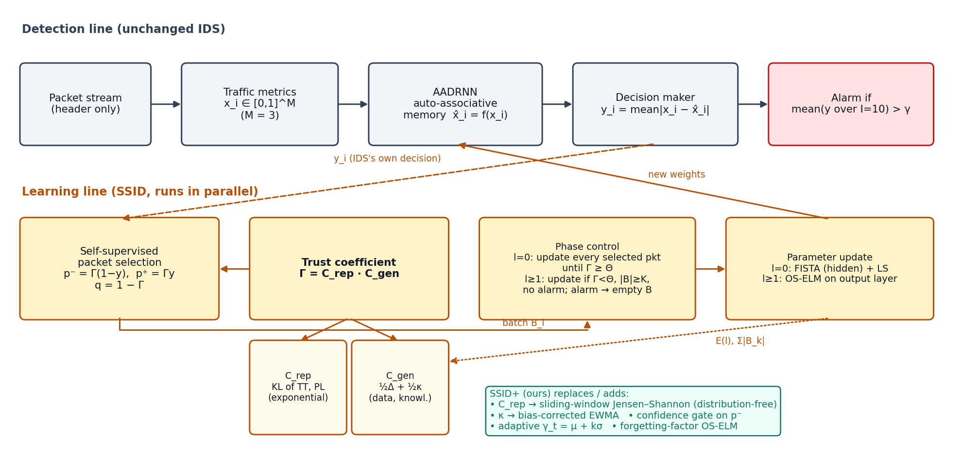
SSID: a learning line in parallel with detection
AUTHORS' CONTRIBUTION
Notes:
Detection is unchanged. The learning line reads y, computes trust, selects packets, and decides when to update. The teal box previews our SSID+ changes.

Slide 12
Self-supervised packet selection, weighted by trust
AUTHORS' CONTRIBUTION
p⁻ = Γ (1 − y_i)
p⁺ = Γ · y_i
q = 1 − Γ
select as benign
select as malicious
do not use
Γ ∈ [0,1] is SSID's confidence in the IDS. Low trust means almost no packets are labelled.
The first packet is assumed benign (p⁻ = 1), so the cold start lasts one packet.
An auto-associative IDS learns only from benign samples.
Notes:
Each packet is used as benign with probability Γ(1−y), as malicious with probability Γy, or skipped. With Γ = 0 nothing is learned. The first packet is assumed benign.

Slide 13
Trust coefficient Γ = C_rep · C_gen
AUTHORS' CONTRIBUTION
Representativeness C_rep
Generalisation C_gen = ½Δ + ½κ
TT and PL are assumed exponential and independent.
D_KL = log(λo/λl) − (λo − λl)/λo
C_rep = ½[(λl/λo)·e^{1−λl/λo} + (μl/μo)·e^{1−μl/μo}]
Data adequacy:
Δ = 1 − min(W / Σ|B_k|, 1)
Knowledge:
κ = 1 − Σ (½)^{l−k+1} E(k)
κ ← ½ − ½(E(l) − κ)
Notes:
C_rep: closed-form KL divergence between exponential TT/PL distributions of learned vs observed traffic, mapped by e^-D. C_gen: half data adequacy, half knowledge (EWMA of the training error).

Slide 14
Two phases decide when to learn
AUTHORS' CONTRIBUTION
Initial learning l = 0
Online learning l ≥ 1
Update after every selected packet.
End the phase once Γ ≥ Θ = 0.95 (14)
Collect selected packets in B_l.
Update if Γ < Θ, |B_l| ≥ K = 100, and mean(y) ≤ γ = 0.25 (15)
If mean(y) > γ: empty B_l (16)
Retraining happens only when needed: trust has dropped and the network looks clean.
Notes:
Phase 0: update on every selected packet until trust reaches Θ. Phase ≥1: update only when trust has fallen, enough packets are collected, and no alarm is active. An alarm empties the batch so false negatives just before the alarm are not learned.

Slide 15
3 · The Paper's Evaluation
Setup, metrics, reported results
Notes:
Member 3 starts here.

Slide 16
Experimental setup in the paper
AUTHORS' CONTRIBUTION
Item | Setting
Datasets | Kitsune Mirai: 764k packets, 84% malicious · Kitsune SYN DoS · Bot-IoT DDoS HTTP/TCP/UDP, DoS HTTP
Tasks | Malicious-traffic detection (M=3) · compromised-device identification CDIS (M=6)
Baselines | AADRNN/MLP offline (83k benign pkts) and incremental (every 750 pkts) · KNN, Lasso · sequential CDIS
Metrics | ROC, accuracy, TPR, TNR · balanced accuracy for CDIS
Parameters | Θ = 0.95, I = 10, K = 100, γ = 0.25
Notes:
Datasets, tasks, baselines, metrics and parameters as reported.

Slide 17
Key results reported by the authors
AUTHORS' CONTRIBUTION
> 0.995
4,161
+18%
TPR at FPR ≈ 10⁻⁵ (Kitsune-Mirai)
packets learned fully online, vs. 83,000 for the offline model
median balanced acc. for CDIS on Bot-IoT DDoS-TCP (+11% UDP)
Also reported: SSID clearly beats incremental learning, and SSID-MLP is second-best overall. Team note: the CDIS gains come mostly from TNR, and TPR is low.
Notes:
TPR above 0.995 at FPR around 1e-5. Learned from only 4,161 packets but competitive with offline training on 83k. CDIS improved by up to 18% median balanced accuracy.

Slide 18
4 · Critical Assessment
What holds up, and what does not
Notes:
Member 3 continues: the team's critique.

Slide 19
Strengths
TEAM'S ANALYSIS
Label-free & online
Decides when to learn
No offline data, no human labels, a one-packet cold start
Trust-triggered updates replace a fixed schedule
Model-agnostic
Lightweight
Works with AADRNN, MLP and CDIS; we confirmed MLP
3–6 header metrics, O(1) statistics, output-layer-only updates
Notes:
Acknowledge what the paper does well before critiquing it.

Slide 20
Weakness 1: the self-labelling loop can be poisoned
TEAM'S ANALYSIS
Boiling-frog attack
Bootstrap deadlock
Training labels come from the IDS itself.
Raise the attack rate slowly → each batch stays just under γ → it is learned → the profile of "normal" follows the attack.
The batch-clearing rule (16) never fires. The paper does not test this.
At l = 0, Δ = 0, so C_gen = ¼(1 − E(0)).
If the untrained IDS outputs y = 1, then E(0) = 1 → κ = 0 → Γ = 0 → q = 1: nothing is ever selected.
The first packet must also be benign: an infected network at deployment is learned as normal.
Notes:
A slowly ramping attack stays under gamma, so it is accepted and learned, and 'normal' moves with the attack. Batch clearing never fires. Bootstrap: if the untrained output is 1, then E(0)=1, kappa=0, Delta=0, so Gamma=0 forever.

Slide 21
Weakness 2: mathematical issues we found
TEAM'S ANALYSIS
Where | Issue | Fix
Eq. (35) | Weights sum to 1 − 2^{−(l+1)}: κ is biased upward (κ = 1 − E/2 at l = 0) | Divide by Σw (bias-corrected)
Eq. (38) | Sign typo: “+ΣE” should be “1 − ΣE” (inconsistent with eq. 37) | [2 − min(·) − ΣE]/2
Eq. (10) | O₀ uses X̂_H, but (11)–(12) use X̂_{H−1}; singular with < M+1 samples | Use X̂_{H−1} + ridge
Eq. (28) | Labelled D^PL but gives D^TT | Relabel
Eqs. (15)/(16) | Window covers I packets in (15) but I+1 in (16) | Use the same window
Eq. (4) | Discriminant negative for small Λ; no domain given | Clip to 0 / state domain
Notes:
Walk through each equation issue.

Slide 22
Weakness 3: assumptions and evaluation gaps
TEAM'S ANALYSIS
Restrictive assumptions
Evaluation gaps
Exponential TT/PL, while real packet lengths are bimodal; C_rep compares means only
Cumulative statistics react slowly to drift
"Observed normal" comes from the IDS's own decisions, which is circular
Fixed γ = 0.25 depends on the metric scale
One detection trace, 84% malicious, so accuracy is inflated
No variance over runs; no sensitivity analysis on Θ or γ
No KitNET baseline; no runtime or memory figures
Benign drift and adversarial attacks are never tested
Per-packet labels on window-aggregated metrics
Notes:
Assumptions on the left, evaluation gaps on the right.

Slide 23
5 · SSID+ and Experimental Validation
Our five fixes, implementation and results
Notes:
Member 4 starts here.

Slide 24
SSID+: five label-free changes
TEAM'S ANALYSIS
1
Windowed Jensen–Shannon C_rep
Distribution-free, bounded in [0,1], follows drift
fixes: exponential / cumulative
2
Bias-corrected κ
κ = 1 − ΣwE/Σw
fixes: κ inflated early
3
Confidence gate
Accept as benign only if y ≤ min(γ/2, μ + 3σ)
fixes: self-poisoning
4
Adaptive threshold
γ_t = clip(μ + 6σ, 0.03, γ) from accepted outputs
fixes: scale-dependent γ
5
Forgetting OS-ELM
λ_f = 0.995 so old traffic fades
fixes: slow adaptation
Notes:
Each change maps to a weakness. Gate and adaptive gamma control what is learned; JS, unbiased kappa and forgetting control how fast it adapts.

Slide 25
Implementation
TEAM'S ANALYSIS
File | What it does
ssid/traffic.py | Scenarios, CSV loader, causal M=3 metrics
ssid/models.py | ζ (eq. 4), FISTA (7), AADRNN + OS-ELM (10–12), MLP-AE
ssid/framework.py | SSID loop (13–38), SSID+ switches, baselines
run_experiments.py | Seeds × scenarios × methods, ablation, sensitivity
pcap_to_csv.py | Run on the real Kitsune / Bot-IoT pcaps
Choices the paper leaves open
• Ridge 10⁻³ in O₀
• Frozen input scaling (otherwise eq. 7 collapses onto the bias)
• Untrained y = 0.5 (y = 1 deadlocks)
• Batch capped at 5,000
• Python 3 · NumPy · scikit-learn
Notes:
Show the code in the editor. Every line of the SSID loop is annotated with its equation number. List the implementation choices the paper does not specify.

Slide 26
Experimental setup
TEAM'S ANALYSIS
mirai
mirai_drift
slow_ramp
Stationary benign traffic, then an abrupt flood at 60 pkt/s (close to the paper's setting)
4 new devices join one by one (benign drift), then the flood
Drift, then an attack that ramps 0 → 60 pkt/s over 900 s (adversarial)
Baselines: Offline-AADRNN / KNN / IForest (5,000 oracle-labelled packets) · Incremental-AADRNN (750) · SSID-AADRNN · SSID-MLP · SSID+. Metrics: TPR, TNR, balanced accuracy, AUC, µs per packet. 5 seeds, about 60–90k packets each.
Notes:
Synthetic, reproducible traces, because Kitsune/Bot-IoT need registration. Three scenarios, five seeds, the paper's parameters. FPR is measured outside attack windows.

Slide 27
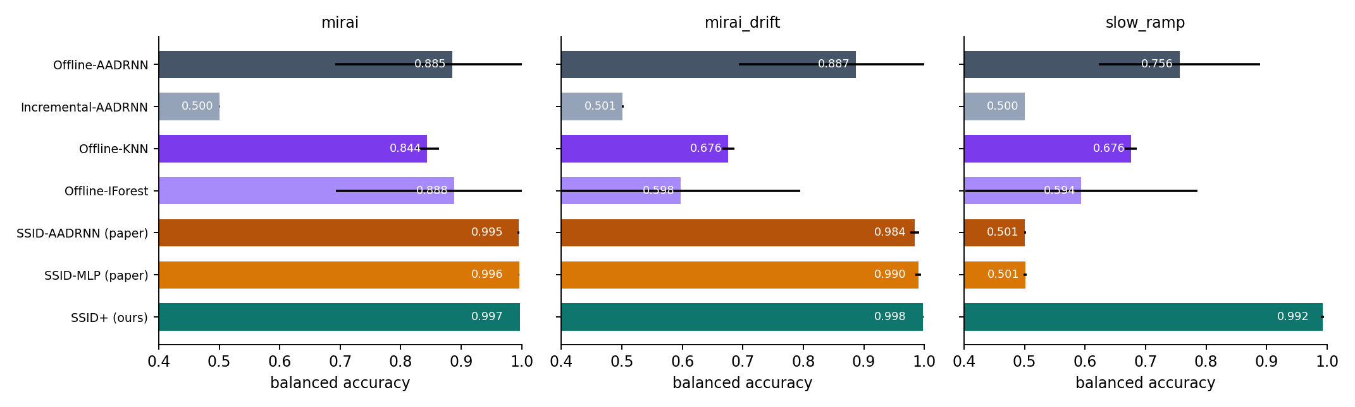
Results: balanced accuracy across scenarios
TEAM'S ANALYSIS
Notes:
Read the numbers. SSID reproduces the paper on mirai and drift. On slow_ramp it collapses to 0.5. SSID+ stays at 0.99. The offline detectors fail under drift.

Slide 28
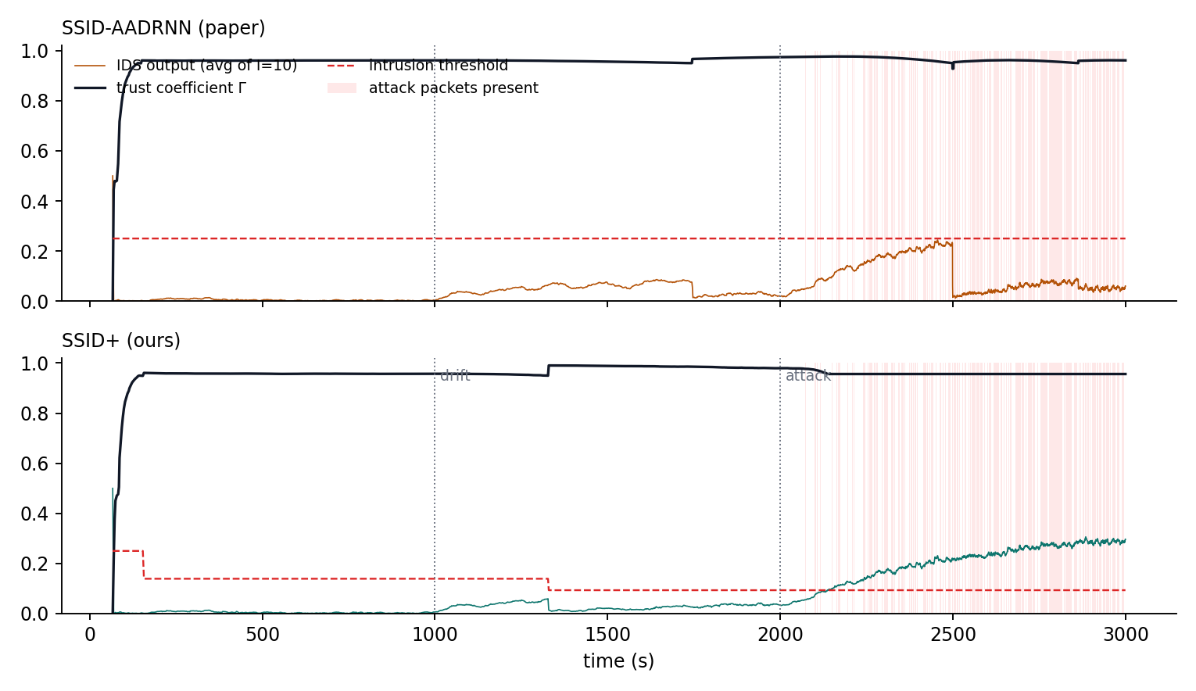
Why SSID fails on the slow ramp, and SSID+ does not
TEAM'S ANALYSIS
TPR 0.002
paper's SSID: attack learned as normal
TPR 0.985
SSID+: attack still detected
TNR 0.9999
same false-alarm rate for both
Notes:
Top: the paper's SSID output rises with the attack but stays under 0.25; trust dips, an update fires around 2,500 s, and the attack becomes 'normal'. Bottom: SSID+'s adaptive threshold (about 0.09) fires early, so attack batches are cleared and never learned.

Slide 29
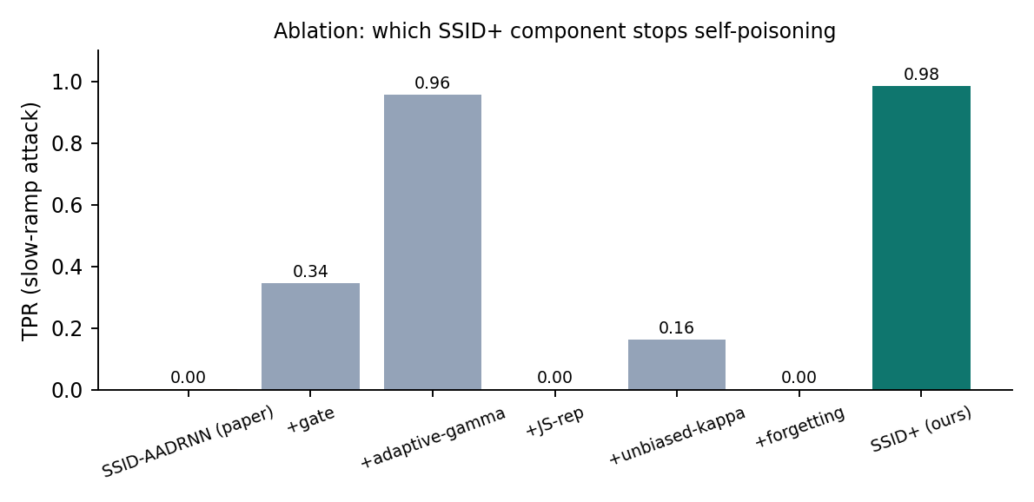
Ablation: which component stops self-poisoning?
TEAM'S ANALYSIS
Reading
How fast it learns: JS, κ and forgetting.
What it learns: the gate and adaptive γ.
You need the second group to resist poisoning.
Notes:
Adaptive gamma does most of the work. The gate helps partly. JS and forgetting alone do not help; they speed adaptation. The full combination is best and has the lowest variance.

Slide 30
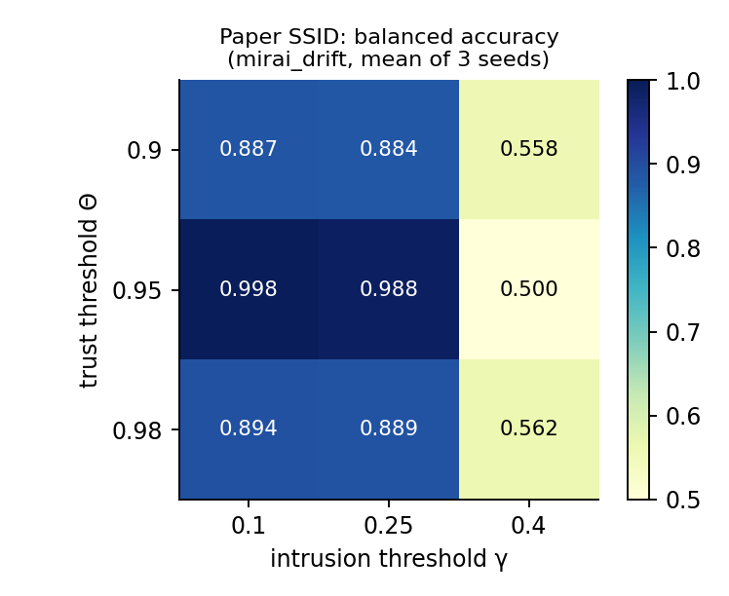
Sensitivity and cost
TEAM'S ANALYSIS
Sensitivity (paper's SSID)
Balanced accuracy ranges 0.50–0.998. γ = 0.40 breaks detection completely. The "no tuning" claim does not hold.
Cost per packet (Python)
SSID 5–44 µs · SSID+ 44–104 µs. That is still more than 10k packets/s on one core.
Notes:
Theta and gamma sensitivity for the paper's SSID: gamma = 0.4 breaks detection, and moving theta from 0.95 costs about 10 points. Cost: SSID+ takes 40–100 µs per packet in Python, still more than 10k packets/s.

Slide 31
Conclusion
Authors' claim: holds
Team's findings
On abrupt attacks and on gradual drift, SSID trains an IDS fully online with no labels and matches offline training. It also handles benign drift, which we tested and the paper did not.
• A slow-ramp attack poisons SSID (TPR ≈ 0)
• Bootstrap deadlock, κ bias, equation typos
• SSID+ restores TPR to 0.985
• Next: test on the real datasets, add change detection and anchor memory, federated SSID
Notes:
Wrap up. State the takeaways, the limits of our study (synthetic traces), and future work.

Slide 32
References
[1] M. Nakıp, E. Gelenbe, “Online Self-Supervised Deep Learning for Intrusion Detection Systems,” IEEE TIFS 19, 2024
[17] Y. Mirsky et al., “Kitsune: An ensemble of autoencoders for online NIDS,” NDSS 2018
[18] N. Koroniotis et al., “Bot-IoT dataset,” FGCS 100, 2019
[58] A. Beck, M. Teboulle, “FISTA,” SIAM J. Imaging Sci., 2009 · [59] N.-Y. Liang et al., “OS-ELM,” IEEE TNN, 2006
J. Lin, “Divergence measures based on Shannon entropy,” IEEE TIT 1991 (JS) · E. Arazo et al., “Pseudo-labeling and confirmation bias,” IJCNN 2020
Figures on slides 9–10: team's re-drawings of Figs. 1–3 in [1]. All result charts are the team's own.
Notes:
Thank the audience and invite questions.

