Slide 1
Automated provisioning of Elastic Stack, Automation Testing and CI/CD Pipeline setup
BDD, TestNG and Maven
UI Automation using Selenium
API Automation using RestAssured/Karate DSL
Devops CI/CD Pipeline setup
ELS provisioning

Slide 2
Testing UI
Functional &Integeration testing of PHP Travels web application TCs : https://s.docworkspace.com/d/AFIgtiTbjuxFuY3t5-GdFA

Slide 3
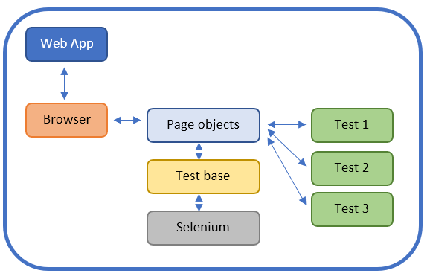
Selenium- Page object model

Slide 4
API Automation Testing :
Uisng Rest Assured - API Automation
RequestSpecification, ResponseSpecification, Given , when, then format to write the scripts
Serialisation and Deserialisation using POJO Classes , Jackson API, Gson , Jhonjon dependencies.
Methods : GET, PUT, POST, PATCH, DELETE.
Using JsonPath , JsonObject to iterate through Json content , and create Json body.
Validations using Asserstions, Hamcrest Matchers
Authentication : O Auth 2.0, Basic, Digest , Form authentication, SSL Authentication.
Using Karate DSL
Gherkin language based feature files, easy to handle and more behavioural driven.
No need to specify the step definations, already been implemented by intuit framework.
Config.js file used to provide the environment &configuration details and tet runner class to execute the scenarios.

Slide 5
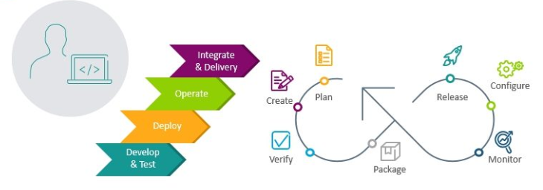

Slide 6
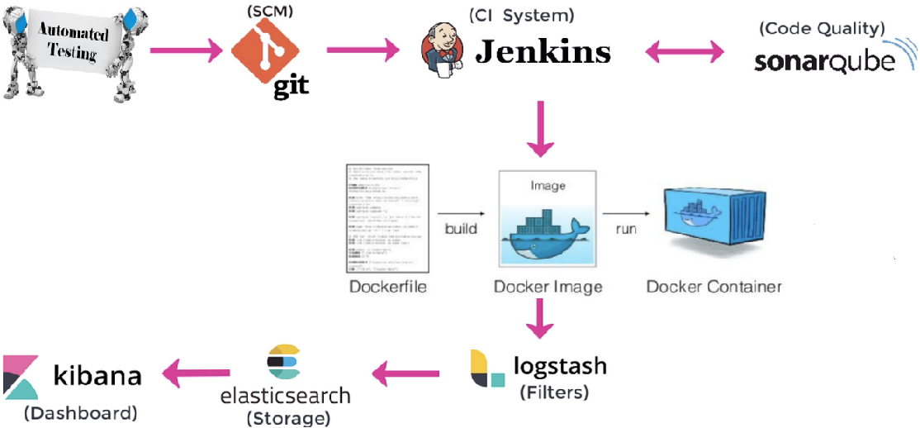
Automated Provisioning of ELS, CI/CD & Testing

Slide 7


