Slide 1

Regular Expressions
Subject - Python
Explained by - S Shashank
RNSIT, Bangalore
www.intellify.in A joint effort by Intellify and NSS IIT Delhi info@intellify.in

Slide 2
Task – Pattern Matching
Extracting lines matching a certain pattern from text
Regex : A powerful library
Complex but highly efficient
5
35
25
22
15
www.intellify.in S Shashank, RNSIT Bangalore

Slide 3
Regular Expressions
Programs to search and parse strings.
Module : re
Method : search()
5
35
25
22
15
www.intellify.in S Shashank, RNSIT Bangalore

Slide 4
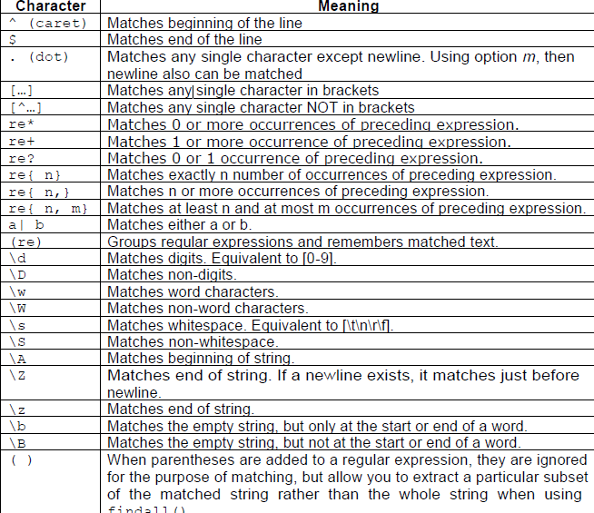
Special Characters in regex
4
Metacharacters
Specify patterns
e.g. Pattern for identifying a number
[0-9]+
e.g. Pattern to identify a char followed by number and starts with ‘!’
^![a-zA-Z][0-9]+
4
35
25
15
www.intellify.in S Shashank, RNSIT Bangalore

Slide 5
Writing Regular Expressions
4
e.g. Identify email
[A-Za-z0-9]+@[A-Za-z0-9]+.com$
e.g. Identify date : dd/mm/yy
[0-9][0-9]/[0-9][0-9]/[0-9][0-9]
4
35
22
15
www.intellify.in S Shashank, RNSIT Bangalore

Slide 6
Application : Extracting E-Mails from a file
4
Process the file
Open file – open()
Process – read()
Close File – close()
Extract email addresses
search() : searches for pattern match
findall() : extract all instances of pattern match
4
25
22
15
www.intellify.in S Shashank, RNSIT Bangalore

Slide 7
Regex: What’s Next?
4
Lexical Analysers : Compilers
Mining Techniques : Data mining
Natural Language Processing : Syntatic and Semantic
4
25
22
15
www.intellify.in S Shashank, RNSIT Bangalore

Slide 8
Thank you
www.intellify.in S Shashank, RNSIT Bangalore

