Slide 1

File Transfer Protocol
Subject – Python
Explained by - S Shashank
RNSIT Bangalore
www.intellify.in A joint effort by Intellify and NSS IIT Delhi info@intellify.in

Slide 2
Problem Statement
Simulate FTP using Python to transfer files from a remote server.
5
35
25
22
15
www.intellify.in S Shashank, RNSIT Bangalore

Slide 3
File Transfer Protocol
Protocol used to transfer files in a network.
Client – Server Architecture.
ftplib : Python module
www.intellify.in S Shashank, RNSIT Bangalore

Slide 4
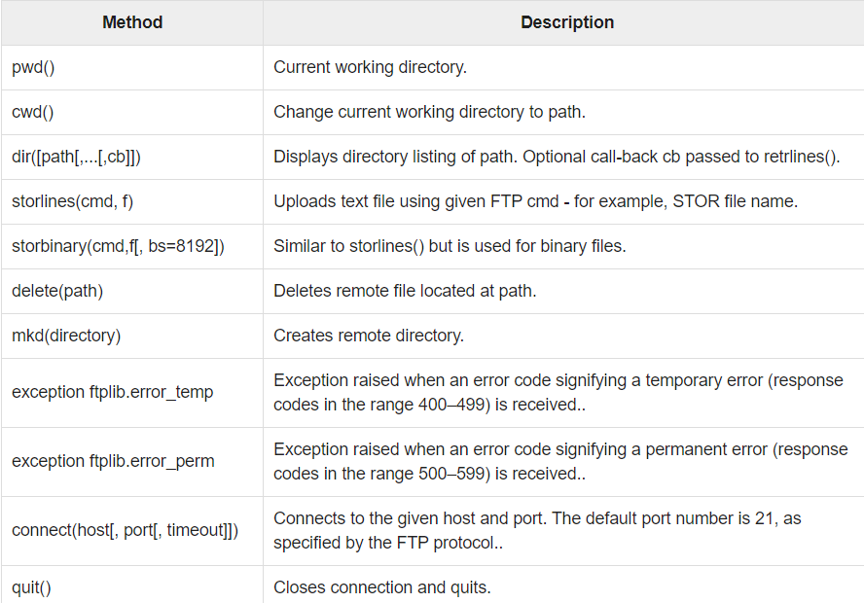
ftplib Methods
Tasks :
- List files from server
- Change Directory
- Fetching the files
www.intellify.in S Shashank, RNSIT Bangalore

Slide 5
Thank you
www.intellify.in S Shashank, RNSIT Bangalore

