Slide 1

Most Occurring Word in File
Subject – Python
Explained by - S Shashank
RNSIT Bangalore
www.intellify.in A joint effort by Intellify and NSS IIT Delhi info@intellify.in

Slide 2
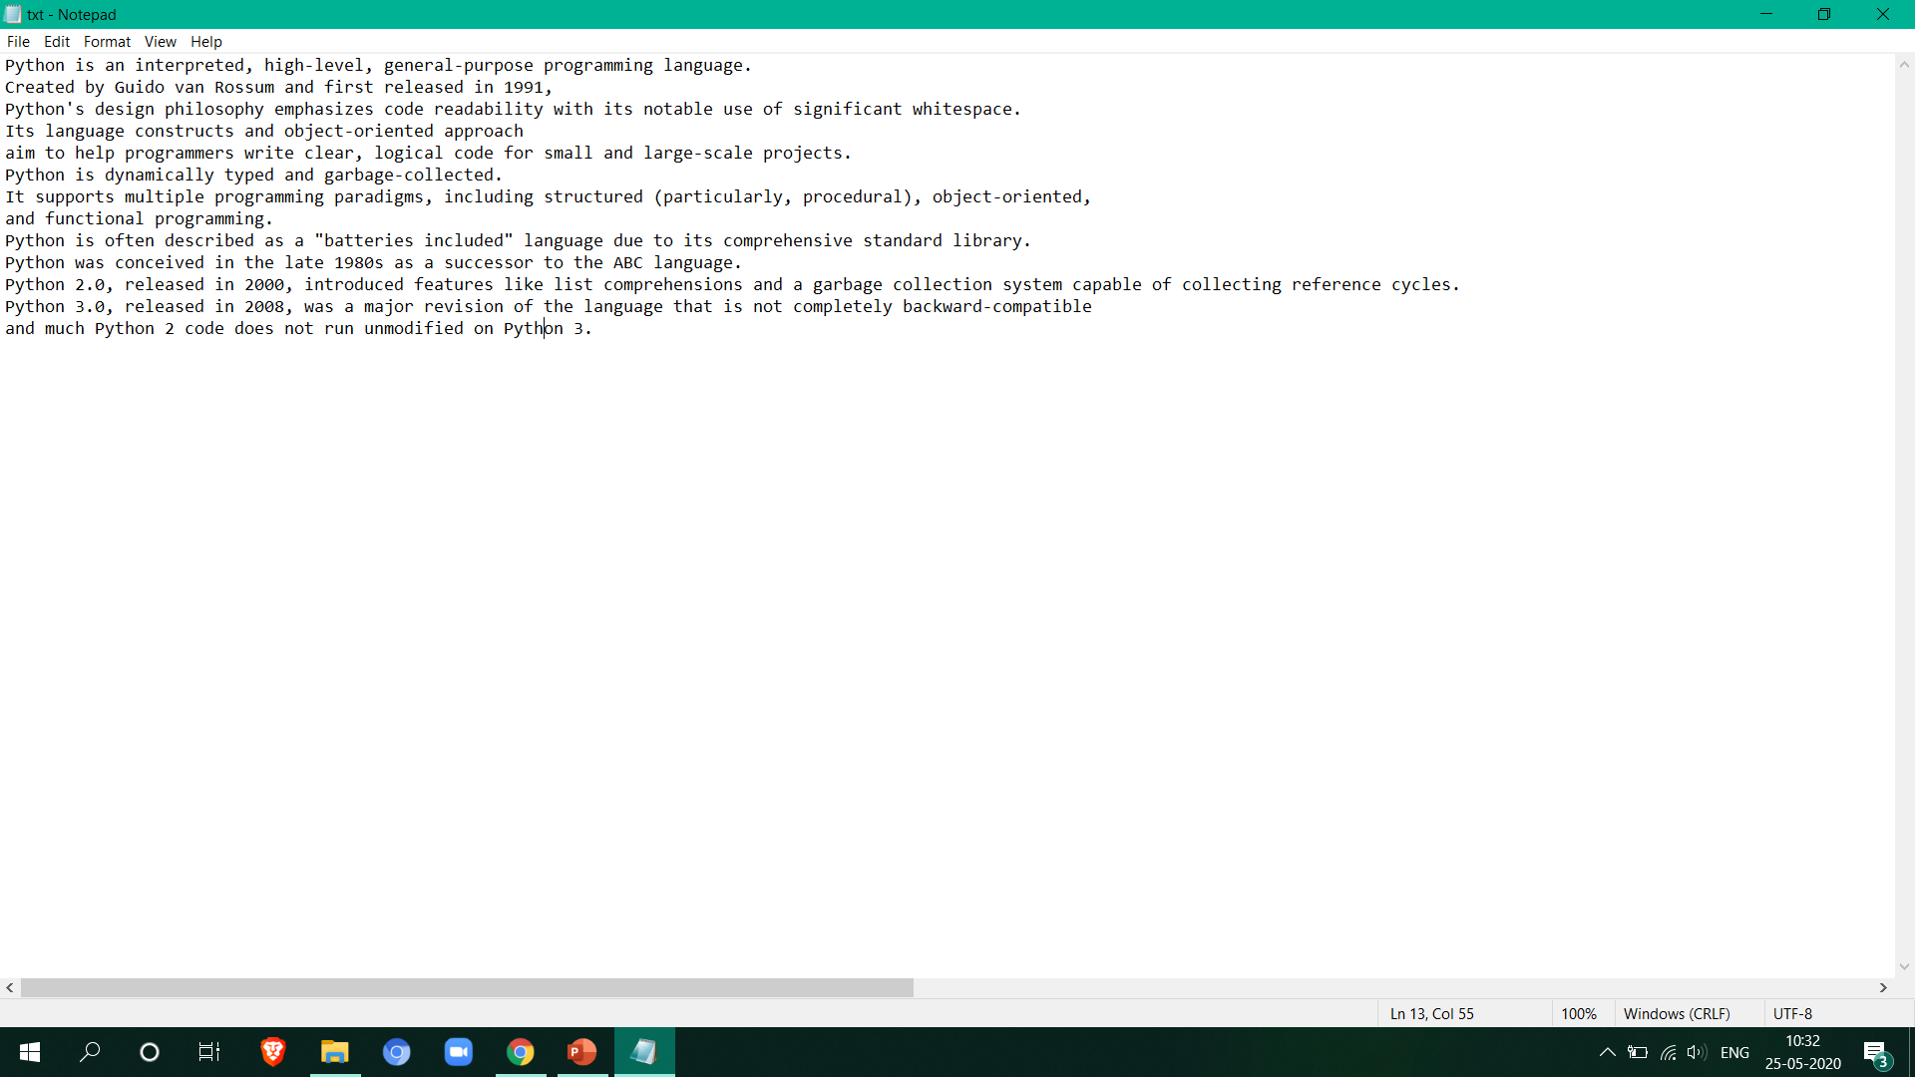
Problem Statement
From a file find the most occurring word and display it.
Output : Python
5
35
25
22
15
www.intellify.in S Shashank, RNSIT Bangalore

Slide 3
Methodology
Data Structure : Dictionary
Open file.
Traverse file line by line.
For each new word encountered, make an entry in dict.
If word already exists increment its count.
The dictionary contains all words and their frequencies.
www.intellify.in S Shashank, RNSIT Bangalore

Slide 4
Methodology
To find highest frequency word :
Sort the dictionary based on value.
Select the last entry from the list.
www.intellify.in S Shashank, RNSIT Bangalore

Slide 5
Thank you
www.intellify.in S Shashank, RNSIT Bangalore

