Slide 1

Progress Bar
Subject – Python
Explained by - S Shashank
RNSIT Bangalore
www.intellify.in A joint effort by Intellify and NSS IIT Delhi info@intellify.in

Slide 2
Problem Statement
Create a progress bar in Python.
- Indicate file download/ process completion.
5
35
25
22
15
www.intellify.in S Shashank, RNSIT Bangalore

Slide 3
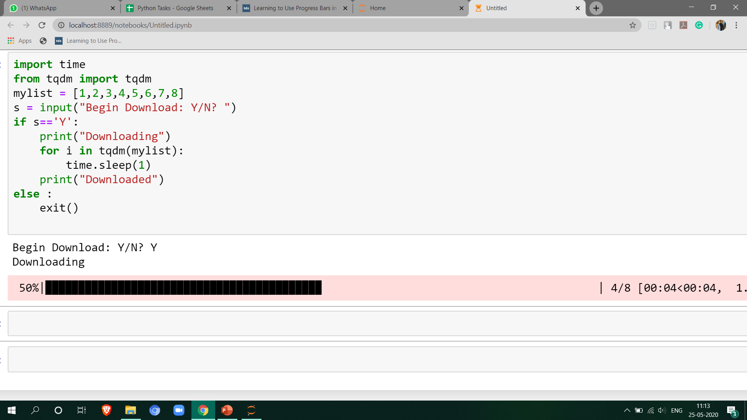
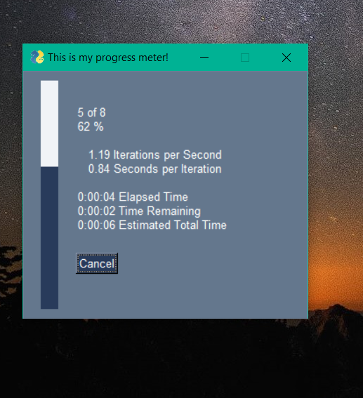
Approaches
Using tqdm library : Useful for Console Programs
Using PySimpleGUI : Useful for Graphical Programs
www.intellify.in S Shashank, RNSIT Bangalore

Slide 4
Applications
Indicate download progress.
Process Completion for Job Schedulers.
www.intellify.in S Shashank, RNSIT Bangalore

Slide 5
Thank you
www.intellify.in S Shashank, RNSIT Bangalore

