Slide 1
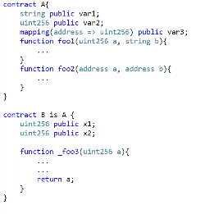
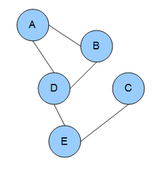
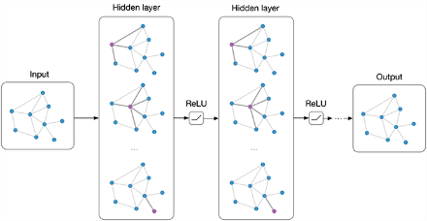





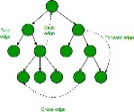
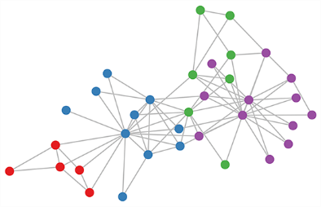









Programs
Graphical Models
Graph Neural Networks
Inferring program properties – Our approach
Goal: Infer types in JS
equivalent to
predict
Corpus of TS programs with annotated types
Dependency graphs of programs
Graph neural networks
Inferring types in programs – Problem setup

