Slide 1

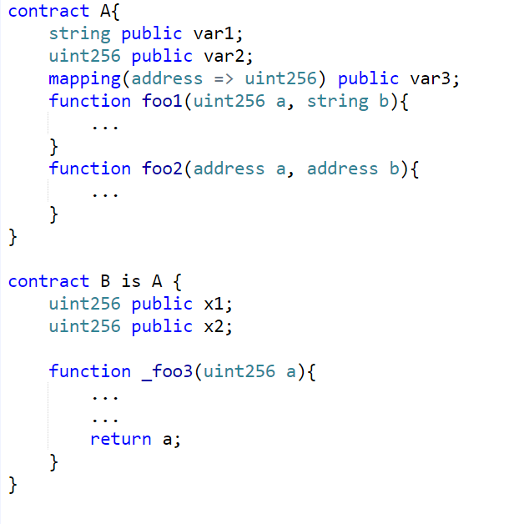
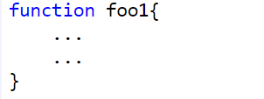



Source code of each function
Abstract syntax tree
Use and Define paths
Feature vector describing foo1()
Extract
features
1
1
0
0
A Solidity source file. Each file contains contracts – equivalent to classes in OOP. Each contract contains functions. Contracts can inherit properties from other contracts.
Use analysis tools for Solidity to find vulnerabilities in functions
For each vulnerability-type, treat the tool’s output as a label
Binary label
Train a classifier for each vulnerability-type
Classify vulnerability presence

Slide 2
Program Representation Stack
Dynamic
Static
Execution snapshots of
Characters
Purely Syntactic
- program variables
Lexicalized tokens
Purely Semantic
- various system parameters e.g. stack, heap, PC etc.
AST
- outputs corresponding to different inputs
Program Graphs
Syntactic
+
Semantic
- other similar trace-based properties
IR
Assembly

Slide 3
Program
AST context
def a
Assignment Node
RHS: Constant expression Node
a = 5
Assignment Node
RHS: Function call Node
def b
b = foo( )
use b
if b == 10
Boolean Expression Node
Operator: ==
b = b-a
use a, b
def a
op -

Slide 4
Program
Program
def a
a = 5
def a
a = 5
def b
b = foo( )
def b
b = foo( )
if b == 10
use b
False
True
use b
if b == 10
Program
b = b-a
a =10
use a, b
def b
use --
def a
False
True
def a
a = 5
b = b-a
a =10
def b
b = foo( )
use a, b
def b
use --
def a
use b
if b == 10
False
True
b = b-a
a =10
use a, b
def b
use --
def a

Slide 5
def a
a = 5
def a
use a
“a”
ID
…
Assign
If
False
Assign
RHS
“a”
Path 1
def b
…
…
b = foo( )
def b
use b
use b
if b == 10
“b”
ID
…
Assign
If
False
Assign
RHS
“b”
Path 2
…
False
True
def b
def b
b = b-a
a =10
“b”
ID
Assign
If
False
Assign
LHS
…
“b”
Path 3
use a, b
def b
…
use --
def a
root
Assignment
Assignment
If Statement
Condition
LHS
RHS
Variable
FunctionDefinition
True
False
Operator
Variable
Literal
ID
Name
Arguments
Assignment
Assignment
equality
Type
ID
value
“b”
“foo”
…
…
LHS
RHS
…
“a”
“5”
Variable
BinaryOp
Operator
Type
ID
LHS
RHS
subtract
…
“b”
ID
ID
“b”
“a”

Slide 6
a = 5
b = foo( )
if b == 10
False
True
b = b-a
a =10

Slide 7
a = 5
def a
use a
“a”
ID
…
Assign
If
False
Assign
RHS
“a”
Path 1
…
…
Program
b = foo( )
def b
use b
if b == 10
“b”
ID
…
Assign
If
False
Assign
RHS
“b”
Path 2
…
False
True
def b
def b
b = b-a
a =10
“b”
ID
…
Assign
If
False
Assign
LHS
…
“b”
Path 3
Paths
root
Assignment
Assignment
If Statement
Condition
LHS
RHS
Variable
FunctionDefinition
True
False
Operator
Variable
Literal
ID
Name
Arguments
Assignment
Assignment
equality
Type
ID
value
“b”
“foo”
…
…
LHS
RHS
…
“a”
“5”
Variable
BinaryOp
Operator
AST
Type
ID
LHS
RHS
subtract
…
“b”
ID
ID
“b”
“a”

Slide 8
a = 5
def a
use a
“a”
ID
…
If
False
Assign
RHS
ID
“a”
Path 1
b = foo( )
…
Program
def b
use b
if b == 10
“b”
ID
If
False
Assign
RHS
ID
“b”
Path 2
…
…
False
True
def b
def b
b = b-a
a =10
“b”
ID
If
False
Assign
LHS
ID
“b”
Path 3
…
…
Paths
root
Assign
Assign
If
Cond
LHS
RHS
Variable
FuncDefn
True
False
Operator
Variable
Literal
ID
Name
Arg
Assign
Assign
equality
Type
ID
value
“b”
“foo”
…
…
LHS
RHS
…
“a”
“5”
Variable
BinOp
Operator
AST
Type
ID
LHS
RHS
subtract
…
“b”
ID
ID
“b”
“a”

Slide 10
def a
use a
“a”
ID
…
RHS
ID
“a”
Path 1
def b
use b
“b”
ID
…
LHS
ID
“b”
Path 2
def b
def b
“b”
ID
…
Variable
ID
“b”
Path 3

