Slide 1
Implementing the GI framework Mentor: Dr. Justyna Petke
Extending a generic SAT solver to the problem of Combinatorial Interaction Testing using GI
Shashank Srikant
MIT
shash@mit.edu

Slide 2
The problem
Can GI help in modifying a generic SAT solver to evolve into being a specific solver for the CIT problem
pow(y, N){
if N > 0
return y*pow(N-1)
}
pow_special(y){
return y*y
}

Slide 3
Algorithm setup
Fitness function / Selection strategy
Mutant passes the entire test suite
Can miss one test case but executes faster
Mutation involves
Delete existing lines
Copy another line from the repo* onto a given line
Replace a line (basically, a combination of above two operations)

Slide 4

Experiment setup
Host source code: miniSAT, generic SAT solver
Test suite: Designed for the CIT problem, but maintains the format of miniSAT (for easy evaluation)
Train, validation set
# of individuals: 30; # of generations: 10, init randomly seeded

Slide 5

Experiment setup
Host source code: miniSAT, generic SAT solver
Test suite: Designed for the CIT problem, but maintains the format of miniSAT (for easy evaluation)
Train, validation set
# of individuals: 30; # of generations: 10, init randomly seeded

Slide 6
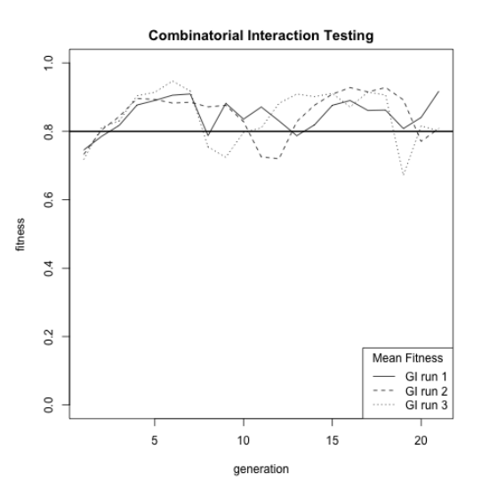
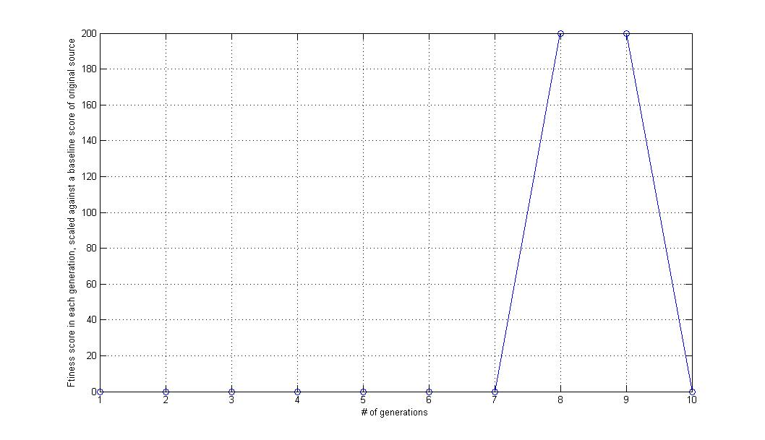
Results
Research question
Does the fitness score improve over evolution runs?

Slide 7
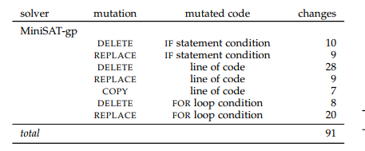
Results
Research question
What does the evolved output look like? What’s changed in the source?
<for1_Solver_671><for1_Solver_439> <for1_Solver_1079><for1_Solver_1010> <IF_Solver_513><IF_Solver_720> <IF_Solver_941><IF_Solver_860> <for3_Solver_660> <for3_Solver_1138><for3_Solver_915> <_Solver_468> <_Solver_988> <_Solver_826> <_Solver_528><_Solver_545> <for2_Solver_671><for2_Solver_453> <_Solver_428> <IF_Solver_1058><IF_Solver_855> <for3_Solver_978><for3_Solver_1138> <IF_Solver_248>

