Slide 1


Computational Intelligence in RTS Games
leading to 3 CI and RTS Related assignments
Mike Preuss

Slide 2
WHEN GAME AI BECOMES… ARTIFICIALLY INTELLIGENT
discussion in game AI research: how intelligent is current game AI?
many users are still frustrated with “intelligence” of NPC/bots
see recent gamasutra post:
http://www.gamasutra.com/view/news/253974/When_artificial_intelligence_in_video_games_becomesartificially_intelligent.php
"My prediction is a little bit controversial. I think the next giant leap of game AI is actually artificial intelligence." - Alex J. Champandard at GDC 2013
Notes:
DANIELE: Only a short comment. I understand the overalps, bu why do you include RL and SVM in classic AI? I see them definitely in CI (as it also includes NN)

Slide 3
OUTLINE
modern Game AI
Computational Intelligence and Games
RTS research
microRTS overview
assignments

Slide 4
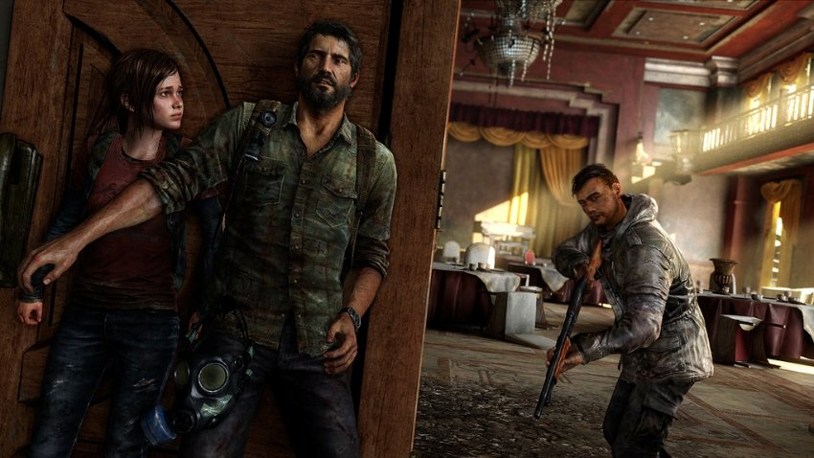
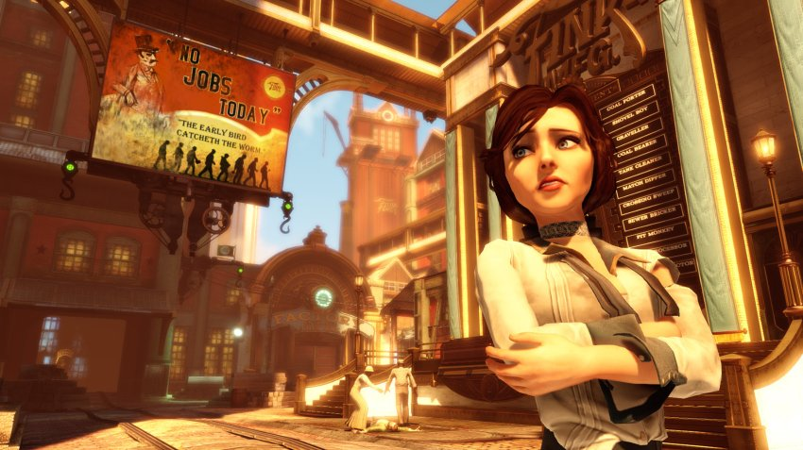
LESS DUMB GAME AI…
more emphasis on atmosphere/narrative (NPC and player able to express personality -> personalization of game)
NPC as sidekicks of main characters: development
NPC must be much more complex, less scripting, more AI
left: The last of us (Sony Computer Entertainment): 2 main characters
right: Bioshock infinite (2K Games): sidekick
but it is not only about NPC AI any more…

Slide 5
GAME AI OVERALL VIEW
game AI
control
design support
directors
strategic (bots)
/supportive AI
NPC behavior
balancing
PCG
game AI traditionally encompasses mostly NPC behavior and bots
control happens during the game, design support before deployment
design support is rather new, but a highly dynamic research area

Slide 6
MODERN APPROACH
modern approach:
we treat all aspects of games, now also game design/production
we use what fits best for a specific problem
algorithms
game design/production
game AI
classic AI / machine learning
computational intelligence
in-game AI use
Notes:
DANIELE: Only a short comment. I understand the overalps, bu why do you include RL and SVM in classic AI? I see them definitely in CI (as it also includes NN)

Slide 7
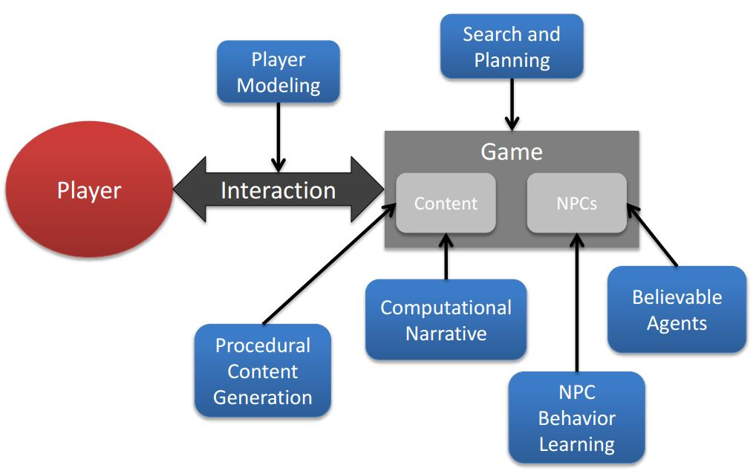
PANORAMIC VIEW
game AI components, player centric view, from:
Yannakakis, G.N.; Togelius, J., "A Panorama of Artificial and Computational Intelligence in Games," in IEEE TCIAIG, 2014
look at the yet unpublished game AI book: http://gameaibook.org/

Slide 8
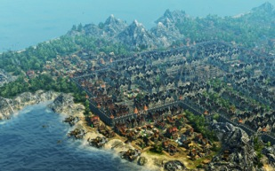
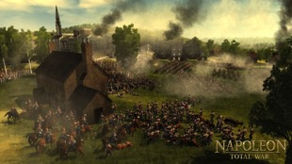
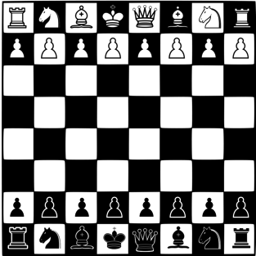
WHY APPLY CI METHODS TO GAMES?
contrary to board games,
game trees often not applicable
incomplete information
concurrency: during planning phase, game situation changes
quantifying a game situation is not trivial
good and fast approximations are needed
evolutionary optimization is
versatile, flexible, still works (somehow)
copes with noise and strange search spaces
can be asked to deliver a result at any time

Slide 9
COMPUTATIONAL INTELLIGENCE AND GAMES: HOT TOPICS
procedural content generation (PCG)
large game worlds are expensive to make
represent specific (designer) styles
believability/adaptability of NPC behavior
more humanlike behavior (also evoke and show emotions)
human/AI interaction
cope with unseen situations, learn how to play
personalization
preference modeling (what do they like?), player type analysis
dynamic adaptation of game content and mechanics
all this involves modeling, learning, optimization ☺
current methods: Evolutionary Algorithms, Deep Learning, MCTS
balancing is
everywhere

Slide 10
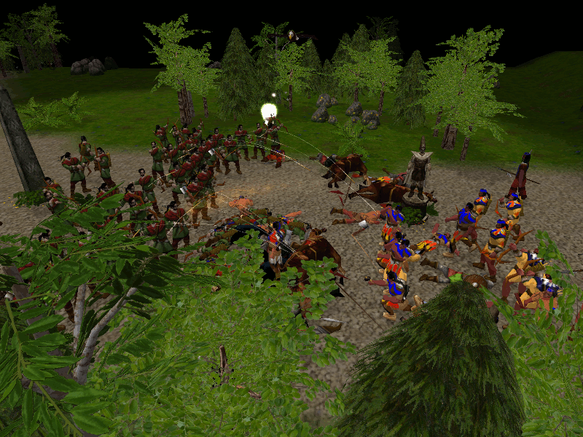
WHATEVER WE CHANGE -> BALANCING
initial (more conceptual) work:
Markus Kemmerling and Mike Preuss. Automatic Adaptation to Generated Content Via Car Setup Optimization in TORCS. IEEE CIG 2010.
test case Megaglest (Warcraft-clone):
autorun interface (quick)
balancing 7 factions impossible
balancing 2 factions not trivial
effects not gradual: little changes can tip over balance
robust solutions needed

Slide 11


MANUAL VS AUTOMATED BALANCING
current research direction: how to combine manual and automated balancing
automated balancing is useful but not perfect
manual balancing is industry standard but time consuming
manual
automated
one good solution after player assessment
multiple good solutions after fitness evaluation
playtesting
many of the automatically found solutions are fun to play (based on player assessment)
Notes:
Three major findings were revealed to us by this step:
Firstly, Automated balancing created different solutions than manual balancing, therefore you have more solutions to playtest
Secondly, the majority of the created solutions were very playable
However not all of them, which may be most notably due to the fact that our Player AI may not represent a real human player sufficiently enough.
And now we hear more about the detailed analysis of the data.

Slide 12
SOME GAME AI VOCABULARY
NPC: non-player character
(game) state evaluation function: heuristic to determine how good the current “board state” is
MCTS: Monte Carlo Tree Search, randomized tree search that works with an incomplete tree and may employ additional heuristics
PCG: Procedural Content Generation, automated or semi-automated generation of maps, levels, items, etc.
forward model: a function that enables an AI to test what happens if a specific action is executed

Slide 13
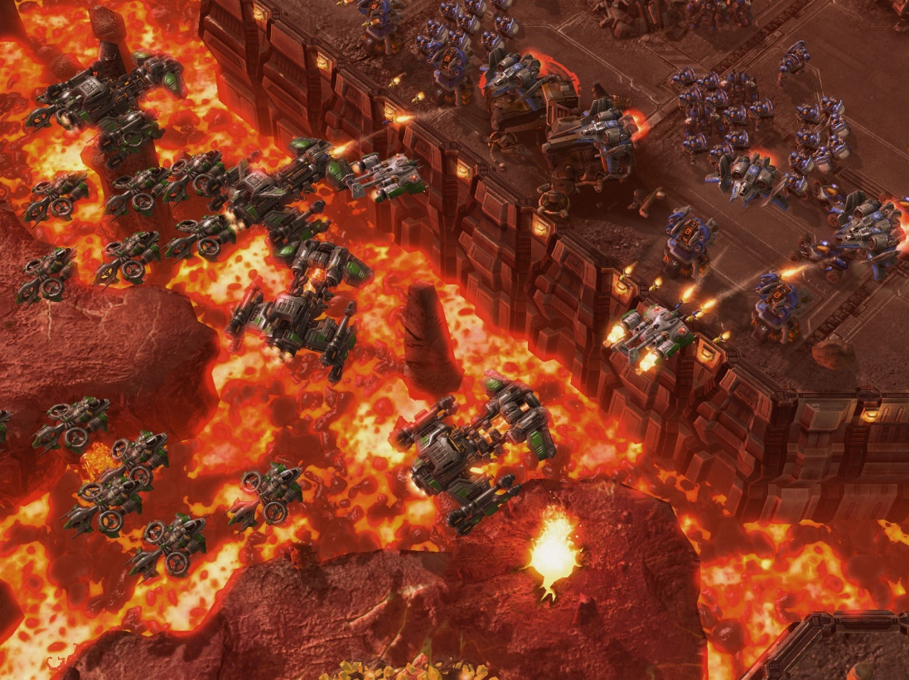
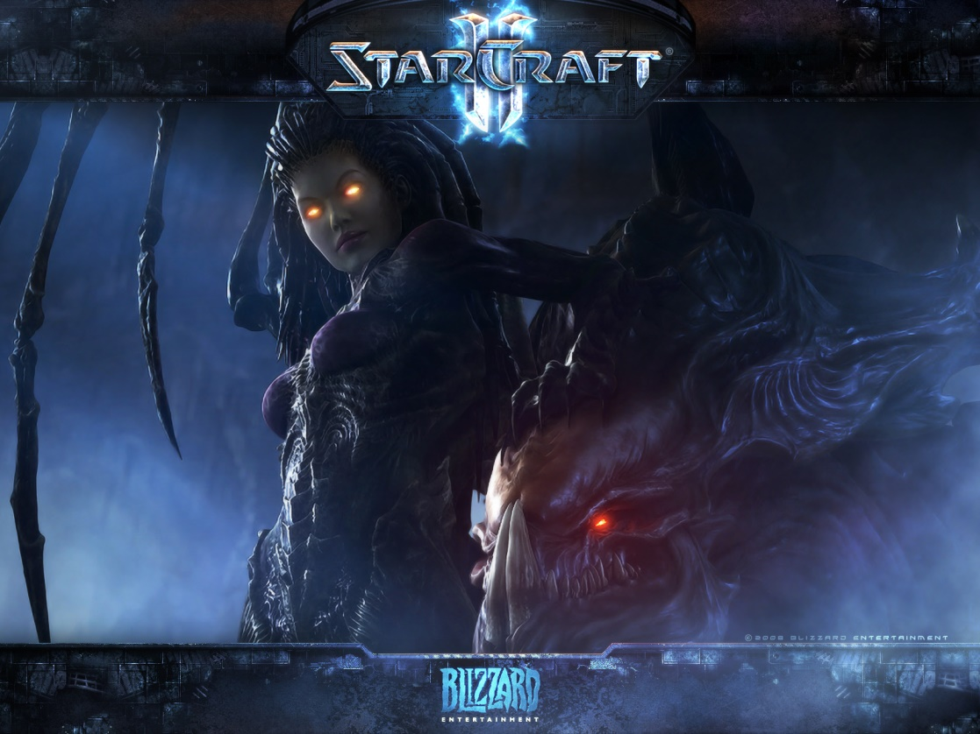
WHAT ARE REALTIME STRATEGY GAMES?
maybe most well-known title: StarCraft/StarCraft II
simultaneous move games
durative actions (take some amount of time to complete)
real-time: one may act at “any time”
usually partially observable and non-deterministic
complex: 400 units on a 128x128 map gives 10¹⁶⁸⁵ states, Go has 10¹⁷⁰

Slide 14
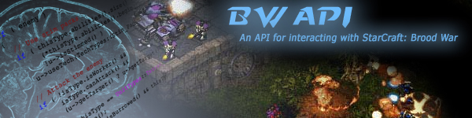
REALTIME STRATEGY GAMES RESEARCH
S. Ontañón, G. Synnaeve, A. Uriarte, F. Richoux, D. Churchill, M. Preuss: A Survey of Real-Time Strategy Game AI Research and Competition in StarCraft. IEEE TCIAIG 2013
StarCraft + BWAPI (3rd party backdoor hack) is main topic of research
the game was/is popular, and comparable games (even StarCraft 2) are not really accessible
we have regular competitions at conferences between bots
high interest: the above paper has been cited already 146 times (Google scholar) from December 2013 on

Slide 15
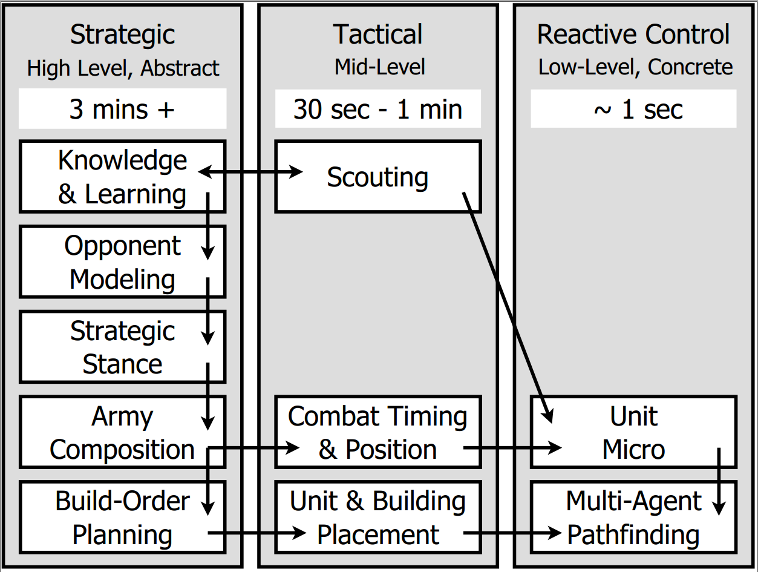
CHALLENGES IN RTS GAME AI
planning
learning (offline, in-game, inter-game)
uncertainty
spatial/temporal reasoning
domain knowledge exploitation
task decomposition:
strategy
tactics
reactive control
terrain analysis
intelligence gathering

Slide 16
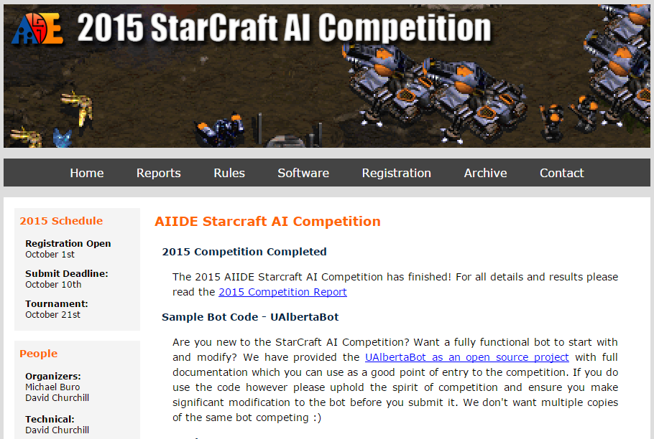
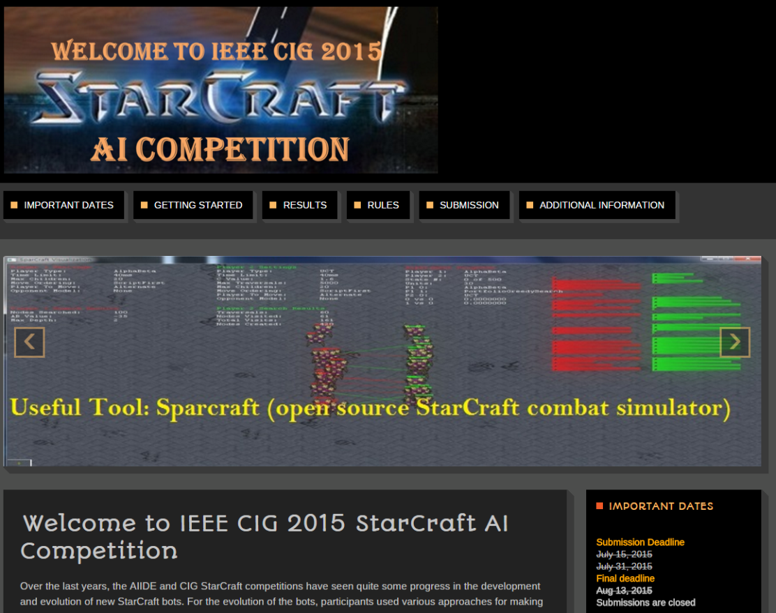
STARCRAFT COMPETITIONS
AIIDE (Annual AAAI Conference on Artificial Intelligence and Interactive Digital Entertainment) conference since 2010 – known maps
CIG (IEEE Conference on Computational Intelligence and Games) since 2011 – unknown maps
SSCAIT (Student StarCraft AI Tournament) since 2011, not bound to a conference
steady flow of bots (many stay for some years only)
some (but slow) progress

Slide 17
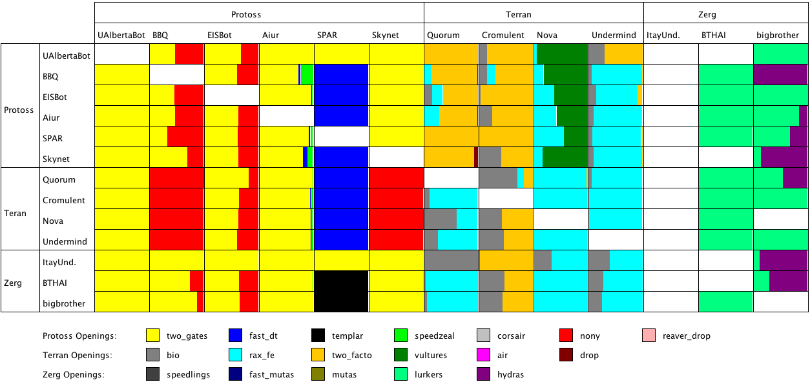
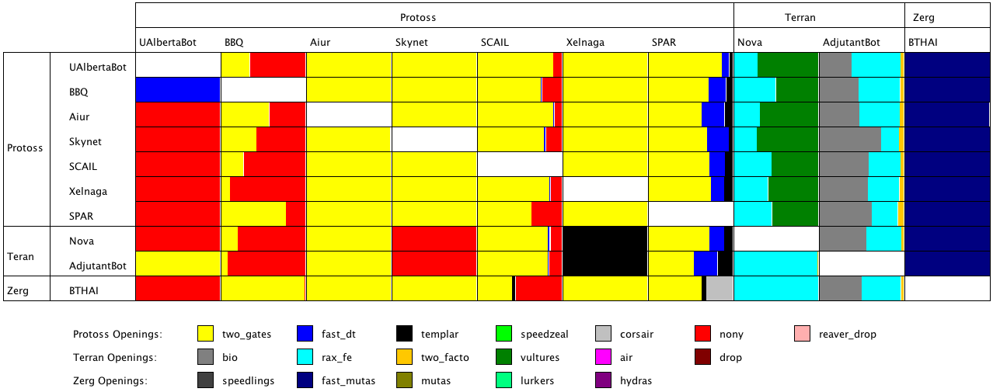
BOT FLEXIBILITY
SparCraft

Slide 18
RECENT DEVELOPMENTS IN RTS GAME AI RESEARCH
TorchCraft: a Library for Machine Learning Research on Real-Time Strategy Games (by Facebook AI team) https://arxiv.org/abs/1611.00625 good for attaching the BroodWar API to Torch, a LUA ML library also recent paper on micro tactics from same group
DeepMind and Blizzard plan to release an open StarCraft 2 API: https://deepmind.com/blog/deepmind-and-blizzard-release-starcraft-ii-ai-research-environment/ expected at some point 2017
Report about several new approaches by Julian Togelius: http://togelius.blogspot.de/2016/11/how-darwin-plays-starcraft.html (e.g. micro tactic videos)

Slide 19
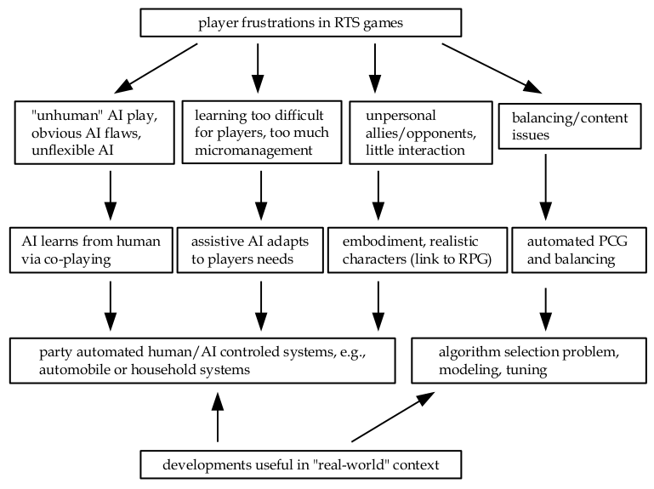
WHAT WE REALLY WANT IN RTS GAMES

Slide 20
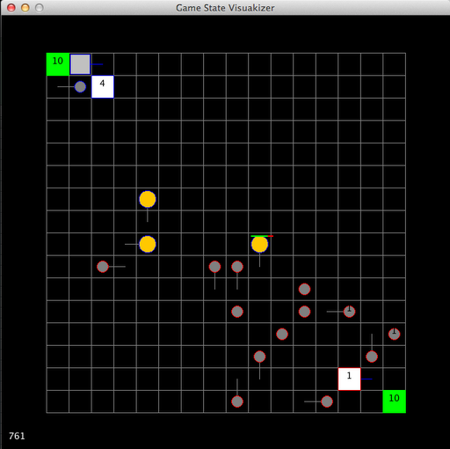
MICRORTS IDEA
minimal RTS system with relatively small state space
rather small maps (usually 8x8 or 16x16)
very few units: light, heavy, ranged, worker
very few buildings: base, baracks
one type of minerals
designed for „discretized“ AI systems
lots of default controllers, including rushes and MCTS
// Called by microRTS at each game cycle.
// Returns the action the bot wants to execute.
public PlayerAction getAction(int player, GameState gs) {
PlayerAction pa = new PlayerAction();
pa.fillWithNones(gs, player, 10);
return pa;
}

Slide 21
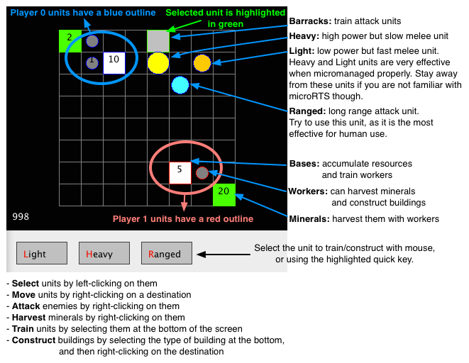
MICRORTS: HOW TO PLAY

Slide 22
OUR FORWARD MODEL IS THE GAME
public void playout(GameState gs, AI playoutPolicy, int playoutLength) throws Exception { boolean gameover = false; int time = gs.getTime(); do{ if (gs.isComplete()) { gameover = gs.cycle(); } else { gs.issue(playoutPolicy.getAction(0, gs)); gs.issue(playoutPolicy.getAction(1, gs)); } }while(!gameover && gs.getTime()<time+playoutLength); }
this function will actually modify the game state, so you might want to call it like this (playoutPolicy could be any AI):
AI playoutPolicy = new RandomAI();
GameState gs2 = gs.clone();
playout(gs2, playoutPolicy, 100);

Slide 23
HOW TO START
install newest version from https://github.com/santiontanon/microrts
look at wiki: https://github.com/santiontanon/microrts/wiki
make it accessible in your IDE and run tests/PlayGameWithMouseTest.java (by default, you then play against NaiveMCTS)
run some experiments with different AIs via the tests/GameVisualSimulationTest.java class
(you may also use the front end for round robin simulations, at gui/frontend/FrontEnd, be careful with iterations (10 take some time))
consider how to create your own AI, preferably at first a variant of an existing one, e.g. look at ai.abstraction.LightRush
Happy experimentation! ☺

Slide 24
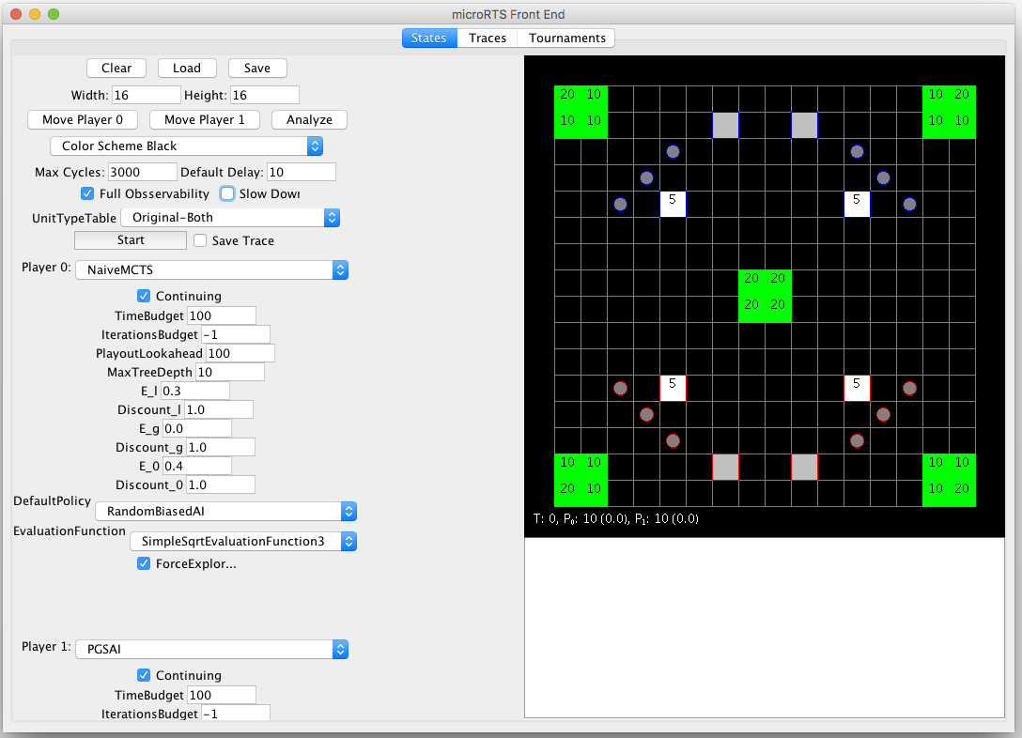
HOW TO USE THE GUI
(java) execute gui/frontend/FrontEnd
Run tournaments with lots of Ais/maps
Load, edit and save maps
Save and view replays
Set the game properties
Built-in branching factor calculator
Choose the Ais that will play (or a human)
Game state is directly editable

Slide 25
ASSIGNMENTS OVERVIEW
experimentally analyze the importance of specific maps and map sizes (for different existing AIs) with the task of recommending a specific AI for a specific map (experimentation, modeling)
design, implement and experimentally assess (by doing simulations with different existing AIs) a new game state evaluation function (little bit of programming, more conceptual, some experimentation)
build a (not too complex) new AI for microRTS on base of one or multiple of the existing ones and test it experimentally against existing AIs (quite some programming, some experimentation)
expected output and deliverable:
short written report, summarizing the main ideas, design decisions, experimental results, code concepts, whatever applies
10 min presentation to be held in front of the panel

Slide 26
GAME AI OVERALL VIEW: ASSIGNMENTS
game AI
control
design support
directors
strategic (bots)
/supportive AI
NPC behavior
balancing
PCG
assignment 1 mainly has to do with balancing and strategic AI
assignment 2 targets a helper function for strategic AI
assignment 3 attempts to set up a new strategic AI

Slide 27
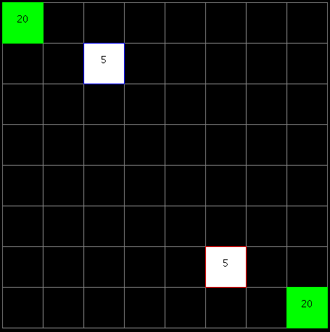
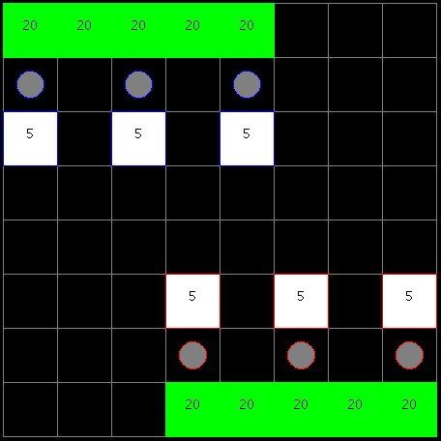
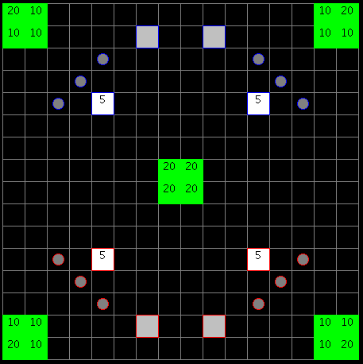
ASSIGNMENT 1
experimentally analyze the importance of specific maps and map sizes (for different existing AIs) with the task of recommending a specific AI for a specific map
you can take existing maps or create some
choose a subset of existing AIs, and run several experiments (enemy AI may be fixed at first)
try to detect some patterns in your results, maybe add some maps or AIs
try to somehow establish a model that can recommend an AI for a specific map (e.g. random forest, ANN, whatsoever)

Slide 28
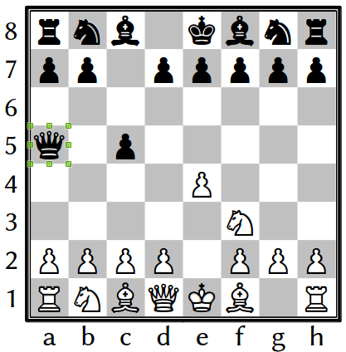
ASSIGNMENT 2
design, implement and experimentally assess (by doing simulations with different existing AIs) a new game state evaluation function
basically, you design a heuristic that tells us how good the current state is for one player
example: chess
simple heuristics:
count pieces
weighted piece count (queen should be more important than pawn)
more complex heuristics:
also consider position on the board
test your heuristic visually and within an existing AI (as MCTS), experiment

Slide 29
ASSIGNMENT 3
build a (not too complex) new AI for microRTS on base of one or multiple of the existing ones and test it experimentally against existing AIs (quite some programming, some experimentation)
how to implement an AI:
at first, look at the existing AIs, e.g., WorkerRush or LightRush
at each game cycle the “getAction” method of each AI will be called.
it needs to return a “PlayerAction” = a set of “UnitAction”s
UnitAction is an action a unit has to perform
an AI only has to return a single player action per game cycle, which contains which actions they want each unit to perform.
each unit MUST have an action at all times. If an AI does not want an idle unit to do anything, it must issue the “idle” UnitAction to it.
after some experimentation, think about a general design, you may use heuristics, MCTS, EAs, whatever you want
playtest against the AI (as a human and with existing AIs)

Slide 30
Summary
BUILDING AN RTS BOT IS A VERY COMPLEX TASK
PLAYER SATISFACTION AND BOT QUALITY ARE ALMOST THE SAME
WE ARE STILL FAR BEHIND HUMAN PERFORMANCE
BOTS SLOWLY EVOLVE VIA COMPETITIONS

