Slide 1
TPMS
Shashank Varshney (2017JVL2507)
Deep Narula(2017JVL2509)
Under the guidance of
Prof. Jayedeva

Slide 2
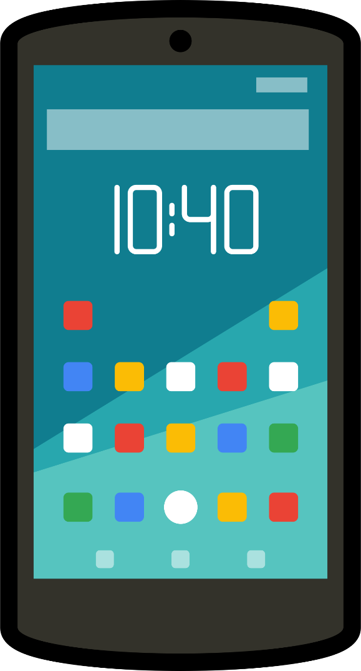


System
Microcontroller
Accelerometer
Bluetooth
Data
Source of Vibrations
Android Phone
Fig. 1 System Block Diagram

Slide 3
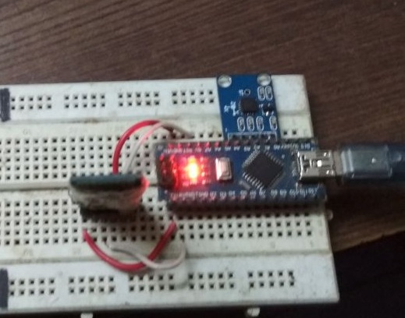
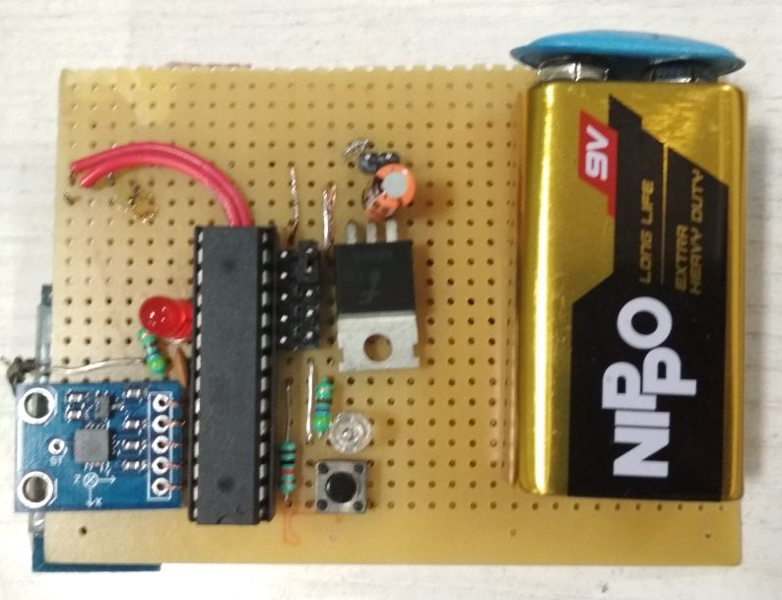
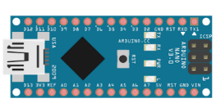
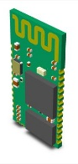
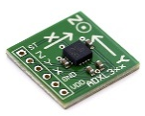
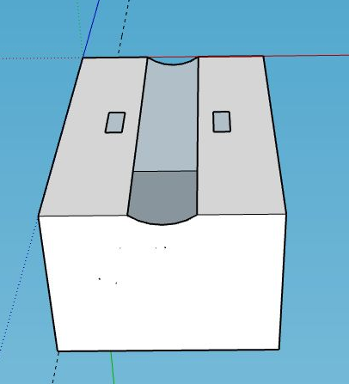
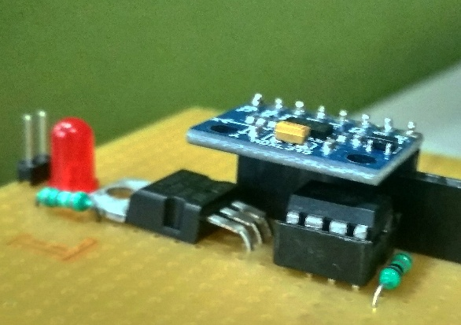
System realizations
β-model
Breadboard assembly
Zero-PCB V1
Components
Arduino
Bluetooth
Accelerometer
α-model
Zero-PCB V2
Reduced size
New Components in V2
ADXL345 ,Digital accelerometer 16 bit output
ATtiny85, 8 Pin PDIP Package, Small form factor than ATmega8A
Low power consumption, Minimum voltage requirement 1.8V @1MHz
Housing for V2

Slide 4
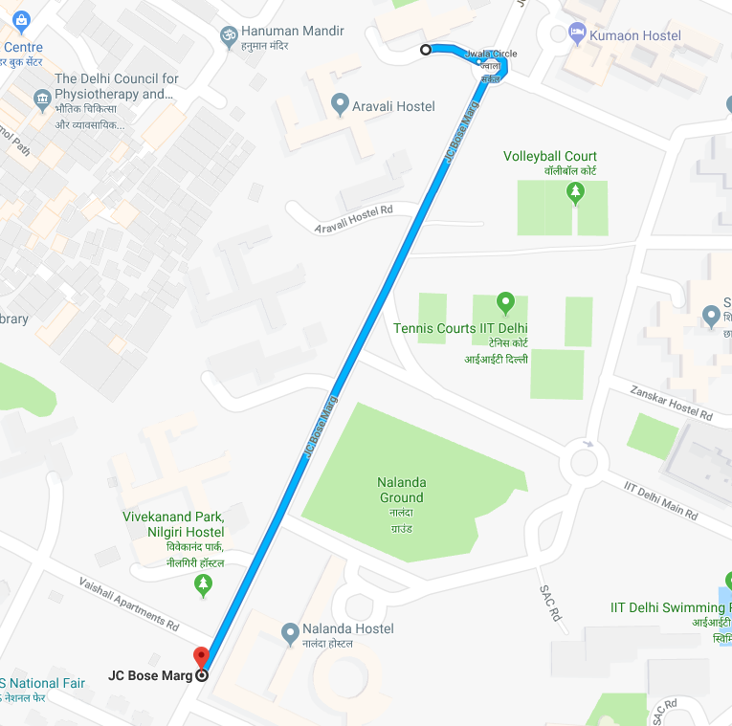
Data Collection
Data collection location : Jwalamukhi Circle to Nilgiri Hostel
Distance between PT1 to PT2 : 500m
No of samples collected : 20

Slide 5
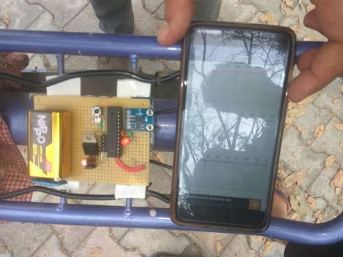
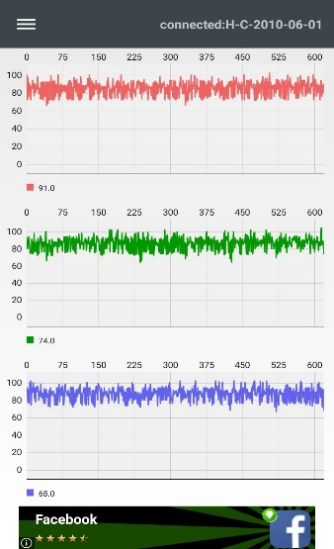
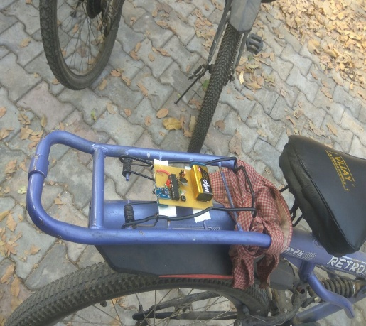
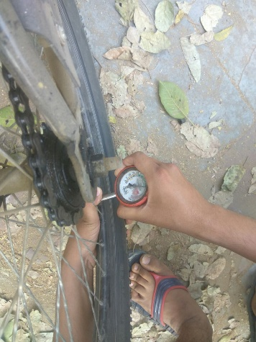
Data Collection
Trial 1
Trial 2
Data on
Android app
Data Logging
Trial 3
Increasing tyre pressure
Trial 4
Trial 5
Pressure Measurement
Before trial
System mounting

Slide 6


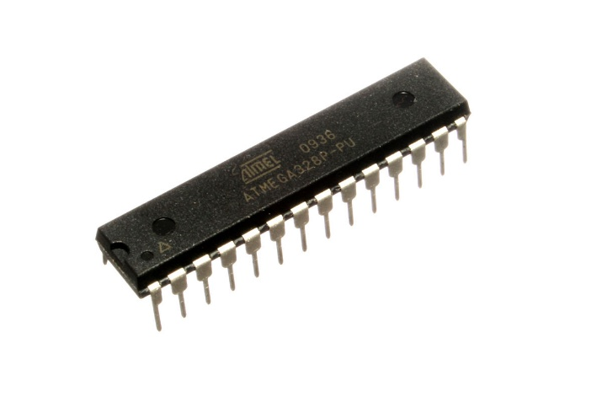
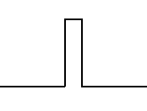
Firmware Update: Power saving mode
Pulse Detection Circuit
No pulse
Pulse
Sleep
To interrupt pin INT0
Inactivity greater than 10 min Atmega goes to sleep
Shutting down everything except accelerometer
Input current is in nA
Huge reduction in power
Wakes up Atmega
Reset inactivity timer
Ref: https://playground.arduino.cc/Learning/ArduinoSleepCode

Slide 7
2-Class Common Spatial Pattern (CSP)
Raw Data with large Feature Set
Common Spatial Pattern Algorithm
Data with significant Feature Set (reduced)
Classifier
(LIBSVM)
Predicted Output

Slide 8
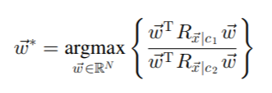

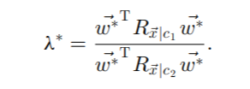
2-Class Common Spatial Pattern (CSP)
The CSP algorithm solves the optimization problem for 2-Class dataset
solutions to above problem are given by eigenvectors of the generalized eigenvalue problem
The eigenvectors correspond to the desired spatial filters. For a given eigenvector w∗, the corresponding eigenvalue determines the value of the cost function

Slide 9
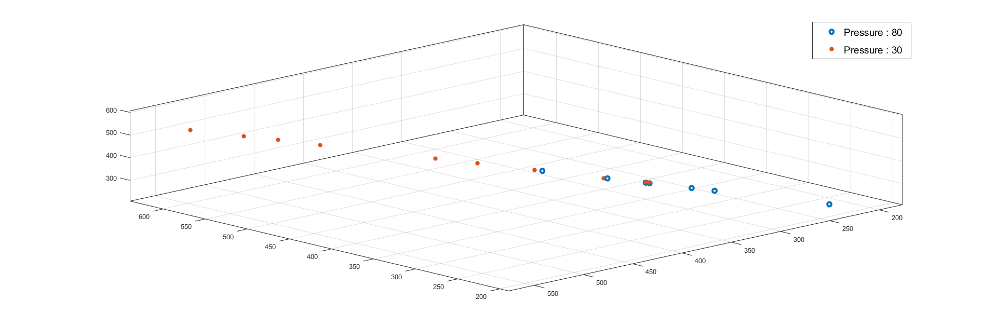
Data Analysis(1)

Slide 10
Data Analysis(2)

Slide 11
Classification(1)
C-SVM has been used for classification.
Kernel used: rbf
Library used: sklearn
5-fold cross validation to train the model
Number of samples used : 2500
Accuracy = 90.758 ± 0.91 %

Slide 12
Classification(2)
Linear Regression has been used.
Library used: sklearn
Number of samples used: 2500
Root mean square error: 11.69
R2 Score: 0.47

Slide 13
Classification(3)
Non linear regression has been used.
Kernel Used: rbf
Library used: sklearn
Number of samples used: 2500
Root mean square error: 6.93
R2 Score: 0.84

Slide 14


