Slide 1

<number>
Fatigue Detection Using EMG
Shashank Varsheny
En. No: 13LEB115 Electronics Deptt. ZHCET,
AMU

Slide 2


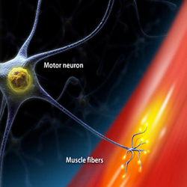
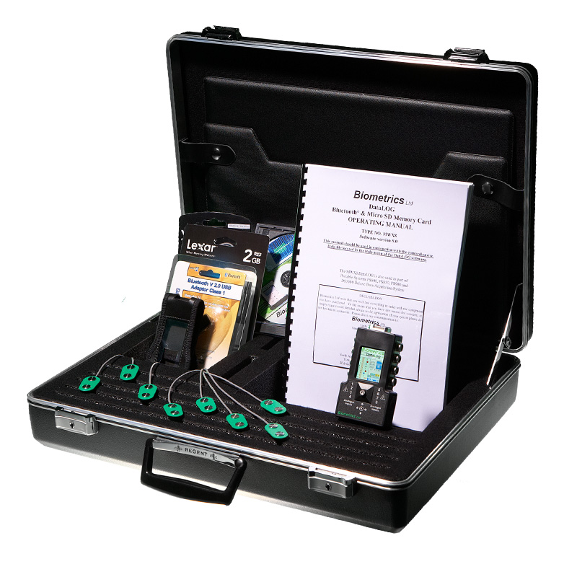

<number>
Overview
Introduction
Muscle Fatigue
EMG
Signal Acquisition
Result Analysis

Slide 3
<number>
Introduction
When we humans perform physical activities which involve repetitive movement, owing to that our muscles can gradually enter into the state of fatigue.
The character of muscle fatigue has an important role in the field of rehabilitation medicine and sports medicine.
Detection of muscle fatigue is fairly complicated and challenging as it involves analysis of physiological, electrical and emotional characteristics of human being.
This project is based on investigating muscle fatigue in Bicep Brachii muscle using EMG.

Slide 4
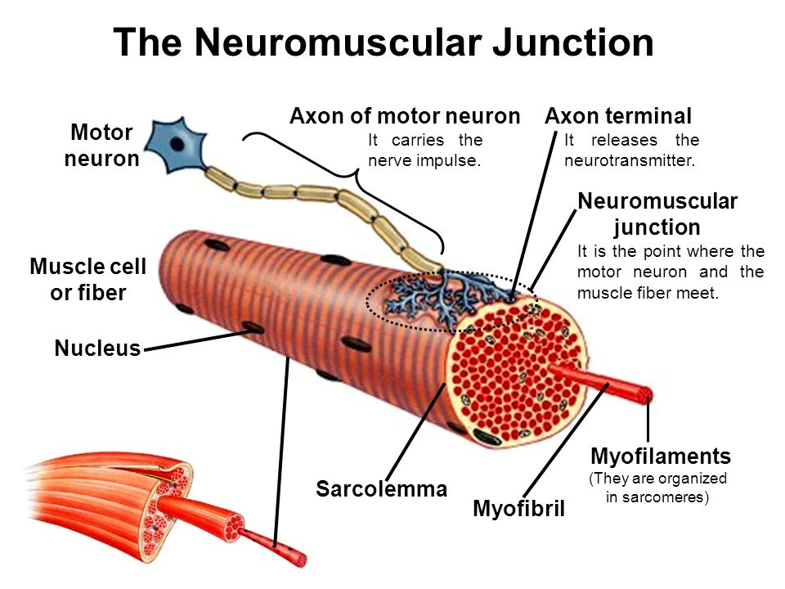
<number>
Muscle and Fatigue
A muscle is composed of bundles of specialized cells capable of contraction and relaxation.
It has the ability to receive and respond to stimuli and can be shortened or contracted.
A motor unit is defined as a single motor neuron and all muscle fibres that it stimulates.
Muscle fatigue can be defined as the failure to maintain a required or expected power output.
Muscle and Motor Unit
(Source: http://slideplayer.com/slide/9410682/)

Slide 5
<number>
Fatigue detection methods
Muscle Fatigue
Muscle fatigue detection can be
broadly classified into :
Invasive methods
Non-invasive methods
Real-time monitoring, better comfort level
Invasive
Non-invasive
Blood Lactate Level
Surface Electromyography
Blood Oxygen Level
Near-Infrared Spectroscopy
pH of muscle
Mechano-myography
Needle
Electromyography
Sono-Myography
Acoustic-Myography
Classification of muscle fatigue detection systems [3]
Notes:
<number>

Slide 6
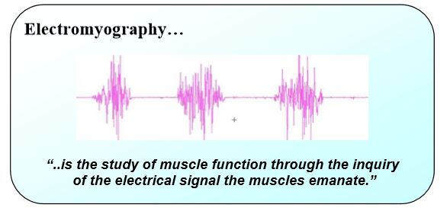
<number>
EMG
The EMG signal is a biomedical signal that measures electrical currents generated in muscles during its contraction representing neuromuscular activities.

Slide 7
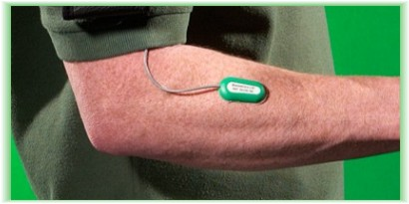
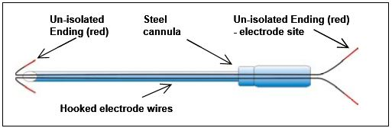
<number>
EMG Measurement
Electromyogram (EMG) can be measured by :
Surface Electromyography (sEMG): It is a non-invasive technique for measuring muscle electrical activity that occurs during muscle contraction and relaxation cycles where electrodes are applied on skin surface.
Intramuscular Electromyography : In this method the electrodes are used invasively within the muscle (needle EMG).
Surface electrode
(Source: http://www.nutronicltd.com/?surface-emg,45 )
Schematic diagram of fine wire electrode [1]
Notes:
<number>

Slide 8
<number>
Factors affecting EMG
Causative Factors
Extrinsic: These are due to electrode structure and placement.
Intrinsic: Physiological, anatomical, biochemical factors such as amount of tissue between surface of the muscle and the electrode.
Intermediate Factors: These are physical and physiological phenomena influenced by one or more causative factors such as crosstalk from nearby muscle
Deterministic Factors: These are influenced by Intermediate Factors such as number of active motor unit.

Slide 9
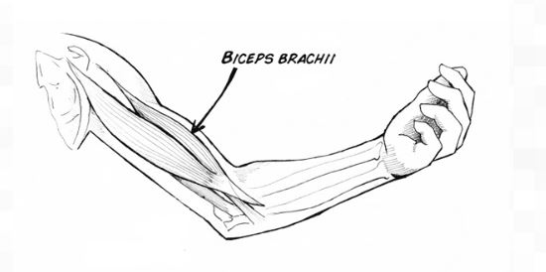
<number>
Signal Acquisition
Pre recorded data is being used for fatigue detection.
Subjects and Setup
Seven healthy people volunteered for the procedure.
The muscle tested was the right Biceps Brachii muscle.
The experimental procedure involved lifting of 3 kg weight.
The elbow positions were kept at right angle.
Subjects were asked to hold the weight until they feel exhaustion
Location of Bicep Brachii
(Source: https://backyardbrains.com/experiments/muscle2chspikerbox )

Slide 10
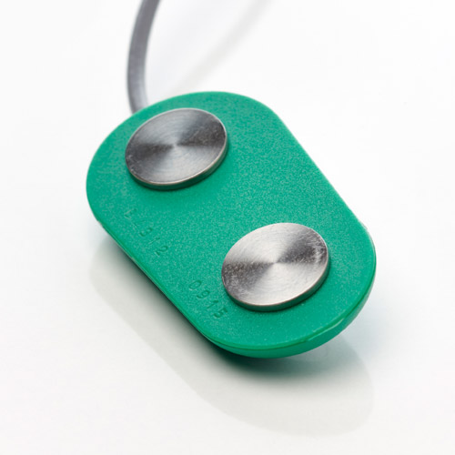
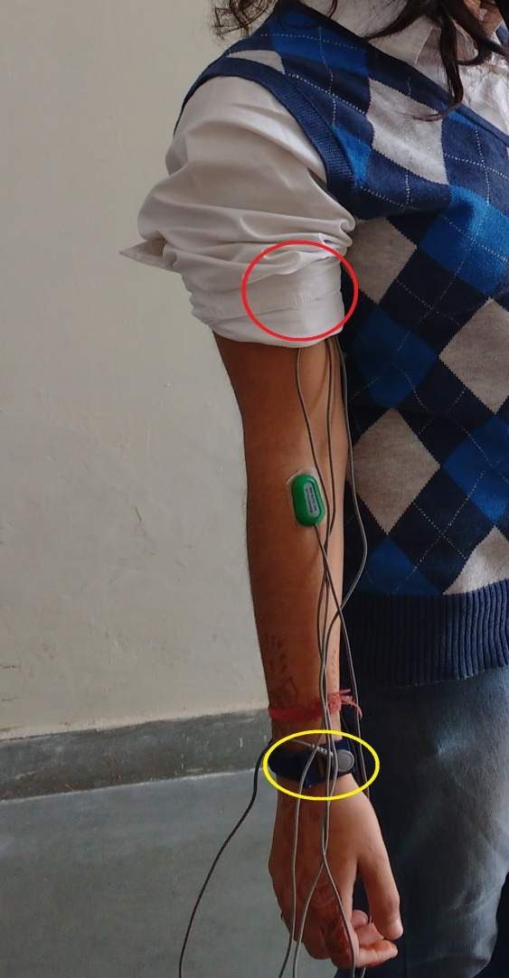
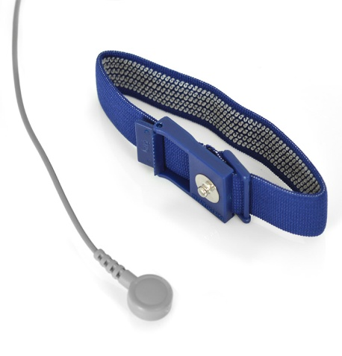
<number>
Signal Acquisition
Instrumentation and Recordings
Four electrodes were used for the recording as shown.
Two Surface EMG Sensor (SX230) placed at Biceps Brachii (within red circle).
One R506 with 4mm band used as reference electrode (within yellow circle).
The data was acquired using Biometrics Analysis Software at a sampling frequency of 1 KHz.
Actual electrode positioning
(Source:www.biometricsltd.com/semg.htm)

Slide 11
<number>
Signal Processing and Results Analysis

Slide 12
<number>
Analysis of sEMG
To extract parameters of clinical importance from the sEMG
Parameters analysed in time and frequency domain
Time domain analysis
Raw data plot
Full wave rectification
Absolute value of the signal samples
Frequency domain analysis
Parameter extracted
PSD
Median Frequency
Notes:
<number>

Slide 13
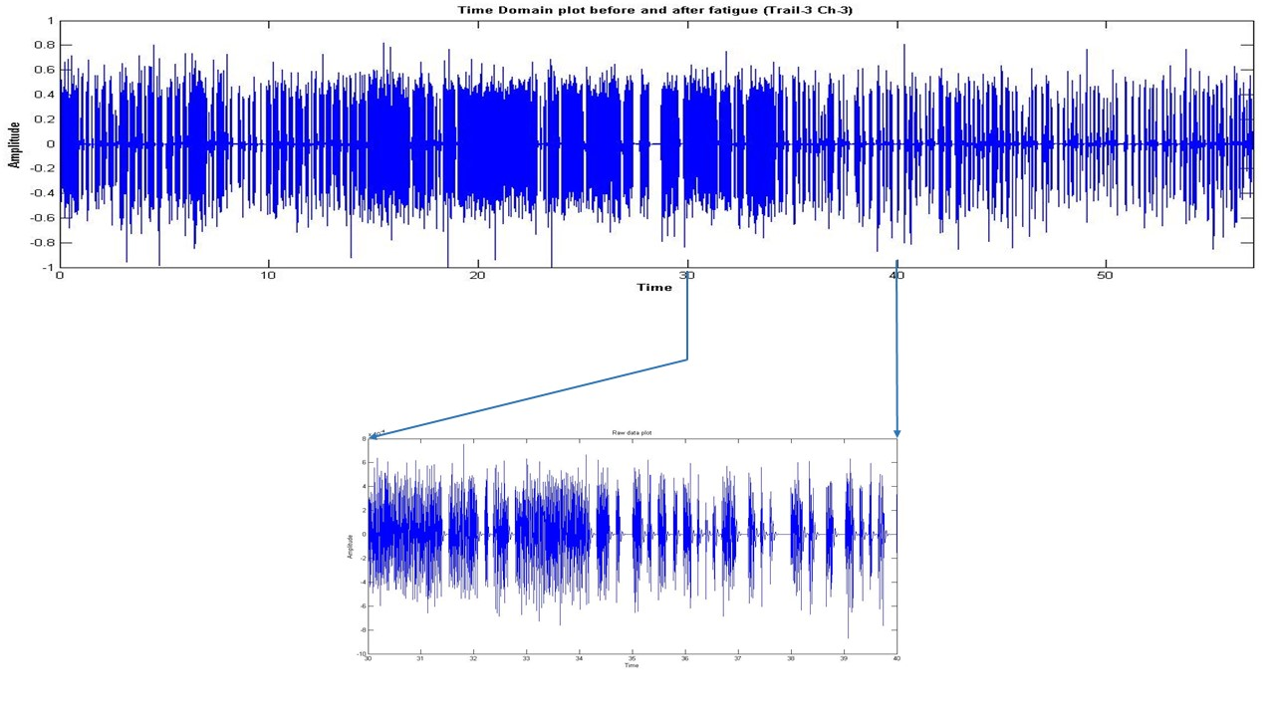
<number>
Raw Data Plot
Plot of Raw Data in Time Domain

Slide 14
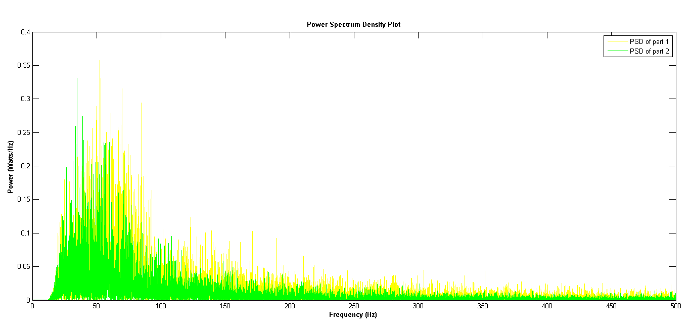
<number>
Power Spectrum Density
Power Spectral Density (PSD) is the frequency response of a random or periodic signal.
It tells us where the average power is distributed as a function of frequency.
Plot of Power Spectrum Density (PSD)

Slide 15
<number>
Median Frequency
Median frequency is a frequency at which the EMG power spectrum is divided into two regions with equal amplitude.
MDF =∫ = =
P (f): EMG signal power spectral density function,
f_{c} : EMG signal centre frequency,
f_{s}: EMG signal starting frequency,
f_{e}: EMG signal end frequency.

Slide 16
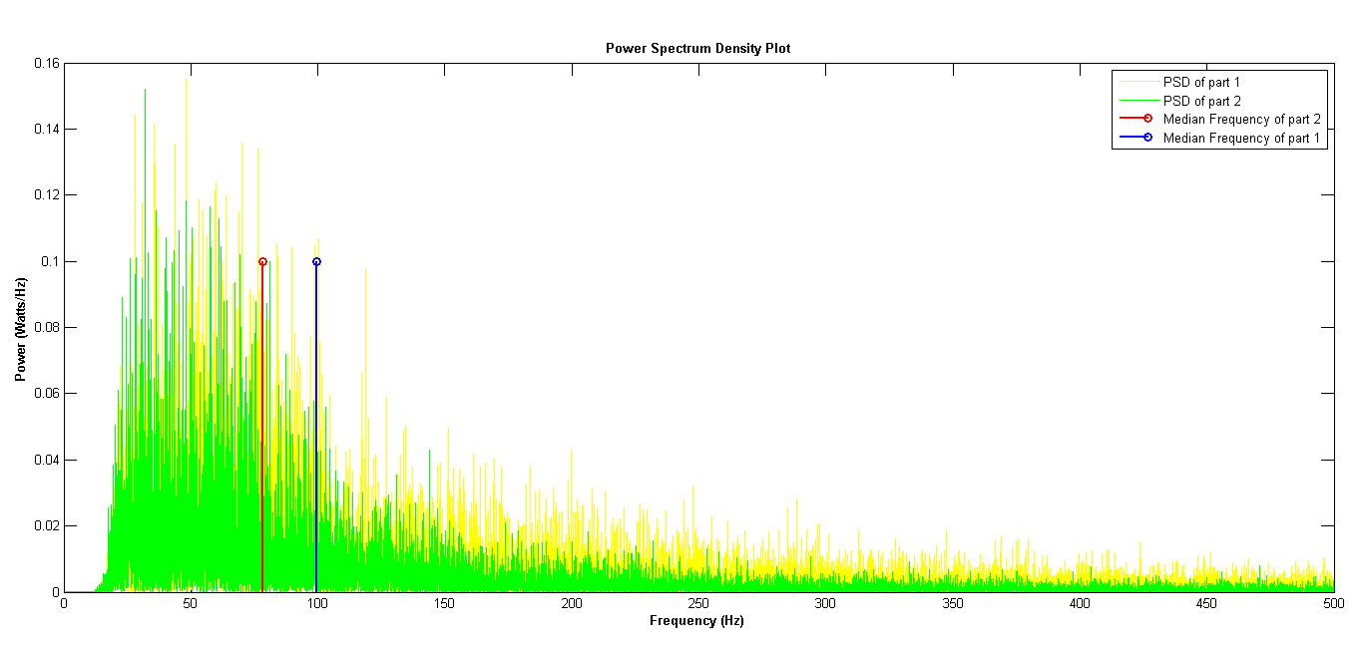
<number>
Plot of Median Frequency Comparison

Slide 17
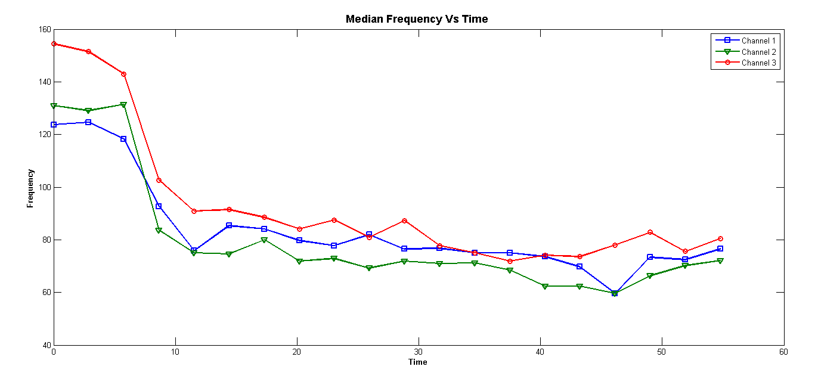
<number>
Median Frequency versus Time
Plot of Median Frequency versus Time (Channel 1,2,3)

Slide 18
<number>
Results Analysis
The amplitude of the EMG signal at any instant of time is stochastic or random.
It consists of artefacts such as dc offsets etc.
Converted into the frequency domain by FFT.
Passed through low pass filter to eliminate higher order frequencies.
Signal was divided into two equal halves and PSD’s for both halves have been plotted
As the fatigue grows the EMG power density spectrum shifts to the lower frequencies.
The Median frequency of second half is lower than that of the first half which signifies the onset of fatigue in samples in the later slot.
The median frequency of the EMG signal decreases with time during the task that induces fatigue

Slide 19
<number>
References
[1]. P. Konrad, “ABC of EMG: A Practical Introduction to Kinesiological Electromyography”, Noraxon
Incorporation, U.S.A., 2005.
[2]. V. Florimond, “SEMG Applied to Physical Rehabilitation & Biomechanics”, Thought Technology
Limited, England, 2010.
[3]. P. Bhat, A. Gupta, “A Novel Approach to Detect Localized Muscle Fatigue during Isometric
Exercises”, unpublished.
[4]. W. Jia, R. Johu, “The Analysis of Muscle Fatigue Based on sEMG”, International Conference on
Mechatronic Sciences, Shenyang, pp. 862-865, 2013.

Slide 20
<number>
Continued…
[5]. M. A. C. Garcia, J. M. Y. Catunda, T. Lemos, L. F. Oliveira, L. A. Imbiriba, and M. N. Souza,“ An
Alternative Approach in Muscle Fatigue Evaluation from the Surface EMG Signal”, 32nd Annual
International Conference of the IEEE EMBS Buenos Aires, Argentina, pp. 2419-2422, 2010.
[6]. A. Georgakis, L. K. Stergioulas, and G. Giakas, “Fatigue Analysis of the Surface EMG Signal in
Isometric Constant Force Contractions Using the Averaged Instantaneous Frequency”, IEEE
Transaction Biomedical Engineering., Vol. 50, No. 2, pp. 262-263, February, 2003.
[7]. T.N.S. T. Zawawi, A. R Abdullah, E.F. Shair, I. Halim, S. M. Saleh,“ EMG Signal Analysis of Fatigue
Muscle Activity in Manual Lifting”, Journal of Electrical System, pp. 319-325, 2015

Slide 21

<number>
THANK YOU

