Slide 1


Srishyla Educational Trust®, Bheemasamudra
GM INSTITUTE OF TECHNOLOG DAVANAGERE
DEPARTMENT OF COMPUTER SCIENCE & ENGINEERING
7th Semester Project Work (21CSP76)
Synopsis Presentation on
“COLLABORATIVE CODING PLATFORM”
Presented by
4GM21CS095 Sanjana V U
4GM21CS098 Shashank M N
4GM21CS101 Shreya Virupakshappa Katagi
4GM21CS107 Spoorthi Amaresh Kaddi
Under the Guidance of
Project Coordinator
Head of the Department
Dr. Arun Kumar B T
Dr. Shankarayya Shastri
Dr. B N Veerappa
Assistant Professor
Department of CSE, GMIT
Assistant Professor
Department of CSE, GMIT
Department of CSE, GMIT
01

Slide 2
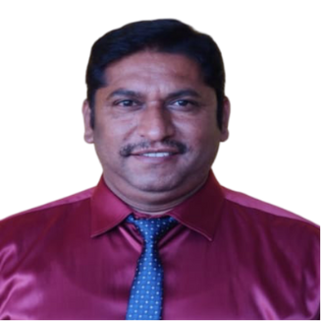
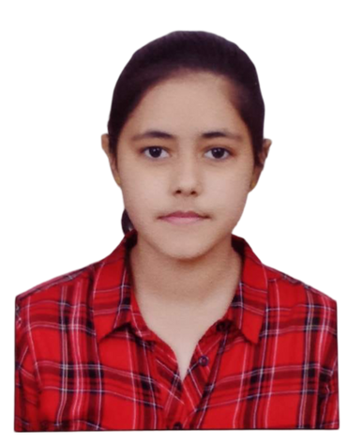
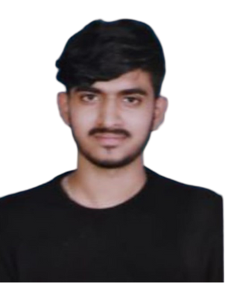


Under the Guidence of :
Dr. Arun Kumar B T
Assistant Professor
Department of CSE, GMIT
Our Team :
4GM21CS095
Sanjana V U
4GM21CS098 Shashank M N
4GM21CS101
Shreya Virupakshappa Katagi
4GM21CS107
Spoorthi Amaresh Kaddi
02

Slide 3


Contents
Introduction
Objectives
Literature Survey
Architecture / Methodology
Requirements
Application & References
03

Slide 4
Introduction
01
Lack of Real-Time Collaboration
02
Inefficient Context Switching
03
No In-Platform Coding in Communication Tools
04
Limited Integration with Project Management Tools
05
Workflow Fragmentation
04

Slide 5
Problem Statement
Current software development tools lack seamless integration between real-time code collaboration, communication, and project management, resulting in fragmented workflows, inefficiencies, and delays.
This project seeks to develop a comprehensive platform that unifies real-time code editing, version control, and integrated video conferencing, allowing developers to collaborate, communicate, and manage projects within a single environment.
05

Slide 6
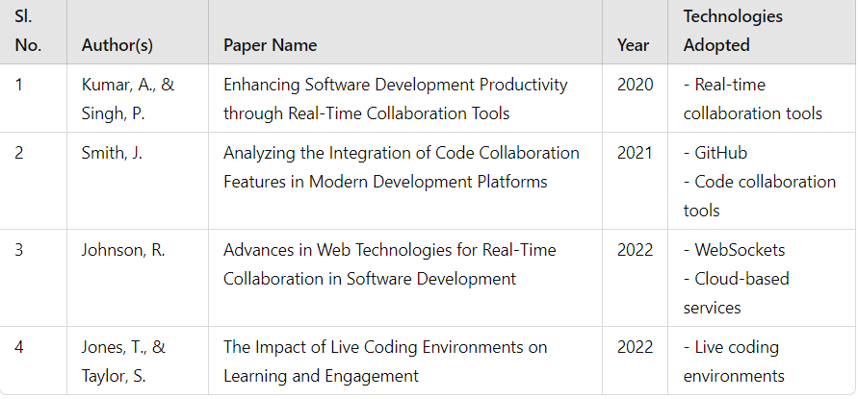
Literature Survey
06

Slide 7
Objectives
01
To Develop an Intuitive User Interface
02
To Implement Live Code Editing
03
To Integrate Video Conferencing
07

Slide 8

Architecture
System Architecture
Frontend
Backend
Microservices Architecture or
Single server Architecture
Code Edtor (Monaco Editor)
File management Interface
User Presence List
Themes and Settings
Code Execution (Piston)
File management (Rest API)
Real Time Collaboration
Room management
Tooltips and tldraw
Database
Real-Time Collaboration and Security
Video Conferencing , Containerization and Deployment
File Storage
Database (for large scale)
WebSockets
End-to-End Encryption
Docker & Kubernetes
Twilio or Jitsi Integration
08

Slide 9
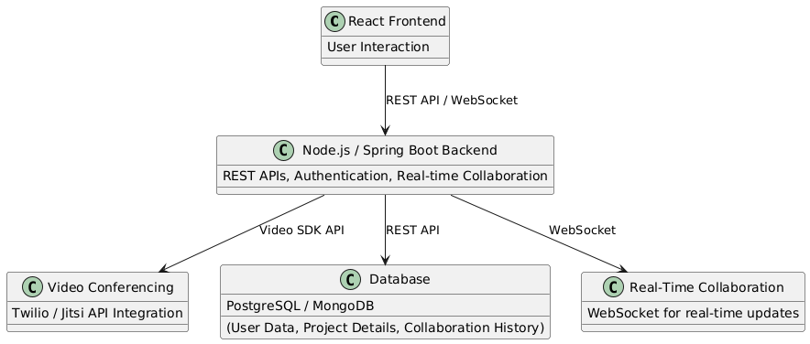
Architecture ....
Fig : UML Diagram of System Architecture
09

Slide 10
Methodology
01
Agile Development
02
User-Centered Design
03
Continuous Integration/Continuous Deployment (CI/CD)
04
Modular Development
10

Slide 11



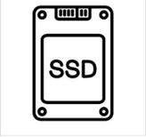
Hardware & Requirements
Hardware Requirements
Minimum : 8 GB RAM, Dual-Core CPU, 256 GB SSD
Recommended: 16 GB RAM, Quad-Core CPU, 512 GB SSD
11

Slide 12


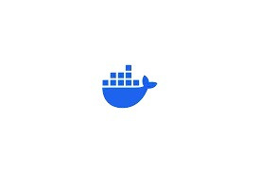









Software Requirements
Frontend
Backend
Development Tools
• React.js
• Redux Toolkit
• Socket.IO
• Tailwind CSS
• Twilio SDK or Jitsi API (100kbps to 3Mbps) & (300 Hz to 3400 Hz)
Node.js
Express.js Framework
or
Spring Boot framework
MySQL
• Git
• Docker
• Postman
• Integrated Development Environments
12

Slide 13
Applications
Software Development Teams
Educational Institutions
Hackathons
Remote Work Environments
13

Slide 14
References
• Kumar, A., & Singh, P. (2020). Enhancing Software Development Productivity through Real-Time Collaboration Tools. Journal of Software Engineering, 15(4), 212-220.
• Smith, J. (2021). Analyzing the Integration of Code Collaboration Features in Modern Development Platforms. International Journal of Computer Science, 12(1), 45-58.
• Johnson, R. (2022). Advances in Web Technologies for Real-Time Collaboration in Software Development. Journal of Web Engineering, 20(3), 180-195.
• GitHub - GitHub Documentation on Code Collaboration (2021)
https://docs.github.com/en/pull-requests/collaborating-with-pull-requests
• JetBrains - Real-Time Code Collaboration: Code With Me (2021) https://www.jetbrains.com/code-with-me/
14

Slide 15
Thank
You
15

Slide 16
Queries

