Slide 1

Note: The data and information in this document is reflective of a hypothetical situation and client. This document is to be used for KPMG Virtual Internship purposes only.
Sprocket Central Pty Ltd
Data analytics approach
[Division Name] - [Engagement Manager], [Senior Consultant], [Junior Consultant]

Slide 2
Note: The data and information in this document is reflective of a hypothetical situation and client. This document is to be used for KPMG Virtual Internship purposes only.
Agenda
Introduction
Data Exploration
Model Development
Interpretation

Slide 3
Note: The data and information in this document is reflective of a hypothetical situation and client. This document is to be used for KPMG Virtual Internship purposes only.
Introduction
Customer Analysis
Age Distribution
Number of Bikes purchased in 3years / percentage purchased
Job Industry Category
Wealth Segments
Number of cars own on each state

Slide 4
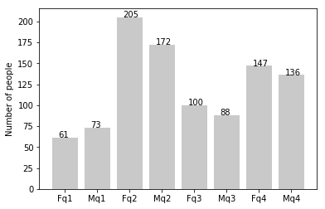
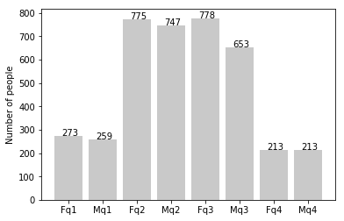
Note: The data and information in this document is reflective of a hypothetical situation and client. This document is to be used for KPMG Virtual Internship purposes only.
Data Exploration
Customer’s age distribution
New
As we can see, mostly our new customers are between 25 to 48 years old
Number of customers from 48 to 59 years old has big drops on percentage
There is a slight increase in number of customer over 59 years old in term of percentages
It looks like the percentage of under 25 years old not really change
Old

Slide 5
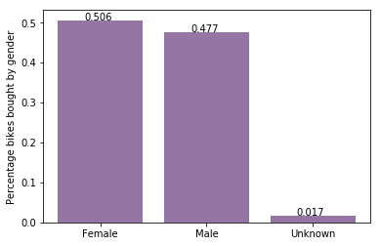
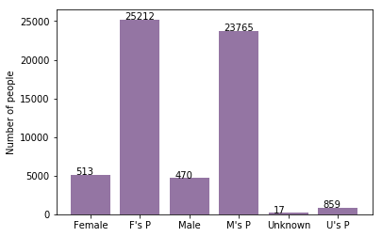
Note: The data and information in this document is reflective of a hypothetical situation and client. This document is to be used for KPMG Virtual Internship purposes only.
Model Development
Bike purchased last 3 years
As we can see, our new customers mostly Female with 50.6% purchases with total of 25,212 bikes
Male contributed to 47.7% purchases with 23,765 bikes
So, we should focus on advertises on Female customers than Male customers

Slide 6
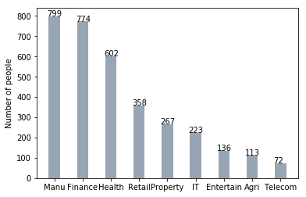
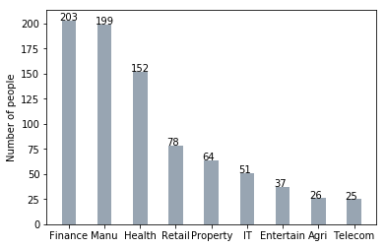
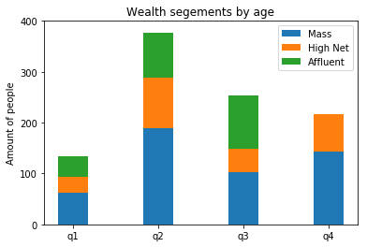
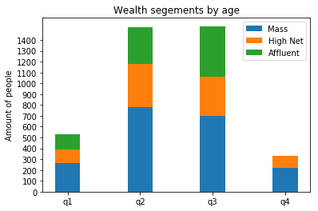
Note: The data and information in this document is reflective of a hypothetical situation and client. This document is to be used for KPMG Virtual Internship purposes only.
Interpretation
Job industry category
Mostly our new customers are on Finance industry and our Manufacturing customers are still on top 2
The rest industries is still same
Wealth Segments
In all ages, the number of Mass Customers is the highest so we should focus on this social class
After that , we should focus on High Net Customer
Then Affluent Customers but mostly second and third quadrant

Slide 7
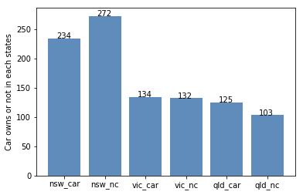
Note: The data and information in this document is reflective of a hypothetical situation and client. This document is to be used for KPMG Virtual Internship purposes only.
Interpretation
Number of cars owned
NSW should be considered the most since number if customers don’t own cars is significantly larger than that own
VIC and QLD has more customers that own car than those who don’t own but trying to have something so that those owns car will buy bikes

Slide 8
Note: The data and information in this document is reflective of a hypothetical situation and client. This document is to be used for KPMG Virtual Internship purposes only.
Appendix

