Slide 1

CYBERSECURITY
CISCO VIRTUAL INTERNSHIP
PROGRAM 2023
Shashank Kumar Srivastava
Inderprastha Engineering College

Slide 2

PART 1 - To create college network topology
A brief outline of what I did
In physical view = Intercity -> Ettimadai -> Amrita Vishwa Vidyapeetham
In logical view = 1 staff room, 1 classroom, 1 lab Networking components = laptops, PCs, personal tablet, IP phone, switch, router(wired+wireless), modem, internet(cloud)

Slide 3
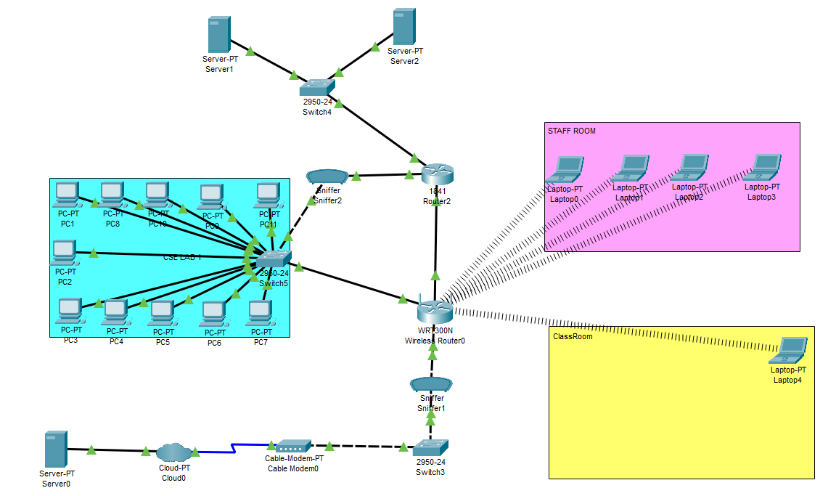
LOGICAL TOPOLOGY

Slide 4
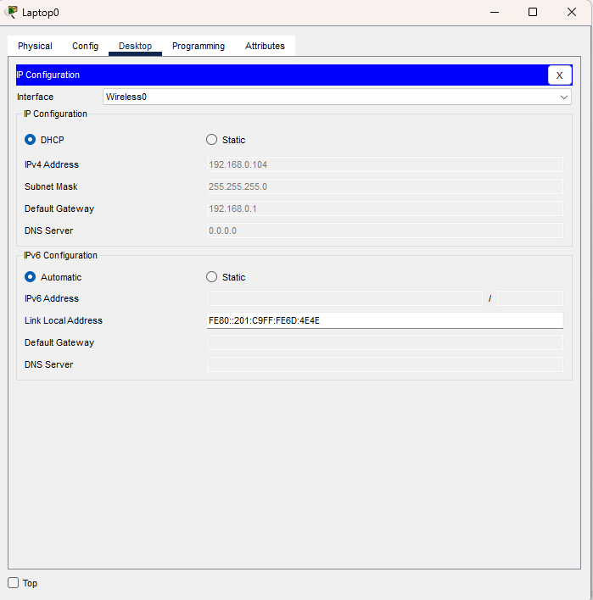
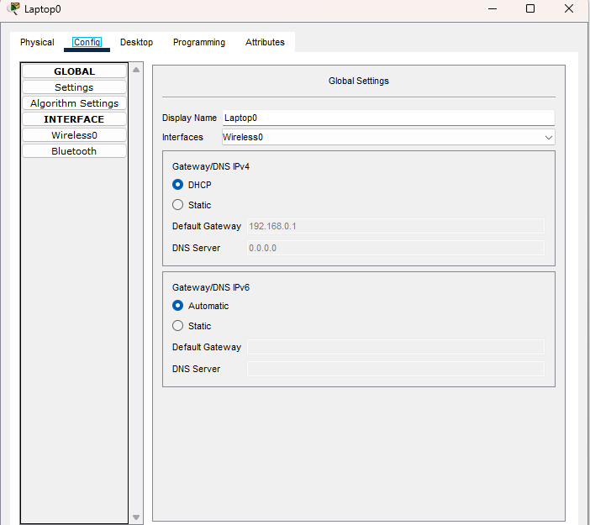
IP ADDRESS, NETWORK, SUBNET AND HOST
CONFIGURATION

Slide 5
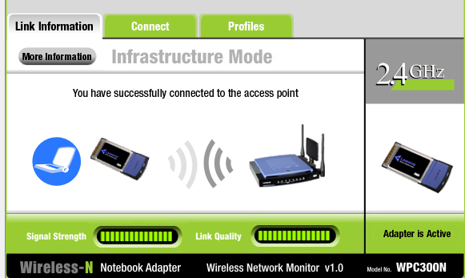
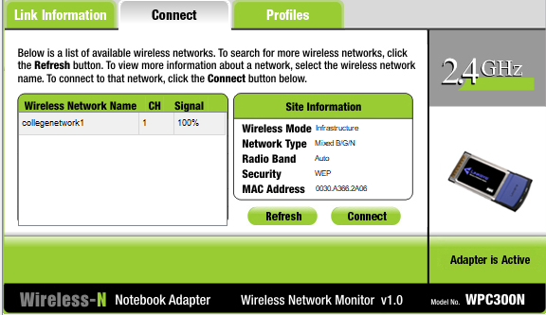
CONNECTION CONFIGURATION ( WIRED & WIRELESS)
CONNECTION BETWEEN ALL THE SUBNETS CONFIGURED AND WORKING. THUS
COMMUNICATION BETWEEN ANY TWO END DEVICES ENABLED.

Slide 6
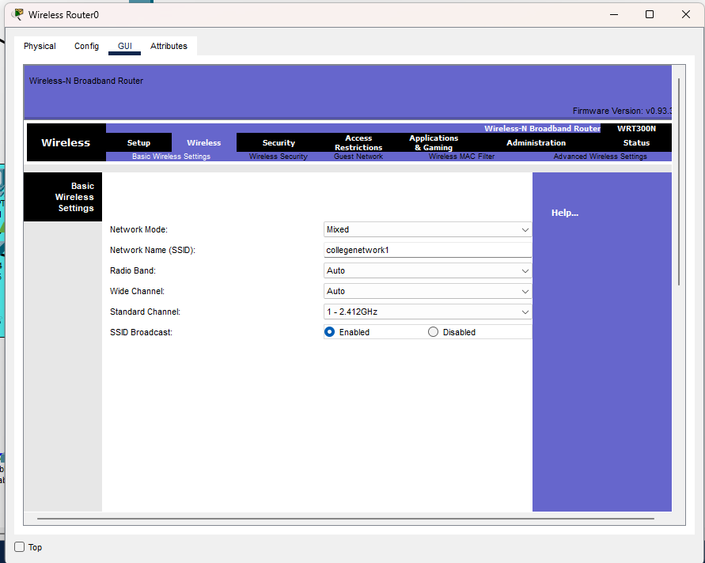
DHCP SERVICE
DHCP SERVICE CONFIGURED.
WIRELESS END DEVICES ACQUIRE IP ADDRESS
THROUGH DHCP WHEN CONNECTED TO THE WIRELESS ROUTER.

Slide 7
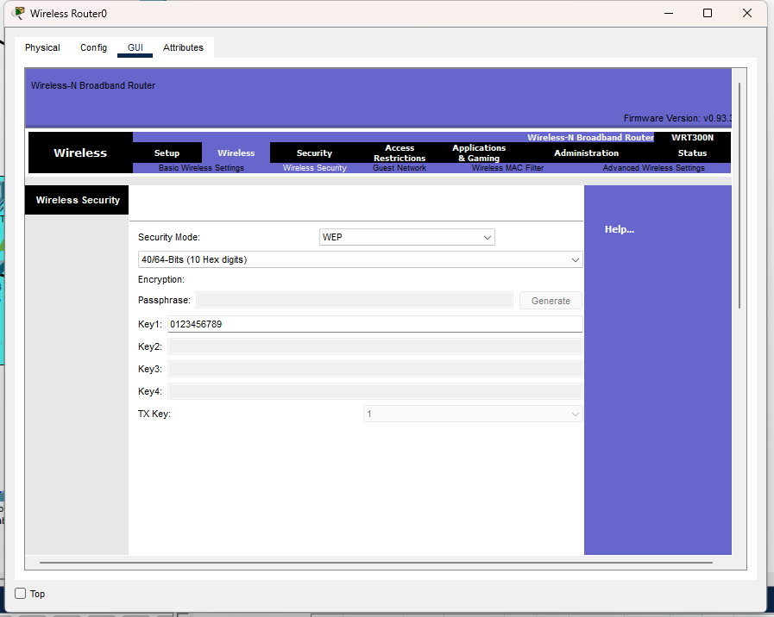
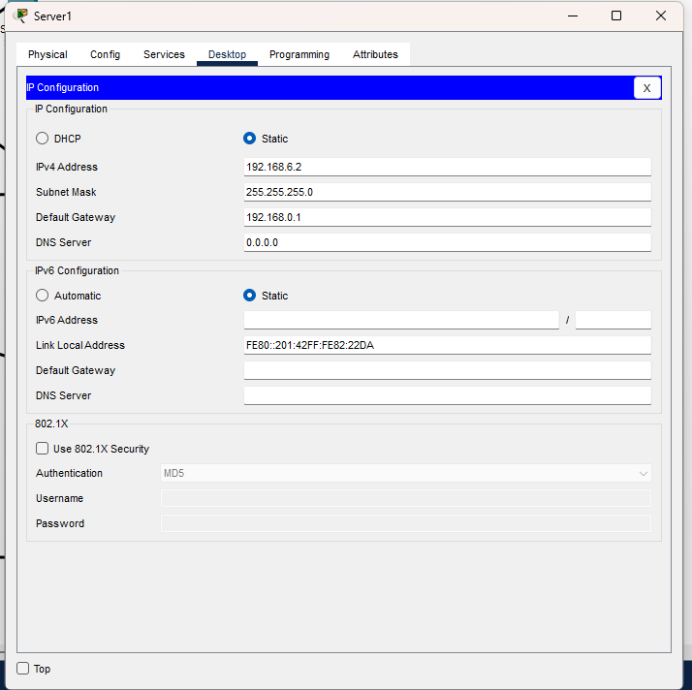
DNS SERVICE
DNS SERVICE CONFIGURED.
REGISTERED THE HOSTNAME AND ITS CORRESPONDING IP ADDRESS. THE PAGE IS ACCESSED THROUGH THE HOSTNAME IS SHOWN IN THE SCREENSHOT

Slide 8
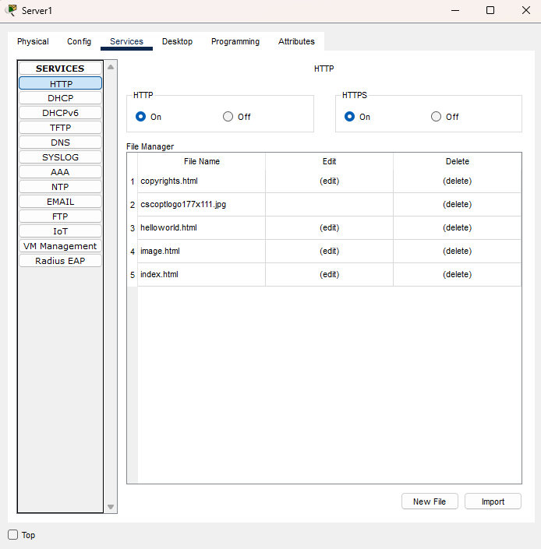
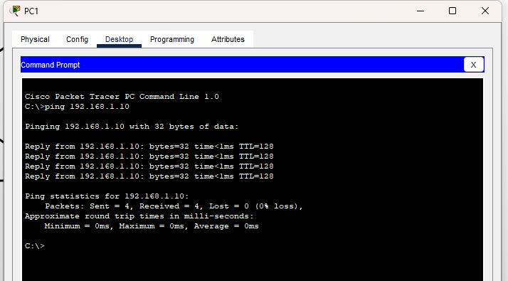
FTP SERVICE
FTP SERVER CONFIGURED.
CREATED USERNAME AND PASSWORD FOR A AMRITA USER.
THE AMRITIAN ACCESS THE FILE USING HIS ACCOUNT IS SHOWN IN THE BELOW
SCREENSHOT.

Slide 9
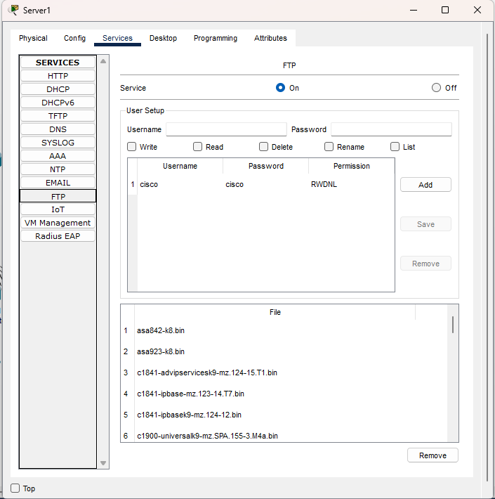
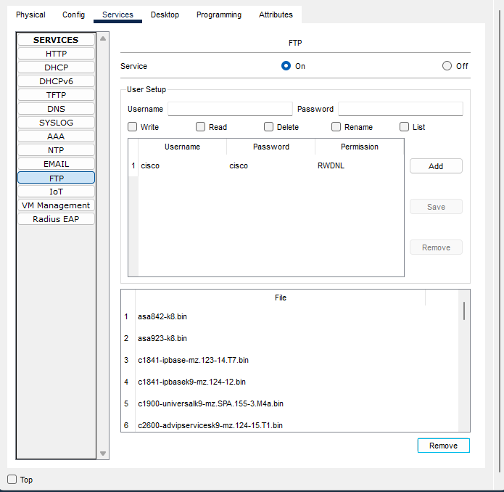
FTP SERVER

Slide 10
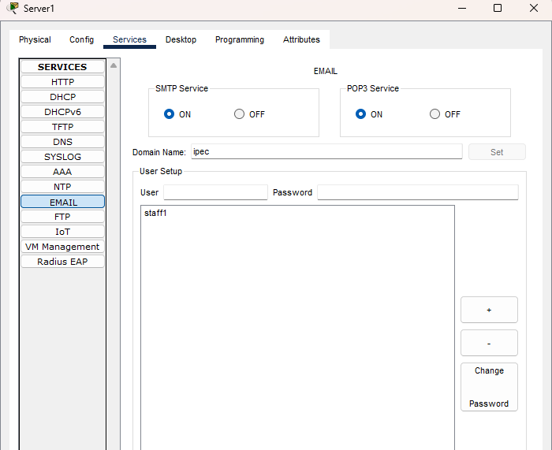
EMAIL SERVICE
MAIL SERVER CONFIGURED.
CREATED DOMAIN AND AN ACCOUNT FOR A STAFF AND A STUDENT.
COMMUNICATION THROUGH MAIL BETWEEN A STAFF AND A STUDENT.
SCREENSHOT SHOWS THE INBOX OF BOTH.

Slide 11
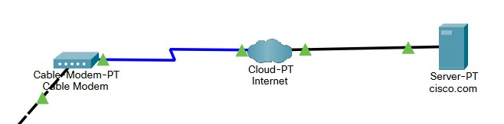
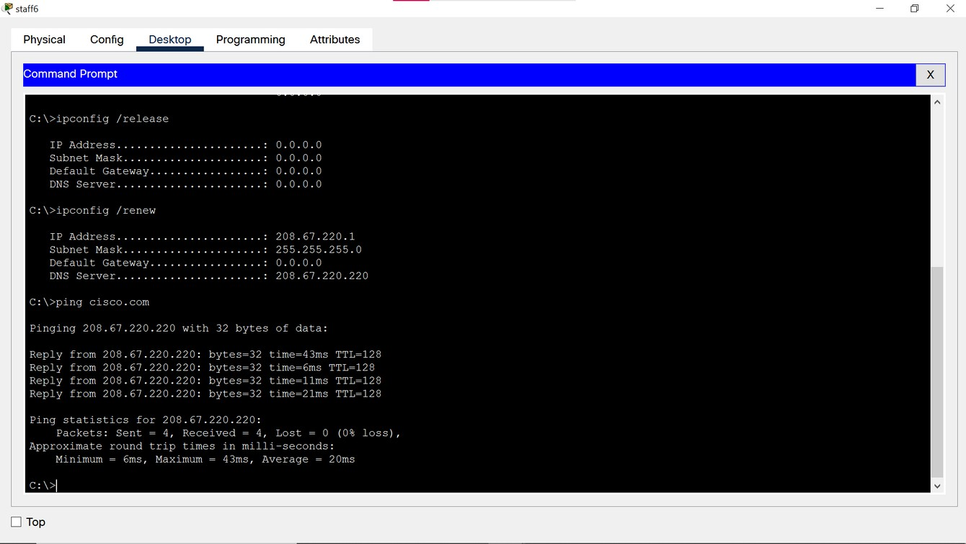
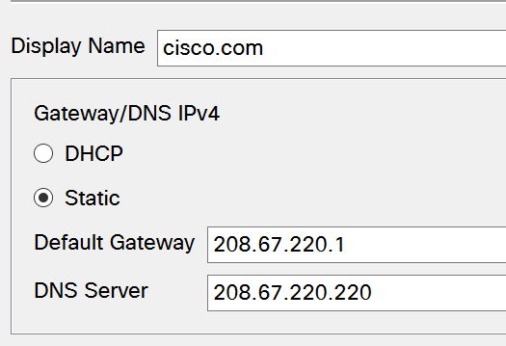
CONNECTING TO EXTERNAL INTERNET
STAFF 6 CONNECTED TO EXTERNAL
SERVER CISCO. COM SUCCESSFULLY.

Slide 12
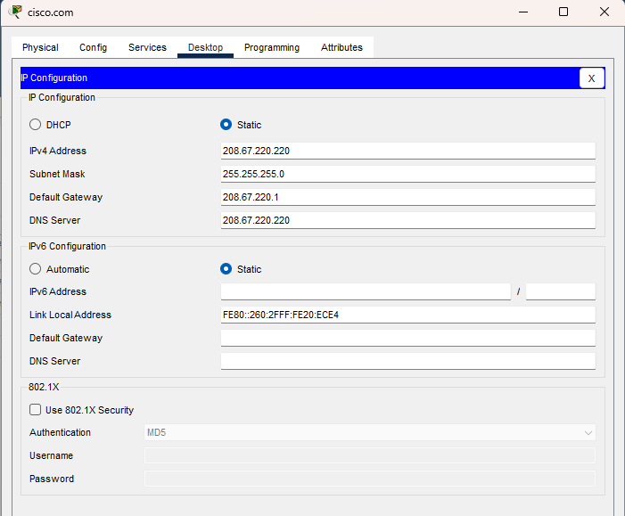
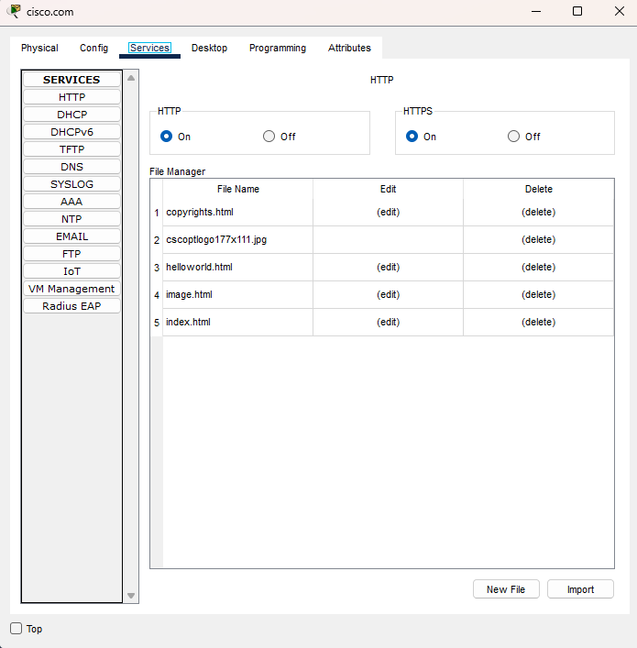

Slide 13

PART 2 - To investigate packet flow
A BRIEF OUTLINE OF WHAT I DID
INTERNAL NETWORK - SNIFFING PACKET FLOW FROM PCS FROM LAB TO SMARTPHONE IN CLASSROOM.
EXTERNAL NETWORK - SNIFFER PACKET FLOW FROM EXTERNAL NETWORK SERVER TO INTERNAL END
SYSTEMS,

Slide 14
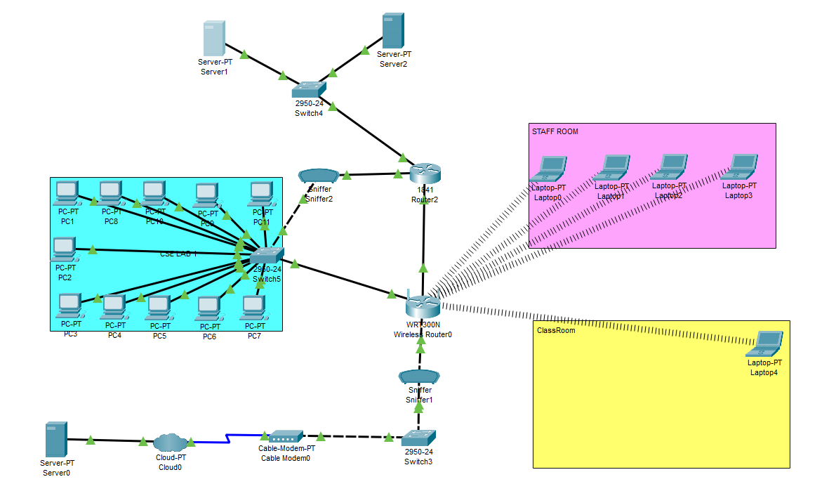
INSTALLATION OF SNIFFERS
SNIFFER 1 INSTALLED BETWEEN THE LAB
SWITCH AND ROUTER TO CAPTURE PACKETS
FLOWING THROUGH THEM ( INTERNAL
NETWORK).
SNIFFER 2 INSTALLED BETWEEN THE SWITCH
AND ROUTER TO CAPTURE PACKETS
FLOWING THROUGH THEM ( EXTERNAL
NETWORK).

Slide 15
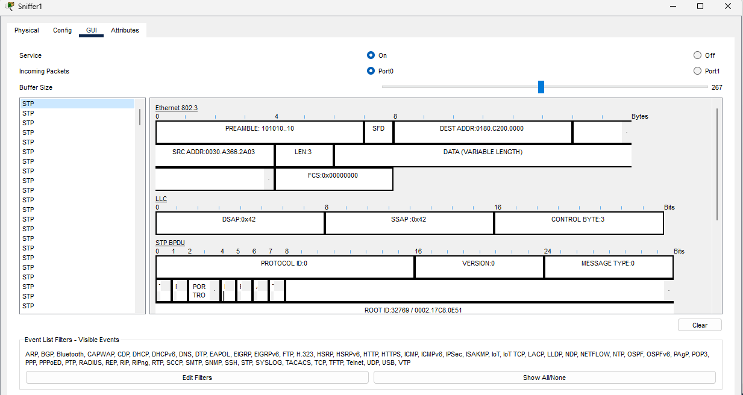
SNIFFING - ARP ( WITHIN INTERNAL NETWORK)
ARP PACKET
DEST MAC ADDR : BROADCAST
SRC MAC ADDR : PC 2 ( FROM LAB)
ARP - TO FIND THE MAC ADDR WHEN THE
DESTINATION IP
ADDRESS IS KNOWN.

Slide 16
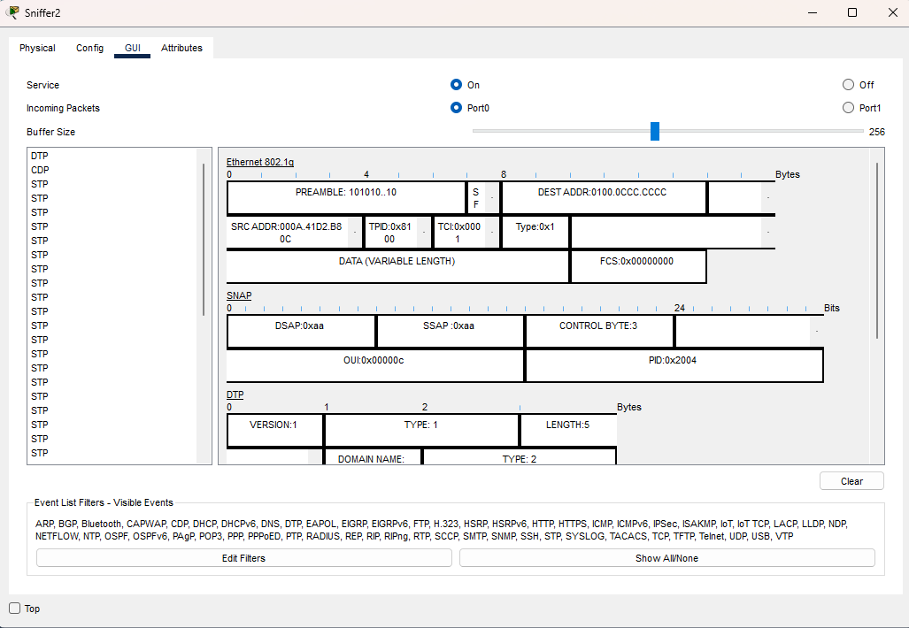
SNIFFING- DTP ( WITHIN INTERNAL NETWORK)

Slide 17
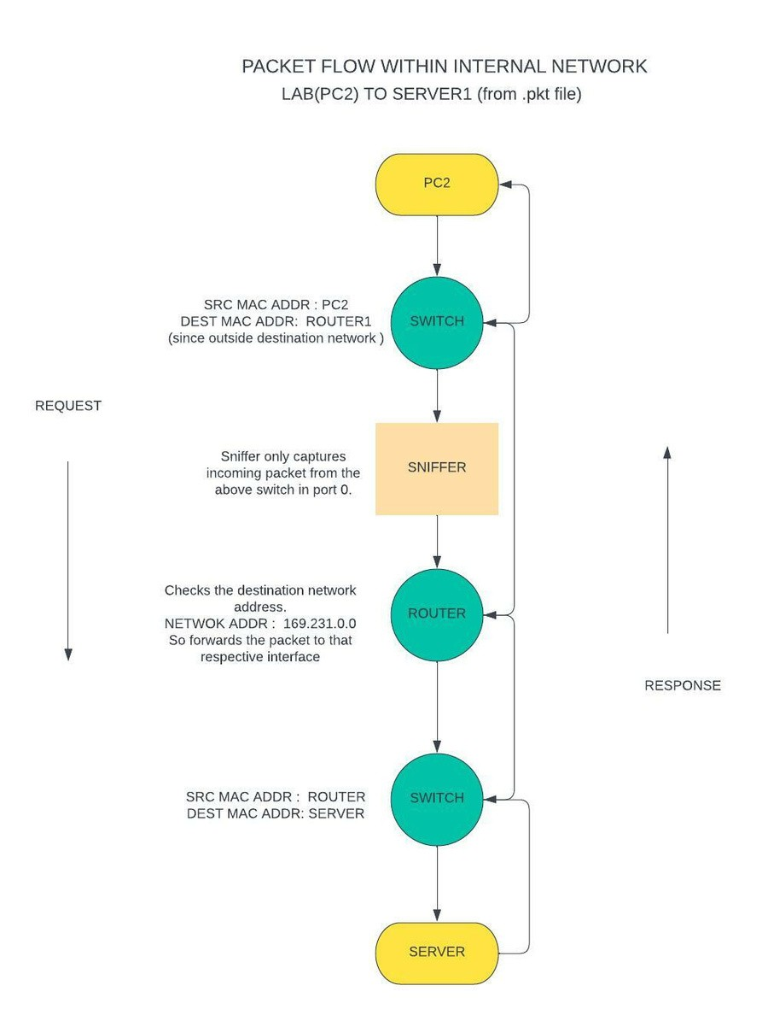
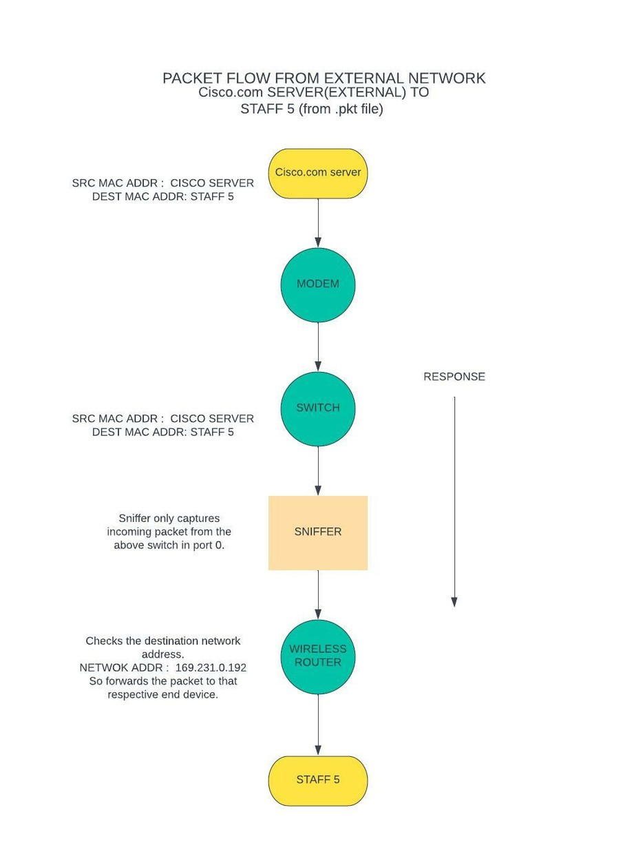
PACKET FLOW

