Slide 1
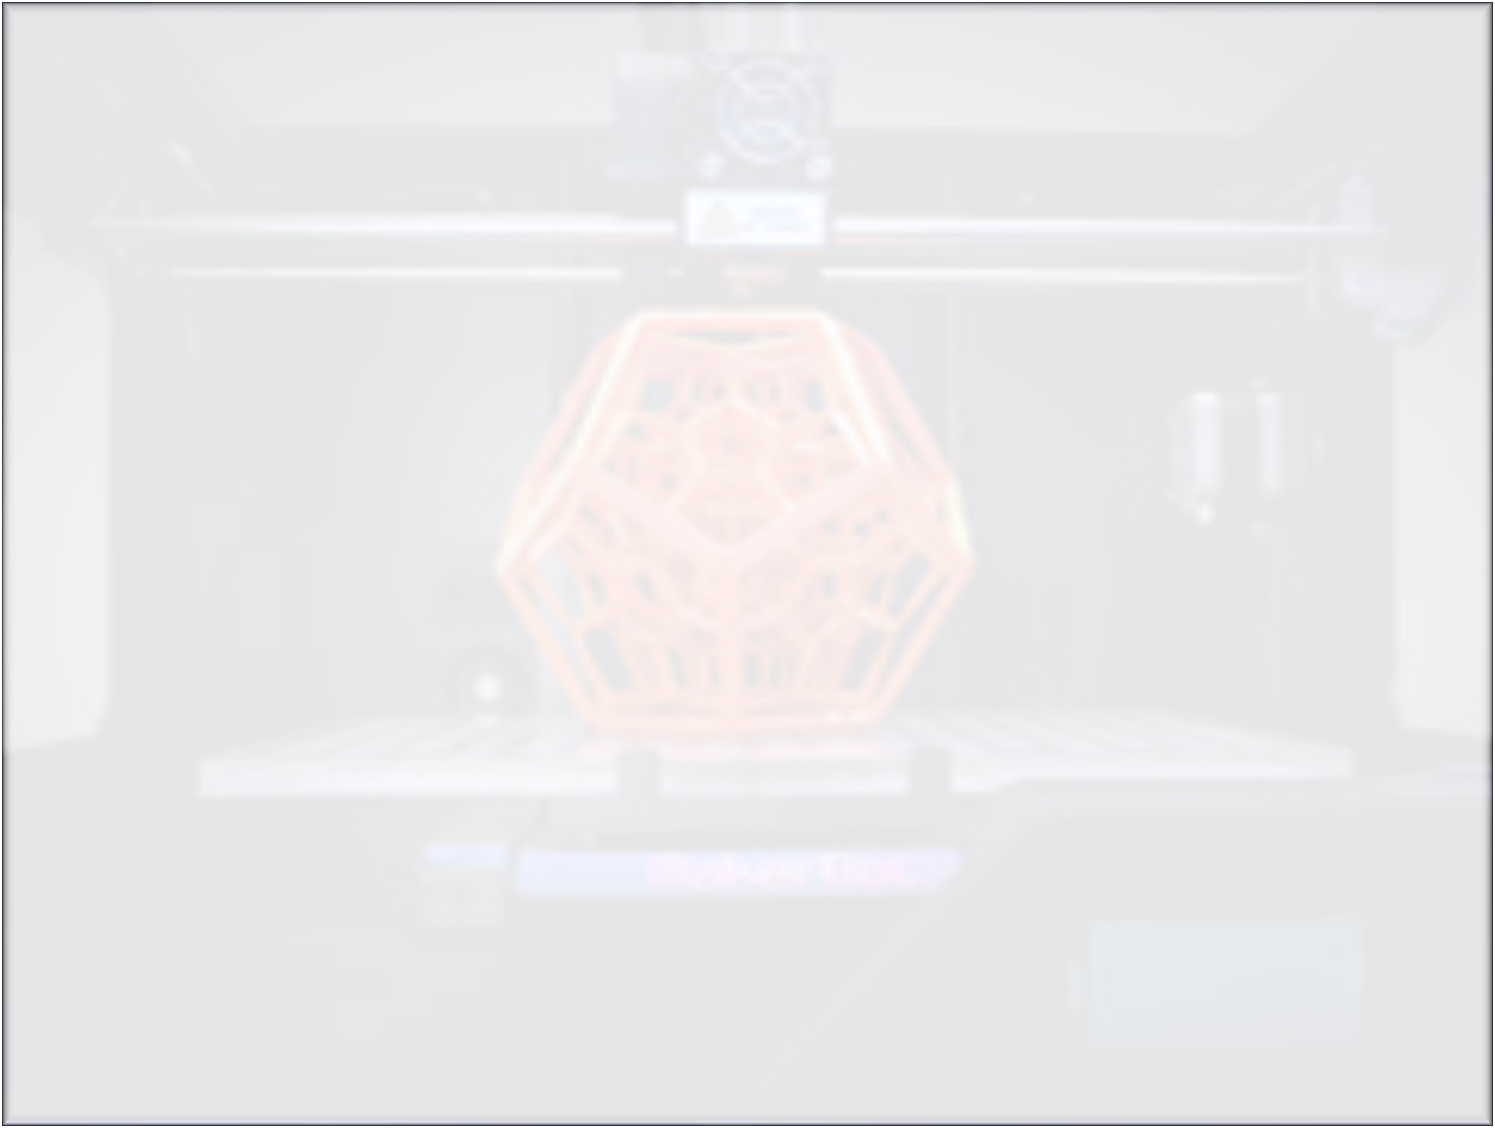
Endevour
By:
Naresh Kadarla
Krishnareddy Peechara
Sitaramireddy Polimera
Shashank Bheemgalkar

Slide 2

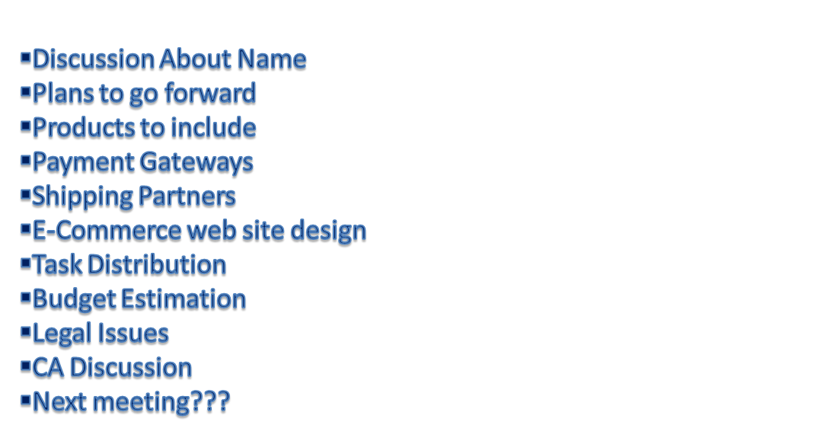
Agenda

Slide 3
Name Discussion
Names Suggested by individual:
Naresh : IIID
3D evolution
Krsihna: 3DTantra
Sitaram: NextThing
Shashank: Nex3D
Endevour

Slide 4

Planes to go forward
???

Slide 5
Products to include
Fashion Design items
Toys
Custom designs
Vendors
etc…etc…

Slide 6
Payment Gateways
What to be included?
To whom we should approach?
How much they will charge?
How much time it will take?

Slide 7

Web site Design
Whom to consult?
Which technology to use?
Whether can go for direct online site?
Payment information regarding this ?
How they maintain it?
Within how many days will it to be ready?(Expecting our site to be ready one day before Ugaadi)

Slide 8
Task Distribution
Individual task distribution as follow(Reviews needed here):
* Shashank : - Promotions * Sitaram: - Technology
- Website maintenance - Integrations
- Market Analysis - Promotions
* Naresh: - Financial Matters * Krishna - Mobile Apps Part
- Legal related issues - Technical architecture
- Promotions -Promotions

Slide 9
Budget Estimation
How much initial budget we need?
Do we need to open any bank account for
this(Current account)?
Where we can open account
Individual initial fund contribution
Balance sheet maintenance

Slide 10

Legal Issues
What are the legal issues involved in this?
Copyrights or any patent related issues?
Whom we will contact for legal issues?
Any advisory board needed (at later stage)?
Any cyber laws there in India on 3D products or Printings?

Slide 11
CA Accounts/Audits
Company audit and account information
Whom do we contact?
Assets related Info…What we need ?
Company registration

Slide 12
LAUNCHING
Ugadi Is our first target to launch the website without fail
Company registration
Website registration
Contact information
Location
Daily Site administration/maintenance

Slide 13
Go ahead and register ☺☺☺
http://bcove.me/zyqzjo0q

