Slide 1

SMART IOT DEVICE FOR
TWO WHEELERS
Under the guidance of:
DR.SYED MUSTAFA,
HOD, Dept. Of ISE,
HKBK College of Engineering
Presented by
1. AQUIB JUNAID S (1HK14IS005)
2. IMRAN PASHA (1HK14IS010)
3. R SKANDHAN (1HK14IS028)
4. SHASHANK S (1HK14IS037)

Slide 2
CONTENT
Abstract
Existing system
Problem statement
Proposed system
Literature Survey
Components of System
Data flow of Bluetooth Module, vibration sensor, GSM, GPS
Software requirements
Hardware requirements

Slide 3
ABSTRACT
The prime concern now-a-days are the security of parked vehicles. A smart IOT device for two wheelers system is developed which can now not only track the vehicle also alerts the user even the slightest displacement in the vehicle. The device makes use of Global Positioning System (GPS) for the tracking the vehicle and electronic mail (EMAIL) for alerting or notifying the user. The system can exhibit 2 modes i.e., Active mode and Parking mode. In Active mode, the system is off which means the system is not connected to user’s smartphone. In parking mode, the system is connected to a cloud server through Low Power Wide Area (LPA) where the system detects the movement in the vehicle from vibration sensor and alerts the user by sending the location coordinates using GPS. The user also gets a mail that the vehicle is on move and to check the application for location by making use of GSM (Global System for Mobile communication). In future, it becomes a small-size low price device by converting it all into a single chip.

Slide 4
Existing system
Various vehicle anti-theft devices have been developed lately, however the result is still disappointing since all kinds of devices have its drawbacks.
Domestic and overseas vehicle anti-theft products are technologically classified into two categories:
1. Vehicle alarm system:
It consists of an array of sensors which includes switches, pressure sensors, and motion detectors. Often a siren creates a variety of distinct sound that helps user to identify the vehicle. The advanced touch mechanism detects the touch and generates the alarm thereby helping the user to protect the vehicle.
fig 1.1 Vehicle alaram system

Slide 5
Existing system(contd...)
2. GPS Vehicle Tracking System:
This device with the help of GPS and GSM technology tracks and locates vehicles that are stolen. The vehicle is fitted with a device that consists of both GPS and GSM module. Whenever the user asks the vehicle for its location the GPS sends its coordinates through the GSM module. The vehicle also notifies the user when the key position is turned to ignition and the vehicle starts to move. The location of the vehicle is continuously updated to a database even when the user doesn’t ask for the coordinates. Whenever the user requests the coordinates are retrieved from the database and sent to the user.
fig 1.2 GPS Vehicle Tracking System

Slide 6
Existing system(contd...)
Advantages :
Anti theft alarm and vehicle tracking system.
Tracking the device using GPS tracker.
Saves time in finding the vehicle.

Slide 7
Existing system(contd...)
Disadvantages :
Consumes more energy
GPS tracker is ON 24/7
Doesn't notify the user
In Alarm system, the sound is annoying and its loud too.

Slide 8
Problem Statement
In India, 1lakh cases of vehicle theft on average are reported each year, and the number is still increasing. If the vehicles that are being stolen are not recovered early they are mostly sold or some cases it is burned if the resale value is considered to be too low. In one case a vehicle is stolen, it becomes hard to situate it and cut through it, which considerably lessens the chances of recouping it. In this project, we propose the design and implementation of a vehicle tracking anti-theft system that will protect, secure vehicles.
The main problem in the existing system is that the GPS tracker tracks and monitors the vehicle 24/7 as a result of which it consumes a lot of energy.
Due to the absence of vibration (movement) sensor the theft of the vehicle cannot be detected immediately.

Slide 9
Proposed Sytem
The proposed system uses a switch to turn ON and OFF the device which is controlled by the user/owner. When the user turn OFF the switch, the device goes to active mode. When the user disconnects to the device goes to parking mode and device is connected to cloud server through LPWA (low- power wide range network). When the device is in parking mode, movement of the vehicle is sensed using vibration sensor and the owner is notified along with the GPS coordinates of the vehicle.

Slide 10
Proposed Sytem(contd..)
Advantages :
Small size and light weight
Sophisticated security system
Consumes less energy
Notifies the user immediately

Slide 11
Literature Survey
[1] RFID Tracking System for Vehicles
RFID tag is used to track a vehicle. The RFID tag is stuck on the windshield whenever it passes through a signal or a toll the information of the tag is stored in a database. The RFID tag can also be used for payments at toll plazas. If the vehicle is stolen, whenever it passes through a signal or a toll its location can be captured.
[2] Design and implementation of vehicle tracking system using GPS/GSM/GPRS technology and smartphone application
This device with the help of GPS and GSM technology tracks and locates vehicles that are stolen. The vehicle is fitted with a device that consists of both GPS and GSM module. Whenever the user asks the vehicle for its location the GPS sends its coordinates through the GSM module. The vehicle also notifies the user when the key position is turned to ignition and the vehicle starts to move. The location of the vehicle is continuously updated to a database even when the user doesn’t ask for the coordinates. Whenever the user requests the coordinates are retrieved from the database and sent to the user.

Slide 12
Literature Survey(contd...)
[3] Alarm System for Vehicles
Alarm systems in vehicle are one of the first safety devices invented to prevent theft. These devices detect motion all over the body of the vehicle. Even a small motion on the surface of the vehicle will tip of the alarm system. The alarm system makes loud noise to warn the owners of the theft taking place.

Slide 13
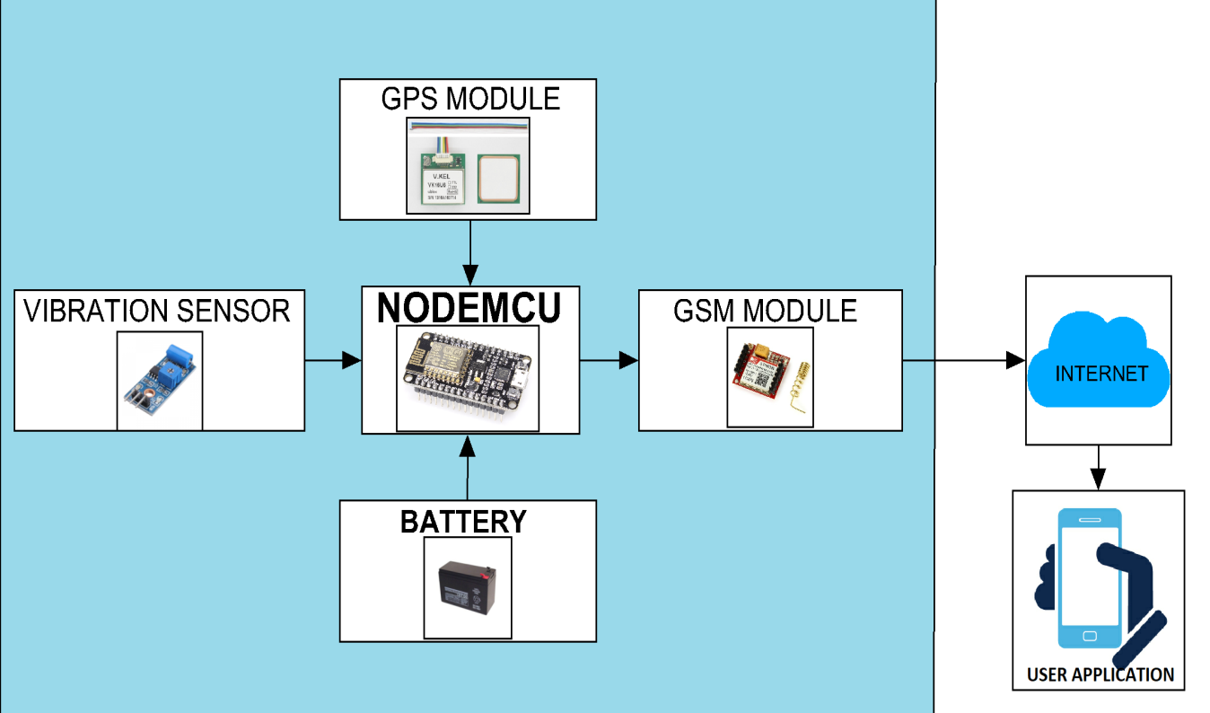
COMPONENTS OF SYSTEM

Slide 14
DATA FLOW DIAGRAM
LEVEL 0 : Active mode
ACTIVE
SMARTPHONE
BLUETOOTH
SYSTEM
PARKING

Slide 15
DATA FLOW DIAGRAM
LEVEL 1 : Parking mode
ACTIVE
SMARTPHONE
SYSTEM
PARKING

Slide 16
GSM DATA FLOW

Slide 17
GPS DATA FLOW

Slide 18
DATA FLOW

Slide 19
SOFTWARE REQUIREMENTS
Programming Languages: 1. Java and XML for Android application
Development.
2. C/C++ programming language for NODEMCU
Programming.
BLYNK
NODEMCU Software

Slide 20
Hardware Requirements
GSM Module
Vibration Sensor
NODEMCU
GPS tracker
Battery

Slide 21
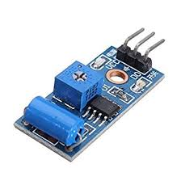
Brief Explanation of Functionality of Each Module
GSM MODULE(SIM 800L):
A GSM module is a chip or circuit that will be used to establish communication between a mobile device or a computing machine and a GSM.
VIBRATION SENSOR(SW - 420):
These sensors can be used to detect continuous vibration or sudden impact or displacement and proximity, or acceleration. In applications such as washing machine load imbalance, vehicle motion sensor, anti-theft devices, vital signs monitoring, and tamper detection.

Slide 22
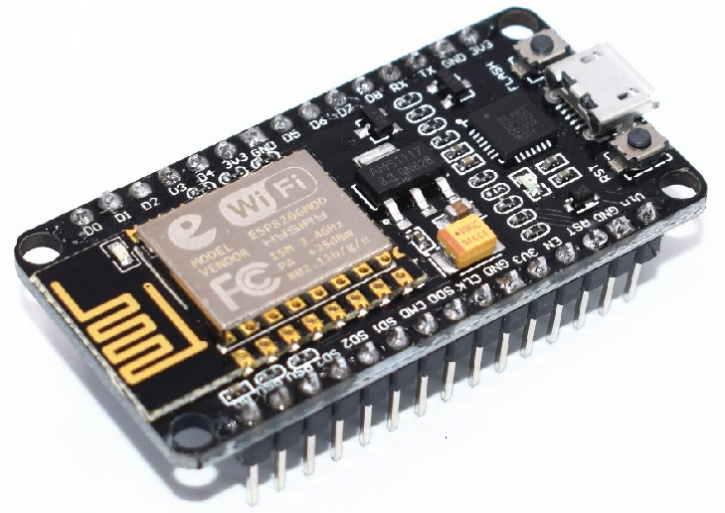
Contd...
NODEMCU:
NodeMCU consists of Wi-Fi Module – ESP-12E module that is similar to ESP-12 module which has 6 extra GPIOs (General-purpose input/output pins). NodeMCU is an open source IoT platform that includes firmware which runs on the ESP8266 Wi-Fi SoC (system on a chip) from Espressif Systems. NodeMCU has a micro USB port that is used for power, debugging and programming.

Slide 23
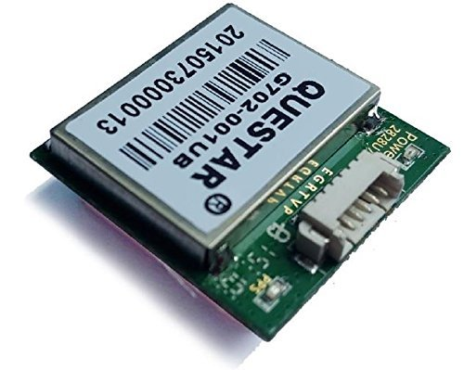
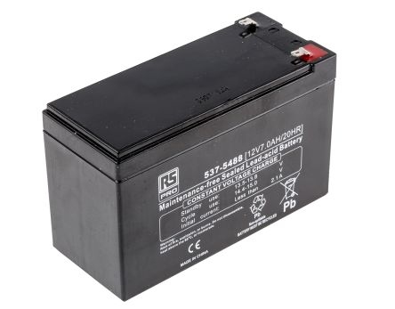
Contd...
GPS TRACKER:
GPS tracker helps in the surveillance of location through use of the Global Positioning System (GPS ) to track the location of an entity or object remotely. It also helps in sending the co-ordinates(latitude, longitude) upon request made by the user.
BATTERY:
Rechargeable battery is used to power the all the components in the device.

Slide 24
CONCLUSION
After the implementation of the all the modules successfully the final device will be in a posture to make all of our objectives with which we started our project. This project has implemented our intentions that are: detecting if any displacement occurring in the vehicle, alerting user by sending a SMS, tracking the vehicle based upon the request made by the user through means of android application. To power up all the components in our project vehicle battery is used.
This project consists of anti-theft system that is useful in detecting the theft of the vehicle which is implemented based on GSM and GPS technology. With the dedicated smartphone-android application one can check for the location of the vehicle. Vibration sensor is fixed with the NODEMCU this helps in detecting any sudden impact or displacement in the vehicle. GSM, GPS and vibration sensor are interfaced on the NODEMCU board and GPS sends the data to the NODEMCU that is the location of the vehicle through GPS coordinates. GPS sends the latitude and longitude coordinates to the NODEMCU board. NODEMCU receives the data from the GPS. Then the GSM get the GPS value and sends the location of the two wheelers to the user via SMS. By such method, theft is prevented by the user itself. As vehicle tracking brings us safety and security this plays an important role in our day-to-day life. Main motto of this task is to comprise different types of sensing elements and devices so that they assist in decreasing the chances of vehicle theft.

Slide 25
REFERENCES
[1] Song, S. Zhu, and G. Cao, “Svats: A sensor-networkbased vehicle anti-theft system”,Networking and Security Research Center, Department of Computer Science and Engineering, Pennsylvania State University, Technical Report NAS-TR-0076-2007, August 2007.
[2] Le-Tien T, Vu Phung-The, “Routing and Tracking System for Mobile Vehicles in Large Area” Electronic Design, Test and Application, 2010. DELTA '10. Fifth IEEE International Symposium on, vol., no., pp.297, 300, 13-15 Jan 2010.
[3] Montaser N. Ramadan, Mohammad A. Al-Khedher, Sharaf A. Al-Kheder “Intelligent Anti-Theft and Tracking System for Automobiles”, International Journal of Machine Learning and Computing, Vol. 2, No. 1, February 2012
[4] Kunal Maurya , Mandeep Singh, Neelu Jain, “Real Time Vehicle Tracking System using GSM and GPS Technology- An Anti-theft Tracking System,” International Journal of Electronics and Computer Science Engineering. ISSN 2277- 1956/V1N3-1103-1107
[5] Fleischer, P.B.; Nelson, A.Y.; Sowah, R.A.; Bremang, A., "Design and development of GPS/GSM based vehicle tracking and alert system for commercial inter-city buses," Adaptive Science &Technology (ICAST), 2012 IEEE 4th International Conference on , vol., no., pp.1,6, 25-27 Oct. 2012
[6] Nagaraja, B. G.; Rayappa, R.; Mahesh, M.; Patil, C.M.; Manjunath, T. C., "Design & Development of a GSM Based Vehicle Theft Control System," Advanced Computer Control, 2009. ICACC '09.International Conference on , vol., no., pp.148,152, 22-24 Jan. 2009.
[7] Zhigang Liu ,Anqi Zhang, Shaojun Li“ Vehicle anti-theft tracking system based on Internet of things”, Vehicular Electronics and Safety (ICVES), 2013 IEEE International Conference on28-30 July 2013.

Slide 26
THANK YOU

