Slide 1
Sapient off site August 2017
Microservices
- Raghuveer Rao

Slide 2
What is a Microservice
Microservices - also known as the microservice architecture - is an architectural style that structures an application as a collection of loosely coupled services, which implement business capabilities.
Microservices are a way of dividing the implementation of an application into a set of network protocol based components.
Microservices are not about identifying a function that is common to multiple applications, and creating a single, shared deployment of that function.

Slide 3
12 Goals of Microservices
Independent deployment of components
Independent scaling of components
Independent implementation stacks for each component
Easy self-serve deployments of components
Repeatable deployments of components (external configuration management)
Deployments without service interruptions
Protection of system availability from individual Instance failure
Automatic replacement of component instances when they fail (self-healing)
Easy scaling of components by adjusting a simple parameter value
Canary testing
"Red/black" or "blue/green" deployments
Instant reversal of new revision deployments

Slide 4
Developing Microservices
One strategy to not use is the “Big Bang” rewrite. That is when you focus all of your development efforts on building a new microservices‑based application from scratch.
As Martin Fowler reportedly said, “the only thing a Big Bang rewrite guarantees is a Big Bang!”
How Micro is Micro ?

Slide 5

Can you identity this tree ?

Slide 6
Strangler Pattern
The Strangler Application is based on an analogy to a vine that strangles a tree that it’s wrapped around.
Divide an application into different functional domains, and replace those domains with a new microservices-based implementation one domain at a time.
This creates two separate applications that live side by side in the same URI space.
Over time, the newly refactored application “strangles” or replaces the original application until finally you can shut off the monolithic application.

Slide 7
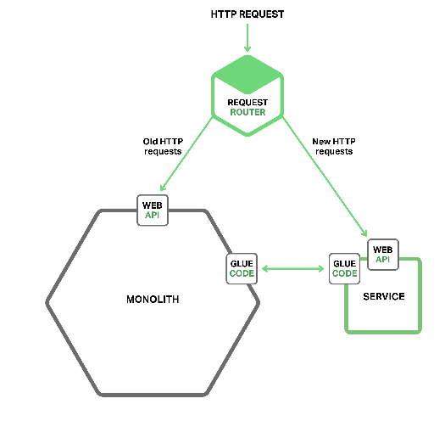
Implementing Microservice

Slide 8
How to Decompose ?
The architecture must be stable
Services must be cohesive. A service should implement a small set of strongly related functions.
Services must conform to the Common Closure Principle - things that change together should be packaged together - to ensure that each change affect only one service
Services must be loosely coupled - each service as an API that encapsulates its implementation. The implementation can be changed without affecting clients
A service should be testable
Each service be small enough to be developed by a “two pizza” team, i.e. a team of 6-10 people
Each team that owns one or more services must be autonomous. A team must be able to develop and deploy their services with minimal collaboration with other teams.

Slide 9
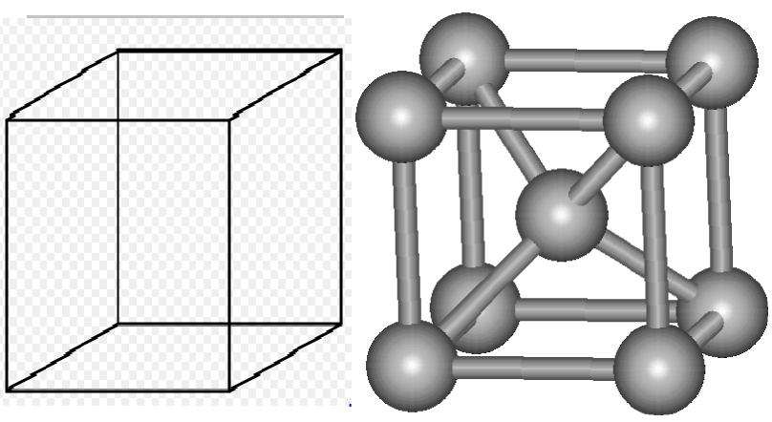
Complexity

Slide 10
API
Design First Approach
Review your API with the client
Evolve your API
Plan on having multiple versions of the API simultaneously
Handle partial responses
Publish API

Slide 11
Handling Partial Responses
Network timeouts – Never block indefinitely and always use timeouts when waiting for a response. Using timeouts ensures that resources are never tied up indefinitely.
Limiting the number of outstanding requests – Impose an upper bound on the number of outstanding requests that a client can have with a particular service. If the limit has been reached, it is probably pointless to make additional requests, and those attempts need to fail immediately.
Circuit breaker pattern – Track the number of successful and failed requests. If the error rate exceeds a configured threshold, trip the circuit breaker so that further attempts fail immediately. If a large number of requests are failing, that suggests the service is unavailable and that sending requests is pointless. After a timeout period, the client should try again and, if successful, close the circuit breaker.
Provide fallbacks – Perform fallback logic when a request fails. For example, return cached data or a default value such as empty set of recommendations.

Slide 12
Interaction Styles
One‑to‑one – Each client request is processed by exactly one service instance.
Request Response
Notification
Request Async Response
One‑to‑many – Each request is processed by multiple service instances.
Publish Subscribe
Publish Async Responses
Synchronous – The client expects a timely response from the service and might even block while it waits.
Asynchronous – The client doesn’t block while waiting for a response, and the response, if any, isn’t necessarily sent immediately.

Slide 13
Messaging
Decouples the client from the service – A client makes a request simply by sending a message to the appropriate channel. The client is completely unaware of the service instances. It does not need to use a discovery mechanism to determine the location of a service instance.
Message buffering – With a synchronous request/response protocol, such as a HTTP, both the client and service must be available for the duration of the exchange. In contrast, a message broker queues up the messages written to a channel until they can be processed by the consumer.
Flexible client‑service interactions – Messaging supports all of the interaction styles described earlier.
Explicit inter‑process communication – RPC‑based mechanisms attempt to make invoking a remote service look the same as calling a local service. Messaging makes these differences very explicit so developers are not lulled into a false sense of security.

Slide 14
Synchronous
REST
“REST provides a set of architectural constraints that, when applied as a whole, emphasizes scalability of component interactions, generality of interfaces, independent deployment of components, and intermediary components to reduce interaction latency, enforce security, and encapsulate legacy systems.”
Apache Thrift
Apache Thrift is an interesting alternative to REST. It is a framework for writing cross‑language RPC clients and servers. Thrift provides a C‑style IDL for defining your APIs. You use the Thrift compiler to generate client‑side stubs and server‑side skeletons.
Protocol Buffers - gRPC

Slide 15
Richardson Rest Maturity Model
Level 0 – Clients of a level 0 API invoke the service by making HTTP POST requests to its sole URL endpoint. Each request specifies the action to perform, the target of the action (e.g. the business object), and any parameters.
Level 1 – A level 1 API supports the idea of resources. To perform an action on a resource, a client makes a POST request that specifies the action to perform and any parameters.
Level 2 – A level 2 API uses HTTP verbs to perform actions: GET to retrieve, POST to create, and PUT to update. The request query parameters and body, if any, specify the action’s parameters. This enables services to leverage web infrastructure such as caching for GET requests.
Level 3 – The design of a level 3 API is based on the terribly named HATEOAS (Hypertext As The Engine Of Application State) principle. The basic idea is that the representation of a resource returned by a GET request contains links for performing the allowable actions on that resource.

Slide 16
Resources
http://www.microservices.io
http://projects.spring.io/spring-cloud/
https://netflix.github.io/

Slide 17
Credits
Chief Accountant: Candace B. Rittenoff
Book Critic: Odessa Paige Turner
DNA Researcher: Gene Hackman
Summer Wardrobe Coordinator: Bermuda Schwartz
Window Dressers: Kurt and Rod
401K Statement Analysts : Douse and Burnham
Construction Manager : Dustin Dubree
Dessert Chef : Tyra Meesu

