Slide 1
59 Minute Scrum
2.09.2015

Slide 2
Agenda
59 Minute Scrum
Notes:
Stephanie

Slide 3

A Few Rules
Each team MUST
work together
demo something at the end of the Sprint
complete their Sprint Planning with a Sprint Backlog on the worksheet
conduct their Daily Scrum meeting
AND
Everyone MUST have work in the Sprint
No Scrum Master is used in this exercise
Self-organization rules!

Slide 4
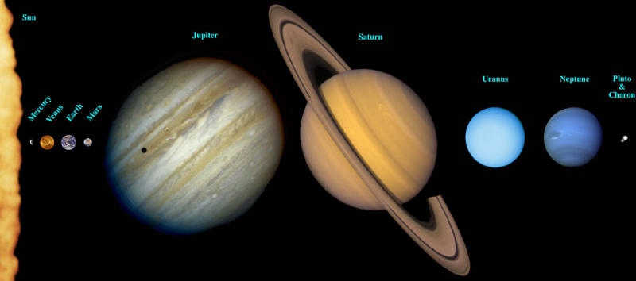
A Martian Visiting Earth – A Tourist Brochure
Create brand concept, cover art, and/or logo
Define major topics for Martian tourism, e.g.
Describe an “Art Interests in Europe” tour
Describe a tour based on photosynthesis
Describe a “Human Sports” tour
Outline a “7 Wonders of the Earth” expedition
Other Inclusion Ideas
Set prices for the tours
Outline hazardous warning messages (i.e., heavy gravity, over-oxygenation, fungi, etc.)
Suggest clothing/dress options for weather or culture
Explain travel options to/from Mars
Outline the refund policy
Suggest related services/offerings
Define Advertisers
Define a 12-month campaign
Set-up a process for how to get more information

Slide 5
Exercise
15 min
Review the Product Backlog
Select a Product Owner
Select an achievable Sprint Goal
Determine the number of features that your team can complete
Think about initial assignments
Produce a Sprint Backlog on the team worksheet

Slide 6
Example: Sprint Backlog
1. Describe entertainment in the park
 | a. Music | 20 min
 | b. Comedy/Improv | 20 min
2. Describe special events
 | a. Bonfire Night | 15 min
 | b. Sandwich appreciation month | 10 min
3. Suggest related nearby activities and events
 | a. Lego Museum | 25 min
 | b. Giant ball of twine | 17 min
Total |  | 107 min
Sprint Goal:
Explain Entertainment
Potential effort:
6 members * 20 min = 120 min

Slide 7
Sprint Backlog Team Worksheet
Sprint Goal |  | 1.
 |  |  | a. |  | min
 |  |  | b. |  | min
 |  | 2.
 |  |  | a. |  | min
 |  |  | b. |  | min
 |  | 3.
 |  |  | a. |  | min
 |  |  | b. |  | min
 |  | Total |  |  | min

Slide 8
Exercise: Day 1–3
Day 1 |  | Day 2 |  | (Last day – must have completed product) Day 3
7 minute work day 3 minute daily scrum |  | 8 minute work day 2 minute daily scrum |  | 8 minute work day 2 minute daily scrum

Slide 9

Exercise: Day 1 Daily Scrum
3 min
Scrum Meeting
Team stands in a circle facing each other
Each team member answers 3 questions
1. What have I completed since our last meeting?
2. What do I intend to complete before our next meeting?
3. What is getting in my way?

Slide 10
Exercise: Day 1–3
Day 1 |  | Day 2 |  | (Last day – must have completed product) Day 3
7 minute work day 3 minute daily scrum |  | 8 minute work day 2 minute daily scrum |  | 8 minute work day 2 minute daily scrum

Slide 11
Exercise: Day 2 Daily Scrum
2 min
Scrum Meeting
Team stands in a circle facing each other
Each team member answers 3 questions
2. What do I intend to complete before our next meeting?
3. What is getting in my way?
1. What have I completed since our last meeting?

Slide 12
Exercise: Day 1–3
Day 1 |  | Day 2 |  | (Last day – must have completed product) Day 3
7 minute work day 3 minute daily scrum |  | 8 minute work day 2 minute daily scrum |  | 8 minute work day 2 minute daily scrum

Slide 13
Exercise: Day 3 Daily Scrum
2 min
Scrum Meeting
Team stands in a circle facing each other
Each team member answers 3 questions
2. What do I intend to complete before our next meeting?
3. What is getting in my way?
1. What have I completed since our last meeting?

Slide 14

Exercise: Sprint Review
Elect a spokesperson to facilitate the Sprint Review and Demo meeting
Conduct a Sprint Review and a Demo of your brochure
What is the potentially shippable product increment?
What did we complete of our Sprint Backlog?
What is the feedback from our Product Owner?

Slide 15
Exercise: Sprint Review
7 min
Sprint Retrospective
+
What could be improved for the next sprint?
What went well during the sprint?

Slide 16
Thanks!

