Slide 1
Kanban Pizza Game
2.09.2015

Slide 2
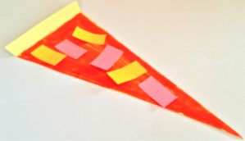
We are open!
You have opened a pizzeria
We are running a one day promo – all pizza is free
Your Objectives
Make as many pizzas as possible until the end of the day (or I stop you)
Try to avoid wasted materials

Slide 3
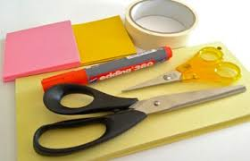
Making Pizza
Hawaiian Pizza Slice
3 pieces of ham
3 pieces of pineapple
Red sauce
Cooking time 30 secs no removing or adding slices while cooking
Get your supplies

Slide 4
Round 1
Briefly discuss a process including all team members to create pizza slices
Work together and try to create as many Hawaiian pizzas as you can
We’ll play until I clap my hands

Slide 5
Round 1 : Let’s count up your scores
Finished Slice : 10 pts
Unfinished pizza base : -4 pts each
Unused topping: -1 pt each

Slide 6
6 Practices of Kanban (1 of 2)
Visualize the workflow
Do you have a workflow?
Make a station for each step
Limit Work in Progress (WIP)
Where was unfinished work piling up
Select a WIP limit
Mark you stations with a WIP Limit
Manage the flow
Normally lead time
We use point system that rewards finished products and punishes unfinished

Slide 7
6 Practices of Kanban (2 of 2)
Implement feedback loops
Are you regularly reviewing your work and processes
Hold standups and retrospectives
Make process policies explicit
Make it easy for people to do the right things, and do them right
Improve Collaboratively
Use metrics and models to continuously improve

Slide 8
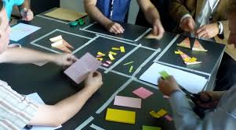
Visualize your flow & limit your WIP
5 min
Make your workflow explicit
Limit the WIP for each station

Slide 9
Round 2
Work together and try to create as many Hawaiian pizzas as you can
We’ll play until I clap my hands

Slide 10
Round 2 : Let’s count up your scores
Finished Slice : 10 pts
Unfinished pizza base : -4 pts each
Unused topping: -1 pt each
Hold retrospective, discuss how to improve (5 mins)

Slide 11
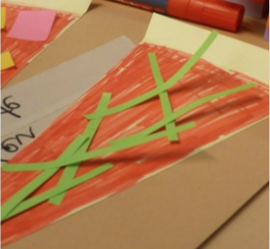
New Pizza in town: Rucola
Rucola Pizza Slice
7 pieces of rocket salad
Red sauce
Rocket salad easily burns so must be added after slice comes out of the oven

Slide 12
Round 3 : Product based on orders
Get your order cards
Once order completed deliver to station for payment
Points for completed orders

Slide 13
Round 3 : Let’s count up your scores
Finished Orders : 10 pts
Unfinished pizza base : -4 pts each
Unused topping: -1 pt each

Slide 14
Discussion

