Slide 1
QA Automation Bootcamp
Best Practices
2.11.2015

Slide 2
Best Practices Module Objectives
Go deeper
Understand lessons learned and patterns from past projects
Prepare to assume the role of Automation Engineer
Notes:
Stephanie

Slide 3
Best Practices
Patterns and lessons learned
Applied experiences
Save time and improve quality
Intellectual Capital
Competitive Advantage
Best Practices are NOT standards…
Soooo….they can always be improved
Ideas wanted!!!

Slide 4
Best Practices
Project Structure

Slide 5
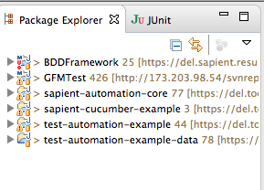
Best Practices: Project Structure
Distribute Cucumber functionality across three Eclipse projects
One reusable test core
Two project specific projects
1. sapient-automation-core
2. test-automation-<project name>
3. test-automation-<project name>-data

Slide 6
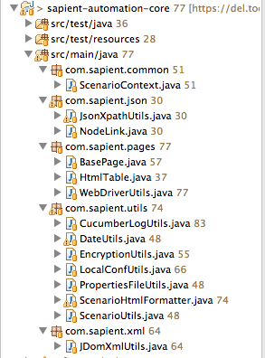
Best Practices: Project Structure
Core
Reusable testing utilities, libraries, base classes and interfaces that can be used by all projects
Continue to build-on as project execution identifies needs and re-use opportunities
Intellectual property contributes to quick starts, productivity, quality and competitive advantage
Completeness of Maven pom file eliminates clutter of other projects

Slide 7
Best Practices: Project Structure
Core
A good java testing core should include:
JSON and XML utilities
Selenium base classes and interfaces
SOAP, Web and Restful service utilities
Database: connect, query and update
JMS topics and queues read/write utilities
Custom cucumber formatting
Standardized cucumber logging
Utilities and standards for managing configuration files
MS Office read/write utilities
Utilities to support connection to common industry tools such as ALM (Quality Center), Jira, Rally, Version One…

Slide 8
Best Practices: Project Structure: Core: Java Libraries
Library | Functional Description |  | Library | Functional Description
info.cukes | Cucumber libraries |  | apache commons | io/java language strings, collections/database
org.springframework | Access to J2EE components supported by Spring |  | org.apache.poi | MS Office
javax.jms | JMS topics and queues |  | net.sf.opencsv | Comma delimited files (CSV)
org.codehaus.jackson | JSON–read, write, query, objectify |  | org.apache.httpcomponents | HTTP utilities
com.google.code.gson | JSON–read, write, query, objectify |  | net.sourceforge.jtds | JDBC driver for MS SQL and Sybase
com.jayway.restassured | SOAP, Web and Restful services |  | dbunit | Database initialization and testing utilities
org.seleniumhq.selenium | Web based UI testing |  | org.jsoup | HTML parser API
org.jdom | XML–read, write, query, objectify |  | com.jcraft | SSH utilities
xmlunit | XML file comparison

Slide 9
Best Practices: Project Structure: Core: Java Libraries (2 of 2)
Library | Functional description
xmlunit | XML file comparison
apache commons | io/java language strings, collections/database
org.apache.poi | MS Office
net.sf.opencsv | Comma delimited files (CSV)
org.apache.httpcomponents | HTTP utilities
net.sourceforge.jtds | JDBC driver for MS SQL and Sybase
dbunit | Database initialization and testing utilities
org.jsoup | HTML parser API
com.jcraft | SSH utilities

Slide 10
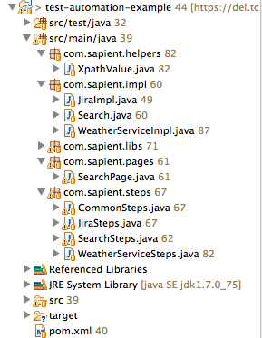
Best Practices: Project Structure
test-automation-<project name>
Project specific Java code
Uses and depends on the core
Cucumber steps and impl(s)
Selenium pages

Slide 11
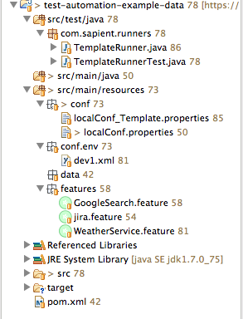
Best Practices: Project Structure
test-automation-<project name>-data
Depends on test-automation-<project name>
Cucumber feature files
Data files required by tests
Configuration files
Cucumber runners--the only Java code
Allows for anyone to develop specifications and run Cucumber tests independent of Java
Continuous Integration

Slide 12
Exercise
Setup Eclipse Projects and Run Samples
Notes:
1. Get everyone’s system up and running

Slide 13
Best Practices
Multi-Environment Configuration

Slide 14
Best Practices: Multi-Environment Configuration
System Properties (-Denv=<environment-name>)
<environment-name>.xml
EnvironmentProperties.java

Slide 15
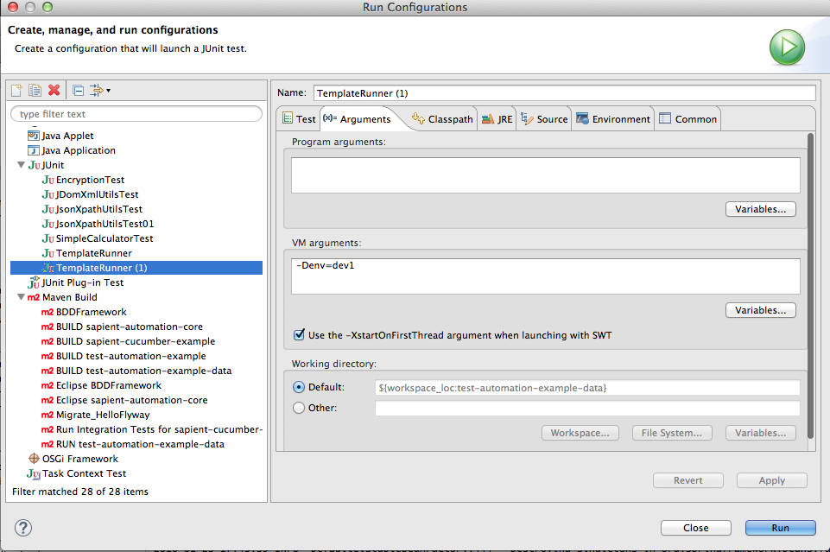
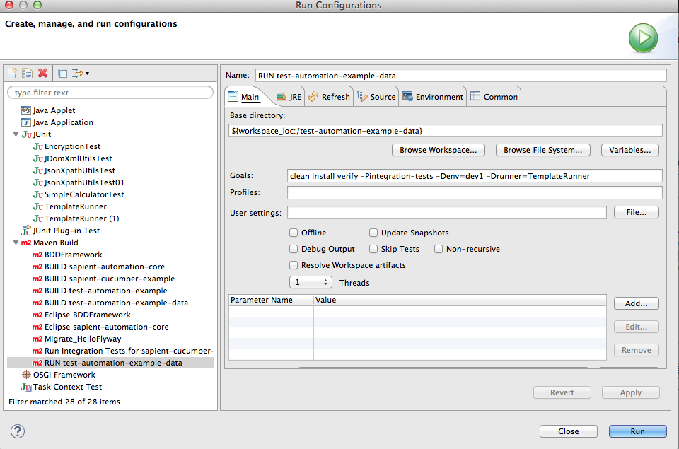
Best Practices: Multi-Environment Configuration
System property: env
Required property to run tests
Set VM arguments for TemplateRunner.java to -Denv=“<environment name>” in Run Configuration
Set Goals if Maven to -Denv=“<environment name>” in Run Configuration
For command line add -Denv=“<environment name>”

Slide 16
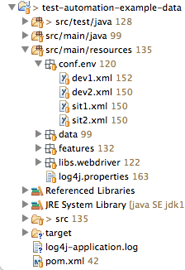
Best Practices: Multi-Environment Configuration
<environment name>.xml
Spring application context file
Application specific configuration parameters
Support many environments
Augment clean Gherkin by keeping technology out
Encrypt passwords
Check-in to SVN
/src/main/resources/conf/env directory of data project
<bean id="EnvBean" class="com.sapient.libs.EnvironmentProperties">
<property name="calculatorHomeUrl" value="http://www.calculator.net" />
<property name="googleHomeUrl" value="http://www.google.com" />
.
.
.
</bean>

Slide 17
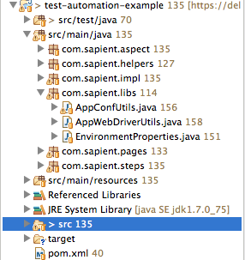
Best Practices: Multi-Environment Configuration
EnvironmentProperties.java
Spring loaded
Access configuration parameters through Java method
Need to update each time new parm added to Spring application context
Check-in to SVN
/src/main/java/com/sapient/libs directory in <app-name> project
public class EnvironmentProperties {
private String calculatorHomeUrl;
public void setCalculatorHomeUrl(String calculatorHomeUrl) {
this.calculatorHomeUrl = calculatorHomeUrl;
}
public String getCalculatorHomeUrl() {
return calculatorHomeUrl;
}

Slide 18
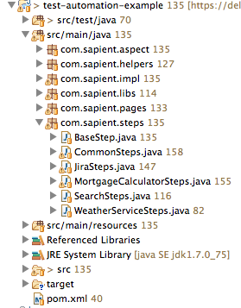
Best Practices: Multi-Environment Configuration
CommonSteps.java
Load Spring Application context using hook
Add to ScenarioContext to use globally
@Before
public void allSetup(Scenario parm) {
String springContextFile = AppConfUtils.getSpringClasspathDir() + AppConfUtils.getEnvironment() + ".xml";
ApplicationContext context =
new ClassPathXmlApplicationContext(new String[] {springContextFile});
EnvironmentProperties envProperties = (EnvironmentProperties)context.getBean("EnvBean");
ScenarioContext.current.put(EnvironmentProperties.ENV_PROPERTIES, envProperties);

Slide 19
Best Practices: Multi-Environment Configuration
<bean id="EnvBean" class="com.sapient.libs.EnvironmentProperties">
<property name="calculatorHomeUrl" value="http://www.calculator.net" /> </bean>
dev1.xml
public class EnvironmentProperties {
private String calculatorHomeUrl;
public void setCalculatorHomeUrl(String calculatorHomeUrl) {
this.calculatorHomeUrl = calculatorHomeUrl;
}
public String getCalculatorHomeUrl() {
return calculatorHomeUrl;
}
}
EnvironmentProperties.java
EnvironmentProperties env;
env = (EnvironmentProperties) ScenarioContext.current.get(EnvironmentProperties.ENV_PROPERTIES);
String calculatorHomeUrl = env.getCalculatorHomeUrl();
Test application code (Java)

Slide 20
Best Practices: Multi-Environment Configuration : System Vars
<bean id="systemPrereqs"
class="org.springframework.beans.factory.config.MethodInvokingFactoryBean">
<property name="targetObject" value="#{@systemProperties}" />
<property name="targetMethod" value="putAll" />
<property name="arguments">
<!-- The new Properties -->
<util:properties>
<prop key="browser">firefox</prop>
<prop key="seleniumHub">localhost</prop>
<prop key="seleniumHubPort">4567</prop>
</util:properties>
</property>
</bean>
dev1.xml
String browser = System.getProperty(“browser”);
String seleniumHub = System.getProperty(“seleniumHub”);
String port = System.getProperty(“”);
Test application code (Java)
Notes:
Use the Spring application context to set system properties

Slide 21
Best Practices: Multi-Environment Configuration
Healthy Gherkin
Given user “jdoe” with password “mysecretpassword” is logged into “https://tools.sapient.com/jira/rest/api/”
Given user is logged into Jira
Notes:
What’s wrong with first one?
Gherkin too technical
What happens when environment changes

Slide 22
Exercise
Configuration Code Walk-Through
Notes:
Walkthrough code from localConf->dev1.xml->EnvUtils
Add a section of parms and output to console from Gherkin->Cucumber steps

Slide 23
Best Practices
Data File Management

Slide 24
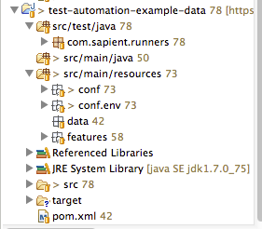
Best Practices: Data
Data is a key testing component
Check-in to SVN
/src/main/resources/data is the root directory in <data> project
Add directories under data root as needed to organize and structure the data files
XML, JSON, CSV, TXT
XML, JSON, CSV, TXT
SOAP, Web Services, Rest, Topics, Queues

Slide 25
Best Practices: Using Data: File to File Approach
Scenario: Creation of JIRA Issue without assignment
Given user is logged into JIRA
When user creates the issue with JSON as "createIssueNoAssignment.json"
Then validate JIRA issue creation response is “issueNoAssignment_exectedResults.json”
Use different flat files for each scenario
One for send and one for expected results
2 files per scenario can be difficult to manage and maintain
Potentially thousands of files
What happens in Sprint 8 when an XML or JSON schema changes
Scenario: Creation of JIRA Issue with assignment
Given user is logged into JIRA
When user creates the issue with JSON as "createIssueWithAssignment.json"
Then validate JIRA issue creation response is “issueWithAssignment_exectedResults.json”
Scenario: Creation of JIRA Issue with assignment but no due date
Scenario: Creation of JIRA Issue without assignment and no due date
Notes:
Do you see any challenges here?
How about the Gherkin?

Slide 26
Best Practices: Using Data: File to File Approach
2 files per scenario can be difficult to manage and maintain
Potentially thousands of files
What happens in Sprint 8 when an XML or JSON schema changes

Slide 27
Best Practices: Using Data: Templates (Golden files)
For send, use a single file and modify it per scenario
For receive, validate specific data points of interest
Scenario: Creation of JIRA Issue without assignment
Given user is logged into JIRA
When user creates the issue with JSON as "createIssueNoAssignment.json” modified as follows:
| xpath | value |
| //fields/assignee | |
| //fields/summary | Test Jira issue creation without assignment |
Then validate JIRA issue creation response is as follows:
| xpath | value |
| //field/error_message | Successfully created issue |

Slide 28
Best Practices: Using Data: Templates (Golden files)
Use Keywords
Improve Gherkin by mapping keywords to complex parameters
In this example complex xpath mapped to keywords (additional code required)
Scenario: Creation of JIRA Issue without assignment
Given user is logged into JIRA
When user creates the issue with JSON as "createIssueNoAssignment.json” modified as follows:
| keyword | value |
| assignee | |
| summary | Test Jira issue creation without assignment |
Then validate JIRA issue creation response is as follows:
| keyword | value |
| error_message | Successfully created issue |

Slide 29
Best Practices: Templates (Golden files)
Summary
Fewer files to manage
Better documentation of the scenario
Checking specific data points improves test reliability, fewer false positives with less maintenance
Keyword mapping can improve readability but each new keyword requires some code

Slide 30
Best Practices
Cucumber Steps : The Object Model and Language Patterns
Notes:
Steps->impl
Steps->impl->page

Slide 31
Best Practices: Object Model and Patterns
<…steps>.java
<…impl>.java
<…page>.java

Slide 32
Best Practices: Object Model and Patterns: <…steps.java>
Connects Feature file to the Java technology
Depends on the <…impl>(s)
Small code footprint
@Given("^weather service is available$")
public void validateWeatherServiceAvailable() throws Throwable {
WeatherServiceImpl impl = new WeatherServiceImpl();
impl.validateAvailable();
}
@When("^system checks weather for city \"([^\"]*)\" with country code \"([^\"]*)\"$")
public void getWeather(String city, String countryCode) throws Throwable {
WeatherServiceImpl impl = new WeatherServiceImpl();
weatherResult = impl.getWeather(city,countryCode);
}
@Then("^user validates weather service sent the following JSON response:$")
public void getWeather(List<XpathValue> xpathList) throws Throwable {
WeatherServiceImpl impl = new WeatherServiceImpl();
impl.validateWeatherResult(weatherResult, xpathList);
}

Slide 33
Best Practices: Object Model and Patterns: <…impl.java>
Use Java, libraries, testing core to process the parameters and run the test
Build evidence in Cucumber html and log data directory
Depends on the <…page>(s) for UI testing
public void validateWeatherResult(String weatherResult, List<XpathValue> xpathList){
for(XpathValue xpathValue : xpathList){
List<String> jsonXpathvalues = JsonXpathUtils.getValuesByXpath(weatherResult, xpathValue.getXpath());
if(!jsonXpathvalues.contains(xpathValue.getValue())){
CucumberLogUtils.logFail("Weather service JSON does not contain expected result. xpath:”
+ xpathValue.getXpath() + " Expected: " + xpathValue.getValue() , false);
}
else{
CucumberLogUtils.logPass("Weather service JSON found expected result. xpath:"
+ xpathValue.getXpath() + " Expected: " + xpathValue.getValue() , false)
}
}
}

Slide 34
Best Practices: Object Model and Patterns: <…page.java>
Selenium page object model
Use Selenium library to manage state for a web page
One <…impl>/<…page> set per web page
<…impl>.java will set and query state
Keep testing and Cucumber logging out of <…page>
import org.openqa.selenium.By;
import org.openqa.selenium.NoSuchElementException;
import org.openqa.selenium.WebDriver;
import org.openqa.selenium.WebElement;
import org.openqa.selenium.support.FindBy;
import org.openqa.selenium.support.PageFactory;
public class SearchPage extends BasePage {

Slide 35
Best Practices
Capturing Evidence
Notes:
Steps->impl
Steps->impl->page

Slide 36
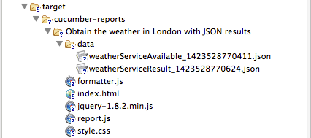
Best Practices: Capturing Evidence
Use Cucumber HTML Report to capture scenario PASS/FAIL evidence
Log applicable text, screenshots and links into report
Save all files used in test scenario ‘data’ dir. Include send, expected and actual result files
Use custom formatter for scenario based logging
Requirements to test scenario traceability
@RunWith(Cucumber.class)
@CucumberOptions(
format = {"com.sapient.utils.ScenarioHtmlFormatter:target/cucumber-reports"},
features = {"src/main/resources/features/WeatherService.feature"},
glue = {"com.sapient.steps"},
tags = {},
dryRun = false,
strict = false,
monochrome = false
)
public class TemplateRunner {

Slide 37
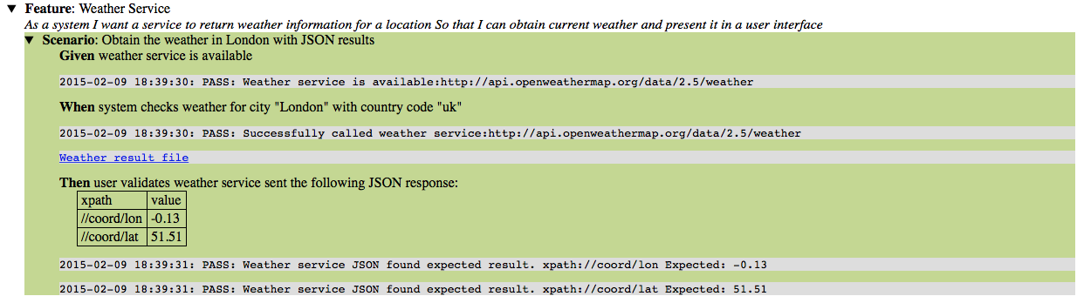
Best Practices: Capturing Evidence
ALM
ZIP
Jira
Rally
Ext System

Slide 38
Best Practices
Code Walk-thru of WeatherService and JiraService Testing
Demonstrate installation and use of HttpRequester plug-in

Slide 39
Exercise
Exercise 2 : Testing Services
Notes:
1. Get everyone’s system up and running

Slide 40
Best Practices
Code Walk-thru of MortgageCalculator UI Testing
Demonstrate installation and use of Firebug and Firepath

Slide 41
Exercise
Exercise 3 : Testing UI
Notes:
1. Get everyone’s system up and running

Slide 42
Thanks!

