Slide 1
SELENIUM TRAINING – Session 5
GM QA Capability Team
November 2014

Slide 2
AGENDA
Automation Concepts
Need for compatibility testing
Introduction to Web Technologies
Overview of Selenium
Selenium IDE

Slide 3
AUTOMATION CONCEPTS

Slide 4

WHAT IS TEST AUTOMATION?
Test automation is the use of software
To set test preconditions.
To control the execution of tests.
To compare the actual outcomes to predicted outcomes.
To report the Execution Status.
Commonly, test automation involves automating a manual process already in place that uses a formalized testing process.

Slide 5
BENEFITS OF AUTOMATION
Frequent regression testing
Rapid feedback to developers
Saves effort and time
Provides more testing coverage
Virtually unlimited iterations of test case execution
Support for Agile and extreme development methodologies
Disciplined documentation of test cases
Customized defect reporting
Finding defects missed by manual testing

Slide 6








AUTOMATION TESTING TOOLS
There are different tools available in market to support the functional automation, performance and web services automation.
Below are some of the most commonly used tools.
Functional Testing Tools
Performance Testing Tools
Web Services Testing

Slide 7
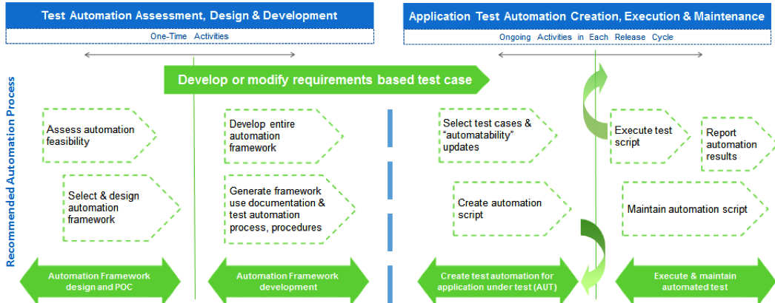
TEST AUTOMATION LIFE CYCLE

Slide 8
Exercise
Prepare a list of few automation tools available in market for the following areas:
Functional Automation Testing
Performance Testing
Web Services Testing
Mobile Application Testing

Slide 9
Quiz
What are the disadvantages of Manual testing?
What are the advantages of Automation testing?
What are the drawbacks of Automation testing?
Name any performance testing tool.
Name any functional testing tool.
Name any webservices testing tool

Slide 10
AUTOMATING A WEB TEST
Automation is about replicating the steps with the help of code. Listed below are some of the actions which we will learn to automate with the help of selenium.
Navigating to the page.
Performing actions on fields edit fields, clicking on link etc.
Downloading/uploading a file.
Retrieving the values from the web page.
Checking the state of any field.
Validating the UI attributes of the fields
Notes:
Discuss a example of FB and list down all the activities a user actions performed
Opening a website
Click on a link/object
Enter values in a text field
Selecting a checkbox
Submit the form by clicking Submit button
Accepting the alerts
Drag and Drop
Checking for availability of any field
Text Checkpoints
Image Checkpoint
Double Click on any object
Verifying the title of webpage
Downloading a file
Checking the font size, font style
Verifying error messages.
Checking for broken links
Running on different browsers/versions
Cookies
Navigating back and forward

Slide 11
NEED FOR COMPATIBILITY TESTING

Slide 12
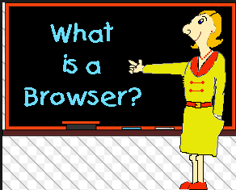

UNDERSTANDING BROWSERS
It is a software application used to locate, retrieve and display content on world wide web, including web pages , images , video and other files. As a client/server model, the browser is the client that run on a computer that contacts the web server and requests information.

Slide 13
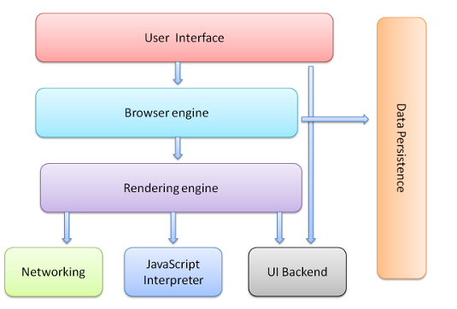
TESTING ON MULTIPLE BROWSERS (COMPATIBILITY TESTING)
Every browser consists of different layers which comprises the architecture of the browser. It’s necessary to ensure that web application works on all the major browsers.
Key components of browsers are shown as below:

Slide 14
RENDERING BROWSERS
Below is the snapshot listing the engines used across browsers:
Blink
Trident
Gecko
Blink
Webkit
Notes:
Fonts are not available
Support for new html

Slide 15
INTRODUCTION TO WEB TECHNOLOGIES

Slide 16
WEB TECHNOLOGIES
The most commonly used techniques that are used for web development and for writing Selenium scripts are:
HTML
JAVASCRIPT
DOM
CSS

Slide 17
WHAT IS HTML?
HTML is a language for describing web pages
HTML stands for Hyper Text Markup Language
HTML is a markup language
A markup language is a set of markup tags
The tags describe document content
HTML documents contain HTML tags and plain text
HTML documents are also called web pages

Slide 18
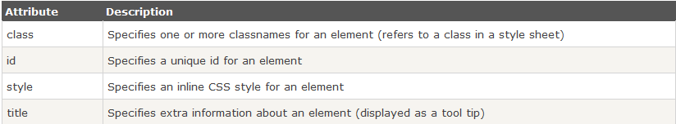
HTML ATTRIBUTES
HTML elements can have attributes
Attributes provide additional information about an element
Attributes are always specified in the start tag
Attributes come in name/value pairs like: name="value“

Slide 19
Exercise
Create a list of HTML tags for different element types

Slide 20
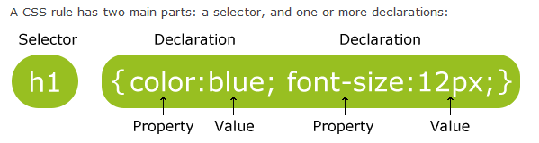
WHAT IS CSS?
CSS stands for Cascading Style Sheets
Styles define how to display HTML elements
Used for describing the look and formatting of a document
It can be applied to any xml document
Notes:
External style sheet
<head> <link rel="stylesheet" type="text/css" href="mystyle.css"> </head>
Internal style sheet
hr {color:sienna;} p {margin-left:20px;} body {background-image:url("images/background.gif");}
Inline style

Slide 21

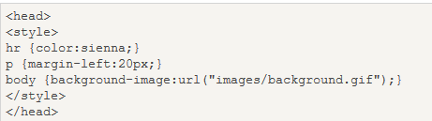
CSS ATTRIBUTES
CSS are used to change UI attributes of a web element
Example:
Background Color
Font Color
Font Size
Alignment
Font Style
And many more…
Implementation of CSS
External Style Sheet
Internal Style Sheet
Inline Styles

Slide 22
WHAT IS JAVASCRIPT?
Javascript is a dynamic computer programming language. It is most commonly used as a part of web browsers, whose implementation allow client-side scripts to interact with the user, control the browser, control asynchronously, and alter the document content that is displayed.
USAGE
Loading new page content or submitting data to a server via AJAX
Animation of page elements
Interactive Content
Validating Input fields
Transmitting information about the user's reading habits and browsing activities to various websites
Notes:
Events like onClick , onBlur . Onload
http://www.w3schools.com/js/js_events_examples.asp

Slide 23
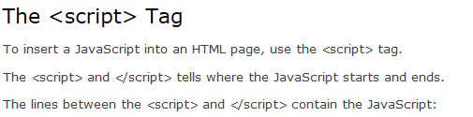
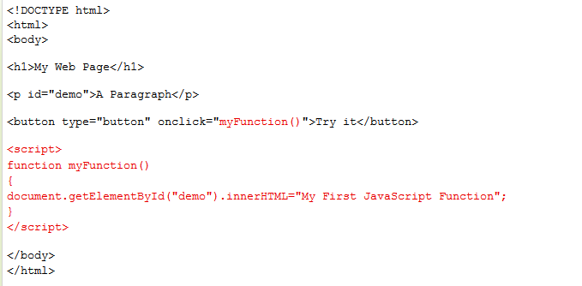
JAVASCRIPT
EXAMPLE:

Slide 24
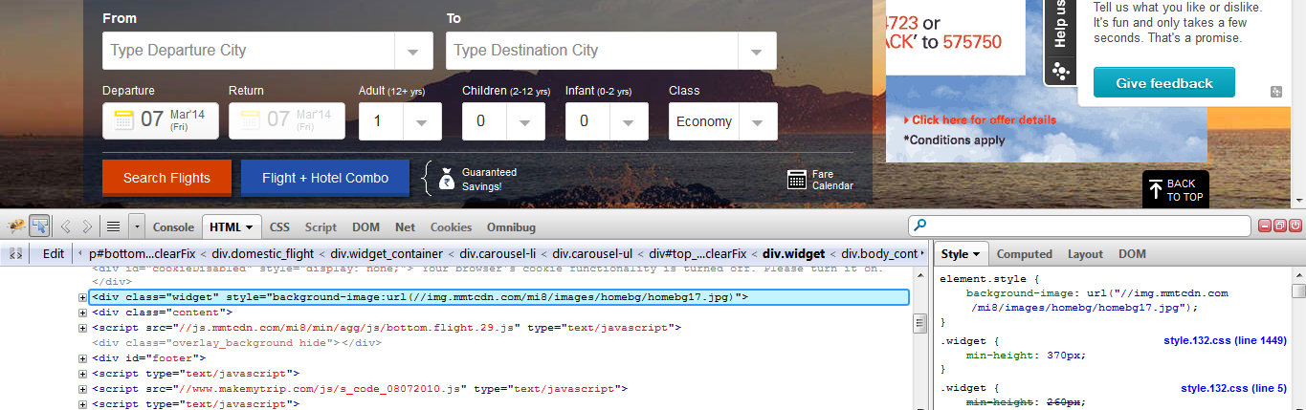
OBJECT SPY
Every browser has in built capability to check the properties of any element. It can be done by installing few add ins through which the properties of each element can be analyzed.
Firebug and FirePath for Firefox
https://getfirebug.com/downloads/
IE Developer for Internet Explorer
http://www.microsoft.com/en-in/download/details.aspx?id=18359
Chrome Dev Tools
https://developers.google.com/chrome-developer-tools/

Slide 25
Quiz
What does HTML stand for?
Which HTML tag/element creates a link to another page or a section of a same document?
Which HTML tag/element accepts user inputs?
Mention any 2 usage of Javascript.
What is the use of <script> tag in HTML?

Slide 26
OVERVIEW OF SELENIUM

Slide 27
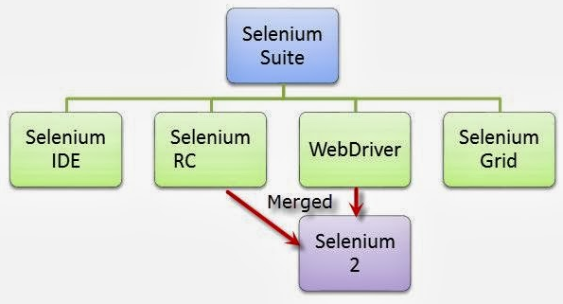
WHAT IS SELENIUM?
Selenium is a suite of tools to automate web browsers across many platforms. It supports the most of the browsers being used.
The below image show the various components of Selenium

Slide 28

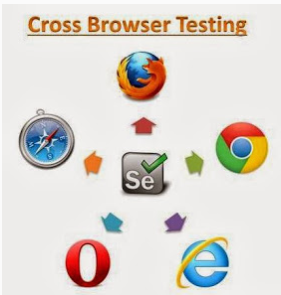
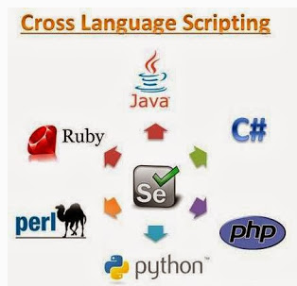

FEATURES OF SELENIUM

Slide 29
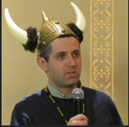
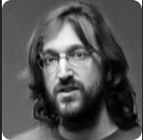

HISTORY OF SELENIUM
Jason Huggins developed Java Script library in 2004
Simon Stewart created Web driver in 2006
Finally we saw the merging of Selenium and Webdriver in 2008

Slide 30
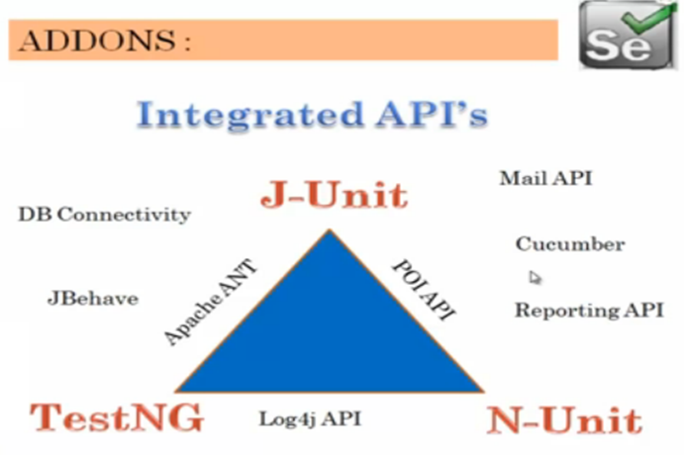
EXTERNAL API’S
To support additional features like parameterization, reporting, database connectivity etc., and to create an end to end solution the user will require lot of additional API’s as depicted in below image.

Slide 31
SELENIUM IDE

Slide 32
SELENIUM IDE
Prototyping Tool for building test cases
Firefox Plugin
Easy to use interface
Provides record and playback mechanism
Can be exported to different languages
HTML Suites can be created
Note : It is not recommended to use record and playback for any automation solution

Slide 33
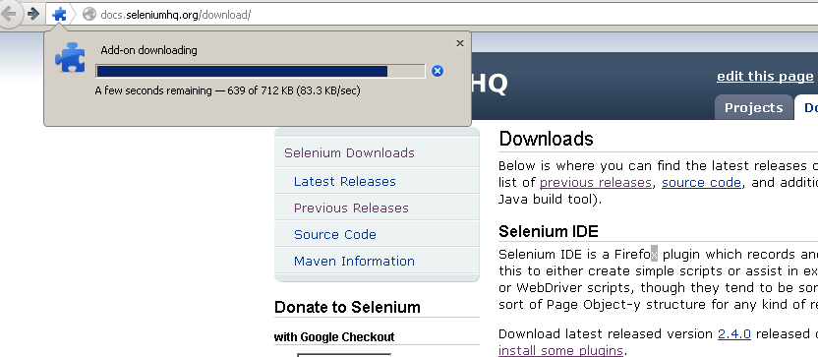
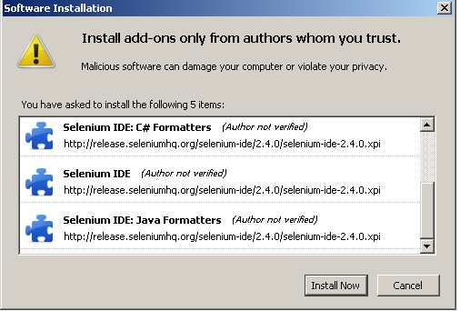
INSTALLATION
Navigate to url: http://docs.seleniumhq.org/download/
Under the section “Selenium IDE” Download the latest version
Click Install Now on the Software Installation window
Proceed with installation and restart browser
Sometimes, the latest version of IDE may not work, in that case try to degrade the browser version.

Slide 34
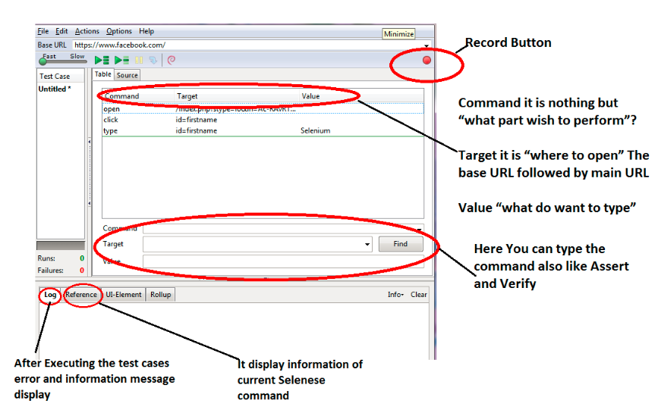
SELENIUM IDE USER INTERFACE

Slide 35
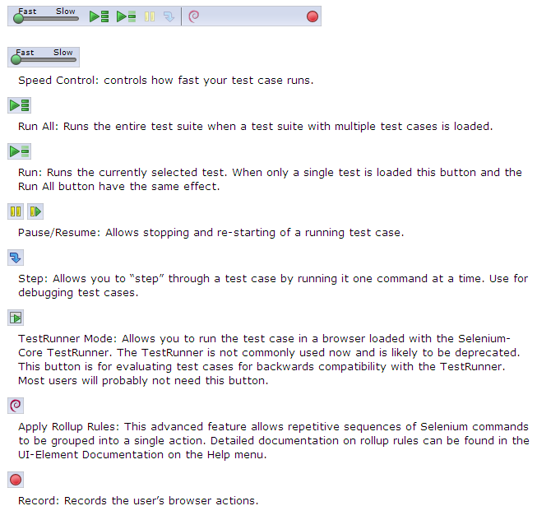
MENU

Slide 36
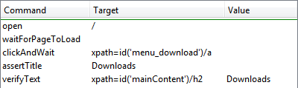

IDE TEST PANE
It has two tabs, one for displaying the command and their parameters in a readable “table” format.
The second tab - Source displays the test case in the native format in which the file will be stored by default it is HTML.
The Source view also allows to edit the test case in its raw form, including copy, cut and paste operations.
The Command, Target, and Value entry fields display the currently selected command along with its parameters.

Slide 37

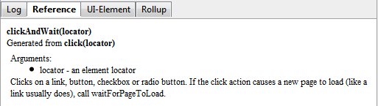
LOGS AND REFERENCE
Log:
Display test cases in progress, error messages and information messages.
These messages are often useful for test case debugging.
Info button is a drop-down allowing selection of different levels of information to log.
Reference:
Reference tab is the default selection whenever you are entering or modifying commands and parameters in Table mode
Reference pane display documentation on the current command.
When entering or modifying commands, whether from Table or Source mode, it is important to ensure that the parameters specified in the Target and Value fields match those specified in the parameter list in the Reference pane

Slide 38
BUILDING TEST CASES
There are three primary methods for developing test cases:
Recording:
First-time users begin by recording a test case from their interactions with a website. When Selenium-IDE is first opened, the record button is ON by default.
Adding Verifications/Asserts:
Test cases will also need to check the properties of a web-page. This requires assert and verify commands.
Editing:
Insert Command:
Table View
Source View
Save:
Selenium distinguishes between test cases and test suites. To save Selenium-IDE tests for later use you can either save the individual test cases, or save the test suite

Slide 39
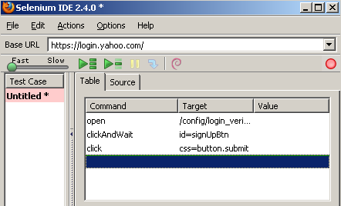
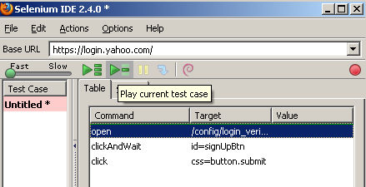
RECORDING AND RUNNING SCRIPTS WITH IDE
Open Firefox browser
Click Tools > Selenium IDE
Click on the red Record button on right side, if not
clicked already
By default, the record button is clicked
Browse to the application site in the browser
Perform the required steps manually in the browser
Observe the steps being recorded in the IDE
The button highlighted on right image can be used to run the test case
The left portion of the IDE window displays
The test result
No. of Runs: Tells the no. of test cases run
Failures: Tells the no. of test cases failed

Slide 40
RUNNING TEST CASES
Running Test Case:
Run a Test Case
Run a Test Suite
Stop and Start
Stop in the Middle
Start from the Middle
Run Any Single Command
Using Base URL:
Allows test cases to be run across different domains.
Selenium Commands – “Selenese”:
A command is what tells Selenium what to do. Selenium commands come in three “flavors”:
Actions
Accessors
Assertions

Slide 41
SOME USEFUL SELENIUM COMMANDS
The most commonly used commands for building tests are:
Open: opens a page using a URL.
Click/clickAndWait: Performs a click operation, and optionally waits for a new page to load.
VerifyTitle/assertTitle: verifies an expected page title.
VerifyTextPresent : verifies expected text is somewhere on the page.
VerifyElementPresent : verifies an expected UI element, as defined by its HTML tag, is present on the page.
VerifyText : verifies expected text and its corresponding HTML tag are present on the page.
WaitForPageToLoad : Pauses execution until an expected new page loads. Called automatically when clickAndWait is used.
WaitForElementPresent : Pauses execution until an expected UI element, as defined by its HTML tag, is present on the page

Slide 42
LOCATING ELEMENTS
Locator Types:
Locating by Id
Locating by Name
Locating by XPath
Locating Hyperlinks by Link Text
Locating by DOM
Locating by CSS
Note : These strategies will be discussed in details during webdriver session

Slide 43
SYNCHRONIZATION
It is very important to wait for the element to reach a state where further action can be performed on it. Selenium IDE provides some of the inbuilt methods to achieve the synchronization.
Page Load and Refresh:
Wait for the page to load. E.g.
clickAndWait
checkAndWait
selectAndWait
Handling AJAX:
With the help of AJAX, any element can be changed without refreshing the whole page. So normal page wait doesn’t work under such conditions.
We can use following methods:
waitForElementPresent
waitForVisible

Slide 44


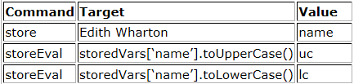
STORE COMMANDS AND SELENIUM VARIABLES
To save the values in a variable to be used somewhere else inbuilt commands allows the user to save the values as variables
Store the value in variable
Use the value in variable
storeElementPresent
storeText
storeEval

Slide 45
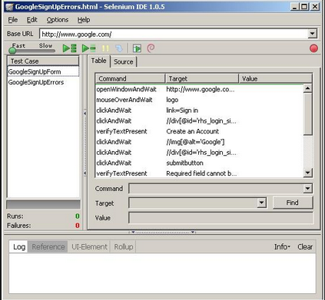
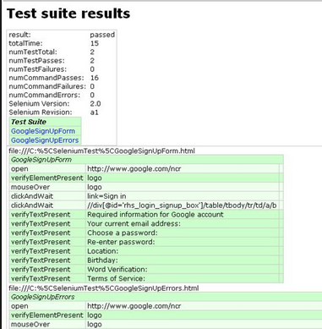
HTML SUITE
It is a set of individual test cases which can be run on any browser with the help of selenium server.
To execute the HTML Suite, below command will be used.

Slide 46
Quiz
In Selenium IDE, which command is used to print?
What is the difference between a command and the same command with "AndWait" (e.g. click and clickAndWait commands)?
Selenium IDE scripts can be exports to different laguages. True or False?

Slide 47

Assessment
On www.facebook.com signup page, identify different tags available for different field types
Create element locator for the following fields

Slide 48
Q & A ?????????

Slide 49
THANK YOU

Slide 50
SELENIUM TRAINING – Session 6
GM QA Capability Team
November 2014

Slide 51
AGENDA
Overview of Selenium RC
Selenium Webdriver Architecture
Object Identification Techniques
Different Drivers
Synchronization

Slide 52
OVERVIEW OF SELENIUM RC

Slide 53
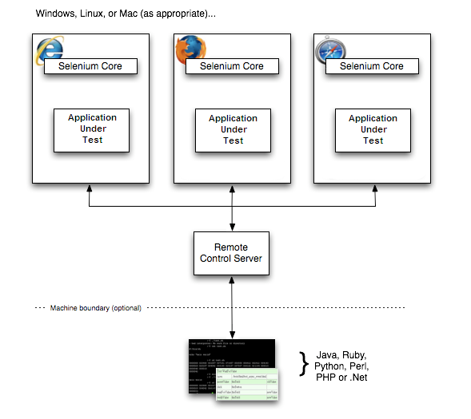
SELENIUM RC
Selenium RC components are:
The Selenium Server which launches and kills browsers, interprets and runs the Selenese commands passed from the test program, and acts as an HTTP proxy, intercepting and verifying HTTP messages passed between the browser and the AUT.
Client libraries which provide the interface between each programming language and the Selenium RC Server.

Slide 54
SELENIUM WEBDRIVER ARCHITECTURE

Slide 55
SELENIUM WEBDRIVER
WebDriver is a tool for writing automated tests of web based applications
It mimics the behavior of a real user
It access the native API of browsers to provide the support for automation.
Supports the integration with many external 3rd party API

Slide 56
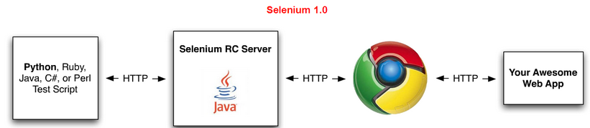
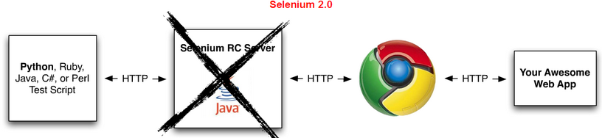
RC Vs. WEBDRIVER
Selenium-WebDriver makes direct calls to the browser using each browser’s native support for automation
Selenium RC ‘injected’ javascript functions into the browser when the browser was loaded and then used its javascript to drive the AUT within the browser

Slide 57
SELENIUM SERVER
Selenium server has to be launched explicitly only under the following conditions:
Using Selenium Grid to distribute the tests
Running the scripts on a remote machine.
Not using Java bindings and would like to use html unit driver named as HtmlUnitDriver
Note : The standalone jar contains everything including the remote selenium server and the client-side bindings

Slide 58
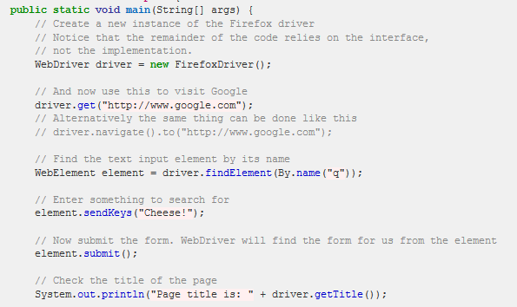
FIRST WEBDRIVER SCRIPT
For the setup, associate the latest selenium jar file to the project. JAR file can be downloaded from http://docs.seleniumhq.org/download/

Slide 59
Quiz
Mention any 2 differences between Selenium RC and Web driver

Slide 60
OBJECT IDENTIFICATION TECHNIQUES

Slide 61
OBJECT IDENTIFICATION TECHNIQUES
Every object visible on a webpage is a “WebElement”.
To interact with the element create a reference to that particular element.
By ID:
By ClassName:
By TagName:
By Name:

Slide 62
OBJECT IDENTIFICATION TECHNIQUES
By Xpath : This technique is one of very powerful way of identifying the objects. With the help of xpath, user can find siblings, parent, children, grandparent of a web element.
Text() function:
//a[text()=‘test’]
//a[contains(text(),’test’)]
Accessing parent
//a[@id=‘user’]/parent::li
Accessing grandparents
//a[@id=‘user’]//ancestor::ul//div[@id=‘test’]
Some other functions
//div[@id=‘userdetails’]/ul[1]
//div[@id=‘userdetails’]//ul[last()]
//div[@id=‘userdetails’]//ul[last()-1]
//div[starts-with(@class,'feature-event')]

Slide 63
OBJECT IDENTIFICATION TECHNIQUES
By CSS
Using CSS selector we can access particular node or immediate child of any node.
Can combine as many conditions as we want for single node.
Can achieve starts-with, contains functionality using ^,* symbols respectively.
We can’t traverse back using CSS selector.
Examples:
css = div.className
css = #id
css = div a

Slide 64
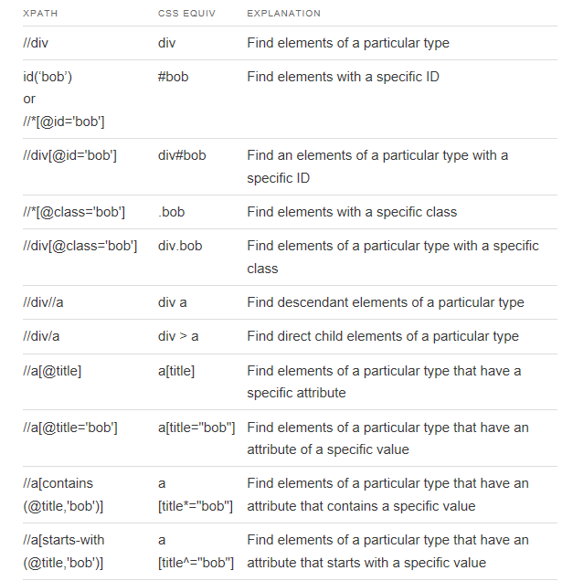
CSS EQUIVALENT OF XPATH

Slide 65
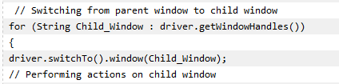
WORKING WITH MULTIPLE WINDOWS AND FRAMES
Multiple Windows
Dealing with multiple windows in Automation Testing has always been a little tricky and requires extra effort. To work with multiple windows it requires to switch the control to the new window which can be done with the help of window handlers.
Frames
An inline frame is used to embed another document within the current HTML document.
User need to switch to the iframe before doing any action on it
Switching to the frame: driver.switchTo().frame("frame1");
Switching back to the parent window: driver.switchTo().defaultContent();

Slide 66
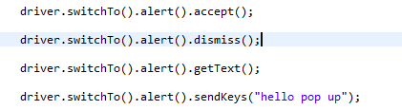
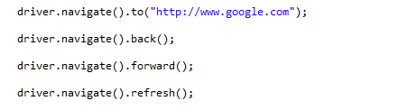
HANDLING ALERTS
JavaScript has three kind of popup boxes: Alert box, Confirm box, and Prompt box.
To handle the alerts webdriver has provided a “Alerts” class.
Navigation
With the help of navigation methods, user can do operations like back button click, forward button click and refresh the page
Notes:
Go To http://www.quackit.com/javascript/
Handle Alerts
Handle new window

Slide 67
Quiz
Why use an XPath locator?
What is the syntax to switch to a frame?
What is the syntax to switch back to parent window?
Webdriver has provided which class handle to Javascript alerts?

Slide 68
OVERVIEW OF SELENIUM DRIVERS

Slide 69
DRIVERS AND BROWSERS
WebDriver supports following browsers
HtmlUnit Driver
Firefox Driver
Internet Explorer Driver
Chrome Driver
Safari Browser
Android and iPhone browser (Through Appium and Selendroid)
Windows Phone
Blackberry Phones

Slide 70
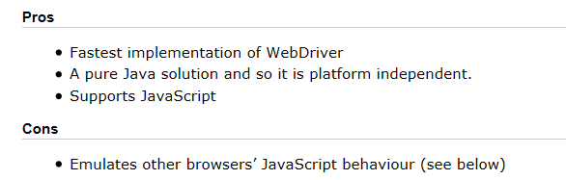
HTMLUNIT DRIVER
Fastest and Most lightweight
Java based implementation of a web browser without GUI

Slide 71
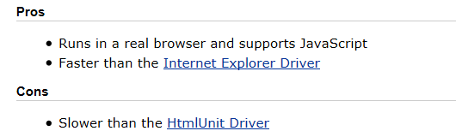
FIREFOX DRIVER
Controls browsers using a firefox plugin.

Slide 72
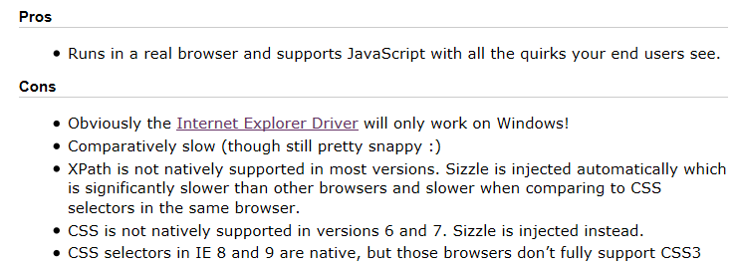
INTERNET EXPLORER DRIVER
Controlled by a .dll

Slide 73
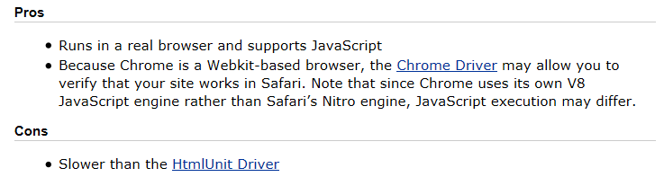
CHROME DRIVER
Maintained through Chromium
Need to include chrome server in PATH

Slide 74

SYNCHRONIZATION
Explicit Wait
Tell the script to wait for a certain condition to occur before proceeding next.
Different Expected conditions on the basis of which the explicit wait can be implemented:
Presence of Element
Element is clickable
Title Contains
Element Selectable
Element Visible
Text to be Present

Slide 75

SYNCHRONIZATION
Implicit Wait
An implicit wait is to poll the DOM for a certain amount of time when trying to find an element or elements if they are not immediately available. The default setting is 0. Once set, the implicit wait is set for the life of the WebDriver object instance.
Thread.sleep
It causes the current thread to suspend execution for a specified period as specified in its argument. In automation it is not a good practice to put hard waits. So ideally Thread.sleep should be avoided.
Thread.sleep(4000);

Slide 76


TAKING SNAPSHOTS
Webdriver has a in built interface to support the screenshot
TakesScreenshot
File screenshot = ((TakesScreenshot)driver).getScreenshotAs(OutputType.FILE);
FileUtils.copyFile(screenshot, new File("c:\\screenshot.jpg"));
Screenshots should be used while creating reports. It helps in analyzing the failures.
Remote Webdriver doesn’t support the TakesScreenshot. So it can be done using below code

Slide 77
ADVANCED INTERACTION
The Actions class(es) allows to build a Chain of Actions and perform them
Click and Hold
Context Click (Right Click)
Drag and Drop
Mouse Hover
Keyboard Actions
Moving to element
Note : The Advanced User Interactions require native events to be enabled. Table can be referred at
http://docs.seleniumhq.org/docs/04_webdriver_advanced.jsp#id3

Slide 78
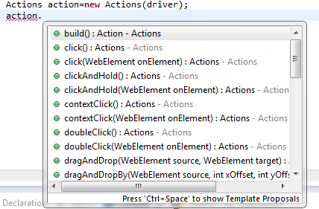
ACTION CLASSES
It is more comprehensive API for describing actions a user can perform on a web page.
This includes actions such as drag and drop or clicking multiple elements while holding down the Control key.
In the below image it shows how to create action class. Also it list down the various methods available for action classes.

Slide 79
ACTION CLASSES
Drag and Drop
Through this an element can be dragged and dropped on some other element.
driver.get("http://jqueryui.com/demos/droppable/");
WebElement draggable = driver.findElement(By.id("draggable"));
WebElement droppable = driver.findElement(By.id("droppable"));
new Actions(driver).dragAndDrop(draggable, droppable).build().perform();
Click and Hold
It allows the user to select multiple items by working as Cntrl+Click
driver.get("http://jqueryui.com/demos/selectable/");
List<WebElement> listItems = driver.findElements(By .cssSelector("ol#selectable *"));
Actions builder = new Actions(driver);
builder.clickAndHold(listItems.get(1)).clickAndHold(listItems.get(2)) .click();
builder.build().perform();

Slide 80
ACTION CLASSES
Context Click
Through context click, user can right click on any element
WebElement webElement = driver.findElement(By.id(location));
actions.contextClick(webElement);
Mouse Hover
There are few in built methods used for mouse hovering
Actions builder = new Actions(driver);
builder.moveToElement(droppable);

Slide 81
JAVASCRIPT EXECUTOR
Javascript can be executed within the browser with the help of JavaScript Executor.
JavascriptExecutor js = (JavascriptExecutor) driver;
js.executeScript("document.getElementById('result').setAttribute('ID', 'newID')");
Can be used to set any attribute of an element
Helps in working with HTML5 elements like video
Can be used to capture the AJAX requests

Slide 82
PROFILING IN WEB DRIVER
With the help of profiling, the settings of browsers can be changed during the execution session. As web driver can access the native API of the browser, so it allows the user to change the default setting as per the requirement.
Few of the setting which can be changed by creating a profile are listed below
Change the default download folder
Load the Add – Ins with the browser
The user agent can be changed
Handling the SSL Certificates
Enabling the native events

Slide 83
FIREFOX PROFILE
User Agent
Accepting SSL Certificates
With the help of following profile, the browser will accept the SSL certificates without any prompt.
FirefoxProfile profile = new FirefoxProfile();
profile.setPreference("general.useragent.override", "iphone");
WebDriver driver = new FirefoxDriver(profile);
driver.get("http://www.timesofindia.com");
ProfilesIni allProfiles = new ProfilesIni();
FirefoxProfile myProfile = allProfiles.getProfile("CertificateIssue");
myProfile.setAcceptUntrustedCertificates(true);
myProfile.setAssumeUntrustedCertificateIssuer(false);
WebDriver Driver = new FirefoxDriver(myProfile);
Driver.get("www.test.com");

Slide 84
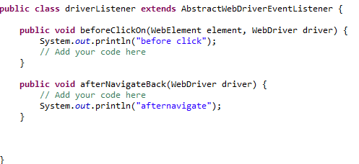

WEBDRIVER LISTENERS
Acts like a recovery scenario
Hooks to the driver
Different Events :
Before Click
After Click
Before navigate
After Navigate
On Exception
Register the listener using following code :

Slide 85
Quiz
What is the difference between implicit wait and explicit wait?
What is the disadvatage of using thread.sleep()?
Which method of Action class can used to drag and drop an element?

Slide 86
Assessments
Write a script to find total no. of images on a flipkart home page.
Write a script to select a value from a custom dropdown on google advance search page
Write a script to select male check box on facebook signup page
Write a script to verify error messages on Gmail login page
On naukri.com pops window will open. You need to switch to a pop-up window and ensure on which pop-up window your are on.
Action Classes
Perform drag and drop : http://jqueryui.com/droppable/
Click and hold : http://jqueryui.com/selectable/
Also find an example for right click*/

Slide 87
Q & A ?????????

Slide 88
THANK YOU

Slide 89
SELENIUM TRAINING – Session 7
GM QA Capability Team
October 2015

Slide 90
AGENDA
Overview of other Selenium features

Slide 91
OVERVIEW OF OTHER SELENIUM FEATURES

Slide 92
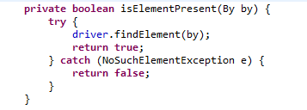
CHECKPOINTS
Selenium doesn’t provide any in built checkpoints for validations so user need to create their own custom checkpoint.
Different validations which can be performed are:
Validate existence of element.
Checking the text of an element.
Image verification.
Database validation.
Custom checkpoints can be created by writing the boolean methods as shown below:
Use below statement for the checkpoint

Slide 93
HOW TO USE DRIVER ACROSS DIFFERENT CLASSES
There can be multiple java files where the test scripts will reside. So it’s important that all the test scripts uses the same driver instance through out the execution.
There are different pattern that ensures that only one instance is created and used across different classes.
As a good practice the automation developer should create a webdriver setup file which will initiate the webdriver session and also can have some generic methods like click, type, navigate etc.
In the next few slides we will discuss how to initiate the web driver session and to be shared across test scripts.

Slide 94
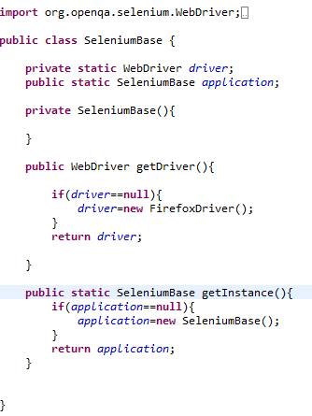
SINGLETON PATTERN
The Singleton's purpose is to control object creation, limiting the number of objects to one only. Since there is only one Singleton instance, any instance fields of a Singleton will occur only once per class, just like static fields. Singletons often control access to resources such as database connections or sockets.
To use driver instance use below code in test scripts :
static WebDriver driver=Seleniumbase.getInstance().getdriver();
Static driver session
First check if session already exist. If not create a new one else return the existing

Slide 95
USING INHERITANCE
Concept of inheritance comes quite handy to create a selenium base file and then all the test scripts extend the base class. All the initiation tasks like web driver creation, database connection or logs are created under the base selenium web driver and the concept of inheritance extends all those instances to the child classes (Test scripts).
One of the major limitation of Singleton pattern is that, it doesn’t allow the parallel execution. So singleton should be avoided when user need to implement parallel execution.
With the help of TestNG ,it becomes quite easy to implement this concept.
Note : This will be discussed in detail after TestNG session

Slide 96
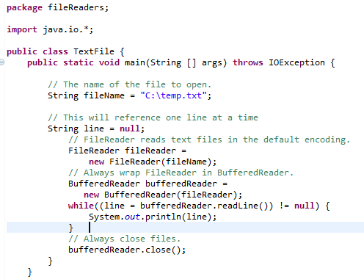
FILE HANDLING USING JAVA
Java IO package has provided many classes which can be used for reading and writing to external test files
FileReader: Used for reading a file

Slide 97
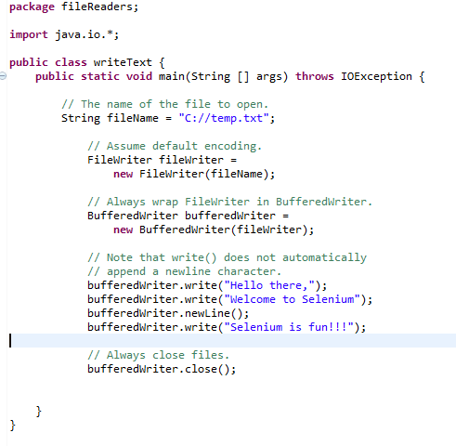
FILE HANDLING USING JAVA
FileWriter: Used to write to a text file

Slide 98

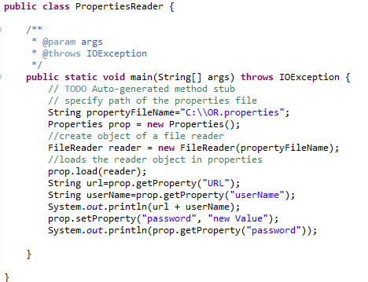
PROPERTIES FILE
Used to store project configuration data or settings like application URL , database server etc. Also can be used to create Object Repository.
It works on the key value pair as shown below
Code to read property file

Slide 99
CREATING OBJECT REPOSITORY
Using Property File
Create a key value pair in Property file
Create a method which will read the values from property file
Example:
login.username=//input[@id='username]
login.password=//input[@id='password']
Constants in Java
Create different java files to create constants
public static By imgNew = By.xpath("//h1/img[@alt='Equinox']");

Slide 100
REPORTING
User has to rely on the external API’s for the reporting. Several API’s are available to support this.
Custom Reporting
HTML Reports
Store result in database
Create Text files
Reporting Add–in
ReportNG (can be used with TestNG)
Master Thought (Used with Cucumber)

Slide 101


DESIRED CAPABILITY
Capabilities are options that you can use to customize and configure the session created with the browser. It helps to create a desired session with the browser.
With the help of desired capabilities we can identify which browser to be used for execution in Selenium Grid.
Example of launching Firefox with the help of desired capability:
Launching a chrome profile using desired capabilities:

Slide 102
REMOTE WEB DRIVER
The RemoteWebDriver is composed of two pieces: a client and a server. The client is your WebDriver test and the server will always run on the machine with the browser you want to test. There are two ways to user the server: command line or configured in code.
As the name suggests, it is used to execute the test scripts on any remote machine. Also it supports the implementation of Selenium Grid. Server should be started on the remote machine.
WebDriver driver = new RemoteWebDriver(new URL("http://10.207.60.83: 4444/wd/hub"), DesiredCapabilities.firefox())
Location of the machine where execution will take place
Specified which browser to be used

Slide 103
Assessments
1) Create custom checkpoint for the following type of validations
Element Present
Image Checkpoint
Text Checkpoint
2) Create a utility that will take the snapshot only of the webelement provided as parameter.
3) Create a text file and write your first name, last name and sapient ID in it.
4) Create a property file with three fields url , username and password. Use the values to perform login in the below url http://newtours.demoaut.com/ username = “mercury” password=”mercury”

Slide 104
Q & A ?????????

Slide 105
THANK YOU

Slide 106
SELENIUM TRAINING – Session 8
GM QA Capability Team
February 2015

Slide 107
Overview of TestNG

Slide 108
TestNG
It is a testing framework inspired from JUnit and NUnit but introducing some new functionalities that make it more powerful and easier to use.
TestNG is an open source automated testing framework; where NG of TestNG means Next Generation. TestNG is similar to JUnit (especially JUnit 4), but its not a JUnit extension. Its inspired by JUnit. It is designed to be better than JUnit, especially when testing integrated classes. The creator of TestNG is Cedric Beust.

Slide 109
TestNG Features
Annotations.
TestNG uses more Java and OO features.
Supports testing integrated classes (e.g., by default, no need to create a new test class instance for every test method).
Separate compile-time test code from run-time configuration/data info.
Flexible runtime configuration.
Introduces ‘test groups’. Once you have compiled your tests, you can just ask TestNG to run all the "front-end" tests, or "fast", "slow", "database", etc…
Supports Dependent test methods, parallel testing, load testing, partial failure.
Flexible plug-in API.
Support for multi threaded testing.

Slide 110
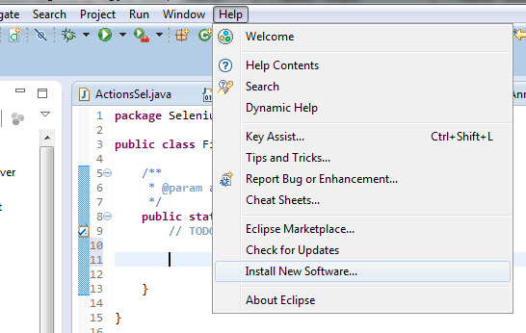
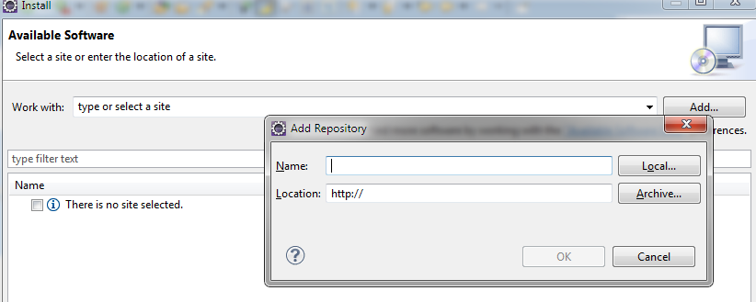
TestNG Setup in Eclipse
TestNG provides an add in which can be installed in eclipse to use TestNG framework
Open Help ->Install New Software
In the install window click onAdd

Slide 111
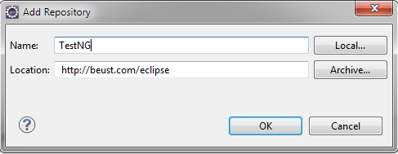
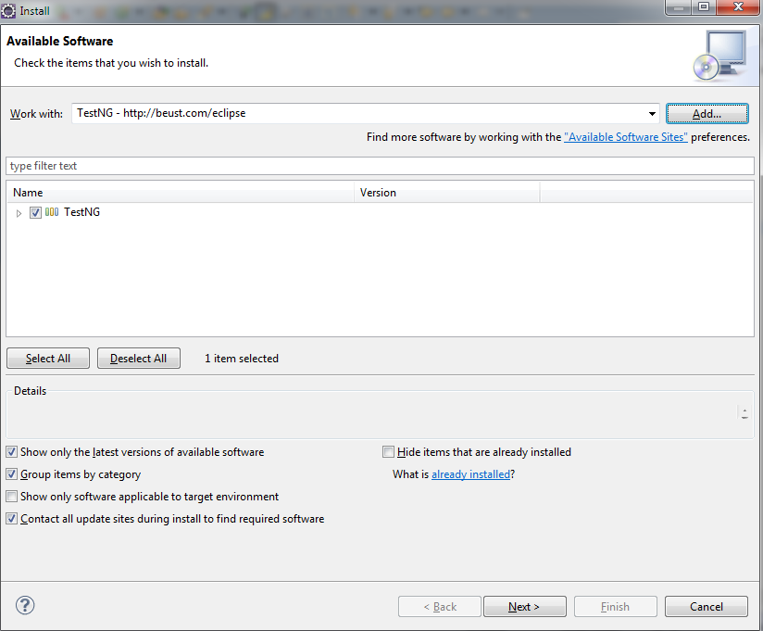
Contd…
Under the Add Repository window enter the values as shown below :
Select TestNG and click next. Follow the steps for the installation.

Slide 112
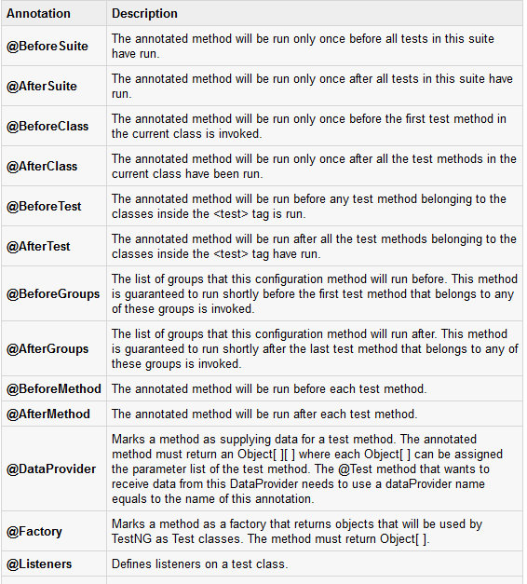
TestNG Annotations

Slide 113

TestNG Suite
A Test suite is a collection of test cases that are intended to test a behavior or set of behaviors of software program. In TestNG, we cannot define a suite in testing source code, but it is represented by one XML file as suite is the feature of execution. This also allows flexible configuration of the tests to be run. A suite can contain one or more tests and is defined by the <suite> tag.
Define the suite

Slide 114
Parameterization Test Case
Parameterization using TestNG plays an important role while creating the framework and automation scripts.
It helps in running multiple iteration with different set of data.
Parallel execution is implemented using TestNG. The browsers are passed as the parameters.
There are two ways to parameterize in TestNG:
Using TestNG.xml
Using Dataprovider class

Slide 115


Passing Parameters through TestNG.XML
Create a java test class say ParameterizedTest1.java.
Add test method parameterTest() to your test class. This method takes a String as input parameter.
Add the annotation @Parameters("myName") to this method. The parameter would be passed a values from testng.xml which we will see in the next step.
Create a testng.xml to execute Test case(s).

Slide 116

Usage of DataProvider
When you need to pass complex parameters or parameters that need to be created from Java (complex objects, objects read from a property file or a database, etc...), in such cases parameters can be passed using Dataproviders. A Data Provider is a method annotated with @DataProvider. This annotation has only one string attribute: its name. If the name is not supplied, the Data Provider’s name automatically defaults to the method’s name. A Data Provider returns an array of objects.

Slide 117
Quiz
Give examples of some of annotations supported by testNG
What are the different ways to parameterize in testNG?
How can you disable a test in TestNG?
What is difference between dependsOnGroups and dependsOnMethods?
What does it mean to pass parameters using dataproviders?

Slide 118
Assessments
What would be the output of the following code?
Open different browsers by parameterization in testNG.xml

Slide 119
Q & A ?????????

Slide 120
THANK YOU

Slide 121
SELENIUM TRAINING – Session 9
GM QA Capability Team
January 2015

Slide 122
AGENDA
Design Pattern

Slide 123
Page Object Model

Slide 124

Page Object Model
The Page Object pattern represents the screens of your web app as a series of objects and encapsulates the features represented by a page.
It allows us to model the UI in our tests.
A page object is an object-oriented class that serves as an interface to a page of your AUT.

Slide 125

Benefits

Slide 126

Framework with Page Object Model

Slide 127

Implementation
Split up the page on the basis of functionalities and will have the methods like LoginToGmailAsValidUser and LoginToGmailAsInvalidUser as shown in below example :

Slide 128
UNDERSTANDING SELENIUM GRID

Slide 129

DISTRIBUTED TESTING WITH SELENIUM GRID
Selenium Grid is used to run the tests parallel
It distributes the test across different machines

Slide 130
SELENIUM GRID
Hub
The Hub acts like the central point, which will receive the entire test request and distribute it to the right nodes.
Selenium server act as the hub and to start the server use the following command
“java -jar selenium-server-standalone-2.35.0.jar -role hub”
Navigate to http://localhost:4444/grid/console and you see a hub window
Nodes
These are the machines where the executions take place
Nodes must be registered to the hub
“ java -jar selenium-server-standalone-2.35.0.jar -role node -hub http://localhost:4444/grid/register “

Slide 131

GRID – CONFIGURING NODES
Nodes should be configured for the execution.
Command Prompt
While starting the node, you can specify the node configuration by using following parameters.
“-browser browserName=firefox,version=3.6,maxInstances=5,platform=LINUX”
Different browsers can be used by changing the values of browser name etc.
JSON file
java -jar selenium-server-standalone.jar -role hub -hubConfig hubconfig.json

Slide 132

GRID – RUNNING THE TEST CASES
Desired Capabilities: Defines the browser, platform and other settings for the execution
Remote Webdriver : Send the request to hub which redirect the tests to the nodes as per desired capability.

Slide 133
FIREFOX PROFILE
User Agent
Accepting SSL Certificates
With the help of following profile, the browser will accept the SSL certificates without any prompt.
FirefoxProfile profile = new FirefoxProfile();
profile.setPreference("general.useragent.override", "iphone");
WebDriver driver = new FirefoxDriver(profile);
driver.get("http://www.timesofindia.com");
ProfilesIni allProfiles = new ProfilesIni();
FirefoxProfile myProfile = allProfiles.getProfile("CertificateIssue");
myProfile.setAcceptUntrustedCertificates(true);
myProfile.setAssumeUntrustedCertificateIssuer(false);
WebDriver Driver = new FirefoxDriver(myProfile);
Driver.get("www.test.com");

Slide 134
WEBDRIVER LISTENERS
Acts like a recovery scenario
Hooks to the driver
Different Events :
Before Click
After Click
Before navigate
After Navigate
On Exception
Register the listener using following code :

Slide 135
Assessments

Slide 136
Q & A ?????????

Slide 137
THANK YOU

