Slide 1
Reactivity in Java
August 15, 2018

Slide 2
Agenda
What is Reactive Programming
Reactive in Netflix
Reactive in Java
Reactive in Action

Slide 3
What is Reactive Programming?
01

Slide 4
According to Wikipedia, Reactive Programming is a declarative programming paradigm concerned with data streams and the propagation of change

Slide 5


Slide 6
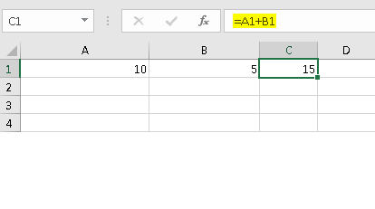
Reactive In English
The value of column C1 is derived by column A1 and column B1. So if value in column B1 is changed, column C1 will be updated accordingly.
It’s a analogy. Excel does not use reactive programming.
Imperative Programming:
a = b + c
Reactive Programming:
Value of ‘a’ changes as either ‘b’ or ‘c’ is changing.

Slide 7
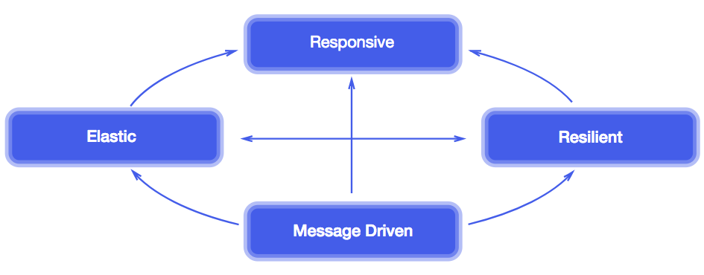
4 Key Principles of Reaction Programming

Slide 8
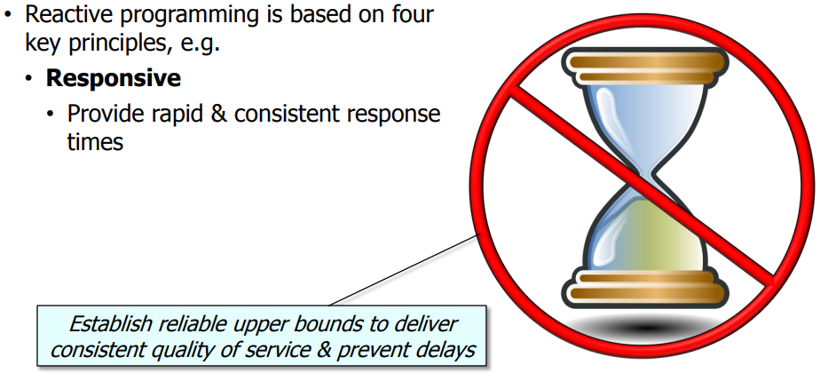

Slide 9
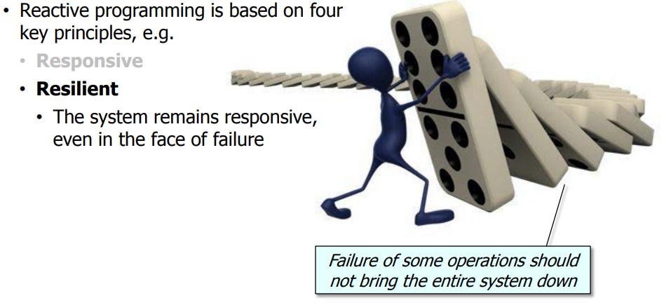

Slide 10
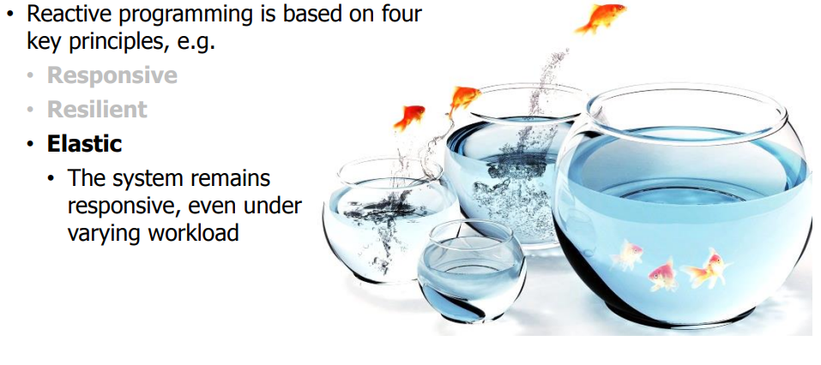

Slide 11
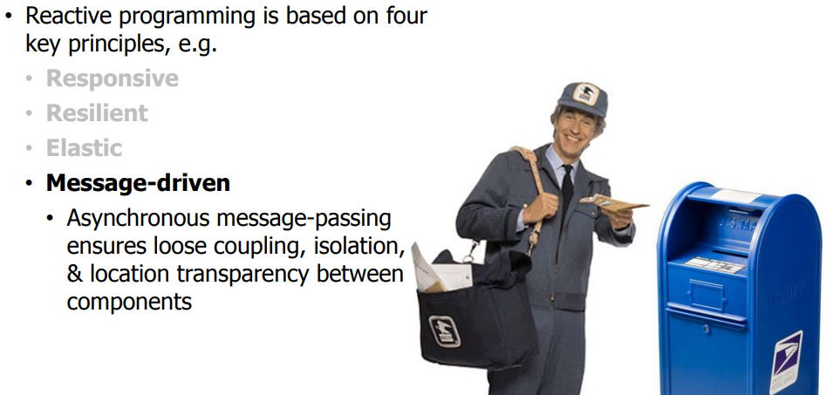

Slide 12
Reactive in Netflix
02

Slide 13
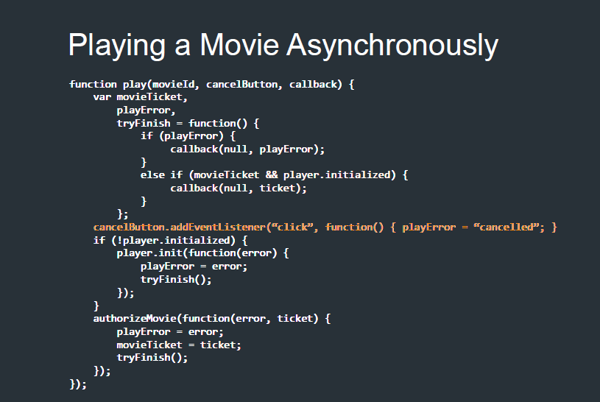
Async is Hard
Callback Hell – Trying to solve something complex with Callback
Difficult to process something based on outputs of 2 callback- Introduce variables
Difficult to handle exception and error.
Memory Leak in case you forget to remove listener

Slide 14
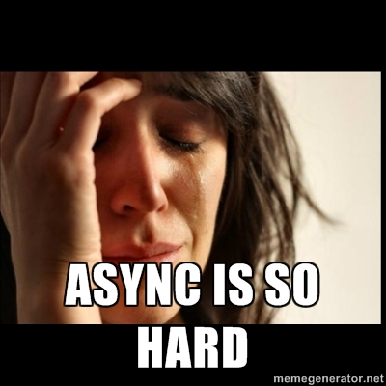

Slide 15
How NETFLIX solved
BIG async problems?
By thinking differently about
EVENTS

Slide 16
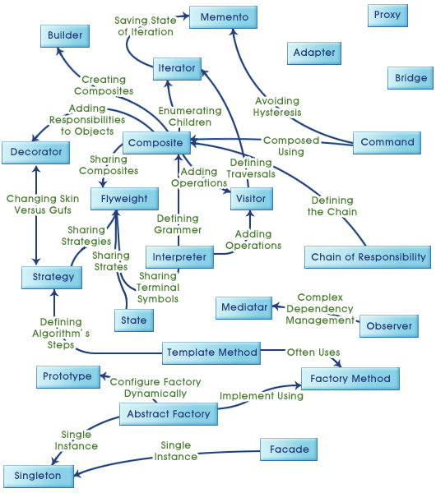
Gang of Four Design Patterns Relation Diagram

Slide 17
Iterator
Progressively send information to consumer
Observer
There is no STOP or ERROR events to consumers

Slide 18
Introducing Observable: Observable === Collection + Time {1……2…………3} 0 5 10 15 20 (Timeline)

Slide 19
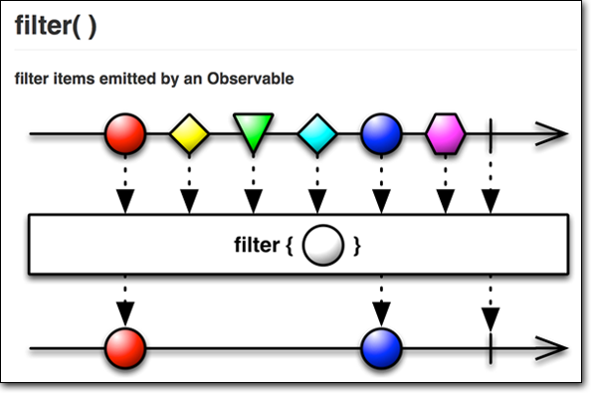

Slide 20
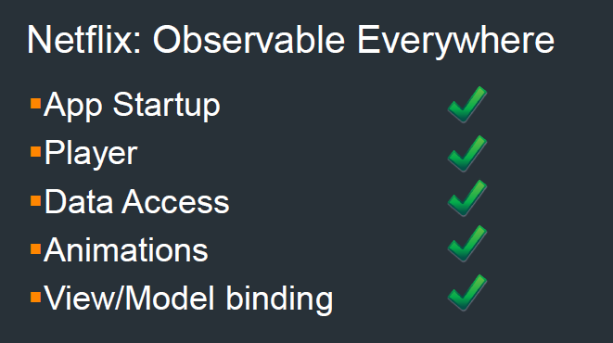

Slide 21
Reactive in Java
03

Slide 22
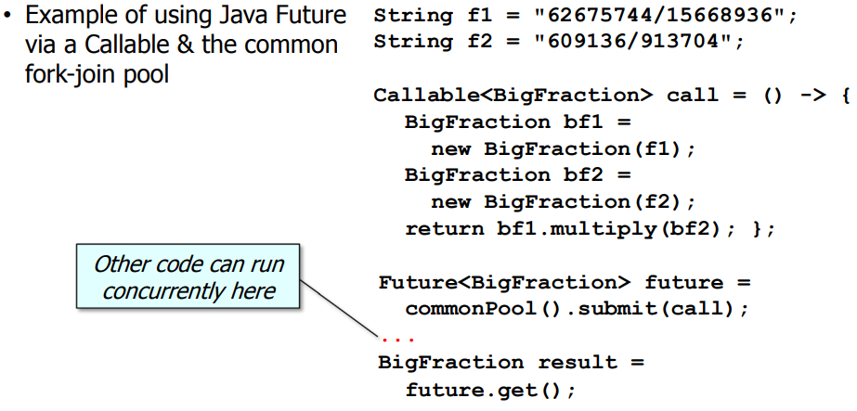
Reactive Programming with Java 5 Futures

Slide 23
Why not Future: • Limited feature set • Cannot be completed explicitly • Cannot be chained fluently to handle async results • Cannot be triggered reactively • Cannot be treated efficiently as a collection of futures

Slide 24
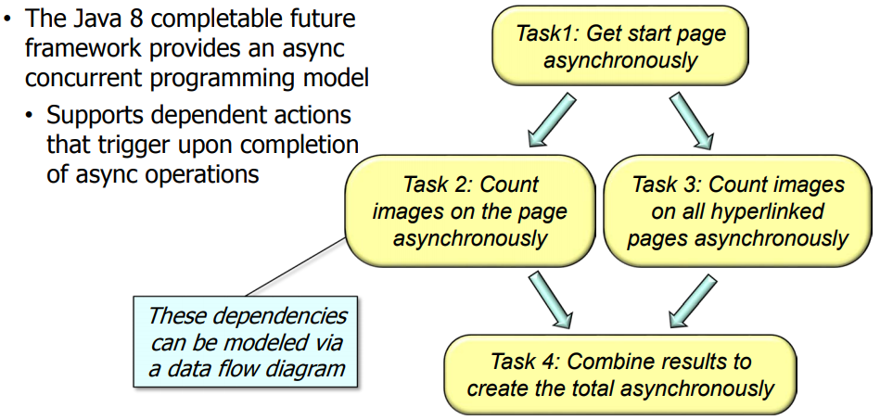
Java 8 Completable Futures

Slide 25
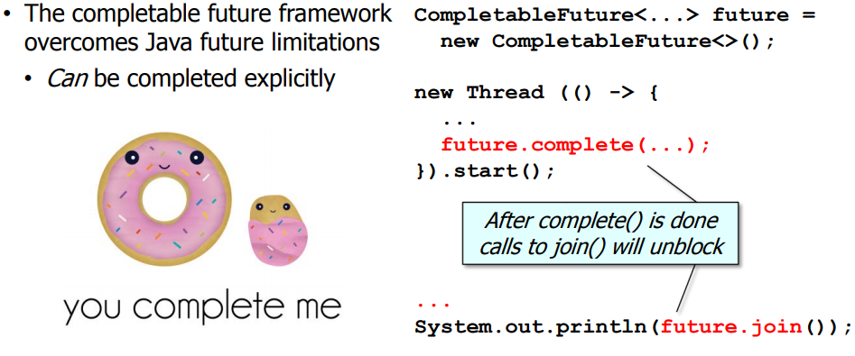
Java 8 Completable Futures

Slide 26
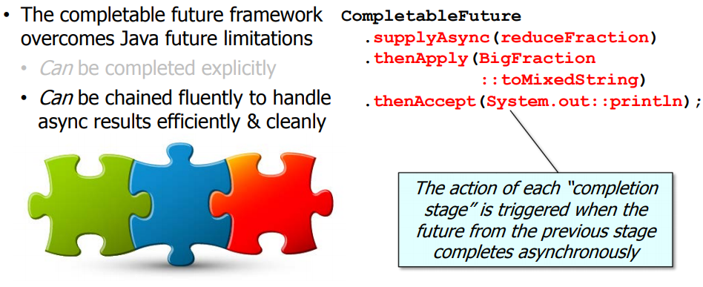
Java 8 Completable Futures

Slide 27
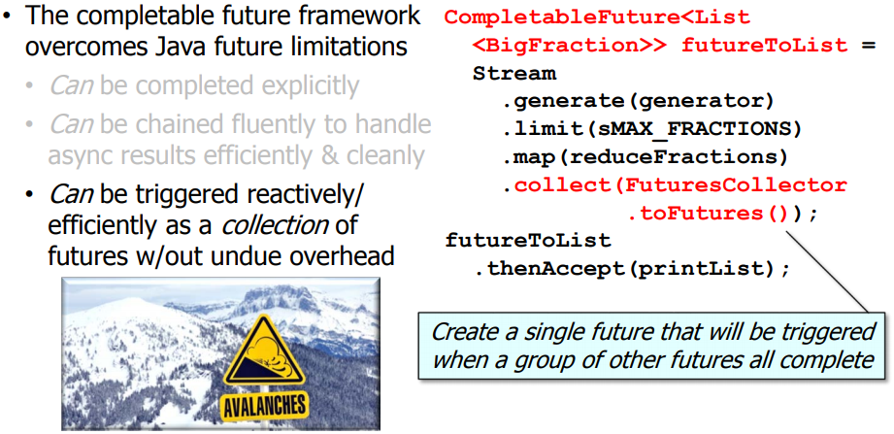
Java 8 Completable Futures

Slide 28


Slide 29
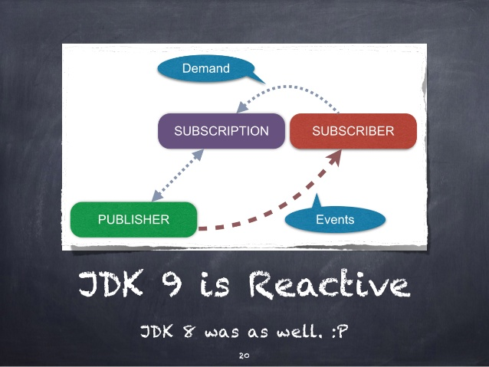
Java 9 Reactive Stream

Slide 30
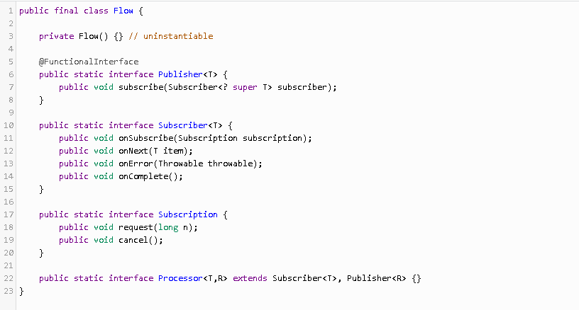
Java 9 Reactive Stream

Slide 31
Reactive in Action
04

Slide 32
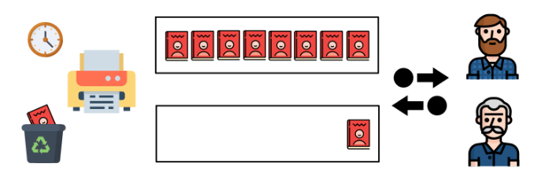
Magazine Publisher
The publisher will produce a series of 20 magazines per subscriber. They know that their readers are not usually at home at the delivery time and they want to avoid the postman to return back the magazines or throw them away.
Instead of that, they implement a very innovative delivery system: the subscriber calls them when they’re at home and they deliver one magazine (the next for that subscriber) almost immediately. The publisher plans to keep a small box per subscriber at the office in case some of them don’t call to get the magazine as soon as it’s published.

Slide 33
Magazine Publisher (Different Situation)
Subscribers are fast enough to request a delivery, as fast as the publisher is printing new magazines, there will be no problems of space.
Subscribers are not calling at the same pace as magazines are printed, the boxes might become full.
Increment the size of the boxes to 20 per subscriber, which would fix the problem
Stop the printing until the situation gets fixed
Any of the boxes are full, wait before printing the next number for a maximum amount of time. If after that time there is no space yet, then they’ll recycle (drop) the new number.

Slide 34


Slide 35




Other Reactive Frameworks :
Rx-Java
Spring 5
Reactor
Akka

Slide 36
