Slide 1
Part B Program 4
Airline Flight Database

Slide 2
Part B Program 5: Airline Filght Database
FLIGHTS(flno: integer, from: string, to: string, distance: integer, departs: time, arrives: time, price: integer)
AIRCRAFT(aid: integer, aname: string, cruising_range: integer)
CERTIFIED(eid: integer, aid: integer)
EMPLOYEES(eid: integer, ename: string, salary: integer)
Note that the Employees relation describes pilots and other kinds of employees as well; Every pilot is certified for some aircraft, and only pilots are certified to fly.
i. Find the names of aircraft such that all pilots certified to operate them have salaries more than
Rs.80,000.
ii. For each pilot who is certified for more than three aircrafts, find the eid and the maximum
cruisingrange of the aircraft for which she or he is certified.
iii. Find the names of pilots whose salary is less than the price of the cheapest route from
Bengaluru to Frankfurt.
Notes:
Cruising_range: the maximum distance a ship or aircraft can travel at a given speed without refueling.
Translate cruising range to

Slide 3
Part B Program 5: Airline Filght Database
FLIGHTS(flno: integer, from: string, to: string, distance: integer, departs: time, arrives: time, price: integer)
AIRCRAFT(aid: integer, aname: string, cruisingrange: integer)
CERTIFIED(eid: integer, aid: integer)
EMPLOYEES(eid: integer, ename: string, salary: integer)
Note that the Employees relation describes pilots and other kinds of employees as well; Every pilot is certified for some aircraft, and only pilots are certified to fly.
iv. For all aircraft with cruising range over 1000 Kms, find the name of the aircraft and the
Average salary of all pilots certified for this aircraft.
v. Find the names of pilots certified for some Boeing aircraft.
vi. Find the aids of all aircraft that can be used on routes from Bengaluru to New Delhi.

Slide 4
FLIGHTS
flno | from | to | distance | departs | arrives | price
AIRCRAFT
aid | aname | cruisingrange
EMPLOYEE
aid | eid
eid | ename | salay
CERTIFIED
Notes:
PERSON (driver_ id: String, name: String, address: String)
CAR (reg_num: String, model: String, year: int)
ACCIDENT (report_num: int, date: date, location: String)
OWNS (driver_id: String, reg_num: String)
PARTICIPATED (driver_id: String,reg_num: String, report_num: int, damage-amount: int)

Slide 5
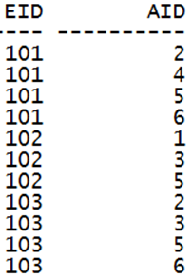
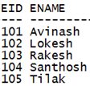


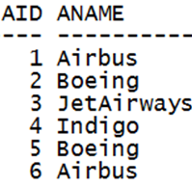
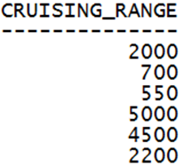
CERTIFIED
EMPLOYEES
AIRCRAFT

Slide 6
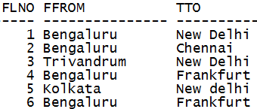
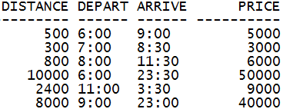
FLIGHT

Slide 7
i. Find the names of aircraft such that all pilots certified to operate them have salaries more than Rs.80,000.
CERTIFIED
EMPLOYEES
AIRCRAFT

Slide 8

i. Find the names of aircraft such that all pilots certified to operate them have salaries more than Rs.80,000.
Select aname
from aircraft
where aid in
(select aid
from certified
where eid in (select eid from employees where salary >=80000));
OUTPUT

Slide 9
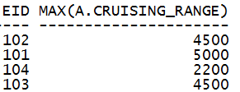
ii. For each pilot who is certified for more than three aircrafts, find the eid and the maximum cruising range of the aircraft for which she or he is certified
CERTIFIED
AIRCRAFT
OUTPUT

Slide 10
ii. For each pilot who is certified for more than three aircrafts, find the eid and the maximum cruising range of the aircraft for which she or he is certified
SELECT C.eid, MAX(A.cruising_range)
FROM Certified C, Aircraft A
WHERE A.aid = C.aid
GROUP BY C.eid
HAVING COUNT(C.aid) > =3 ;
OUTPUT

Slide 11

iii. Find the names of pilots whose salary is less than the price of the cheapest route from Bengaluru to Frankfurt.
FLIGHT
EMPLOYEES
SELECT ename FROM employees
WHERE salary < ( SELECT MIN(price)
FROM Flights
WHERE ffrom = 'Bengaluru‘
AND tto = 'Frankfurt' ) ;
OUTPUT

Slide 12
iv. For all aircraft with cruising range over 1000 Kms, find the name of the aircraft and the average salary of all pilots certified for this aircraft.
CERTIFIED
AIRCRAFT
EMPLOYEES

Slide 13
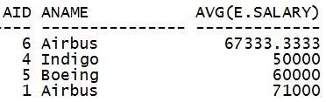
iv. For all aircraft with cruising range over 1000 Kms, find the name of the aircraft and the average salary of all pilots certified for this aircraft.
SELECT a.aid, a.aname, AVG (e.salary)
FROM aircraft a, certified c, employees e
WHERE a.aid = c.aid AND
c.eid = e.eid AND
a.cruising_range > 1000
GROUP BY a.aid, a.aname;
OUTPUT

Slide 14
v. Find the names of pilots certified for some Boeing aircraft
CERTIFIED
AIRCRAFT
EMPLOYEES

Slide 15

v. Find the names of pilots certified for some Boeing aircraft
SELECT DISTINCT e.ename
FROM employees e, certified c, aircraft a
WHERE e.eid = c.eid AND
a.aid = c.aid AND
a.aname = 'Boeing' ;
OUTPUT

Slide 16

vi. Find the aids of all aircraft that can be used on routes from Bengaluru to New Delhi.
FLIGHT
AIRCRAFT
OUTPUT

Slide 17
vi. Find the aids of all aircraft that can be used on routes from Bengaluru to New Delhi.
SELECT DISTINCT a.aid FROM aircraft a
WHERE a.cruising_range > ( SELECT MIN(f.distance)
FROM flights f
WHERE f.ffrom = 'Bengaluru' AND
f.tto = 'New Delhi' );
OUTPUT

