Slide 1
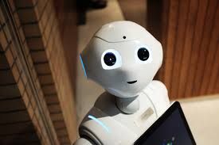
Code Bots
Developers:
Shashank Bhatnagar
Avdhut Sonpethkar
Rajesh Kumar

Slide 2
CITI HACKATHON
IBM WATSON
MACHINE LEARNING
Topic : Service Now Optimization by categorization of tickets by analyzing ticket description using NLP

Slide 3
Tech Stack
Model :
Python , NLP , Text Classification , Keras, NLTK , LSTM
IBM Watson : Watson Machine Learning , Jupyter Notebook Auto AI , Chat Assistant , Chat Bot
Deployment IBM Cloud

Slide 4
Chat Bot Link
https://web-chat.global.assistant.watson.cloud.ibm.com/preview.html?region=eu-gb&integrationID=3f27b35a-6218-4886-8c97-022ecce13d9c&serviceInstanceID=54d74100-f664-4ebb-8b06-bb7705aca4d2
Deployment IBM Cloud

Slide 5
Running Manual
Manual to use CodeBot
Please open below link
https://web-chat.global.assistant.watson.cloud.ibm.com/preview.html?region=eu-gb&integrationID=3f27b35a-6218-4886-8c97-022ecce13d9c&serviceInstanceID=54d74100-f664-4ebb-8b06-bb7705aca4d2
Deployment IBM Cloud
This Model will classify Service request portfolio based on the context and identify the ticket belongs to which team and direct user to contact them directly
Payroll Team
Help Desk Team
Product Development Team
Operation Team
Infra Team
Example Question That we can ask
Water is leaking on my floor who can help
Printer is not working whom to contact
I am not able to login whom i need to contact
Can you help me with form c download or payrolls

Slide 6
Silent Feature
When a user request for the Support, it’s easy to grab the text and with the help of model we can determine…
a) if the model finds the text relevant
b) which category best fits the text

Slide 7
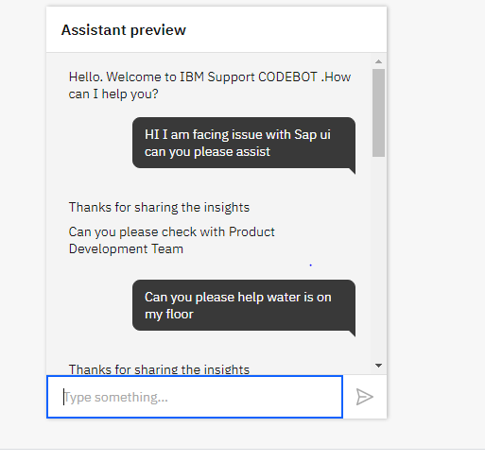
Preview1

Slide 8
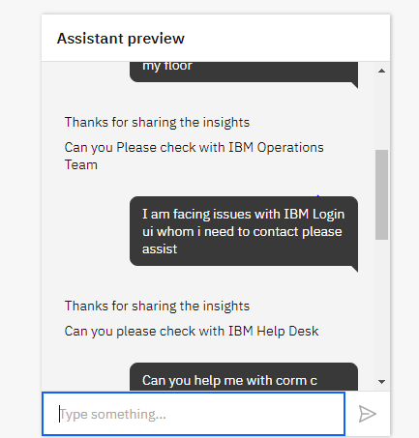
Preview2

Slide 9
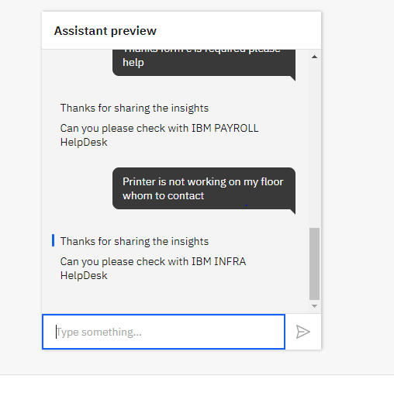
Preview 3

Slide 10
Solution Architecture
ML Model
Jupyter Notebook
-Watson Machine Learning/Auto AI
Auto AI Deployment on IBM Watson Space
IBM Watson Assistant
ChatBot Deployment
IBM Cloud
ChatBot Services
Intent/Dialog
Webhook Integration

Slide 11
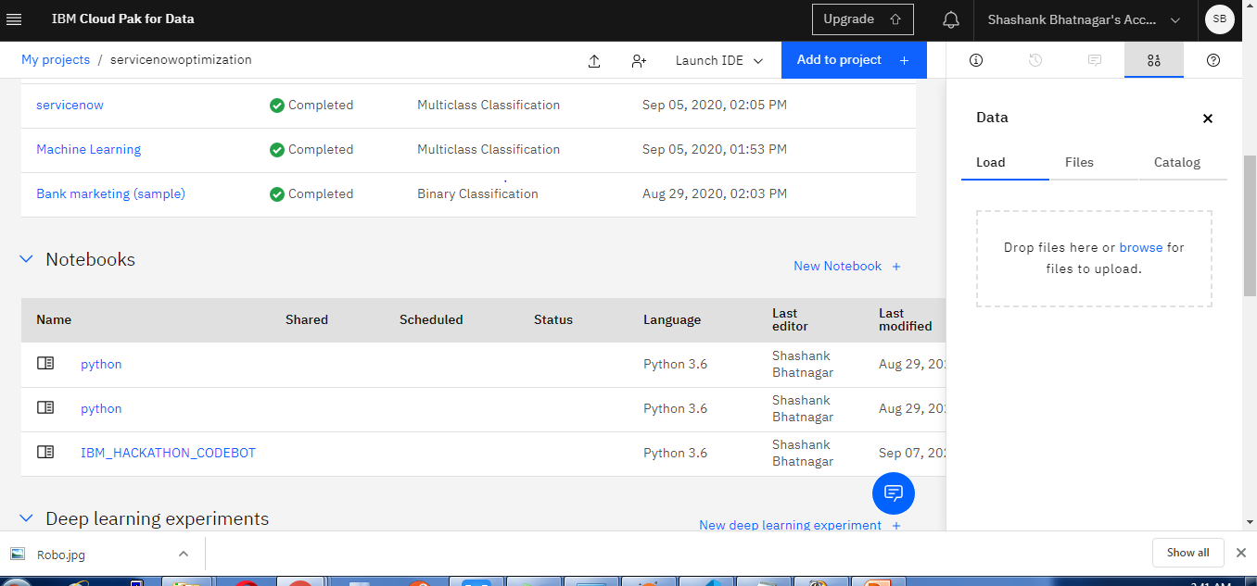
IBM Services

Slide 12
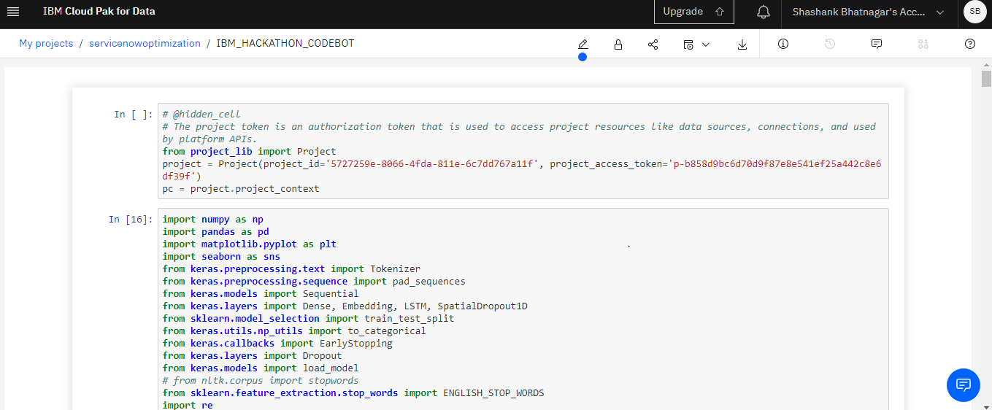
Jupyter Notebook IBM Watson

Slide 13
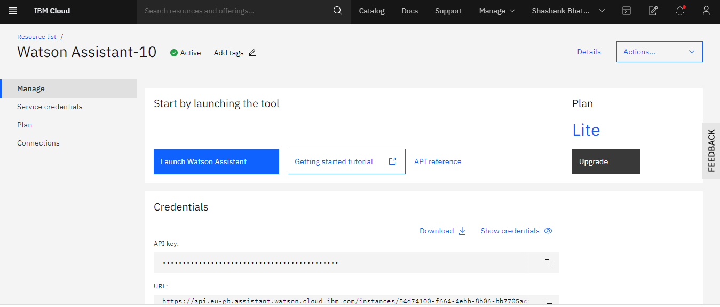
IBM Watson Assistant

Slide 14
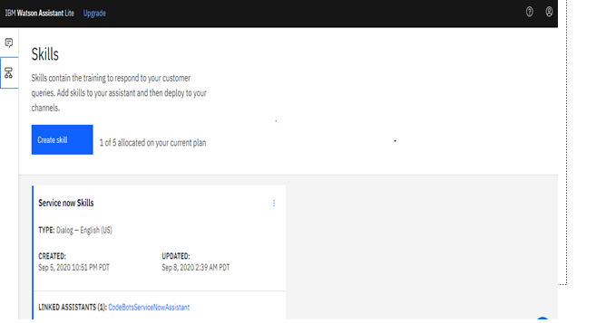
Skills

Slide 15
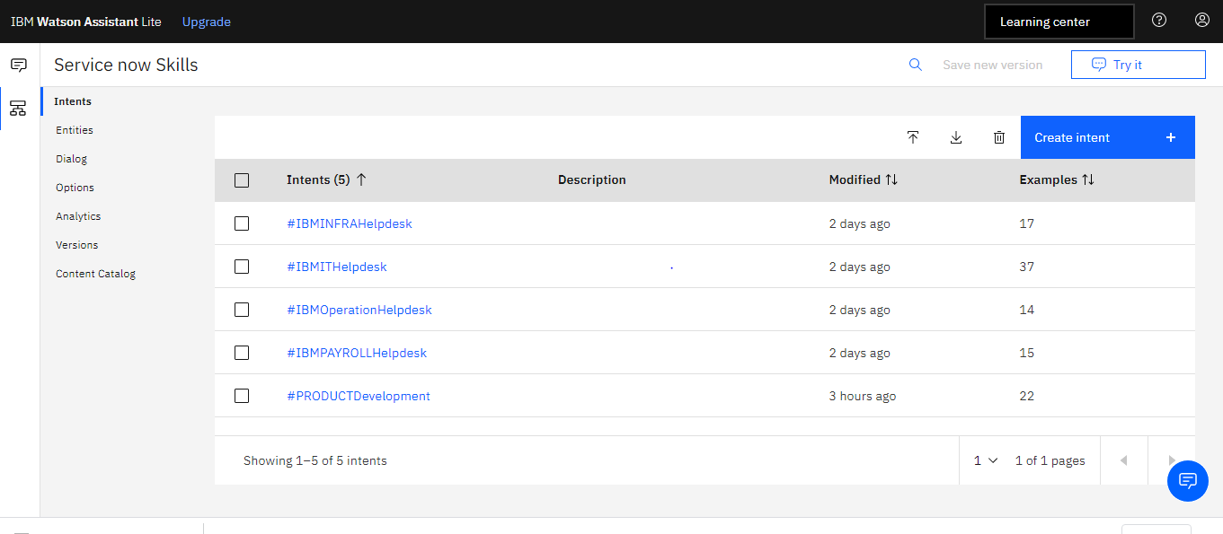
Intents

Slide 16
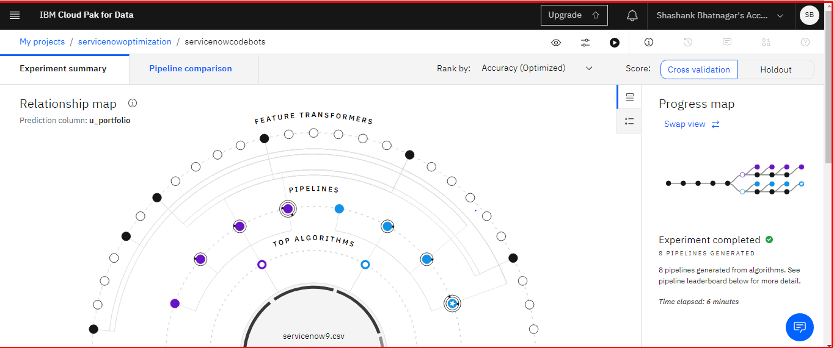
Auto Ai

Slide 17
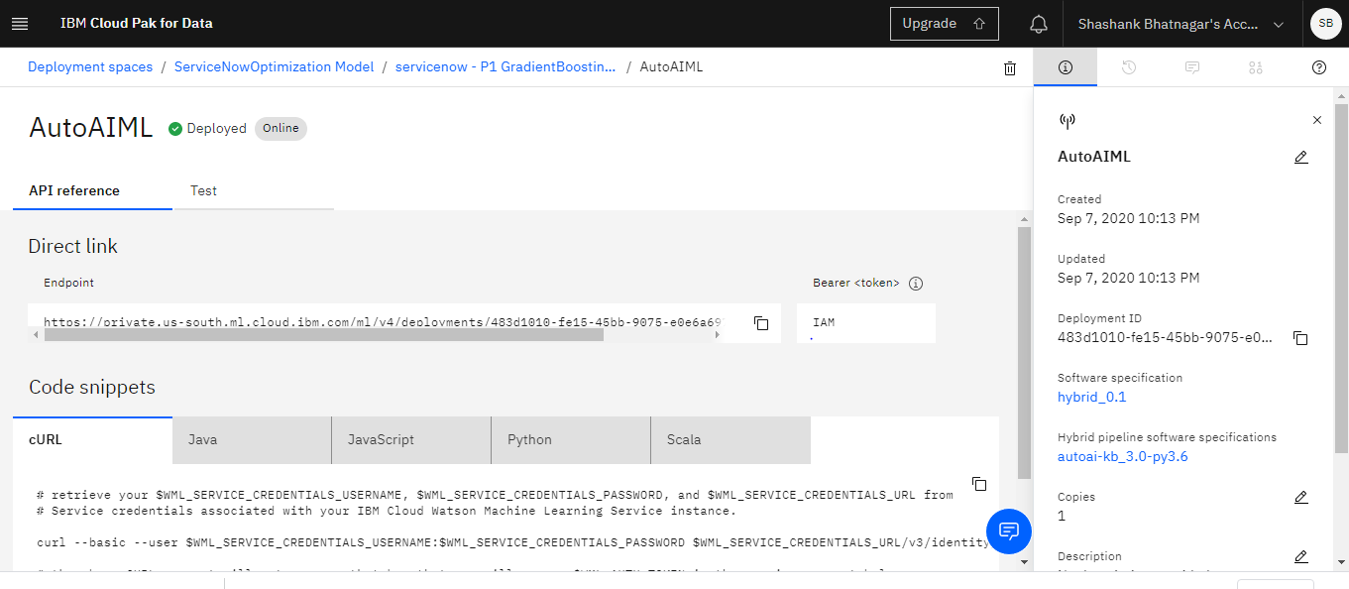
Auto AI Deployment

Slide 18
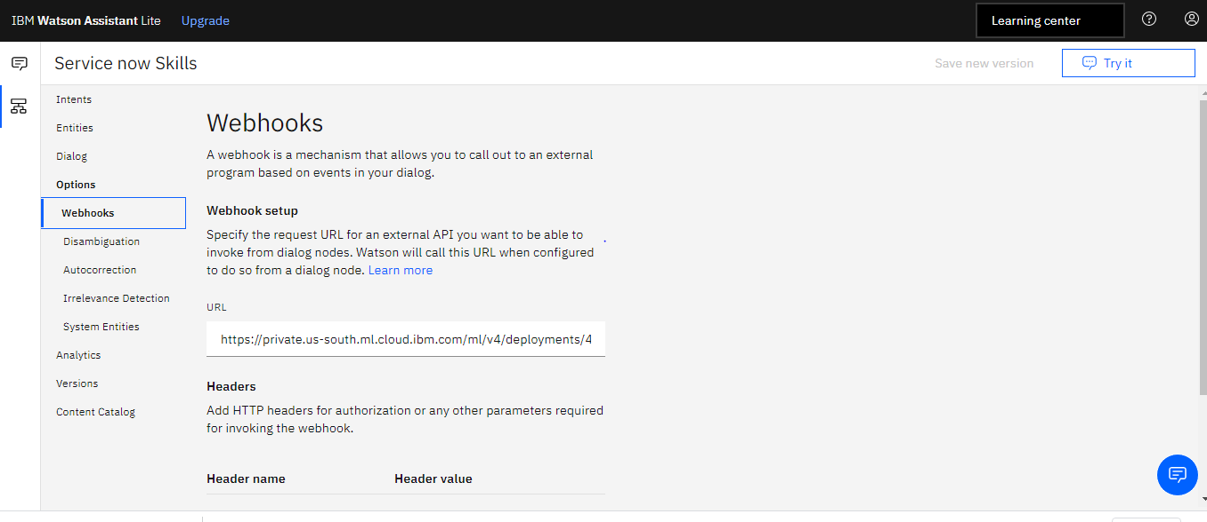
Web Hooks Auto AI API

Slide 19
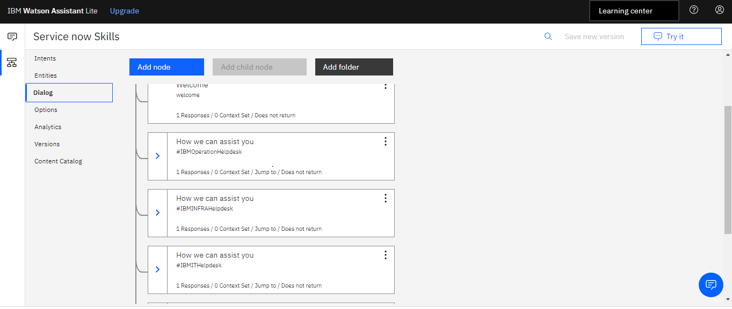
Dialog

Slide 20
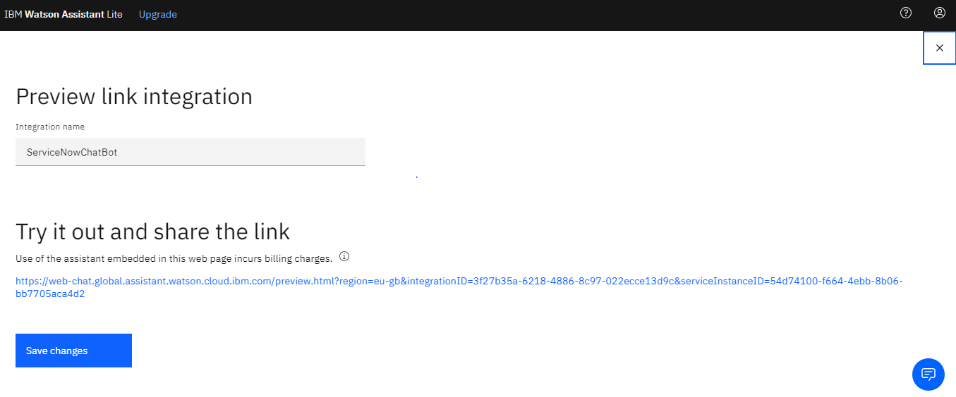
BOT Integration

