Slide 1


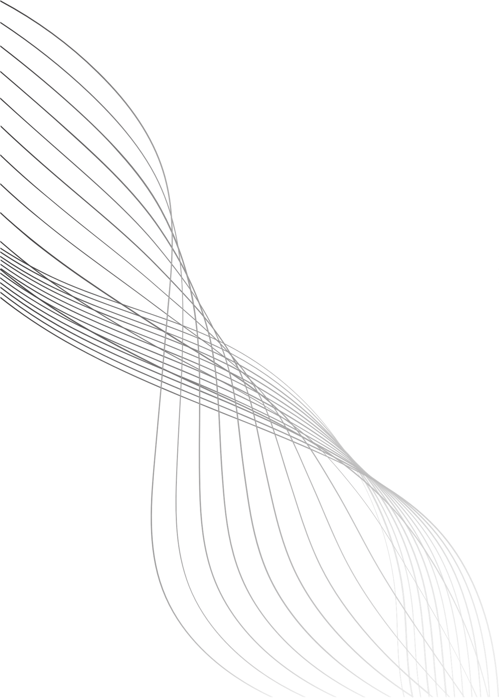

SIDDAGANGA INSTITUTE OF TECHNOLOGY, Tumakuru- 03
(An Autonomous institution affiliated to Visvesvaraya Technological University- Belagavi, Approved by AICTE,
Accredited by NAAC with ‘A++’ Grade, Awarded Diamond College Rating by QS I-GAUGE & ISO 9001:2015 certified)
MINI PROJECT PRESENTATION
“SMART HEALTH COMPANION : A Wearable Health Monitoring System”
Under the guidance of
Dr Mallikarjun B C
Associate Professor
Department of Electronics and Telecommunication Engineering
SUBMITTED BY:
SANMATHI JAIN B J
SHASHANK H
SHASHANK T V
SHREYAS A JAIN
1SI23ET043
1SI23ET044
1SI23ET045
1SI23ET047

Slide 2
Content
Problem Statement
Introduction
Objectives
Motivation
Literature Survey
Methodology
Output
Implementation
Results
Conclusion
References

Slide 3


PROBLEM STATEMENT
Existing wearable health monitoring devices are often expensive, closed-source, and lack customization for academic research and elderly care applications. Many systems do not provide real-time cloud connectivity, emergency alert mechanisms, or affordability for widespread use. Hence, there is a need for a low-cost, compact, IoT-enabled wearable system that can continuously monitor vital health parameters and provide emergency alerts.
01

Slide 4
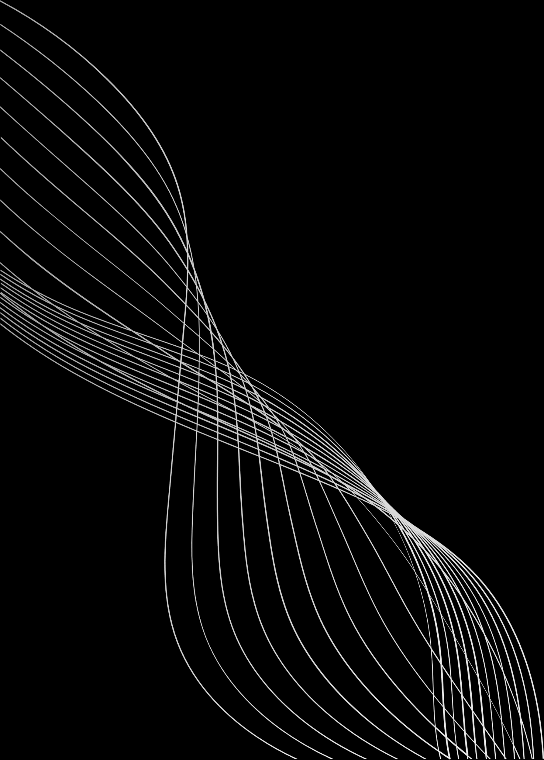
INTRODUCTION
Project Overview
The Smart Health Companion is a wearable IoT-based health monitoring device designed to continuously measure essential vital parameters.
It integrates heart rate, SpO₂, body temperature, and step count into a compact hardware system built using IndusCoin V2 microcontroller.
Key Features:
Real-time measurement using MAX30102, LM35, and onboard accelerometer.
OLED display for instant on-device monitoring.
MQTT- based cloud integration using HiveMQ.
Web dashboard for live data visualization and CSV Report.
SOS button for emergency alert triggering.
02

Slide 5
OBJECTIVES
To design and develop a functional wearable health monitoring prototype.
To interface MAX30102 for accurate Heart Rate and SpO₂ measurement.
To measure body temperature using LM35.
To implement step counting using the inbuilt accelerometer.
To display real-time vitals on a 1.3-inch OLED screen.
To publish live sensor data to the internet via HiveMQ MQTT Broker.
To build a website that shows real-time vitals and allows CSV download.
To implement an SOS alert button for emergency notifications.
03

Slide 6
MOTIVATION
Increasing need for affordable wearable medical devices for elderly care.
Existing market devices are expensive and not customizable.
Remote health monitoring is essential for chronic patients and senior citizens.
Real-time tracking enables early detection of abnormalities and timely action.
IoT advancements allow seamless cloud connectivity and data storage.
04

Slide 7
LITERATUTRE SURVEY
Authors | Year | Paper Title | Remarks
Balachandra D S, Maithreyee M S | 2023 | Smart safety watch for elderly people and pregnant women | Methodology: Two Arduinos, Bluetooth module, sensors,Flutter app handled heavy processing. Result: Fall detection, SpO2 monitoring, and panic alerts with location messaging were predicted correctly. Research Gaps: Large size, high energy consumption, poor GPS accuracy, and reliance on two Arduino boards.
Anshuman Mishra, Richards Joe Stanislaus | 2023 | Smart Watch Supported System for Health Care Monitoring | Methodology: Arduino UNO gathered vital data; ESP8266 sent it to ThingSpeak; managed wheelchair with joystick. Result: Developed a smartwatch system successfully controlling a wheelchair and monitoring remote patient health. Research Gaps: Design relies on Arduino and external ESP8266; large size; limited discussion on sensor accuracy/power optimization.
05

Slide 8
LITERATUTRE SURVEY
Authors | Year | Paper Title | Remarks
M.M.Hosseini | 2023 | Role of Smartwatches in Healthcare and Medicine | Methodology: Reviewed healthcare applications of smartwatches using heart rate, SpO₂, and motion sensors . Result: Smartwatches reliably support continuous health monitoring and early disease detection . Research Gaps: High cost and limited customization restrict use for elderly-focused applications .
R.K.Kher | 2021 | Wearable Health Monitoring Systems | Methodology: Surveyed wearable devices and compared sensors and IoT-based cloud communication techniques . Result: Wearables enable continuous, non-invasive monitoring with effective remote data access . Research Gaps: Power consumption, comfort, and data security remain major challenges .
06

Slide 9
LITERATUTRE SURVEY
Authors | Year | Paper Title | Remarks
J.O.Olmedo-Aguirre | 2022 | Remote Healthcare for Elderly People using Wearables | Methodology: Analyzed elderly-care wearable systems with vital sign and activity monitoring . Result: Wearables improved elderly safety and reduced hospital visits through remote monitoring . Research Gaps:Lack of integrated SOS alert and real-time on-device display .
G.P.M.Pinheiro | 2024 | Smart Band for Vital Signs Monitoring using MAX30102 | Methodology:Developed a smart band using MAX30102 and ESP32 for heart rate and SpO₂ monitoring . Result: Achieved high accuracy in vital sign measurement with cloud connectivity . Research Gaps: Activity tracking and emergency alert features were not included .
07

Slide 10
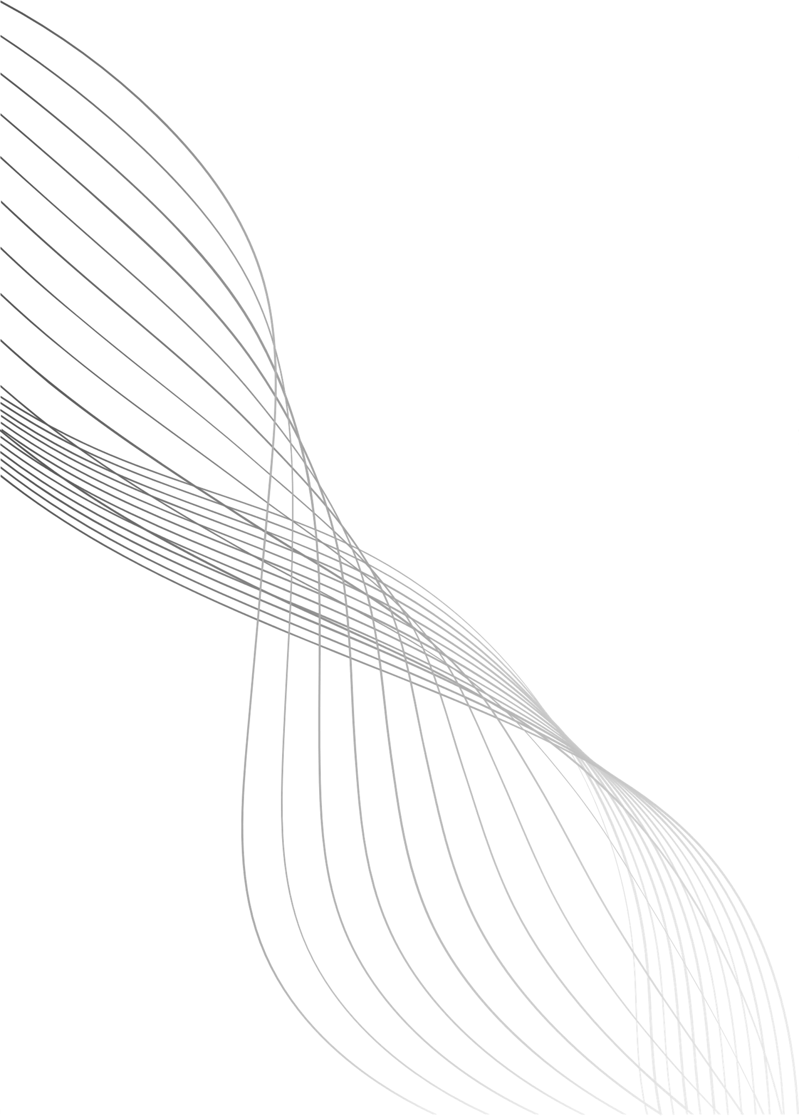
METHODOLOGY
Step-by-Step Approach:
Hardware Setup
Sensor Data Acquisition
User Interface
IoT Communication
Web Dashboard Integration
SOS Function
08

Slide 11
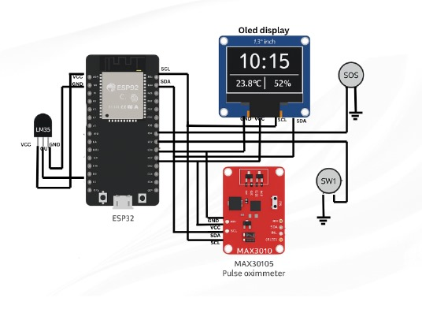
IMPLEMENTATION
09

Slide 12
RESULTS
Category | Metric | Result
Data Output | Sensor Readings | Successfully reads, calculates, and outputs BPM, SpO2, Temperature, and Step Count (4 metrics).
Real-time Visualization | Local Display | OLED display shows the most recent reading for each of the four metrics simultaneously.
Remote Monitoring | Cloud Proof | Our dashboard successfully shows three synchronized charts , proving the Wi-Fi and data transmission logic works.
Validation | Temperature (LM35) | LM35 temperature readings were validated to be within 0.5°C of a reference thermometer.
Validation | Motion (MPU6050 - inbuilt) | MPU6050 accelerometer readings accurately reflect prototype movement(used for Step Count and Fall Detection Logic).
10

Slide 13
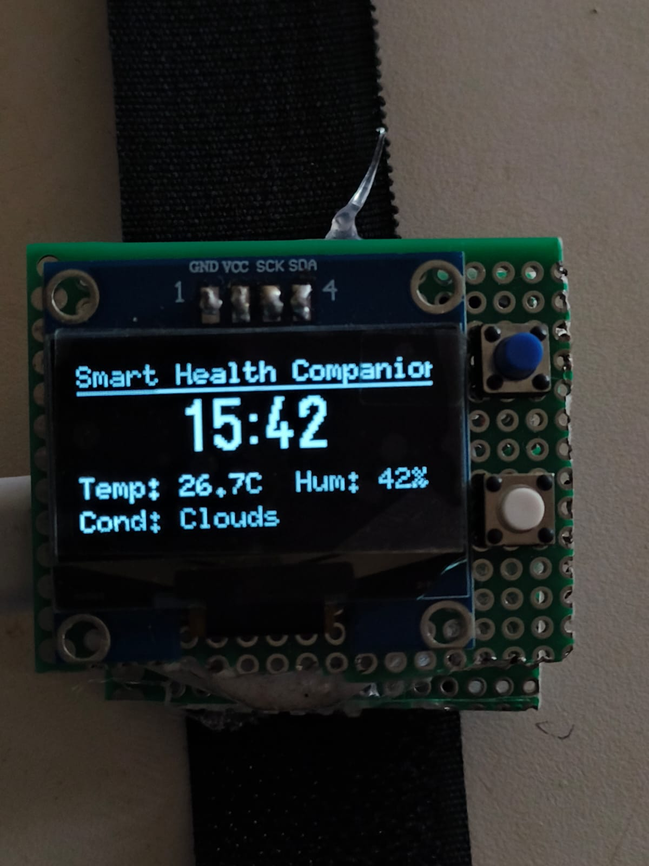
OUTPUT
Figure 1: Home Tab of Smart Watch
11

Slide 14
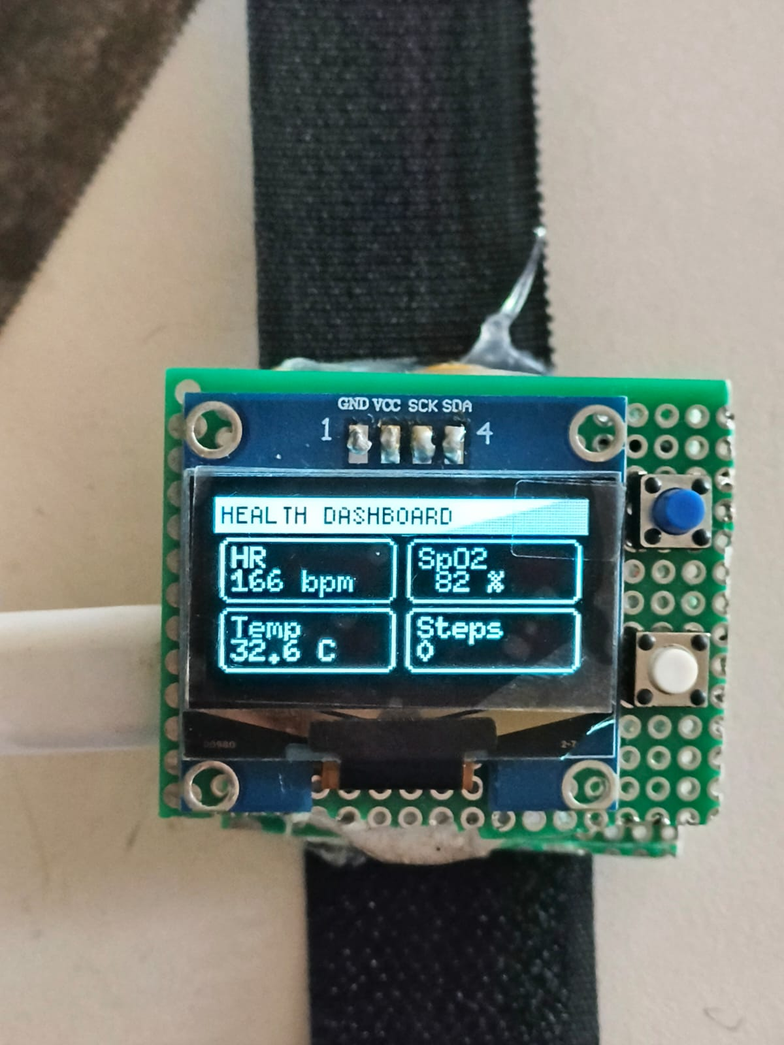
Figure 2: Health Dashboard
12

Slide 15
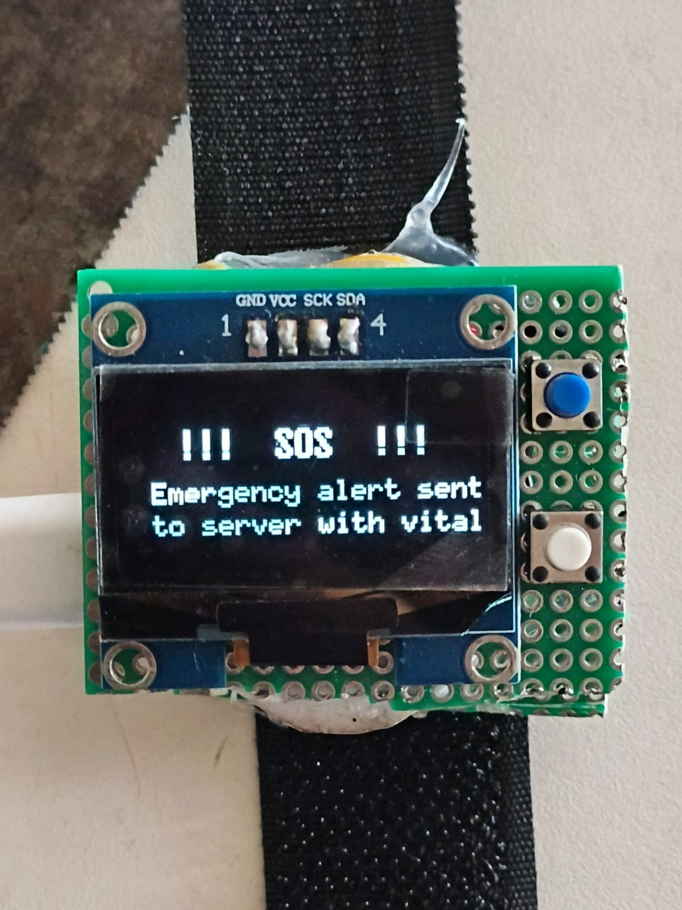
Figure 3: SOS Alert
13

Slide 16
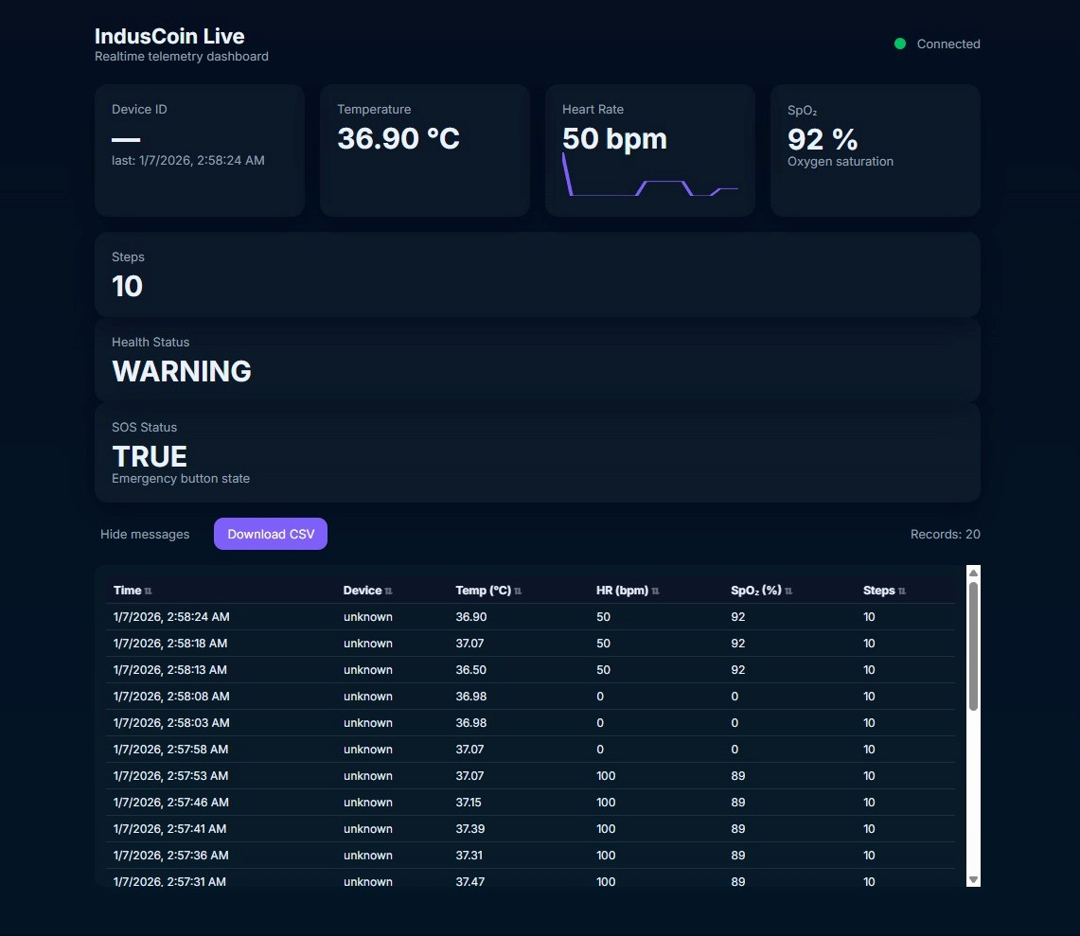
Figure 4: Cloud Health Dashboard
14

Slide 17
CONCLUSION
Successfully built a complete wearable IoT health monitoring system.
Achieved seamless integration of sensors, display, MQTT, and web dashboard.
The system is stable, low-cost, and suitable for elderly monitoring.
The modular design supports future upgrades like GPS, fall detection, mobile app, and data storage.
Demonstrates strong application of embedded systems, IoT, and real-time data analytics.
15

Slide 18
REFERENCES
[1] Balachandra D S , Maithreyee M S , Saipavan B M , Shashank S , Dr. P Devaki , Ms.
Ashwini M - arXiv:2312.01302
“Smart safety watch for elderly people and pregnant women”
https://arxiv.org/abs/2312.01302
[2] Anshuman Mishra, Richards Joe Stanislaus - arXiv:2304.07789
“Smart Watch Supported System for Health Care Monitoring”
https://arxiv.org/abs/2304.07789
[3] Datasheet - https.//kaggle.com
16

Slide 19
REFERENCES
[4] M. M. Hosseini – Journal Review
“Role of Smartwatches in Healthcare and Medicine”
https://doi.org/10.3390/s23073456
[5] R. K. Kher – Open Biomedical Engineering Journal
“Wearable Health Monitoring Systems”
https://benthamopen.com
17

Slide 20
REFERENCES
[6] J. O. Olmedo-Aguirre – Remote Healthcare Systems
“Remote Healthcare for Elderly People Using Wearable Devices”
https://www.mdpi.com/1424-8220/22/3/1012
[7] G. P. M. Pinheiro – Sensors / Wearable Systems
“Smart Band for Vital Signs Monitoring Using MAX30102”
https://www.mdpi.com/1424-8220/24/4/1345
18

Slide 21
THANK YOU

