Slide 1

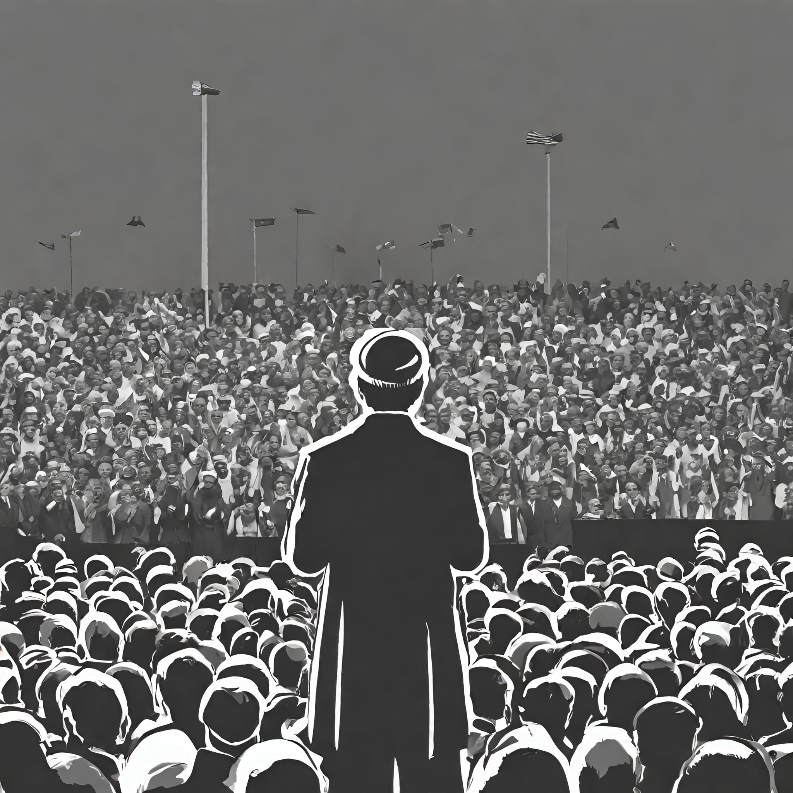

MULTIMODAL MULTILINGUAL SOCIAL MEDIA ANALYSIS ON POLITICAL LEADERS
Ankur Tiwari Anshuman Uniyal Hrishikesh Khambete
Karanbir Singh Shashank Sharma Vani Mittal
Group-26

Slide 2
PROBLEM STATEMENT
The primary goal is to develop an automated system that can convert images posts of prominent political figures into multilingual textual content in the context of ShareChat.The system should be able to extract sentiments from this textual data across diverse languages, with a focus on accurately categorizing posts into positive, negative, and neutral sentiments.

Slide 3
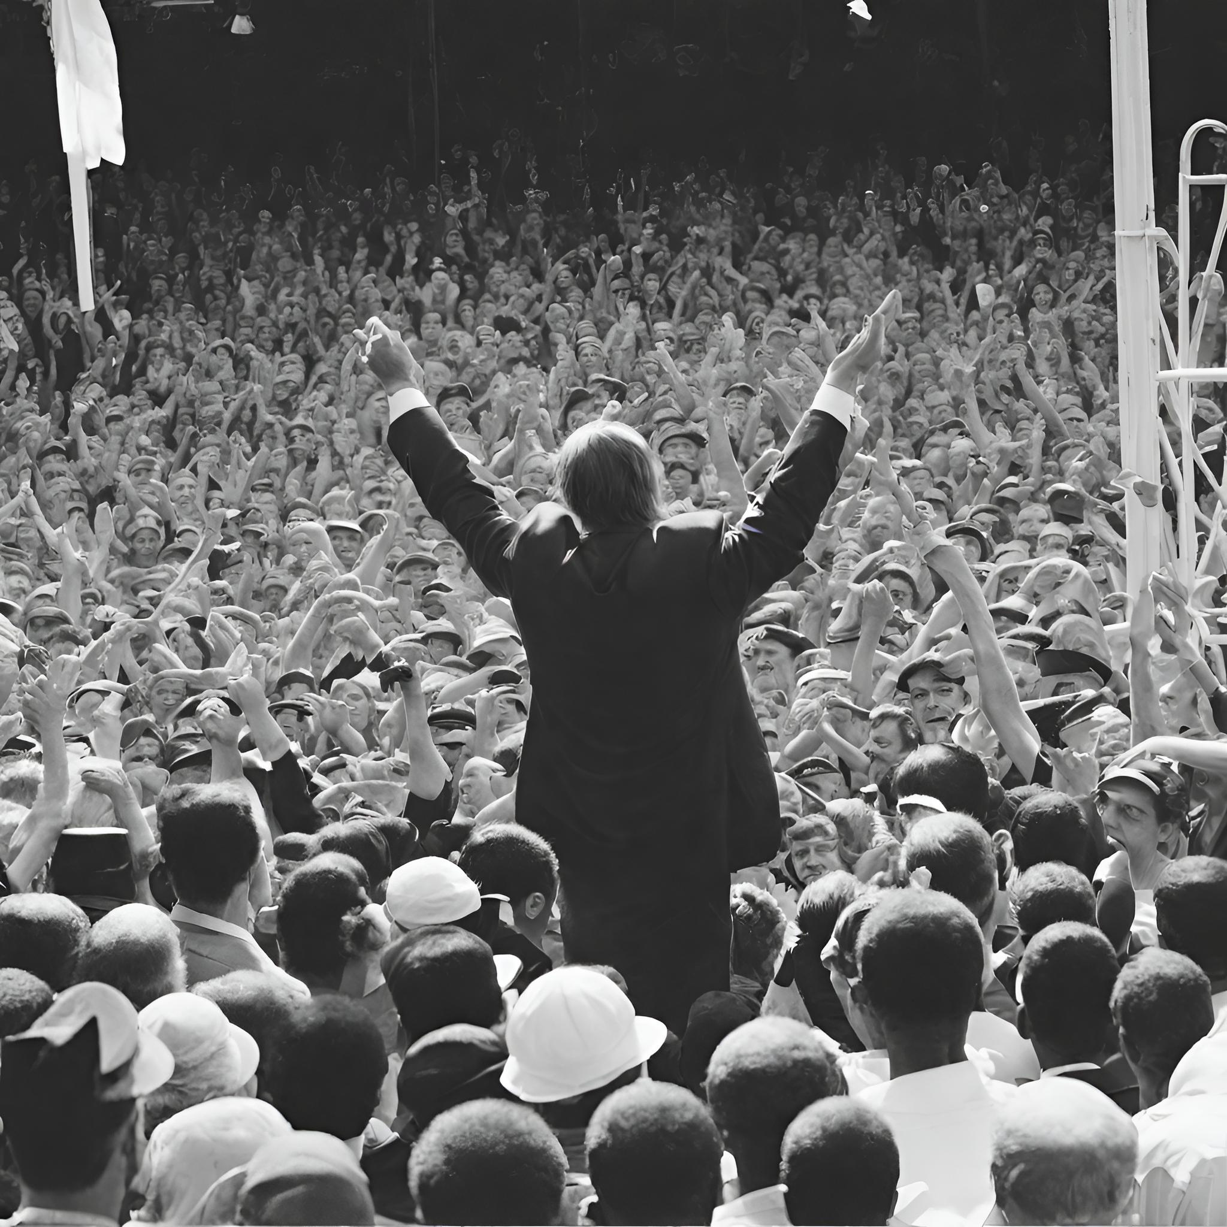
MOTIVATION
Insights into Public Sentiment: The project contributes valuable insights into public sentiment on social media, shedding light on perceptions and attitudes towards political figures.
Validation of Traditional Polling Methods: By comparing sentiment analysis results with traditional polling methods, the project validates the usefulness of sentiment analysis as a complementary approach for measuring public opinion.

Slide 4
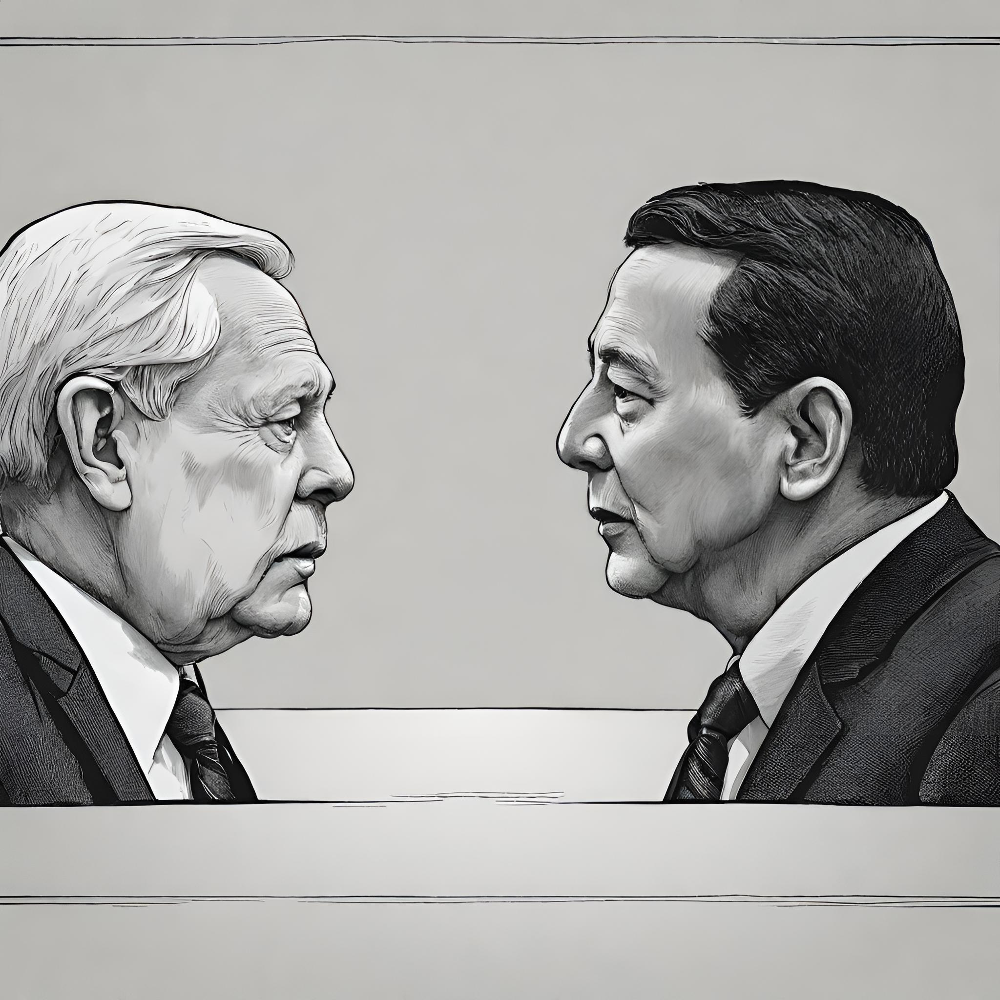
LITERATURE REVIEW
+ Gauba et al. used MARC Dataset and Twitter dataset for training and evaluating models, focusing on BERT-based multilingual classification and comparative analysis.
+ MSA: State of the Art and Independent Comparison of Techniques implemented 11 sentiment analysis techniques in English and other languages, highlighting discrepancies between reported results and experimental outcomes.
+ MSA for Under-Resourced Languages: A Systematic Review methodology following the PRISMA framework, emphasizing the significance of deep learning methods for under-resourced languages.
+ Aspect-Based Sentiment Analysis in Hindi Language by Ensembling Pre-Trained mBERT Models, demonstrating the effectiveness of BERT-based models in aspect-based sentiment analysis in Hindi.

Slide 5
Challenges and Limitations:
+ Limited word and character reviews in datasets, inability to capture negation of words and word combinations, and reliance on machine translation leading to translation errors.
+ Lack of cultural awareness in sentiment analysis models and the need for fine-grained sentiment analysis.
Future Research:
+ Further utilization and comparison of BERT-based models trained on Twitter datasets.
+Exploration of transfer learning techniques for cross-lingual sentiment analysis.

Slide 6
PROPOSED SOLUTION
Ground Truth Labeling:
Manual labeling establishes sentiment
ground truth, ensuring reliability.
Model Prediction and Labeling:
Models predict sentiment scores; highest score determines label.
Evaluation Metrics:
Metrics like Accuracy, Precision, Recall, F1-Score, and ROC-AUC provide insights.

Slide 7
PROPOSED SOLUTION
Models Utilized:
DistilBERT, Flair Bi-LSTM, TextBlob NB-Classifier, and VADER models used.
Performance Comparison:
Models compared against Bi-LSTM Transformer baseline.
Rigorous Evaluation:
Ensures methodological robustness for informed decision-making.

Slide 8
NOVELTY
Approach:
Investigating multi-modal and multilingual data analysis on ShareChat, a platform with diverse user-generated content.
Bridging Gap:
content including textual, visual, and audio content, provides a holistic understanding of user interactions on ShareChat.
Advancing Insights:
By combining multi-modal and multilingual analyses, this research aims to uncover patterns, sentiments, and cultural nuances

Slide 9
METHODOLOGY
Scraping of data from ShareChat platform.
Image-to-Text Conversion:
Utilization of Tesseract OCR for converting images to text.
Text Translation :
Further processing of translated text using DeepTranslator.
Leveraging the GoogleTranslator module for efficient translation.
Text Preprocessing Techniques:
Standard preprocessing techniques are applied like Lowercase conversion, tokenization.

Slide 10
METHODOLOGY
Sentiment Analysis with NLTK's Vader Module:
Employing NLTK's Vader module for sentiment analysis of each post
Normalization of Sentiment Scores:
Introduction of normalization step for aggregate sentiment scores.
Aggregation of Sentiment Scores:
Aggregate sentiment scores used to compute average sentiment score for political figures

Slide 11
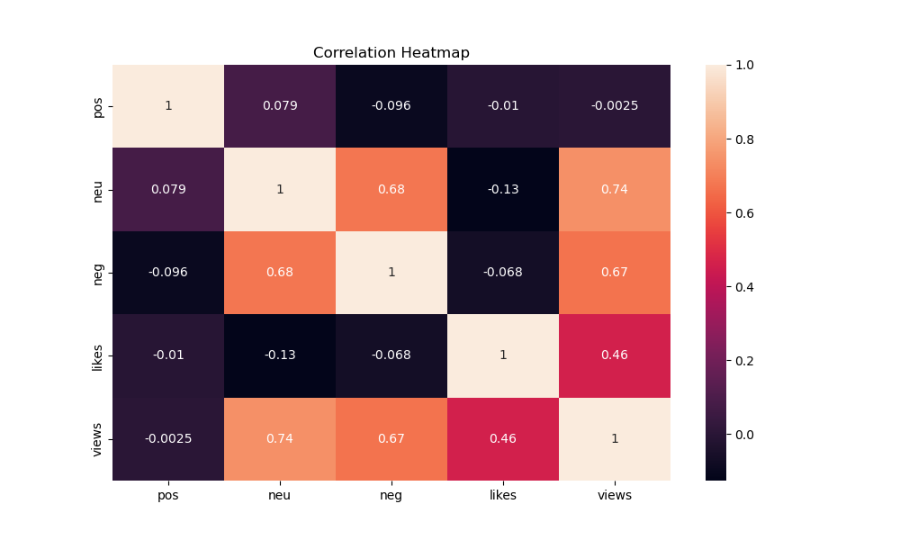
RESULTS
Results generated for Hindi languages
Arvind Kejriwal:
Neutral sentiment dominates posts about Arvind Kejriwal among Hindi-speaking audiences (43.9%).
The diverse range of opinions suggests a balanced perception without clear Positive or Negative sentiment dominance.

Slide 12
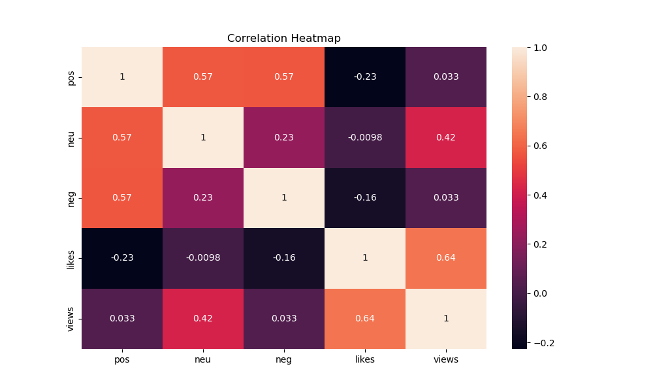
RESULTS
Narendra Modi:
Negative sentiment is significantly present in posts about Narendra Modi among Hindi-speaking audiences (42.4%).
The prevalence of Negative sentiment suggests potential challenges in public perception.

Slide 13
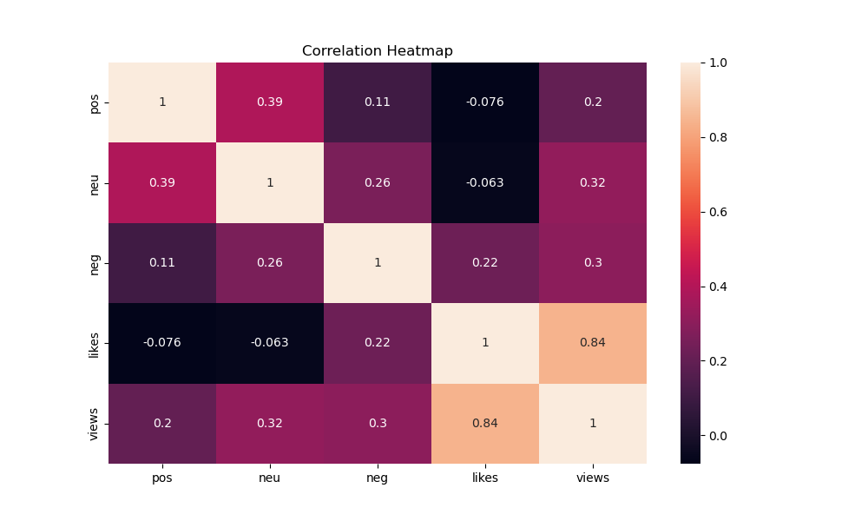
RESULTS
Rahul Gandhi:
Negative sentiment is prevalent in posts about Rahul Gandhi among Hindi-speaking audiences (40.9%).
The dominance of Negative sentiment indicates potential challenges in public perception.

Slide 14
THANKS FOR LISTENING
https://github.com/shashank23088/ir_project

