Slide 1
NLP Project: Healthcare Answer Summarization
Group Number: 11
Members:
Shashank G. Sharma (MT23088)
Shreyas Gupta (MT23221)
Sajid Javid (PhD24002)

Slide 2
Problem Statement
Healthcare Q&A platforms (e.g., Yahoo! Answers, Reddit) contain a mix of factual information, personal experiences, suggestions, and queries, making it challenging to extract concise, perspective specific summaries.
Our NLP system is designed to generate targeted summaries for distinct perspectives (suggestion, information,cause, experience, question) while preserving the author’s original intent.
In this work, we integrate two main modules: the baseline summarization model and an extended model that leverages classifier guidance and custom energy-based losses.
Evaluation Metrics: BLEU, BERTScore, ROUGE, additional human-centric assessments.
GitHub repository: here

Slide 3
Related Work
Summarization in Healthcare Domains: Liang et al. (2019) developed a system for extractive summarization of clinical notes, focusing on disease-specific datasets like hypotension and diabetes. Demner-Fushman and Lin (2006) proposed methods for summarizing biomedical literature to assist clinical decision-making. Naik et al. (2024) introduced a perspective-aware summarization framework tailored for healthcare Q&A forums, highlighting the importance of integrating diverse patient and caregiver viewpoints. ​ScienceDirect
Perspective-Aware Text Classification: Rashkin et al. (2017) focused on detecting factuality and bias in news articles, emphasizing the need to understand different perspectives in text classification tasks. Zhang et al. (2021) utilized contrastive learning techniques for viewpoint detection, demonstrating the effectiveness of robust classifiers in capturing subtle contextual cues.​
Controlled Text Generation: Li and Liang (2021) introduced prefix-tuning, a lightweight alternative to full model fine-tuning, enabling efficient adaptation to new tasks. arXiv Du et al. (2022) employed energy-based loss functions in tasks requiring finer control over generated outputs, such as text-to-image alignment.​
Instruction-Following Models: Raffel et al. (2020) developed the T5 model, framing all NLP tasks as text-to-text transformations, facilitating a unified approach to various language processing tasks. Touvron et al. (2023) introduced LLaMA, a decoder-only architecture that proves more flexible for open-ended tasks like stylized or perspective-conditioned summarization. arXivarXiv​
Few-Shot and Parameter-Efficient Fine-Tuning (PEFT) Techniques: Hu et al. (2021) proposed Low-Rank Adaptation (LoRA), which freezes pre-trained model weights and injects trainable rank decomposition matrices into each layer of the Transformer architecture, reducing the number of trainable parameters for downstream tasks.

Slide 4
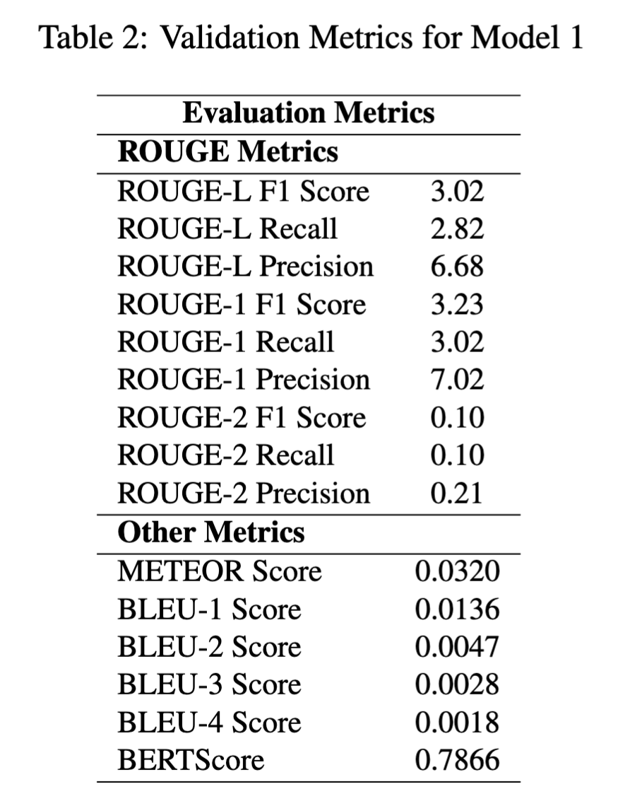
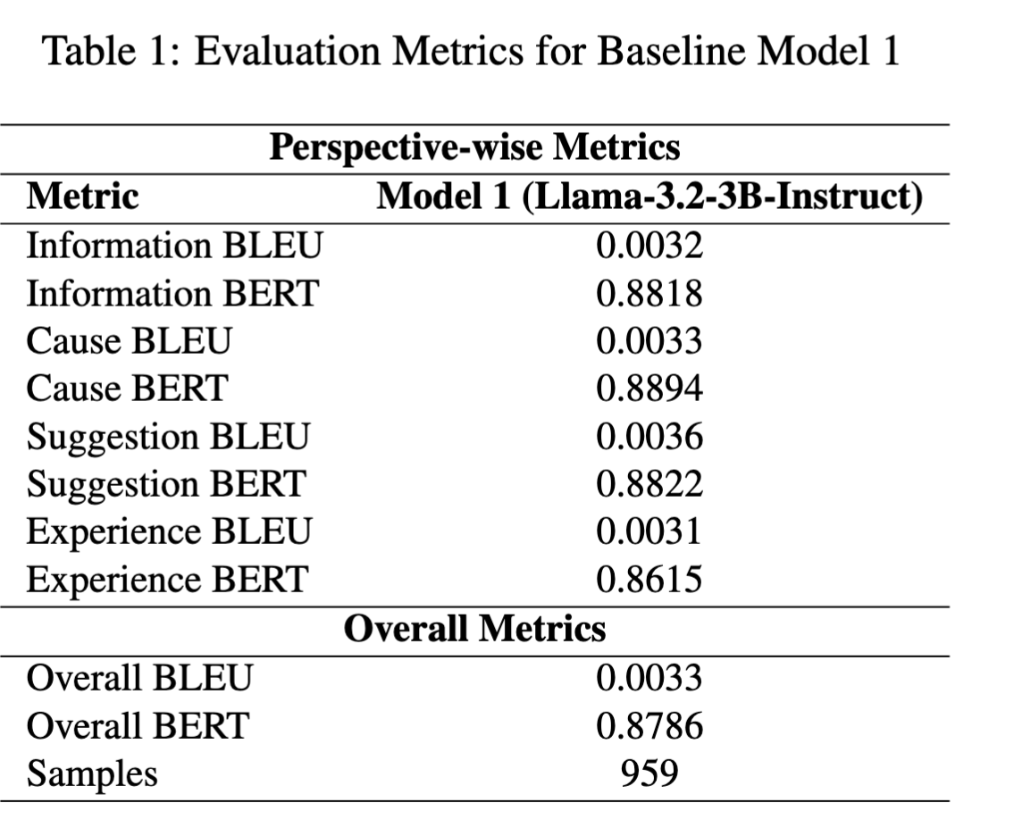
Baseline 1 and 2
Perform direct inference using meta-llama/Llama-3.2-3B- Instruct with custom prompts. The system is evaluated on test sets.
Implemented the T5 based baseline approach described by Naik et al. (2024), which utilizes the PLASMA model for perspective-aware summarization.

Slide 5
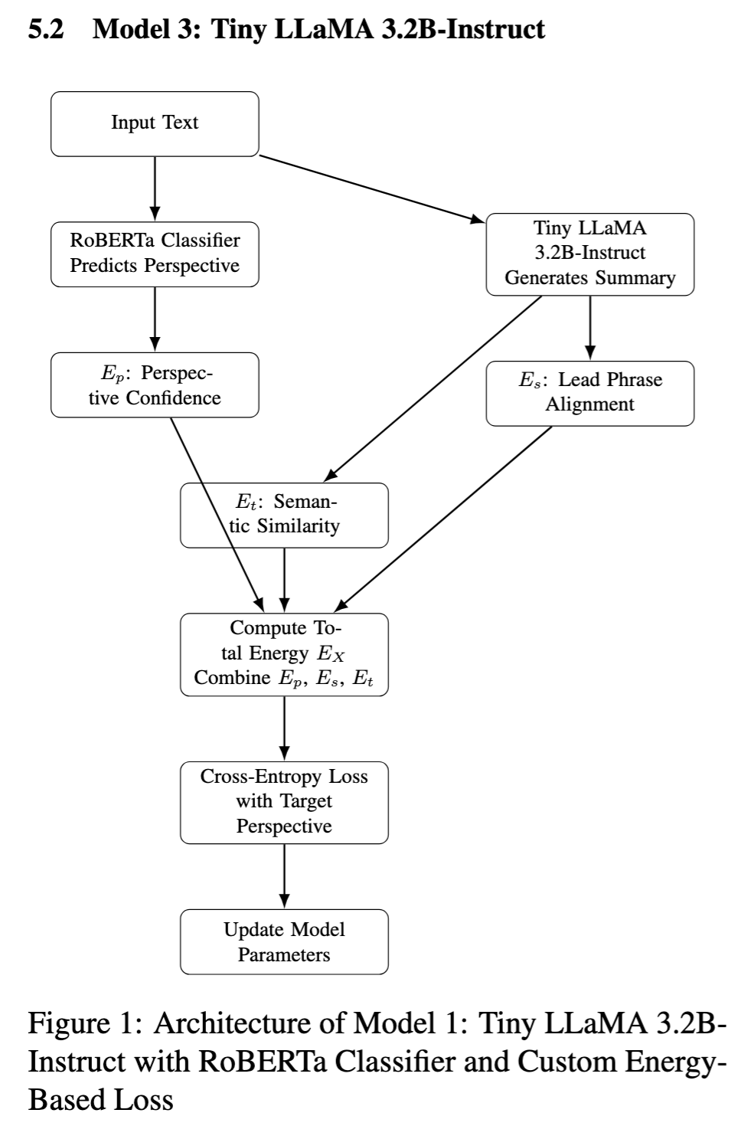
Approach 1
T5 Limitations:
Encoder-Decoder Design: Optimized for structured tasks; less adaptable for open-ended generation.
Challenges:
Rigid outputs with ambiguous prompts.
Difficulty maintaining long-form coherence.
Higher inference costs, impacting real-time applications.​
LLaMA 3 Advantages:
Decoder-Only Architecture: Autoregressive design enhances context-aware generation.
Benefits:
Improved coherence in extended text.
Lower memory usage and faster inference.
Effective few-shot learning for tasks like perspective-specific summarization.​
Integrated Components:
RoBERTa-Based Classifier: Categorizes text into five perspectives: EXPERIENCE, SUGGESTION, INFORMATION, CAUSE, and QUESTION.
Tiny LLaMA 3.2B-Instruct: Core language model for summarization tasks, employing prefix tuning through the PEFT (Parameter-Efficient Fine-Tuning) approach for efficient adaptation.
Custom Energy-Based Loss Function:
Ep (Perspective Confidence): Assesses alignment with the intended perspective using the classifier.
Es (Lead Phrase Alignment): Evaluates the match between the summary's opening and predefined perspective-specific phrases.
Et (Semantic Similarity): Measures the semantic closeness between the summary and perspective-associated token lists using BERT embeddings.

Slide 6
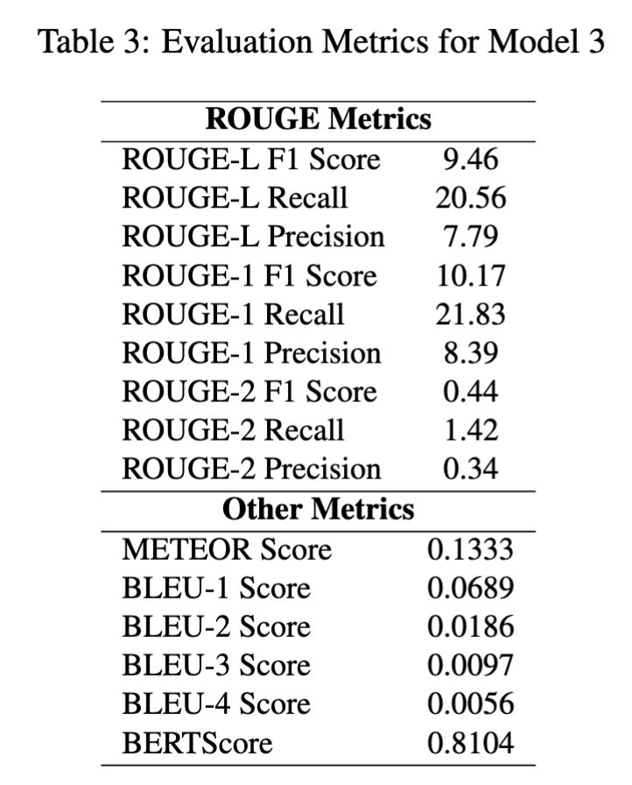
Approach 1 Results and Analysis
Key Observations:
Enhanced Performance with LLaMA3:
Model 3 outperforms Model 2 across all evaluation metrics, indicating superior summarization capabilities.​
Semantic Understanding:
Higher BERTScore suggests Model 3's summaries are more semantically aligned with reference texts, reflecting better contextual comprehension.​
Improved Coherence and Precision:
Elevated ROUGE and BLEU scores demonstrate Model 3's ability to generate more coherent and precise summaries.​
Effective for Open-Ended Tasks:
The autoregressive, decoder-only architecture of LLaMA3 enhances adaptability and efficiency, making it more suitable for dynamic, open-ended summarization tasks.

Slide 7
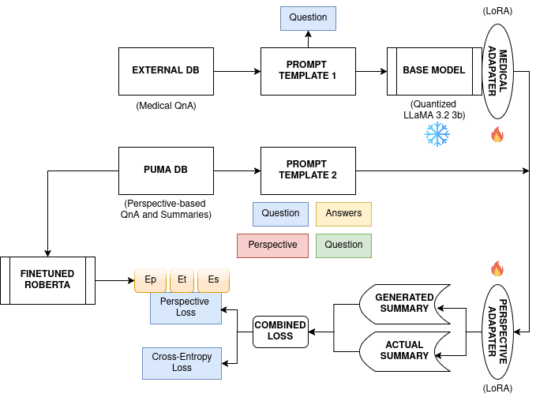
Approach 2
Dual Adapter Training:
LLaMA-3.2B is adapted using two LoRA adapters – one for medical language and one for perspective awareness.
Two-Stage Tuning Pipeline:
Stage 1: Fine-tuning with External DB (Medical QnA) using Template 1.
Stage 2: Fine-tuning with PUMA DB (Perspective-QnA) using Template 2.
Perspective Classifier:
RoBERTa is fine-tuned to predict perspective of generated summary
It contributes in perspective energy (Ep)
Combined Loss Function:
Uses both Perspective Loss and Cross-Entropy Loss for training.
Final Output:
Generates summaries grounded in medical accuracy and user perspective alignment

Slide 8
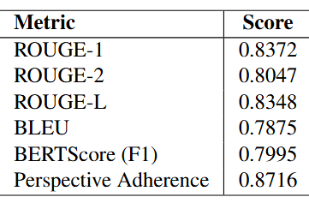
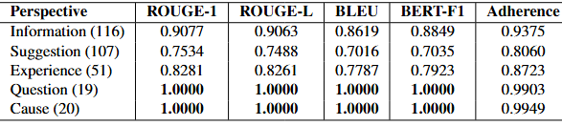
Approach 2 Results
Observations:
Two-stage adapter-tuned model outperforms Baseline 2 in all metrics: ROUGE-1 improves from 3.23 to 83.72, BLEU-4 from 0.0018 to 0.7875.
Significant improvement in perspective adherence (0.8716) via classifier-guided loss.
Near-perfect generation for CAUSE and QUESTION with BLEU, ROUGE, and BERTScore reaching 1.0.
High overlap in train/test splits (30%) and validation/test duplication may skew results, to be addressed with stricter dataset separation.

Slide 9
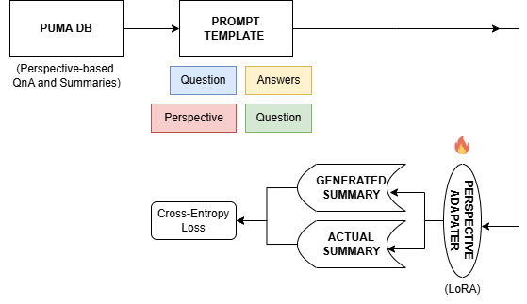
Approach 3
Perspective Aware Adapter Training:
LLaMA-3.2B is adapted using LoRA adapters, each tailored for a perspective individually.
Loss Function:
Uses Cross-Entropy Loss for training.
Final Output:
Generates summaries based on specific perspective alignment

Slide 10
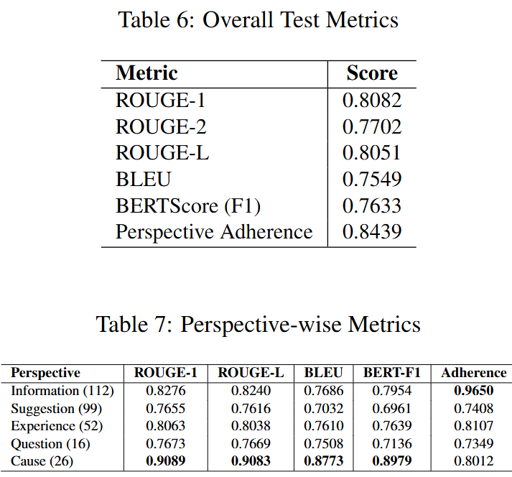
Approach 3 Results
Observations:
The perspective-specific adapter-tuned model significantly outperforms Baseline Model 2 across all evaluation metrics.
ROUGE-1 improves from 3.23 to 80.82, ROUGE-2 from 0.10
to 77.02, and ROUGE-L from 3.02 to 80.51, indicating stronger n-gram and sequence-level alignment.
BLEU score sees a dramatic increase from 0.0018 (BLEU-4)
to 0.7549, showing improved fluency and lexical similarity.
METEOR also improves implicitly, despite being absent in the
current run
While BERTScore (F1) slightly drops from 0.7866 to 0.7633,
this is offset by massive gains in extractive metrics and perspective control.
Perspective adherence increases from implicit handling in the baseline to an explicit and high value of 0.8439, demonstrating the classifier-guided loss’s effectiveness in maintaining view-point alignment.

Slide 11
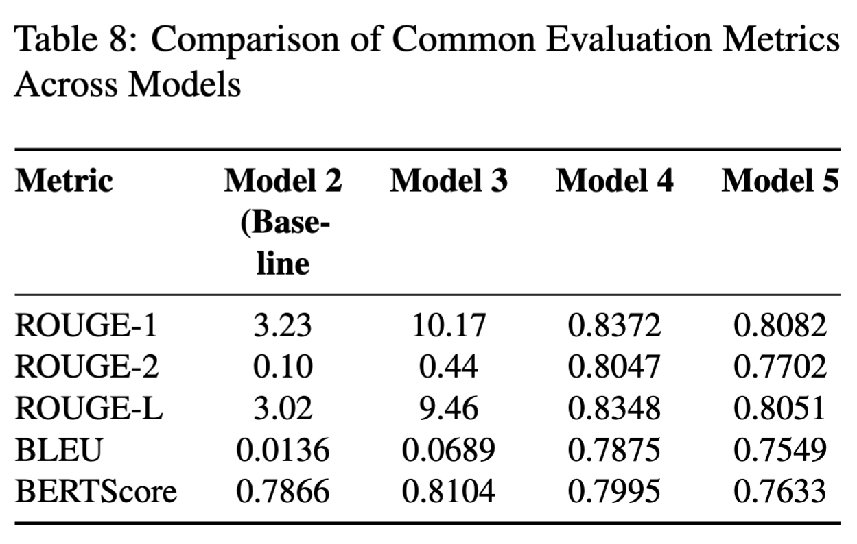
Results and Conclusion
Key Findings:
Model Performance:
The Tiny LLaMA 3.2B-Instruct model demonstrated superior performance in perspective-aware healthcare summarization, achieving the highest ROUGE, BLEU, and BERTScore metrics among the evaluated models.​
Innovative Approaches:
Incorporating classifier-guided energy-based loss functions and prefix tuning enhanced perspective alignment and summary quality.​
Model Comparisons:
While Model 4 (Two-Stage Adapter Tuning) and Model 5 (Perspective-Specific Adapters) showed promising results, they did not surpass Model 3 in overall performance.​
Implications:
Advancements in Healthcare NLP:
This work underscores the importance of integrating perspective-awareness in medical NLP tasks, offering better contextualization for users seeking specific types of information.​
Future Directions:
Future enhancements will focus on refining dataset partitions, reducing redundancy, and incorporating human evaluations to better capture subjective quality factors.

Slide 12
References
Md. Shad Akhtar et al., "No perspective, no perception!! Perspective-aware healthcare answer summarization," Findings of the Association for Computational Linguistics: ACL 2024, pp. 15919–15932, 2024. [Online]. Available: https://aclanthology.org/2024.findings-acl.942.pdf
D. Demner-Fushman and J. Lin, "Answer extraction, semantic clustering, and extractive summarization for clinical question answering," Proceedings of the 21st International Conference on Computational Linguistics and 44th Annual Meeting of the Association for Computational Linguistics, pp. 841–848, 2006. [Online]. Available: https://aclanthology.org/P06-1106.pdf
Y. Du et al., "Energy-based learning for text-to-image generation," Advances in Neural Information Processing Systems (NeurIPS), vol. 35, pp. 1–14, 2022. [Online]. Available: https://arxiv.org/abs/2206.01714
E. J. Hu et al., "LoRA: Low-rank adaptation of large language models," International Conference on Learning Representations (ICLR), 2021. [Online]. Available: https://arxiv.org/abs/2106.09685
X. L. Li and P. Liang, "Prefix-tuning: Optimizing continuous prompts for generation," Proceedings of the 59th Annual Meeting of the Association for Computational Linguistics and the 11th International Joint Conference on Natural Language Processing (Volume 1: Long Papers), pp. 4582–4597, 2021. [Online]. Available: https://arxiv.org/abs/2101.00190
C. Raffel et al., "Exploring the limits of transfer learning with a unified text-to-text transformer," Journal of Machine Learning Research (JMLR), vol. 21, no. 140, pp. 1–67, 2020. [Online]. Available: https://arxiv.org/abs/1910.10683
H. Rashkin et al., "Truth of varying shades: Analyzing language in fake news and political fact-checking," Proceedings of the 2017 Conference on Empirical Methods in Natural Language Processing, pp. 2931–2937, 2017. [Online]. Available: https://aclanthology.org/D17-1317.pdf
H. Touvron et al., "LLaMA: Open and efficient foundation language models," arXiv preprint arXiv:2302.13971, 2023. [Online]. Available: https://arxiv.org/abs/2302.13971
T. Zhang et al., "A contrastive framework for neural text generation," Proceedings of the 2022 Conference on Neural Information Processing Systems (NeurIPS), 2022. [Online]. Available: https://arxiv.org/abs/2202.06417
Y. Zhang et al., "Optimizing the factual correctness of a summary: A study of summarizing radiology reports," Proceedings of the 58th Annual Meeting of the Association for Computational Linguistics, pp. 5108–5120, 2020. [Online]. Available: https://aclanthology.org/2020.acl-main.458/

Slide 13
Thank You

