Slide 1

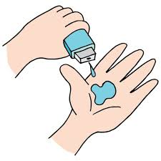
Project Title: Diabetes prediction
SHASHANK R R
STU6508501cd45be1695043612

Slide 2

PROBLEM STATEMENT
Classification of patients based on the chance of affecting diabetes

Slide 3
Diabetics Prediction:
Learning Outcome:
Gain a deep understanding of fundamental AI and ML concepts
Acquire proficiency in data preprocessing techniques
Learn how to build machine learning models using popular libraries
Develop the ability to identify and frame real-world problems that can be addressed with AI/ML solutions
Software/Technology Requirements:
Jupyter Notebook or
Anaconda
About the Project:
The project's problem statement revolves around the urgent need to develop a robust and accurate machine-learning model for the classification of patients based on their risk of developing diabetes. Diabetes, a chronic health condition, is on the rise globally, and early detection and intervention are paramount for effective management and prevention of complications. The goal is to classify patients into two groups: those at elevated risk of developing diabetes and those not at risk, thereby assisting healthcare professionals in targeted intervention strategies, and preventive measures, and ultimately improving patient outcomes in the realm of diabetes management.

Slide 4

WHO ARE THE END USERS?
The end users are the doctors and the patients
This helps the doctors in easily able to classify the patients

Slide 5

Technology Used
Artificial Intelligence
Machine Learning
Libraries Used - Pandas, Matplotlib, Numpy, Scikit-learn, Sklearn

Slide 6
MODELLING -
I have used k nearest neighbour
The K-Nearest Neighbors (KNN) algorithm is a robust and intuitive machine learning method employed to tackle classification and regression problems. By capitalizing on the concept of similarity, KNN predicts the label or value of a new data point by considering its K closest neighbours in the training dataset. In this article, we will learn about a supervised learning algorithm (KNN) or the k – Nearest Neighbours, highlighting it’s user-friendly nature.

Slide 7
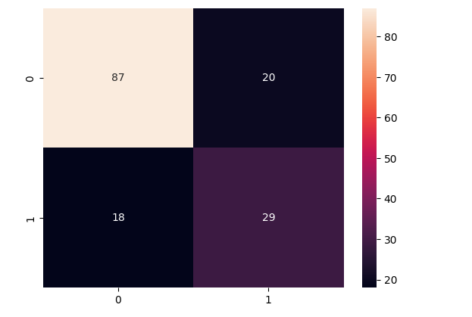
RESULTS
Heatmap
Demo Link

Slide 8
Thank you
.
.

