Slide 1
Restaurant Risk Classification

Slide 2
Part A: Risk Score Based on Inspection Reasons and Results
Methodology:
(I) For each restaurant, calculate the percentage of each type of inspection out of total inspections and
(II) percentage of each type of inspection results to compare all restaurants on the same scale irrespective of number of inspections and finally
(III) Assign weights and calculated the risk score based on I and II

Slide 3
Part A: Risk Score based on Inspection Reasons and Results
Value | State | Field | For
1 | FL | Complaint Full | Inspection-Type
0.5 | FL | Complaint Partial | Inspection-Type
2 | FL | 'Facility Temporarily Closed | Inspection-Result
0.5 | FL | 'Follow-up Inspection Required | Inspection-Result
1 | WA | Complaint | Inspection-Type
0.5 | WA | Consultation/Education Field | Inspection-Type
1 | WA | Reinspection | Inspection-Type
1 | WA | Return Inspection | Inspection-Type
1 | WA | Needs Assessment | Inspection-Result
0.5 | WA | Not Ready For Inspecti | Inspection-Result
2 | WA | Unsatisfactory | Inspection-Result

Slide 4
Part A: Adjusted Risk Score based on number of inspections
Methodologies Considered:
Confidence intervals⁽¹⁾
How to rank based on confidence interval?
Bayesian Methods⁽²⁾
How to account for known standard dev.?
Fusion method combining the above⁽³⁾

Slide 5
Part A: Adjusted Risk Score based on Number of inspections
Score distribution of a particular restaurant.
Mean=m, Stdev=σ/√n
Score distribution of all restaurants.
Mean=m, Stdev=σ
m
x⁽⁴⁾
M
x is the point at which both shaded regions have equal areas
As number of inspections for a restaurant increases, the adjusted score ‘x’ moves closer and closer to actual score ‘m’

Slide 6
Part B: Risk Score Based on Number of Infractions
Methodology:
We follow a similar procedure to how we calculate the score in part A
(I) For each restaurant, calculate the percentage of each type of violation out of total violations and
(II) Calculate percentages of criticality, priority and responsiveness to violations and
(III) Assign different weights and calculated the risk score based on I and II and finally
(IV) Calculate the adjusted score as explained in the previous slide

Slide 7
Part B: Risk Score Based No. of Violations
Value | State | Field | For
1 | FL | correctedOnSite False | Violation
1 | FL | repeatViolation True | Violation
1 | FL | priorityFoundationItem True | Violation
1 | FL | coreItem True | Violation
1 | FL | riskCategory 'Basic' | Violation-Risk
3 | FL | riskCategory 'High Priority' | Violation-Risk
6 | FL | riskCategory 'Intermediate' | Violation-Risk
2 | FL | critical True | Violation
1 | FL | priorityItem True | Violation
15 | WA | Critical True | Violation
1 | WA | Points | Violation

Slide 8
Composite score based on from Parts A and B
A correlation analysis with HD score shows that Part A - risk score has a correlation of 0.27 and the Part B – risk score has a correlation very close to zero
Regressing HD score with risk scores from Part A and Part B also shows similar results with HD score having very excellent linear dependency on inspection-based results
Therefore we will simply consider Part A risk score as the composite score and ignore Part B risk score

Slide 9
Forecasting for the next year
Major issue here is the small size of sample to forecast
Methodologies considered:
Moving Average model with first difference
Holts – Winter method
Simple Regression on Inspection Scores

Slide 10
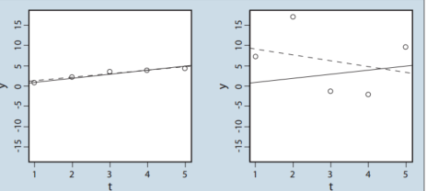
Forecasting based on inspection scores
Methodology
Do we have at least 5 inspection scores?
Is there a clear trend (R-square > 0.25)?
Find slope where there is a clear trend
Forecast = Score*(1+2*slope)
(Assumed that forecast for next year will be after two inspections)
Recalibrate scores based on new forecast
Use
Ignore

Slide 11
Bonus Part: Scanning key words from inspection detail
Methodology for identifying key words associated with violation types
Represent each comment as a matrix of n-grams (bag of words)
Apply TF-IDF as a weighting factor in identifying importance of n-grams
Build a linear support vector machine (SVM) model against the violation category
Identify key n-grams associated with each category of violation based on the weight of the coefficients
Plot the features in word cloud

Slide 12
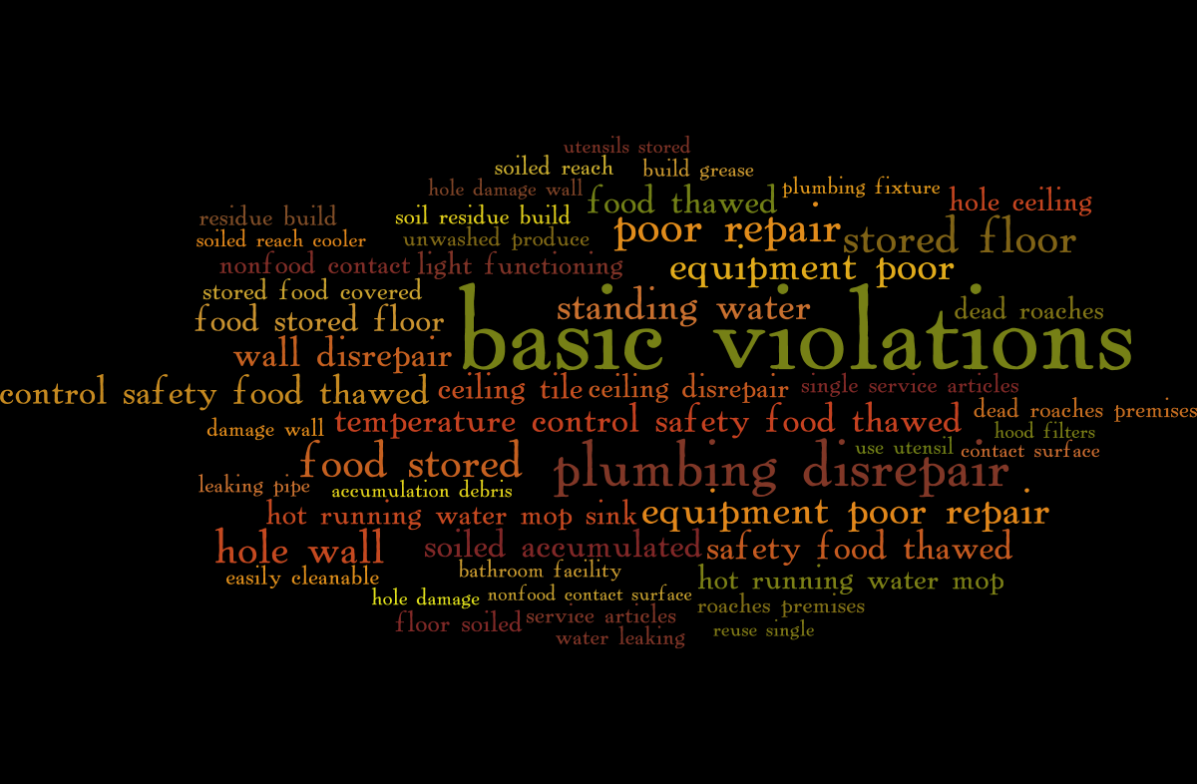
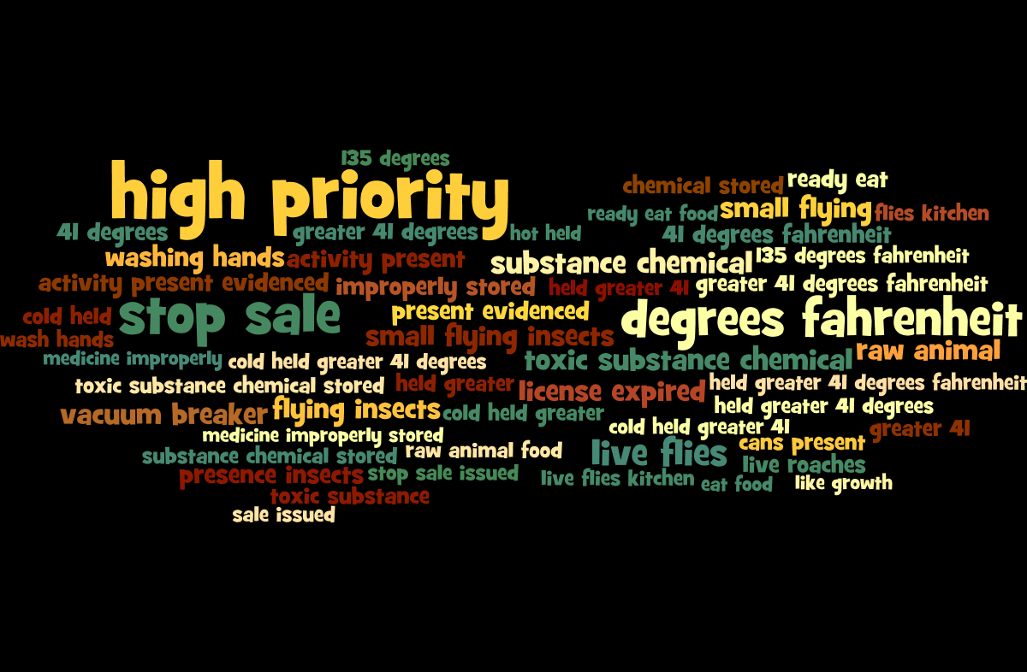
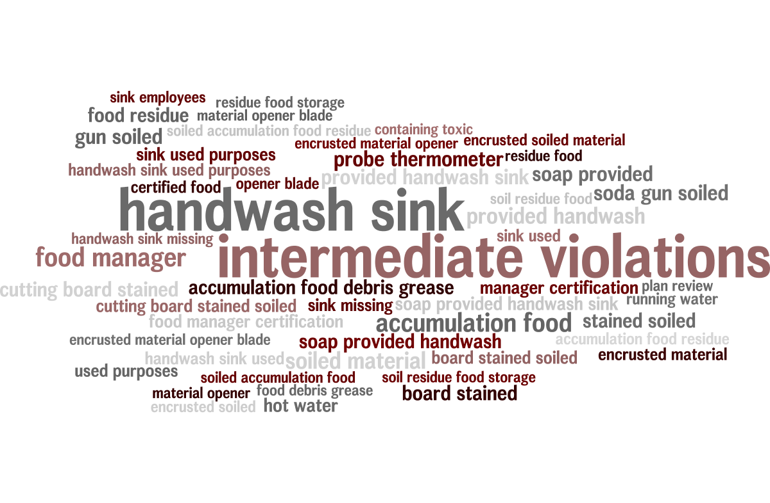
Word Clouds

Slide 13
How do we use Word Clouds?
Currently weightages for violations are set based on intuition
Based on the word clouds a subject matter expert can construct possible risk scenarios and their probability of occurrences
Weightages for violations can then be set proportional to the estimated insurance risk
The code can be used to find key phrases against any risk, inspection or violation type

Slide 14
Questions?
Thank You

Slide 15
Appendix
(1) http://blogs.sas.com/content/iml/2011/03/30/ranking-with-confidence-part-2.html
(2) http://stats.stackexchange.com/a/16053
(3) We assume the standard deviation of the scores of all restaurants to be the standard deviation of the scores for each restaurant
(4) X is the point at which the p-values for both distributions become equal. One can think of it as the point at which the competing distributions have the equal probability. The strength of these distributions is encapsulated in the standard deviation of these distributions
(5) List of features and weights for each violation type –
(6) Python code to identify key words –
(7) Forecasting methods - http://www.bishophill.com/admin/sidebar_images/1741759940_test.pdf

