Slide 1
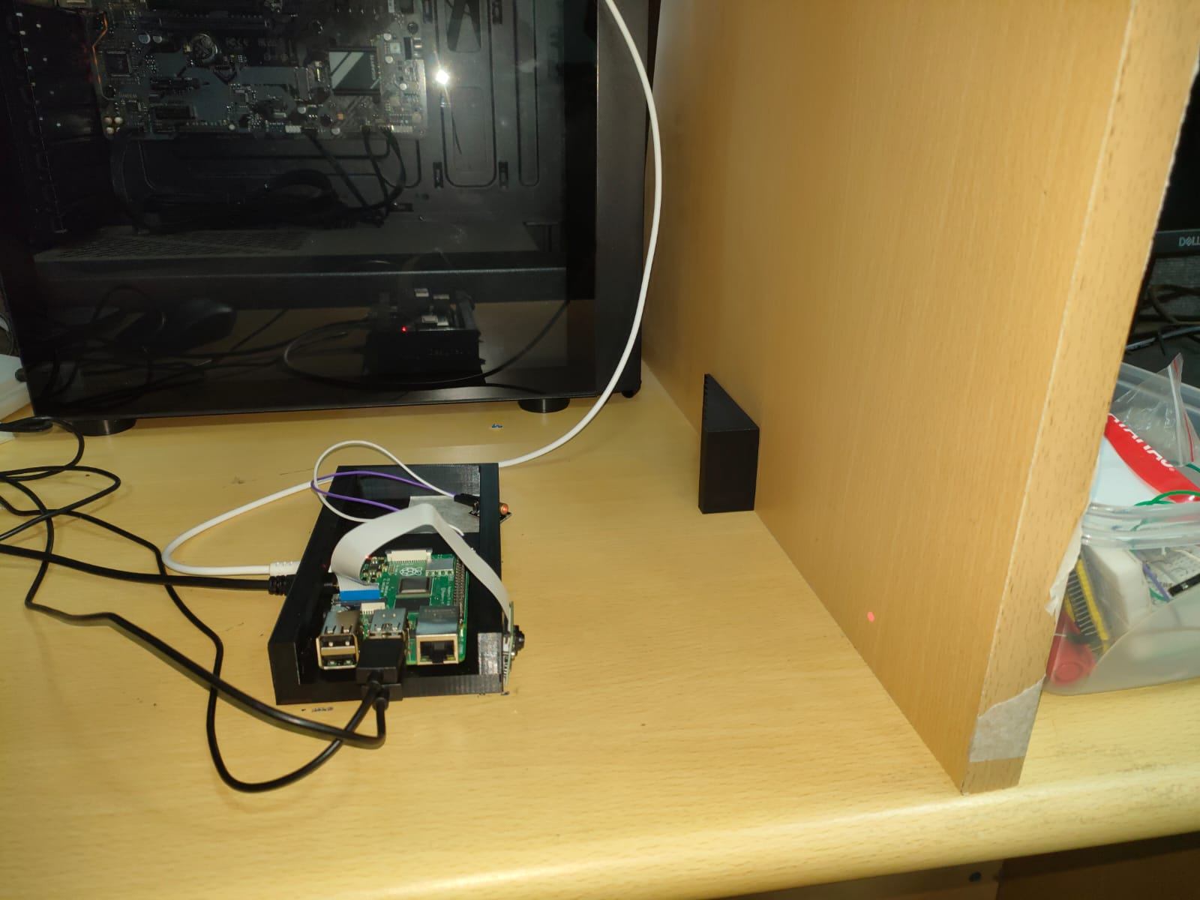

OBJECT HEIGHT MEASUREMENT
Through laser triangulation
Raspberry Pi + camera based
non-contact height measurement system
Department of Instrumentation & Applied Physics
23 September 2026
Mayank Bisht • Suseenthar T.G. • Swarnabha • Shashank Shanbhang

Slide 2
01 / PHYSICS & PRINCIPLE
Laser Triangulation
An active 3D non-contact optical technique used to capture surface geometry, profile measurements, and depth data
Projects a structured light source (laser spot or line) onto an object and uses a displaced camera to capture the reflection angle
Critical Requirement - Diffuse Reflection: System relies on the surface scattering light in all directions so the camera sensor can "see" the laser spot
Formed by three fixed points: Laser, Camera Lens and Object

Slide 3

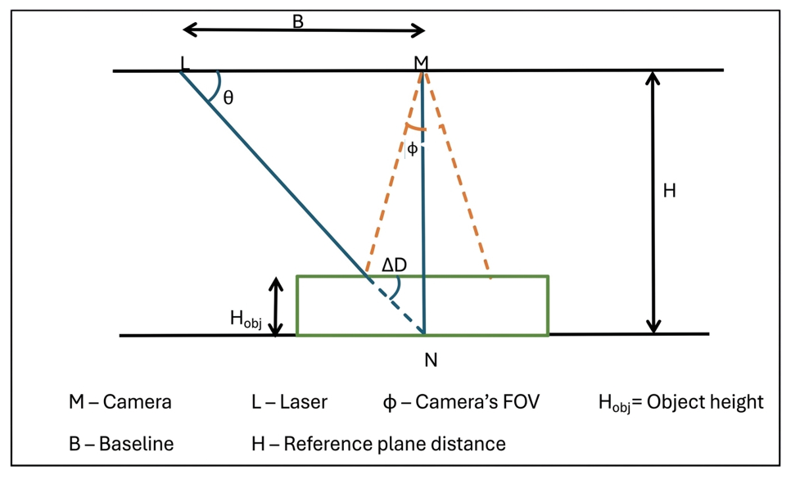
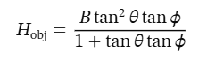

01 / PHYSICS & PRINCIPLE
Triangulation Geometry
Geometric relation used to connect spot displacement with object height
Principle:
Laser triangulation converts the horizontal displacement of the laser spot in the camera image into object height using the fixed geometry and a calibration curve.

Slide 4


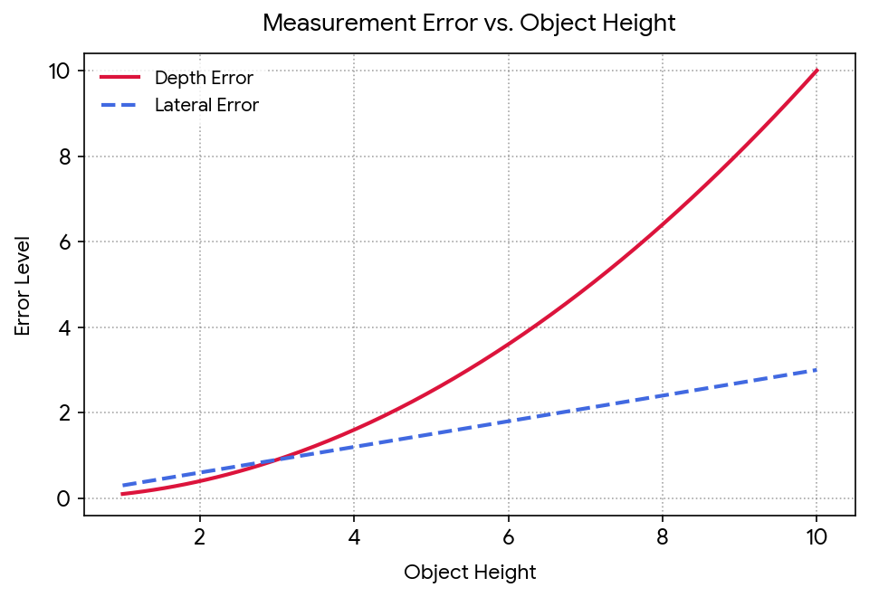


01 / PHYSICS & PRINCIPLE
Resolution
Lateral Resolution
Minimum physical distance between two distinct points on the X-Y plane
Varies linearly with distance
Depth Resolution
Minimum physical distance between two distinct points on the Z plane
Varies quadratically with distance

Slide 5
01 / PHYSICS & PRINCIPLE
Physics & Principle
Basic operating principle of the measurement system
01
02
03
04
05
LASER
OBJECT
CAMERA
PIXEL SHIFT
HEIGHT
Projects a red spot
Height changes the spot position
Captures the shifted spot
Software finds ΔX
Calibration converts ΔX to mm

Slide 6
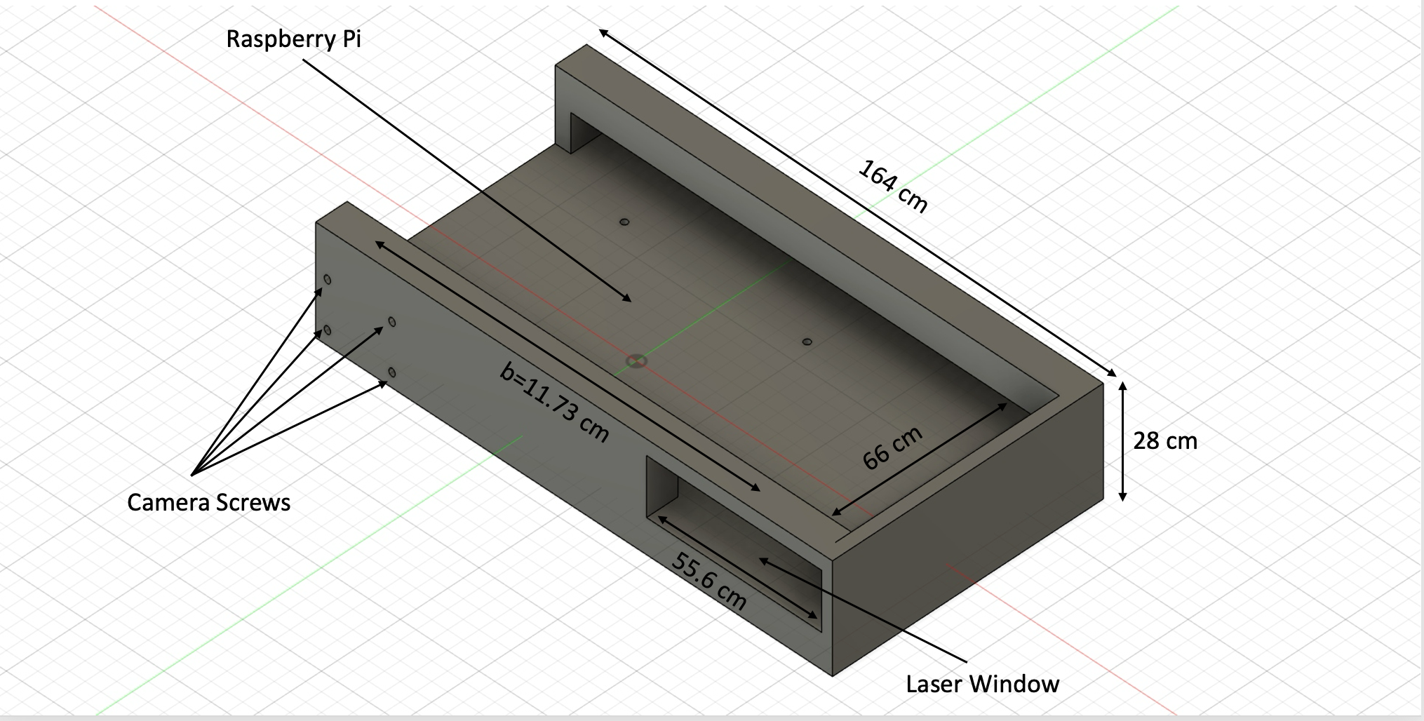
01 / PHYSICAL SETUP
Physical Setup & Measurement Process
Hardware arrangement and the sequence used during a measurement
Actual experimental setup
3D-printed holder with dimensions
1
Place reference / object
2
Laser forms spot
3
Camera captures image
4
Find spot centre X
5
Convert shift to height

Slide 7
02 / SYSTEM
System Specifications
Hardware, geometry and calibrated measurement span
Specification | Value
Camera | Raspberry Pi Camera Rev 1.5
Image resolution | 2592 × 1944 pixels
Pixel pitch | 1.4 µm
Horizontal / vertical FOV | 53.5° / 41.41°
Camera–laser baseline | 117.3 mm
Camera-to-reference distance | 139.0 mm
Triangulation angle | 49.90°
Detection ROI | X = 900–2400 px; Y = 1250–1550 px
Calibrated height range | 0–50 mm
MEASUREMENT SPAN
0 mm reference
X₀ = 1187.92 px
50 mm point
X₅₀ = 2344.15 px
0 mm
50 mm
Total horizontal shift
1156.22 px
Average over full range
23.12 px/mm
The local shift per mm is not constant, which is why a calibration curve is used instead of one straight conversion.

Slide 8
02 / SYSTEM
Theoretical Parameters
Definition, formula and calculation for the main geometry-based parameters
X lateral resolution
Y lateral resolution
Physical distance represented by one horizontal pixel at the working distance.
Formula: Rₓ = FOVₓ / Nₓ
FOVₓ = 2D tan(FOVₓ/2) = 145.72 mm; Nₓ = 2592
Rₓ ≈ 0.0562 mm/pixel.
Physical distance represented by one vertical pixel.
Formula: Rᵧ = FOVᵧ / Nᵧ
FOVᵧ = 2D tan(FOVᵧ/2) = 106.93 mm; Nᵧ = 1944
Rᵧ ≈ 0.0550 mm/pixel.
Depth sensitivity
Measurement range
Approximate height change produced by one horizontal pixel of spot movement.
From H = ΔD tan θ: Rz ≈ Rₓ tan θ
= 0.0562 × tan(50°) ≈ 0.0670 mm/pixel.
Calibrated height interval over which the system is used.
Formula: Range = hmax − hmin
= 50 − 0 = 50 mm.
The calibration code uses points from 0 to 50 mm.

Slide 9
02 / CALIBRATION
Calibration Height Data
Mean laser position, horizontal shift and measured spot width at the calibration heights
Height (mm) | Mean X (px) | ΔX from 0 mm (px) | Shift / interval (px/mm) | Spot width (px)
0 | 1187.92 | 0.00 | — | 105.3
3 | 1242.71 | 54.79 | 18.26 | 67.7
6 | 1283.94 | 96.02 | 13.74 | 75.3
9 | 1333.65 | 145.72 | 16.57 | 82.3
12 | 1377.70 | 189.78 | 14.69 | 84.4
15 | 1440.36 | 252.43 | 20.88 | 80.0
18 | 1488.95 | 301.03 | 16.20 | 82.5
21 | 1551.40 | 363.48 | 20.82 | 90.5
24 | 1613.12 | 425.20 | 20.57 | 92.2
27 | 1678.99 | 491.07 | 21.96 | 98.1
30 | 1741.49 | 553.57 | 20.83 | 97.7
34 | 1849.84 | 661.91 | 27.09 | 96.0
40 | 2024.87 | 836.95 | 29.17 | 103.3
46 | 2204.26 | 1016.33 | 29.90 | 105.1
50 | 2344.15 | 1156.22 | 34.97 | 110.4
Calibration points: 0–30 mm in 3 mm steps, then 34, 40, 46 and 50 mm. Overall shift = 1156.22 px.

Slide 10
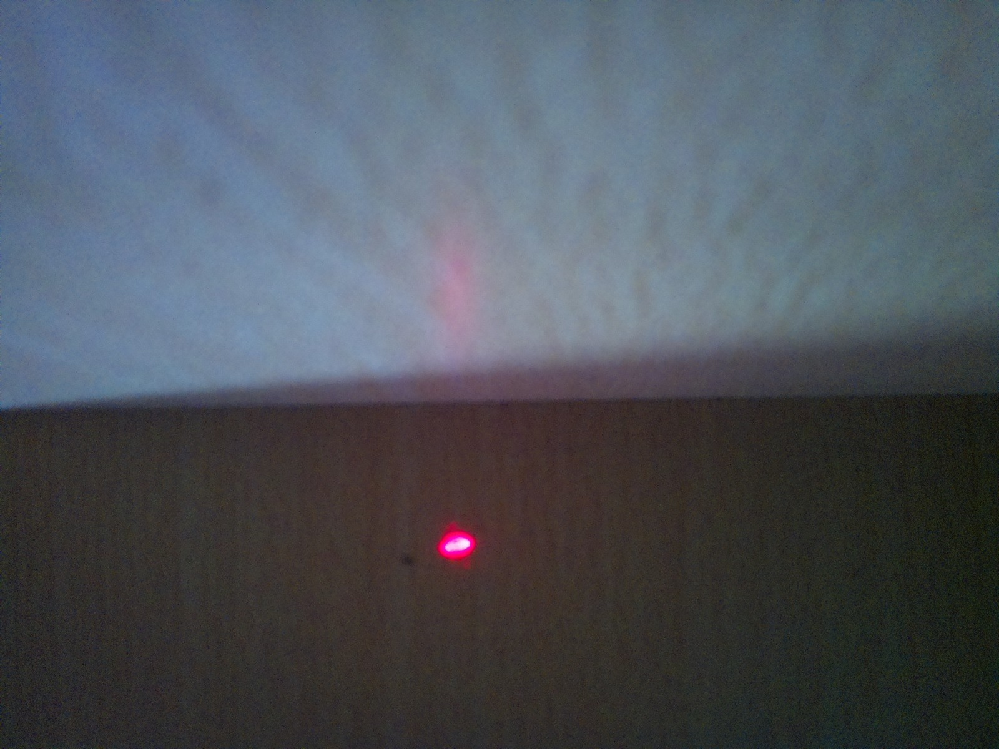
02 / SPOT
Laser Spot Used for Measurement
The image feature that the software tracks
1. Find the red spot
The camera image is searched inside the fixed measurement region.
2. Find its centre
The bright spot is reduced to one horizontal centre position X.
3. Use the X shift
Xobject − Xreference gives ΔX, which is then converted to height.
Measured red laser spot
Average detected spot width during calibration ≈ 91.4 px

Slide 11
03 / SOFTWARE
Software Flow — Calibration → Height Measurement
Two Python programs share one saved calibration model
CALIBRATION.PY
HEIGHT_CALC.PY
Load camera + detector settings
Load calibration_model.json
Capture known heights
Lock saved detector/camera settings
Detect laser centre X,Y
Capture 0 mm reference
Reject outliers + average
Capture object shots
Build height vs ΔX data
Detect + filter spot positions
Test 4 curve models
Compute ΔX and normalize u
Select best model
Apply saved model
Save calibration_model.json
Print + save height result
calibration_model.json

Slide 12
03 / SOFTWARE
Calibration Algorithm & Data Generation
Detailed processing performed by calibration.py
1. CAMERA
Lock / save exposure, gain and colour gains
WHAT IS SAVED?
2. HEIGHTS
0, 3, 6 … 30, 34, 40, 46, 50 mm + 10 known objects
3. CAPTURE
30 frames at each known height
Detector
4. ROI
Crop X=900–2400, Y=1250–1550
ROI, red thresholds, blur, background percentile, centroid threshold and saturation limit.
5. COARSE DETECTION
Red-dominant threshold
Reference
6. FINE CENTRE
Gaussian blur → local background → 60% peak threshold
0 mm reference X,Y and all averaged calibration points.
7. CENTROID
Weighted red-channel centroid gives sub-pixel X,Y + spot width
8. SHIFT
0 mm mean X becomes reference; compute ΔX for every height
Model
9. FIT
Compare PCHIP, rational, 3rd-order and 4th-order models
Selected curve type, fitted parameters and calibrated X range.
10. SAVE
Write calibration CSVs + detector settings + selected model to JSON
Camera
Resolution, exposure, analogue gain and colour gains used during calibration.

Slide 13

03 / SOFTWARE
Height Calculation — Pixels to mm
The measurement program applies the already-fitted calibration relationship
IMAGE
SPOT
SHIFT
NORMALIZE
CALIBRATE
HEIGHT
Camera frame
Find laser centre X
Compare with current 0 mm reference
u = ΔX / 1000
Evaluate saved rational model
Height in mm
u = ΔX / 1000
$$h= \frac{\text{69.9439u − 0.3481}}{\text{0.5299u + 1}}$$
The fitted coefficients are stored in calibration_model.json.
Pixel position → horizontal shift ΔX → normalized shift u → calibrated height h (mm)
The same detector and camera settings saved during calibration are reused during measurement.

Slide 14
03 / SOFTWARE
Curve Fitting & Model Selection
Four candidate relationships were tested on the calibration data
Model | Test error (mm) | Used?
PCHIP | 0.332 | No
Rational | 0.245 | YES
Polynomial 3 | 0.251 | No
Polynomial 4 | 0.278 | No
How was the test done?
One calibration point is left out, the curve is fitted with the remaining points, and the hidden point is predicted. This is repeated across the calibration set.
Why was the rational model used?
It gave the smallest test error among the four models, so the program selected it automatically.
Saved equation
h = (69.9439u − 0.3481)/(0.5299u + 1)
u = ΔX / 1000

Slide 15
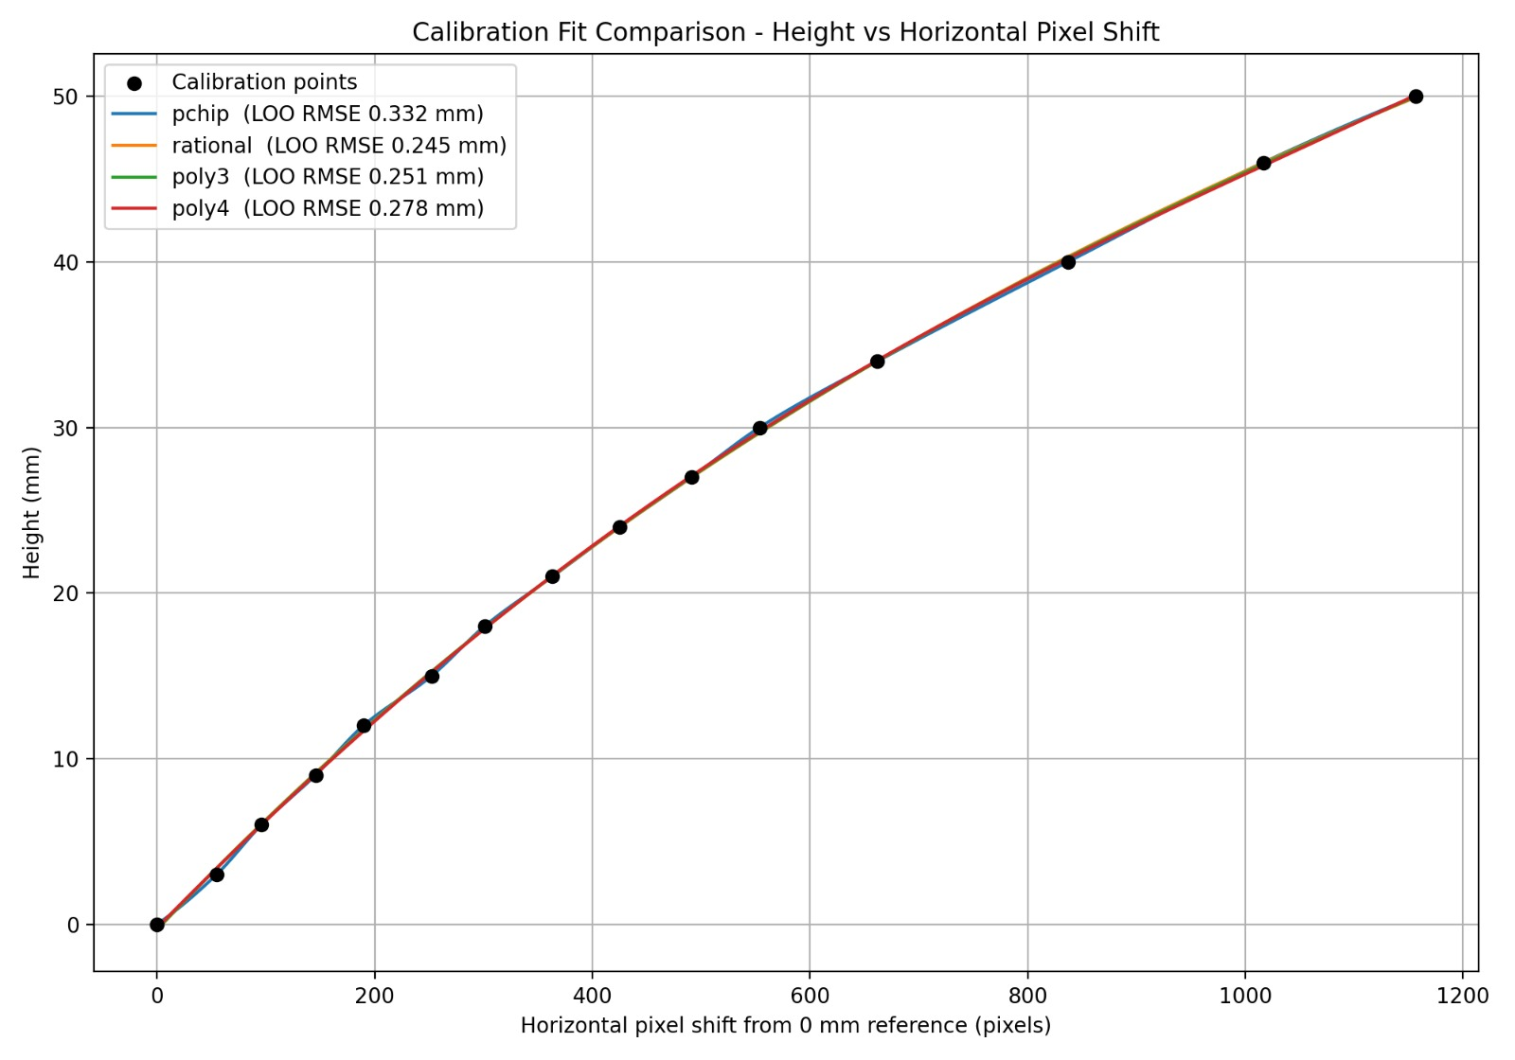
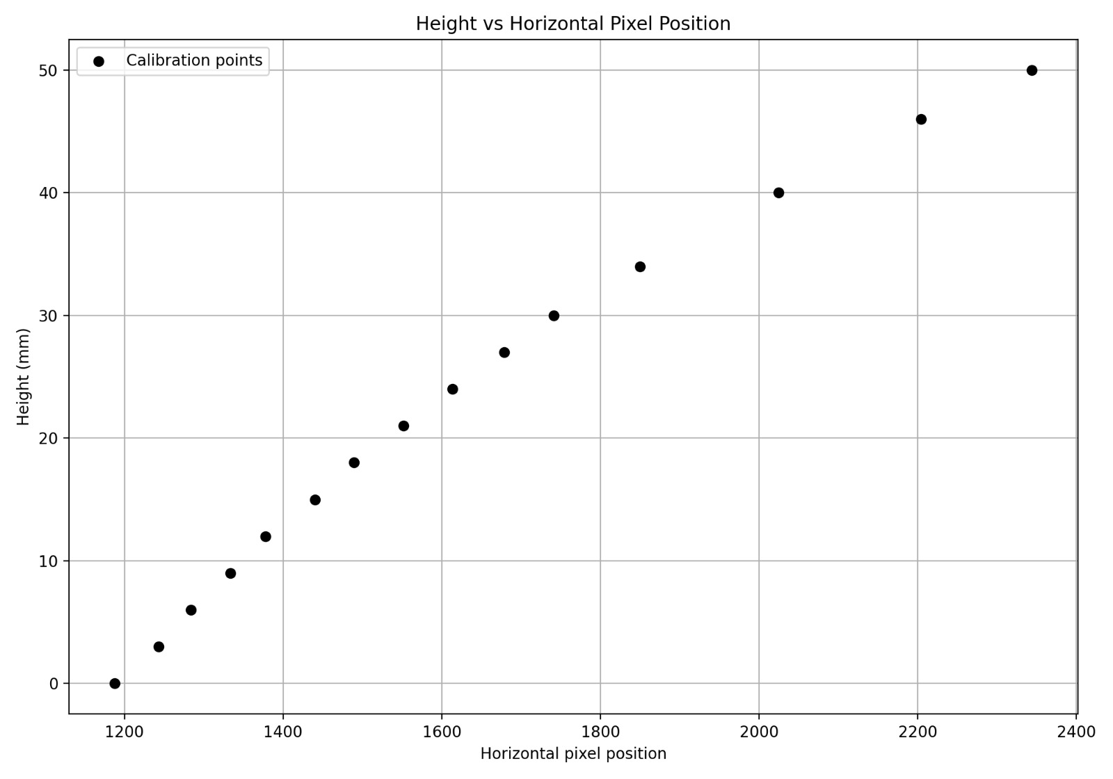
03 / RESULTS
Calibration Results
The two key plots used to judge the calibration relationship
Height vs horizontal pixel shift — model comparison
Height vs horizontal pixel position — calibration data

Slide 16
04 / EXPERIMENTAL RESULTS
Experimental Measurement Results
Notebook measurements arranged in ascending order of actual height
Object | Actual height (mm) | Measured height (mm)
ID | 0.730 | 0.607
Ref. 4 | 2.000 | 2.052
Ref. 1 | 3.000 | 3.126
Ref. 6 | 4.000 | 4.074
Ref. 7 | 10.000 | 9.938
Black lid | 10.300 | 9.860
Eraser | 10.620 | 10.519
Ref. 2 | 12.000 | 11.804
Battery | 13.860 | 13.834
Ref. 8 | 16.000 | 15.899
Headphone pouch | 23.880 | 24.106
Charger | 27.370 | 27.190
Ref. 3 | 30.000 | 29.845
Ref. 5 | 50.000 | 50.216
Values are transcribed from the experimental notebook; no error column is included.

Slide 17
04 / PERFORMANCE & CONCLUSION
Practical Performance, Conclusion & Improvements
Comparison of the main theoretical and measured system characteristics
Parameter | Theoretical | Practical / measured
Height resolution | 0.064 mm | ≈ 0.1 mm/pixel
Horizontal resolution | 0.054 mm | ≈ 0.055 mm
Depth sensitivity | 0.0670 mm/pixel (max) | ≈ 0.057329 mm/pixel (avg)
Measurement range | 52.15 mm | 0–50 mm calibrated
Calibration test error | — | 0.2447 mm
Conclusion
The system provides non-contact height measurement over a 0–50 mm calibrated range. The saved rational model gave the lowest test error among the four tested models.
Current limitations
The laser spot is relatively large. Background lighting and surface reflectivity can affect spot detection. Calibration is limited to 50 mm.
POSSIBLE IMPROVEMENTS
Smaller spot
Rigid alignment
Reduce background light
More calibration points
Use a narrower / better-collimated laser.
Fix camera–laser geometry more firmly.
Limit unwanted illumination around the measurement area.
Add points where the height–pixel curve changes faster.

