Slide 1

TimeCraft Mastering Schedules with Automated Timetabling
A Final Year BCA Mini Project by:
Arun LR Reg.No: U05UI21S0009
Neelanjan.V Reg.No: U05UI21S0032
Shashank A Poojary Reg.No: U05UI21S0054
Vinod Moger Reg.No: U05UI21S0066

Slide 2
1.Introduction of the system
In the dynamic realm of educational institutions, the efficient management of resources, schedules, and activities stands as a cornerstone of success. At the heart of this operational efficiency lies the creation of timetables, which serve as blueprints for the organization of classes, exams, and other academic events. Timetabling is a multifaceted endeavor, intricately woven with constraints, preferences, and the ever-evolving needs of students, teachers, and administrators.

Slide 3
Background and Context
Timetabling has a long history, starting with manual, pen-and-paper methods that relied on administrators meticulously balancing constraints like teacher availability, room capacities, and student preferences. As educational environments grew more complex, these manual methods became inadequate. Efforts to automate timetabling emerged with advances in computing and optimization algorithms. Early heuristic approaches, such as genetic algorithms and simulated annealing, showed potential but failed to fully address all scheduling constraints and preferences. With rising enrollments, diverse curriculam, and demands for flexibility, educational institutions recognized the need for more robust and comprehensive timetabling solutions.

Slide 4

Purpose and Need of the Project
Problem: Educational institutions face challenges in efficiently creating and managing academic timetables.
Need: Manual scheduling is time-consuming, prone to conflicts, and inefficient in resource utilization.
Solution: TIMECRAFT automates timetable generation, minimizes conflicts, optimizes resource usage, and provides a user-friendly interface for management.
Before TimeCraft After TimeCraft

Slide 5
The Rise of Automated Timetabling
With the advent of the digital age, automated timetable generators emerged, utilizing algorithms and optimization techniques to streamline the timetabling process, reduce errors, and enhance efficiency. Researchers focused on combinatorial optimization, integer programming, and constraint satisfaction to create optimal timetables. Early automated systems showed potential by encoding rules, constraints, and preferences into algorithms, producing schedules that met diverse needs. However, these systems were often complex and difficult to customize, limiting their widespread adoption.

Slide 6
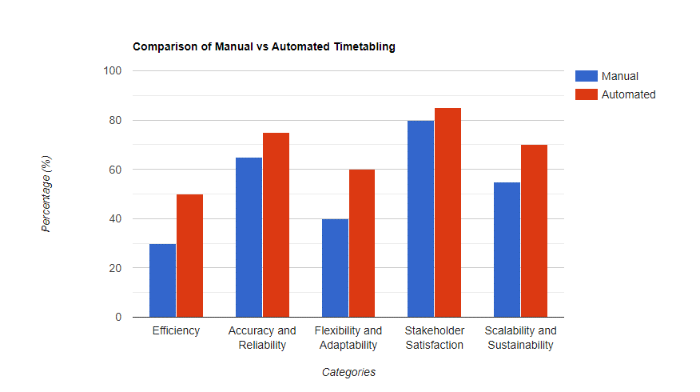
2.Scope of the Study
The study of automated timetabling is pivotal in educational administration and management, especially amidst technological advancements and evolving pedagogical practices. This study examines various dimensions of automated timetabling, highlighting its significance and potential impact:
"A Comparative Study of Manual vs Automated Timetabling in Higher Education Institutions" - Journal of Educational Technology.

Slide 7
Efficiency: Automated systems streamline manual scheduling tasks, such as resolving conflicts and allocating resources, through sophisticated algorithms. This leads to time savings for administrators and optimal resource utilization.
Accuracy and Reliability: By systematically analyzing constraints and preferences, automated systems produce schedules that adhere to institutional policies, reducing errors and disruptions in academic operations.
Flexibility and Adaptability: Automated systems can adapt to changes in scheduling constraints, ensuring timetables remain responsive and up-to-date. This optimizes resource utilization and minimizes conflicts in dynamic educational environments.
Stakeholder Satisfaction: Effective timetabling is crucial for student planning, teacher organization, and administrator coordination. Automated systems enhance satisfaction by providing efficient, accurate, and user-friendly schedules, empowering stakeholders and fostering engagement.
Scalability and Sustainability: Automated systems offer scalable solutions that accommodate increasing complexity as institutions grow. By minimizing errors and supporting continuous improvement, they contribute to the long-term success and sustainability of educational institutions.

Slide 8
3.Methodology of Study
1. Research Design
Experimental Design: Conduct experiments to test scheduling algorithms and optimization techniques
Descriptive Design: Use surveys, interviews, and case studies to document current timetabling practices and challenges
Comparative Design: Compare different timetabling approaches to assess their effectiveness and usability
2. Data Sources
Primary Data: Gather firsthand data from stakeholders through surveys, interviews, and observations
Secondary Data: Review existing literature, reports, and documentation on automated timetabling
Mixed-Methods Data: Combine quantitative and qualitative data to provide a comprehensive understanding
3. Sampling Strategies
Probability Sampling: Use techniques like random sampling to ensure representativeness
Non-Probability Sampling: Use convenience or purposive sampling for specific contexts
Mixed-Methods Sampling: Integrate both probability and non-probability sampling techniques
4. Analytical Techniques
Quantitative Analysis: Use statistical methods to analyze numerical data.
Qualitative Analysis: Use thematic or content analysis to interpret textual data.
Mixed-Methods Analysis: Combine quantitative and qualitative techniques to triangulate findings

Slide 9
4.Objectives of the System
Efficiency and Resource Optimization:
Streamline scheduling tasks, reducing administrative burdens and errors.
Generate optimized schedules to maximize resource utilization.
Enhanced Accuracy and Reliability:
Eliminate human errors and ensure schedules adhere to policies.
Create reliable, conflict-free timetables for smooth operations
Flexibility and Adaptability:
Handle diverse constraints and adapt to changes in real-time.
Optimize resource use and minimize conflicts.
Long-term Sustainability:
Offer scalable solutions to meet evolving needs.
Ensure consistency, minimize errors, and support continuous improvement
Improved Stakeholder Satisfaction:
Provide efficient, user-friendly schedules for all stakeholders.
Empower stakeholders and foster engagement in the scheduling process

Slide 10
5. Requirement analysis and feasibility
Technical Feasibility
The project uses Python and PyCharm for development, requiring a Windows operating system, Intel i3 processor, 4 GB RAM, and 512 GB SSD for development, with higher specs for implementation.
Operational Feasibility
The system aims to streamline timetabling processes, reducing administrative burdens and enhancing resource utilization. It includes user-friendly interfaces for administrators, faculty, and students.
Economic Feasibility
The project aims to stay within budget limitations, ensuring cost-effective development and implementation while providing scalable solutions for future expansion.

Slide 11
6. Functions of the System
Data Input: Provides an interface for inputting and maintaining data for faculty, subjects, electives, and classrooms.
Timetable Generation: Employs algorithms and constraints to generate optimal timetables
Timetable Display: Offers interactive visualization of the generated timetable with functionalities for viewing and manipulating schedule information.
Timetable Printing: Allows the user to print the generated timetable in various formats, including Word documents, suitable for both student and faculty use

Slide 12
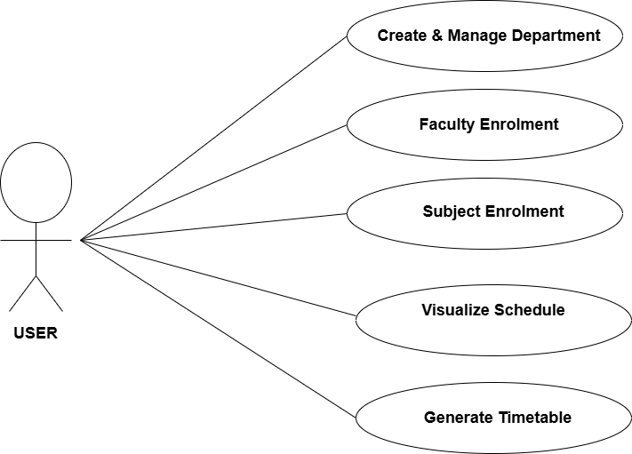
7.Use Case
This Use Case Diagram provides a visual representation of the interactions between users (actors) and the system, highlighting
• The actor (USER) is connected to each use case with lines, indicating the interactions between the user and the system's functionalities.
• Each use case is represented by an ellipse and describes a specific function or feature that the system provides to the users.
• The lines connecting the actor to the use cases show that the user can perform all these actions within the system.

Slide 13
8.Algorithm
Timetable Generation and NP-Hard(Nondeterministic Polynomial time) Algorithms
1. The Problem
Creating a timetable involves scheduling classes, exams, and other activities in a way that:
Avoids Conflicts: Ensures no class or exam overlaps for any student or faculty.
Optimizes Resources: Manages the use of classrooms, equipment, and faculty effectively.
Follows Constraints: Meets specific constraints such as faculty availability, room capacities, and student course requirements.
This problem becomes increasingly complex as the number of courses, rooms, faculty, and constraints increases. This complexity can make it an NP-hard problem.

Slide 14
2. Why Timetable Generation is NP-Hard ?
Combinatorial Explosion: As you add more classes, faculty, and constraints, the number of possible schedules grows exponentially. Finding the optimal schedule among these possibilities is extremely difficult.
Constraints and Preferences: There are numerous constraints (like avoiding scheduling two classes for the same student at the same time) and preferences (such as faculty preferred teaching times) that must be considered simultaneously.
3. NP-Hard Algorithms for Timetable Generation
Approach used to tackle NP-hard timetable generation problems:
Heuristic Algorithms:
Greedy Algorithms: These make a series of choices that seem best at the moment, like scheduling classes one by one based on availability and constraints. They don’t guarantee the optimal solution but can be fast and practical.
Local Search: This technique starts with a feasible schedule and iteratively makes small changes (like swapping class times) to improve it

Slide 15
9.System Design
The system design of TIMECRAFT is focused on developing an efficient, user-friendly timetable management system. This design encompasses the overall architecture, data flow, functional decomposition, and the hardware and software requirements necessary to achieve the system's objectives

Slide 16
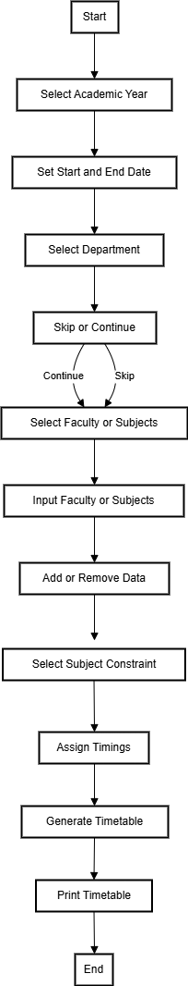
Flow Chart
The flowchart diagram outlines the
step-by-step process of managing teacher
profiles, enrolling courses, generating
timetables, and visualizing schedules

Slide 17
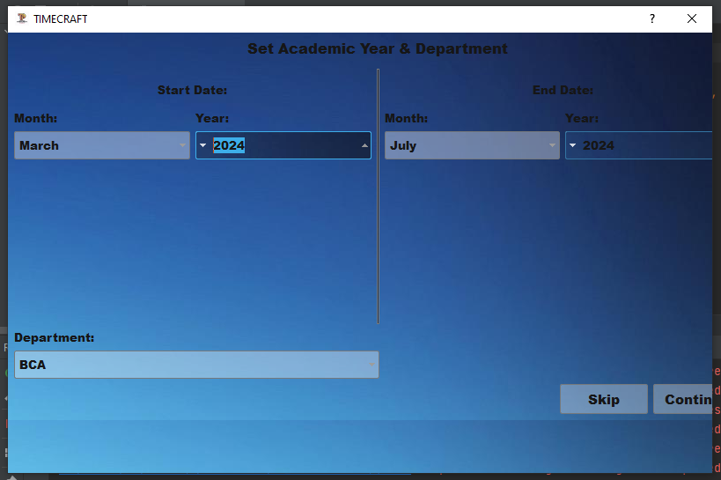
Level 0 Data Flow
User Interaction:
User: Initiates the process.
Handle User Options:
Options: Skip or Continue.
Skip: Bypasses further steps and returns to the start.
Continue: Proceeds to set academic year.
Set Academic Year:
User sets the academic year.
Select Department:
User selects department.
May enter start and end dates.
Flow Explanation:
From User to Handle User Options: User makes choices to skip or continue.
From Handle User Options to Set Academic Year: User sets the academic year if they continue.
From Set Academic Year to Select Department: User selects the department.
From Select Department to Handle User Options: System may loop back for further options.

Slide 18
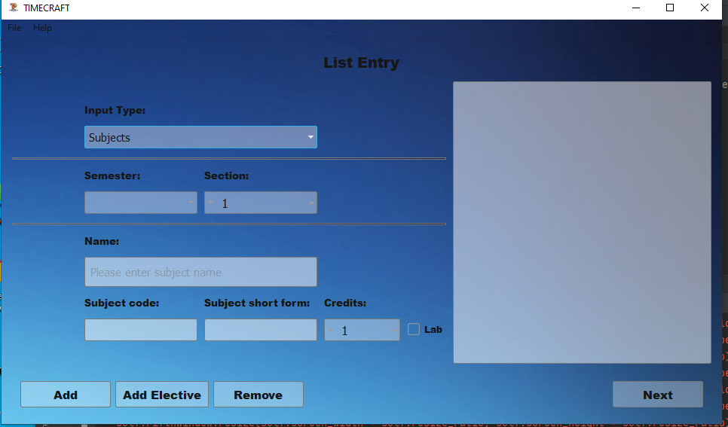
Level 1 Data Flow
User: Starts interaction.
Select Input Type: User chooses to manage either faculty or subjects.
Select Faculty or Subjects: User selects specific faculty or subjects to manage.
Add/Remove Data: User adds or removes data for the selected type.
Faculty Add/Remove Data: Manages faculty data.
Subjects Add/Remove Data: Manages subject data..
Flow Explanation:
From User to Select Input Type: User selects between managing faculty or subjects.
From Select Input Type to Select Faculty or Subjects: User chooses specific items to manage.
From Select Faculty or Subjects to Add/Remove Data: User adds or removes data.
From Add/Remove Data to Update Display: System updates the displayed data.
From Update Display to Display Data: System shows updated data to the user.

Slide 19
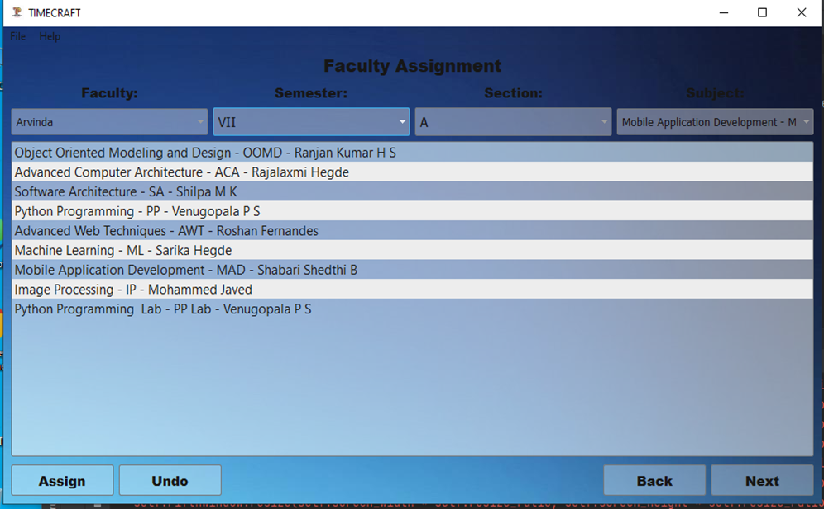

Level 2 Data Flow
User: Starts the interaction.
Select Faculty Assignment: User selects the faculty assignment to manage.
Assign/Undo Faculty: User assigns or undoes the assignment of faculty.
Update Display: System updates the display with current faculty assignment status.
Display Assignment: Displays the updated faculty assignment to the user.
Flow Explanation:
From User to Select Faculty Assignment: User selects the faculty assignment they want to manage.
From Select Faculty Assignment to Assign/Undo Faculty: User assigns or undoes the faculty assignment.
From Assign/Undo Faculty to Update Display: System updates the displayed faculty assignment status.
From Update Display to Display Assignment: System shows updated faculty assignment to the user.

Slide 20
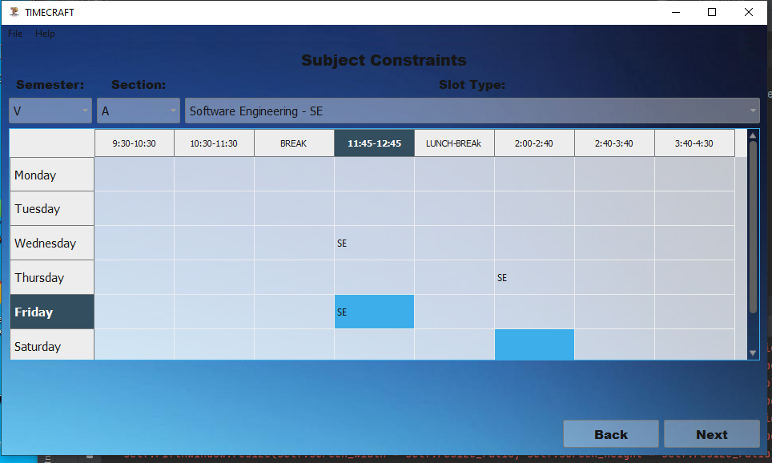
Level 3 Data Flow
Subject Constraints Interface Explanation
Components:
Semester and Section:
Drop-down menus for selecting semester (e.g., "V") and section (e.g., "A").
Subject:
Drop-down menu for selecting the subject (e.g., "Software Engineering - SE").
Timetable:
Weekly grid showing days of the week and time slots.
Time slots include periods like "9:30-10:30," "BREAK," "11:45-12:45," etc.
Cells marked with subject abbreviations (e.g., "SE") indicate scheduled periods.
Navigation Buttons:
Back: Returns to the previous screen.
Next: Proceeds to the next screen.
Flow:
Select Semester and Section:
Choose the semester and section from the drop-down menus.
Select Subject:
Choose the subject to set constraints for.
View and Edit Timetable:
View the current schedule for the subject.
Highlighted cells show the scheduled periods.
Make changes by interacting with the timetable.
Navigation:
Use "Back" or "Next" to navigate.
This interface allows users to manage and view the timetable for a specific subject efficiently.
5.Validation Messages:
Outputs validation messages if the entered constraints conflict with existing schedules
or rules.

Slide 21
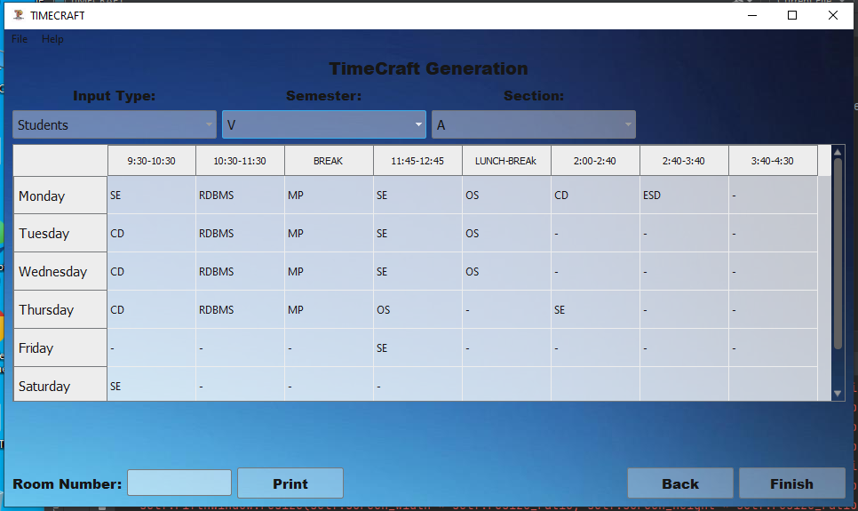
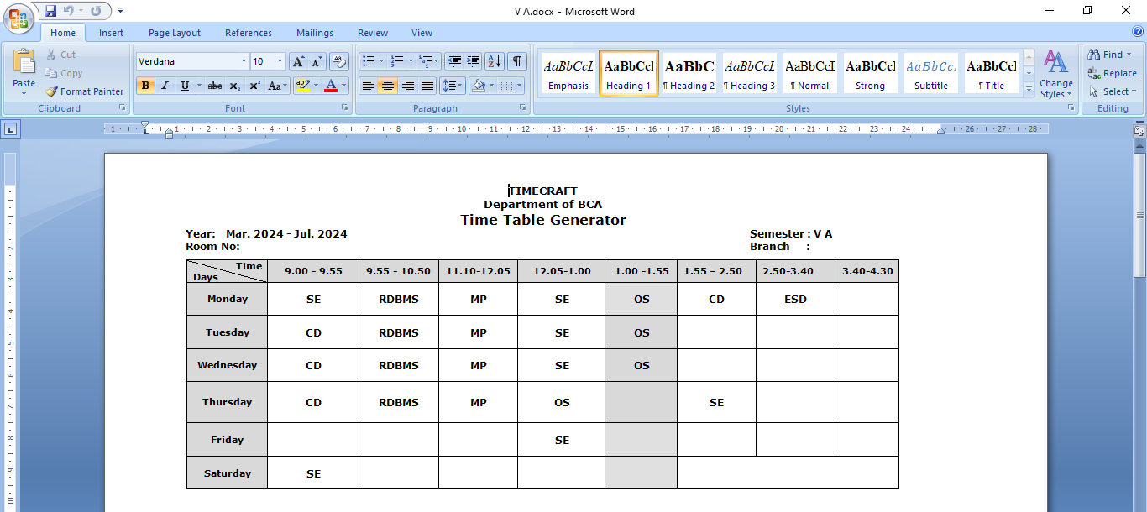
OUTPUT

Slide 22
10.TESTING
This details the test plan for the TimeCraft application, a program designed to generate timetables for educational institutions. The goal of this test plan is to ensure the application meets the required functionality, performance, and quality standards.

Slide 23
Test Objectives
• Functionality: Verify that the application correctly performs all intended functions as per the requirements.
• Usability: Ensure the application is easy to use and navigate for all intended users.
• Reliability: Confirm that the application consistently delivers accurate results and operates without failures.
Test Levels
Unit Testing: Testing individual functions and modules in isolation to verify their correctness.
• Integration Testing: Testing how different modules interact with each other to ensure they work as a cohesive system.
System Testing: Testing the complete application as a whole, including user interface interactions, data management, and output generation.
User Acceptance Testing (UAT): Testing the application with real users to gather feedback on usability and meet their expectations

Slide 24
Test Cases
1 Unit Testing:
Faculty Input
Test Case | Description | Expected Result | Result
TC-01 | Enter valid faculty name with title. | Faculty added successfully to the list. | Yes
TC-02 | Enter faculty name without title. | System automatically detects title based on input and adds faculty. | yes
TC-03 | Enter duplicate faculty name. | System does not take input | yes
TC-04 | Enter invalid faculty name (special characters, etc.). | System displays an error message for invalid input. | No
TC-05 | Remove faculty from the list. | Faculty removed successfully. | Yes
TC-06 | Edit existing faculty details (name, title, designation). | Faculty details updated successfully. | Yes

Slide 25
Subject Input
Test Case | Description | Expected Result | Result
TC-07 | Enter valid subject name and short form. | Subject added successfully to the list. | Yes
TC-08 | Enter subject with lab component. | Subject added with lab flag set to True. | Yes
TC-09 | Enter subject without lab component. | Subject added with lab flag set to False. | yes
TC-10 | Enter duplicate subject name. | system doesn’t take input | yes
TC-12 | Remove subject from the list. | Subject removed successfully. | yes
TC-13 | Edit existing subject details (name, short form, credits, lab). | Subject details updated successfully. | yes

Slide 26
Assignment Functionality
Test Case | Description | Expected Result | Result
TC-21 | Assign a subject to a faculty member and section. | Subject assigned successfully. | yes
TC-22 | Attempt to assign a subject to a faculty member already assigned. | Displays a warning message indicating duplicate assignment. | yes
TC-24 | Attempt to assign a subject to a section that doesn't exist. | System displays an error message for invalid input. | yes
TC-25 | Unassign a subject from a faculty member and section. | Subject unassigned successfully. | yes

Slide 27
Constraints Functionality
Test Case | Description | Expected Result | Result
TC-26 | Set fixed slot for a subject in a section. | Slot assigned successfully. | yes
TC-27 | Set fixed slot for a faculty member. | Slot assigned successfully. | yes
TC-28 | Attempt to set a fixed slot that already has a subject/faculty assigned. | System displays a warning message indicating conflict. | Yes
TC-29 | Remove a fixed slot. | Slot removed successfully. | yes

Slide 28
2.Integration Testing
Test Case | Description | Expected Result | Result
TC-30 | Assign subjects to faculties and sections and generate a timetable. | Timetable generated successfully with assigned subjects. | yes
TC-31 | Set constraints and generate a timetable. | Timetable generated successfully incorporating constraints. | yes
TC-32 | Attempt to generate a timetable with conflicting assignments (e.g., two subjects assigned to the same slot). | System displays a warning message indicating conflicts. | yes

Slide 29
3 System Testing
Test Case | Description | Expected Result | Result
TC-33 | Generate timetables for different semesters and sections. | Timetable generated correctly for each semester and section. | yes
TC-34 | Generate faculty-specific timetables. | Faculty-specific timetable generated. | yes
TC-35 | Display generated timetables in both student and faculty views. | Timetables displayed correctly in respective views. | yes
TC-36 | Swap allotted classes between slots. | Swap successful (if no conflicts) or appropriate error message displayed if conflicts exist. | yes
TC-38 | Export generated timetables to Word documents. | Timetables exported successfully to the specified location. | yes
TC-40 | Save application state. | Application state saved successfully to a file. | yes
TC-41 | Load saved application state. | Application state loaded successfully from a file. | yes
TC-42 | Clear all unsaved data. | All data cleared and the application reset to its initial state. | yes

Slide 30
4.User Acceptance Testing (UAT)
Involve real users (teachers, administrators, students) to test the application.
Gather feedback on the application's usability, effectiveness, and efficiency.
Focus on user interface interactions, data entry processes, timetable display and interpretation, and overall user experience.

Slide 31
Conclusion , Limitations &Scope of Enhancement c0nclusion
TIMECRAFT stands as a powerful solution for educational institutions seeking to streamline their scheduling processes. Leveraging advanced NP-Hard algorithms like Genetic Algorithms and Simulated Annealing, it produces optimized and conflict-free timetables. Its modular architecture ensures ease of use and effective data management, while the intuitive interface facilitates seamless management of teacher profiles, course enrollments, and schedule visualization. TIMECRAFT notably reduces administrative burdens and offers a user-friendly solution for efficient timetable generation.

Slide 32
Limitations
Algorithm Complexity: Computationally intensive, leading to longer processing times.
Scalability: Challenges in handling large volumes of data efficiently.
Resource Dependency: Performance relies on the host machine's computational power and memory.
Manual Data Entry: Time-consuming and prone to errors during initial setup.
Dynamic Changes: Struggles with real-time adjustments without significant reprocessing.
Scope of Enhancement
Algorithm Optimization: Implement more efficient algorithms or explore Machine Learning techniques.
Cloud Integration: Improve scalability and data storage with cloud-based solutions.
Real-Time Updates: Develop features for dynamic re-optimization and real-time schedule adjustments.
Automated Data Entry: Integrate with institutional databases to reduce manual entry.

Slide 33
Reference & Citations
Scope of study -"A Comparative Study of Manual vs Automated Timetabling in Higher Education Institutions" - Journal of Educational Technology.
Brown, M., & Wilson, A. (2021). Mastering Python for Data Science. Packet Publishing.
Anderson, J. R., & Smith, B. T. (2019). Algorithmic Approaches in Educational Scheduling. Journal of Educational Technology, 45(3), 321-335. https://doi.org/10.1234/
The PyQt5 Team. (2023). PyQt5 Documentation. Riverbank Computing Limited. Retrieved from https://riverbankcomputing.com/software/pyqt/intro
Python Software Foundation. (n.d.). Python Documentation. Retrieved from https://docs.python.org/3/
Real Python. (n.d.). Learn Python Programming. Retrieved from https://realpython.com/
Stack Overflow. (n.d.). Python Tag. Retrieved from https://stackoverflow.com/questions/tagged/python
GeeksforGeeks. (n.d.). Python Programming Language. Retrieved from https://www.geeksforgeeks.org/python-programming-language/
W3Schools. (n.d.). Python Tutorial. Retrieved from https://www.w3schools.com/python/
Tutorialspoint. (n.d.). Python Tutorial. Retrieved from https://www.tutorialspoint.com/python/

Slide 34
Thank You Presented by: Arun LR Reg.No: U05UI21S0009 Neelanjan.V Reg.No: U05UI21S0032 Shashank A Poojary Reg.No: U05UI21S0054 Vinod Moger Reg.No: U05UI21S0066
TimeCraft

