Slide 2




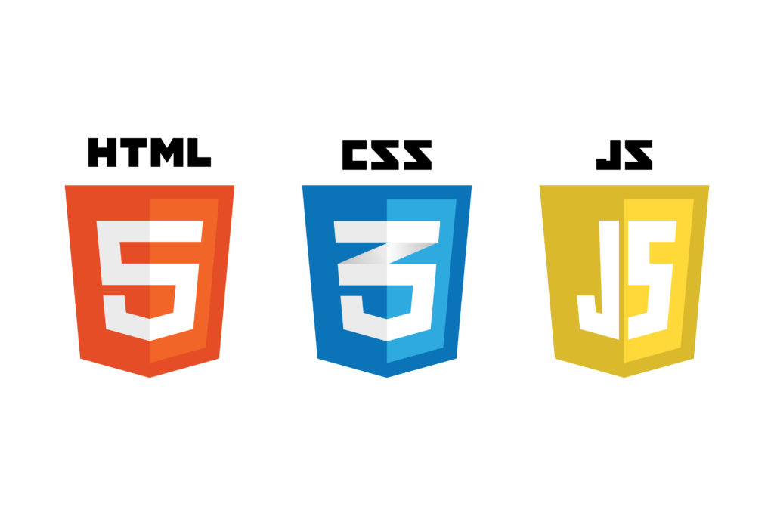






Technologies used
Data
DevOps
FrontEnd
Backend

