Slide 1
Socket Programming

Slide 2
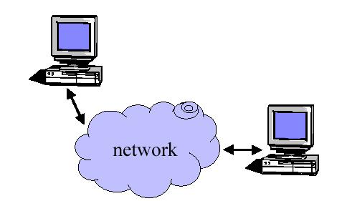
Why do we need sockets?
socket provide mechanisms to communicate between computers across the network

Slide 3
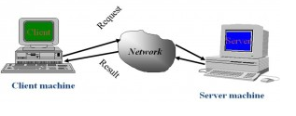
Definitions
Socket is a method of communication between a client program and a server program in a network
A socket is an endpoint of a two-way communication link between two programs running on the network.

Slide 4
Client/Sever model
Client asks (request) – server provides (response)
Typically: single server - multiple clients
The server does not need to know anything about the client even that it exists
The client should always know something about the server at least where it is located
1. Client sends request
Client
process
Server
process
Resource
4. Client
handles
response
3. Server sends response
2. Server
handles
request
Note: clients and server are processes running on
different hosts.
Notes:
Both Can run on the same machine

Slide 5
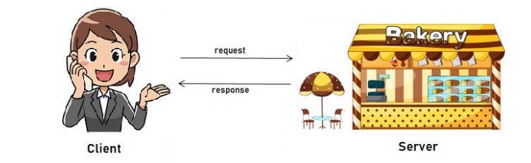
Client/sever model
Notes:
Both Can run on the same machine

Slide 6

Sockets as means for inter-process communication (IPC)
application layer
application layer
Client Process
Internet
Server Process
Socket
Socket
transport layer (TCP/UDP)
transport layer (TCP/UDP)
Internet
network layer (IP)
network layer (IP)
link layer (e.g. ethernet)
link layer (e.g. ethernet)
Internet
physical layer
physical layer
OS network
stack
OS network
stack
The interface that the OS provides to its networking subsystem

Slide 7
Internet Connections (TCP/IP)
Address the machine on the network
  By IP address
Address the service
  By the “port”-number [0………65,535]
The pair of IP-address + port – makes up a “socket-address”
Client socket address
192.168.0.10:3479
Server socket address
192.168.0.26:22
Client
Server
(port 22)
Connection socket pair
(192.168.0.10:3479, 192.168.0.26:22)
Client host address
192.168.0.10
Server host address
192.168.0.26
Note: 3479 is an
ephemeral port allocated
by the kernel
Note: 22 is a well-known port
associated with ssh servers

Slide 8










CLIENT
SERVER

Slide 9
Types of Sockets
Two different types of sockets :
  stream vs datagram
Stream socket :( a. k. a. connection- oriented socket)
  It provides reliable, connected networking service
  Error free; no out- of- order packets (uses TCP)
  applications: telnet/ ssh, http, …
Datagram socket :( a. k. a. connectionless socket)
  It provides unreliable, best- effort networking service
  Packets may be lost; may arrive out of order (uses UDP)
  applications: streaming audio/ video (realplayer), …

Slide 10
Analogy
There is a nice analogy of sockets to a telephone.
A socket is like a telephone, and the port number is like a telephone number.
The machine name is like the area code. Thus, in order for someone to "call you up", they need to request a connection to your area code/port number,
just like making a phone call.

Slide 11
Client – high level view
Create a socket
Setup the server address
Connect to the server
Read/write data
Shutdown connection

Slide 12
Server – high level view
Create a socket
Bind the socket
Listen for connections
Accept new client connections
Read/write to client connections
Shutdown connection

Slide 13
TCP Server
socket()
bind()
Well-known port
TCP Client
listen()
Max client connections
Socket()
accept()
connect()
Connection establishment
blocks until connection from client
write()
Data(request)
read()
process request
Data(reply)
write()
read()
close()
End-of-file notification
read()
close()

Slide 14
DEMO
Its time TO SEE PRACTIACL PROGARAMMING ON SOCKETS

Slide 15
Types of client –server models
We can establish the communication between client & server using either TCP / UDP
1.Connection oriented client –server model(TCP)
2.Connection less client-server model(UDP)

Slide 16
Connection-Oriented Client and Server Operations
Server
operations
create SOCKET
Client
operations
BIND a ‘well-known’
port number to the socket
Establish a LISTEN
queue for connections
create SOCKET
ACCEPT a connection
CONNECT to server’s port
As required
by application
READ from connection
WRITE to connection
WRITE to connection
READ from connection
‘END-OF-FILE’
CLOSE connection

Slide 17
Connection Oriented Client
Steps to design client program:
  Create a socket
  Establish a connection with connect()
  Communicate with send() and recv()
  Use close() to destroy the socket

Slide 18
Sockets (cont.)
Create a socket with the socket() call
socket(int domain, int type, int proto)
    domain = AF_INET for IP
    type is SOCK_STREAM (TCP) or SOCK_DGRAM (UDP)
    proto is end-to-end protocol IPPROTO_TCP or IPPROTO_UDP should be used (0 gives default, which is these anyway… at the moment)
 | domain | Type | Protocol
TCP | AF_UNIX /AF_INET | SOCK_STREAM | IPPROTO_TCP
UDP |  | SOCK_DGRAM | IPPROTO_UDP
Notes:
A UNIX domain is an inter-process communication mechanism that allows bidirectional data exchange between processes running on the same machine.
IP sockets (especially TCP/IP sockets) are a mechanism allowing communication between processes over the network. In some cases, you can use TCP/IP sockets to talk with processes running on the same computer (by using the loopback interface).

Slide 19
Sockets (cont.)
The socket() call returns a “descriptor”
  A descriptor here is an integer which gives a “handle” to the socket
    Just like file handles returned from open()
    It’s a reference that you store away and then use whenever you need to reference that socket in any future systems calls
    It should be nonnegative; if socket() returns –1 this indicates an error creating the socket
    close(int socket) when you’re done

Slide 20
Sockets (cont.)
Calling connect:
  int connect(int socket, struct sockaddr *destAddress, unsigned int addressLen)
  socket is a socket descriptor,
  the sockaddr is generic,
  len is sizeof(struct sockaddr_in);

Slide 21
Socket Addresses
Special datatype called sockaddr
struct sockaddr
{
unsigned short sa_family; /* AF_INET */
char sa_data[14]; /* Protocol-specific address formation */
};
This is the “generic” datatype containing only the address family (AF_INET for IP) and the address specific to the protocol of the 14 bytes, we’ll use 4 bytes for the IP address and 2 for the port number

Slide 22
Socket Addresses (cont.)
IP Specific version of the sockaddr struct
struct sockaddr_in
{
unsigned short sin_family; /* AF_INET */
unsigned short sin_port; /* Port (16-bits) */
struct in_addr sin_addr; /* Internet address (32-bits) */
char sin_zero[8]; /* Not used */
};
struct in_addr {
unsigned long s_addr; // load with inet_aton()
};
The sockaddr_in is the internet version of the sockaddr struct. It can be cast to a generic sockaddr
  It’s the right size and has a compatible first field

Slide 23
Calling send/recv
int send(int socket, const void *msg, unsigned int msgLen, int flags)
int recv(int socket, void *rcvBuffer, unsigned int bufferLen, int flags)
msg is a pointer to the message, and msgLen is its length;
rcvBuffer captures the incoming bytes up to a max of bufferLen;
flags=0 gives default behavior (more later)
send blocks until ALL bytes transferred;
recv blocks until at least SOME bytes received
send and recv return the number of bytes sent or received; if –1 we have an error
  If recv returns 0, it means connection was closed at other end

Slide 24
Constructing the Server
Steps to design server program :
  1) Create a TCP/IP socket
  2) Assign a port number with bind()
  3) Allow incoming connections with listen()
  4) Repeat the following:
    a) Call accept() to get a new socket for each connection
    b) Use send() and recv() to communicate via each socket
    c) Close the client connection when finished with close()

Slide 25
The bind() Call
  int bind(int socket, struct sockaddr *localAddr, unsigned int addressLen)
assigns a port number to the socket
Once bind() succeeds, all connect() requests to this host for this address/port will go to this socket
If the address is set to INADDR_ANY then all connections to this port will go to this socket, regardless of the Internet address used (useful if host happens to have multiple Internet addresses)

Slide 26
The listen() Call
Once socket is created and bound, we need to begin listening for connection requests
int listen(int socket, int queueLimit)
socket is the socket descriptor
queueLimit is the largest number of incoming connections which can be waiting (or “queued”)
this socket is for setting up a connection only
  We never use send() or recv() on this socket once it is used for listen() calls; instead we use this socket as a queue for incoming connections, and use accept() to dequeue the requests

Slide 27
The accept() Call
accept() dequeues the next connection request from the listen socket’s queue
int accept(socket, struct sockaddr *clientAddr, unsigned int *addrLen)
  If queue is empty, accept() blocks until connection request is made
  socket is the listen socket
  clientAddr is filled in with client’s address
  addrLen is filled in by you initially with max size of clientAddr, and changed by accept() to actual size of clientAddr
  accept returns new socket descriptor on success, -1 on failure

Slide 28
Server Interaction
Once we have a connection (via accept()) we may interact with this client via send() and recv()
  Same as before for client-side
  Use the socket returned by accept() not the listen socket
If we have multiple clients, we interact separately by referencing the appropriate socket
When a particular client interaction is complete, use close() on the appropriate socket
When server no longer wishes to accept incoming connections, call close on the listen socket

