Slide 1
PROCESS MANAGMENT

Slide 2
Scheduling Algorithms
Non Preemptive Algorithms
  The scheduling in which a running process cannot be interrupted by any other process is called non-preemptive scheduling. Any other process which enters the queue has to wait until the current process finishes its CPU cycle.
  Ex: SJF (Shortest Job First)
  FIFO (First-In First-Out), etc
Preemptive Algorithms
The scheduling in which a running process can be interrupted by other process and that is allocated to the CPU is called preemptive scheduling.
Ex: Priority Based Scheduling
SRTF (Shortest Remaining Time First)
RR(Round-Robin), etc

Slide 3
Throughput :
      No. of processes that complete their execution per time unit.
Turnaround Time:
Amount of time to execute a particular process.
Waiting time :
Amount of time a process has been waiting in the ready queue .
Response time :
Amount of time it takes from when a request was submitted until the first response is produced.
Preemption :
Preemption as used with respect to operating systems means the ability of the operating system to preempt (that is, stop or pause) a currently scheduled task in favor of a higher priority task.

Slide 4
FIFO
J1 = 20, J2 = 5, J3 = 15, J4 = 8
Job WT ET TT
J1 00 20 20
J2 20 05 25
J3 25 15 40
J4 40 08 48
---------------------------------------------------------------
Avg TT = 133/4
= 33.25

Slide 5
SJF
J1 = 20, J2 = 5, J3 = 15, J4 = 8
Job WT ET TT
J2 00 05 05
J4 05 08 13
J3 13 15 28
J1 28 20 48
---------------------------------------------------------------
Avg TT = 94/4
= 23.50

Slide 6
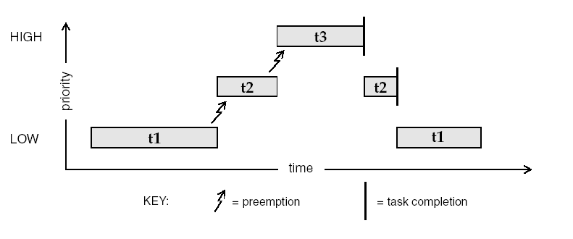
Priority Based Preemptive

Slide 7
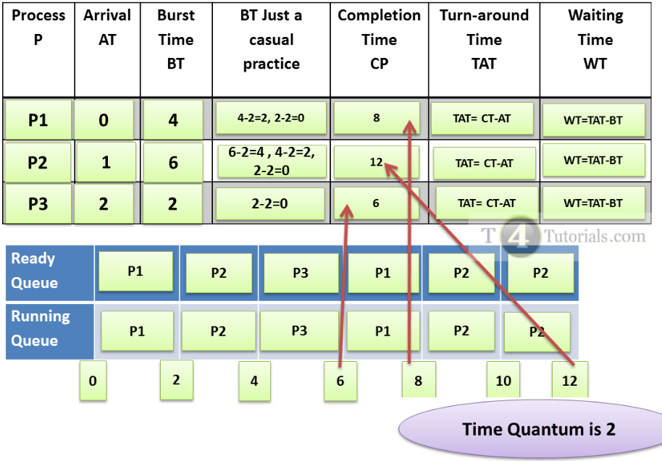
Round Robin

