Slide 1
MINI PROJECT PRESENTATION (2020-21) Android-based Quiz Application “Quiz Master”
Submitted by –
Rohan Bhardwaj (181500589)
Shashank Kumar Pandey (181500654)
Shivani Chauhan (181500678)
Vanshika Mahle (181500781)
Vimal Mishra (181500792)
Supervised by –
Mr. Anand Parkash Gupta
Technical Trainer
Department of Computer Engineering & Application

Slide 2
MOTIVATION
Online Learning has become the new normal. Smartphones are no longer a luxury. They have become a must-have as the COVID-19 pandemic has re-shaped education. Even during the toughest times, the world has never stopped learning.
Recent studies have shown that there is a drastic increase in the usage of technology by educational institutions to educate and assess the learnings of the students online.
It has been observed that Multiple Choice Questions (MCQs) based assessments are an effective way to evaluate one’s learnings. It motivates us to develop a ‘want’ to learn more and remember what we have learned. An Online Quiz Application is a better alternative to paper-based offline evaluation techniques. It is user-friendly and reduces manual effort, thereby saving time & resources.
It is an application where a user with the admin privilege can do administrative tasks like add, delete, and edit from the application user interface and the user can participate in the MCQ quiz with a time limit. So, this project facilitates users to configure quizzes as well as giving quizzes using smartphones, tablets, and laptops.

Slide 3
OBJECTIVE
This project proposes an idea to develop a user-friendly, android based application that can educate as well as entertain users with a quick quiz on any category.
The application will contain multiple sets of questions in each category.
There will be a specific time limit set for answering each question.
After completion of the contest, scores will be displayed which will help the user to improve their performance.
It provides a fun-loving way to learn, so it can be used by people of all age groups who want to learn and assess their knowledge.

Slide 4
PROBLEM STATEMENT
It is essentially required to assist students for the learning and preparation of different tests conducted.
This is what we tried to address in the development of Quiz Master: Quiz Application Development using Android-Based Platform, which can provide candidates with the preparation of tests in both user friendly and interactive way.
We designed the application to facilitate the users to be able to take short quizzes using portable devices such as smart phones and tablets.

Slide 5
FEATURES USED
Select favorite topics for assessment
Access to multiple sets within each category
Time constraints in each question
Display correct option upon answering the questions
View scores after completing the quiz
Admin login to the application
Admin can customize the quiz

Slide 6
DATABASE DIAGRAM
Quiz
Categories
Categories
cat_ID (String)
cat_Name (String)
cat_ID
Name(String)
Sets(Number)
Set_ID(String)
Set_ID
QuestionID
QuestionID
Question(String)
OptionA(String)
OptionB(String)

Slide 7
USECASE DIAGRAM
Login
Add/delete/update questions
Add/delete/update category
Add/delete sets
Take quiz
View score

Slide 8


CLIENT APP

Slide 9
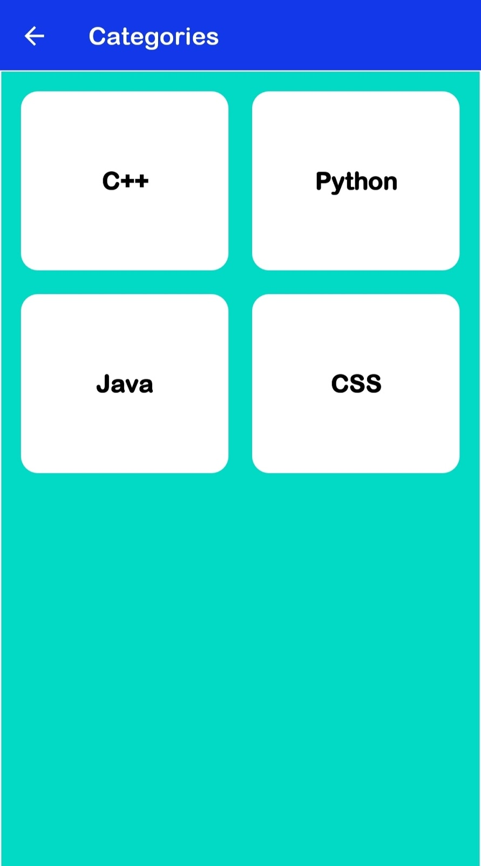
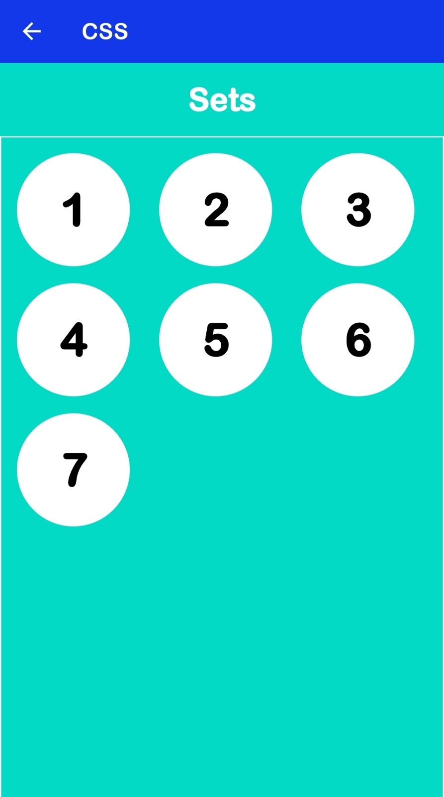

Slide 10
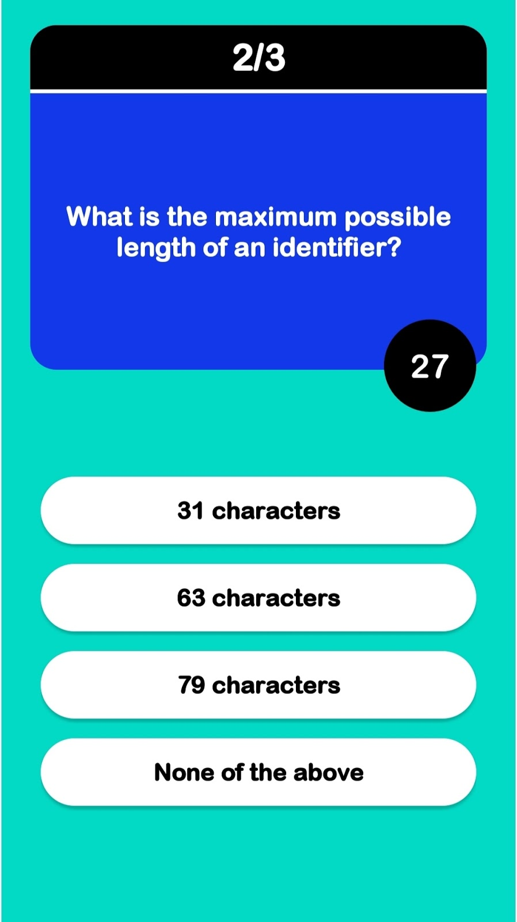
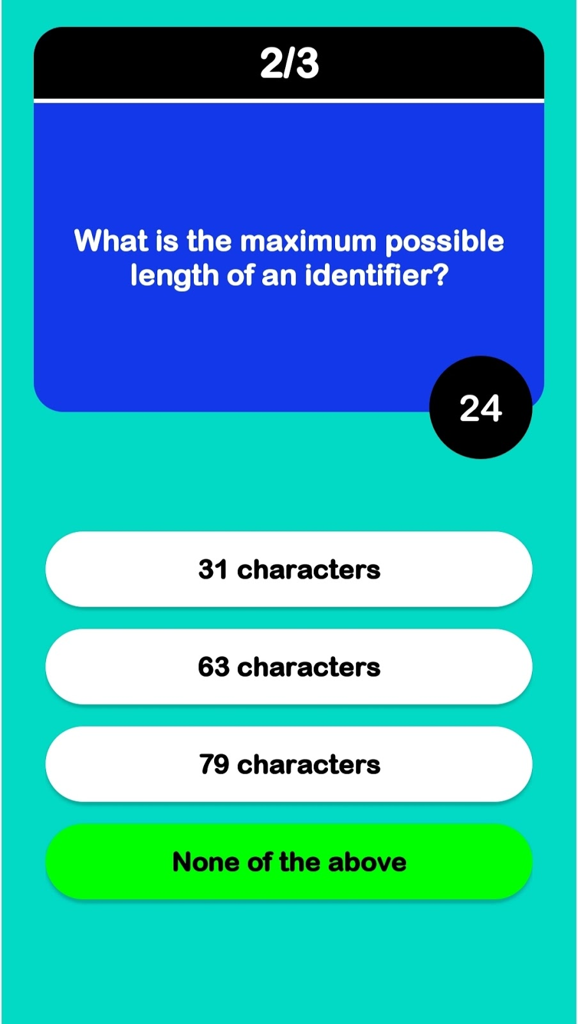

Slide 11
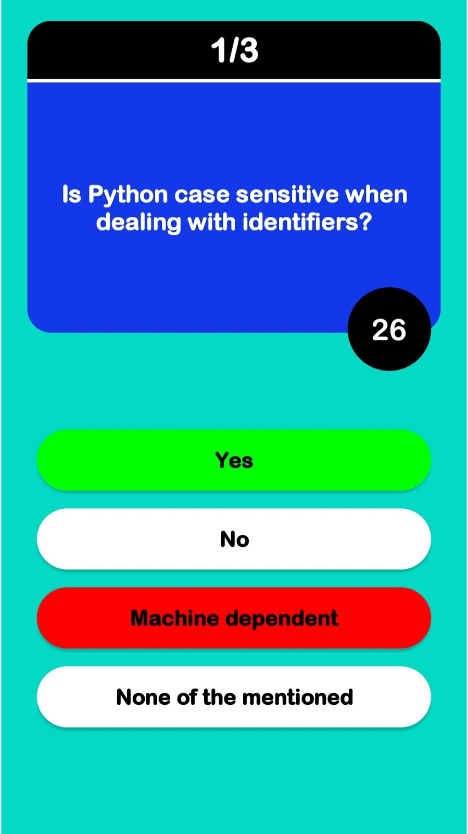
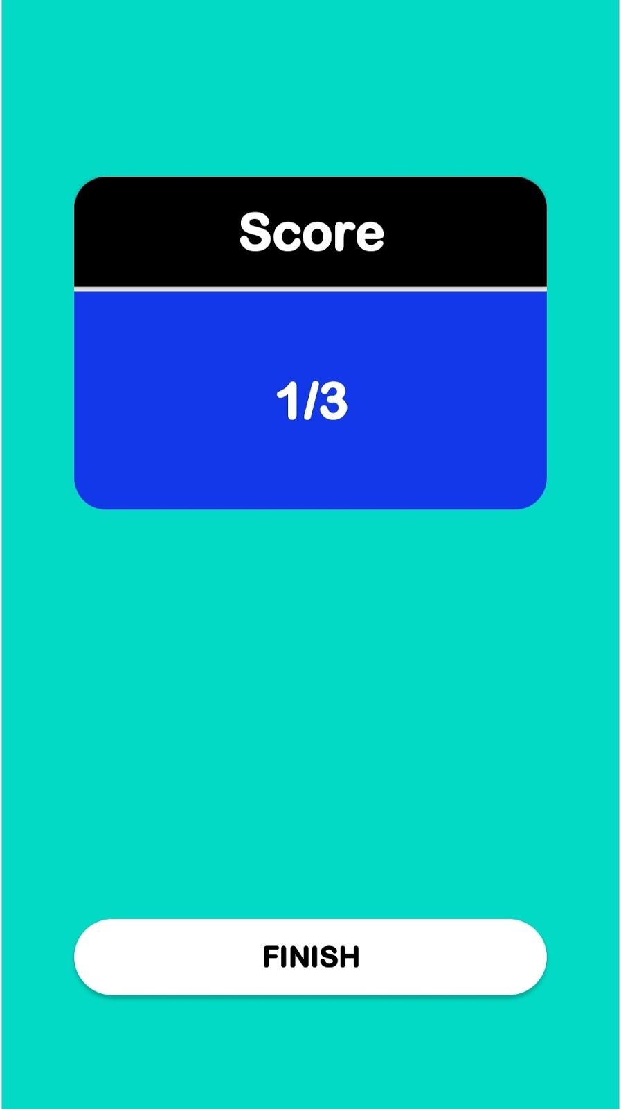

Slide 12
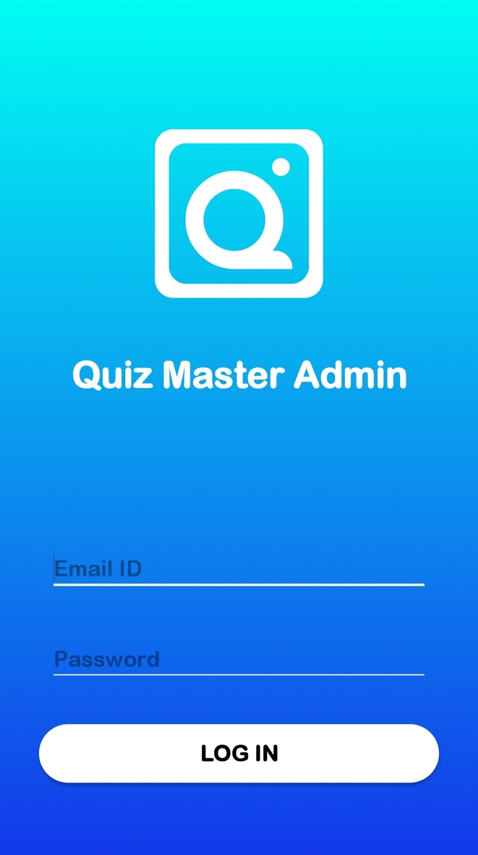
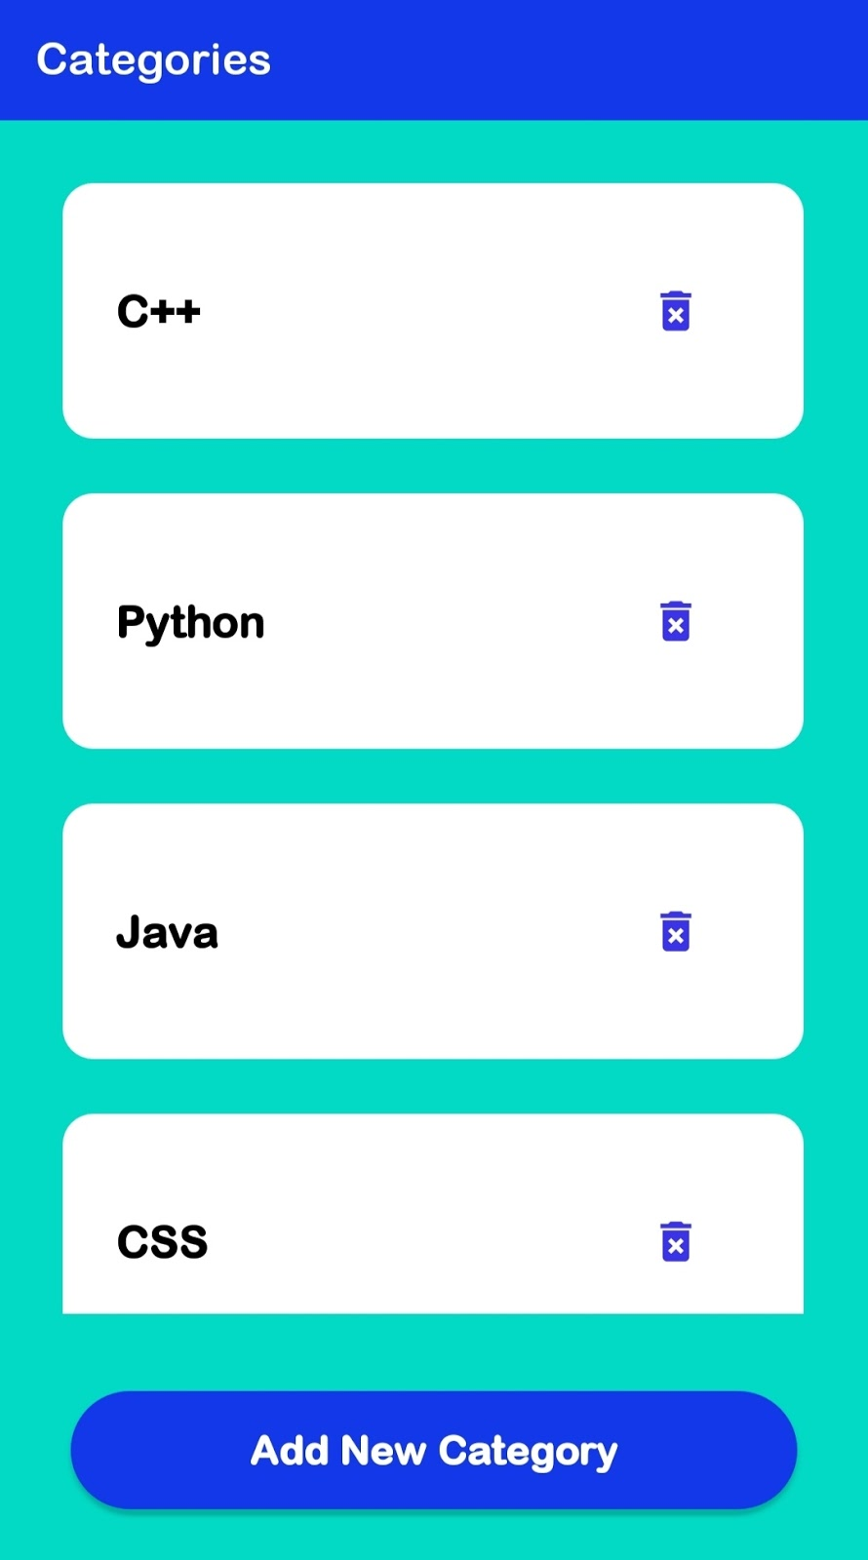
QUIZ MASTER ADMIN APP

Slide 13
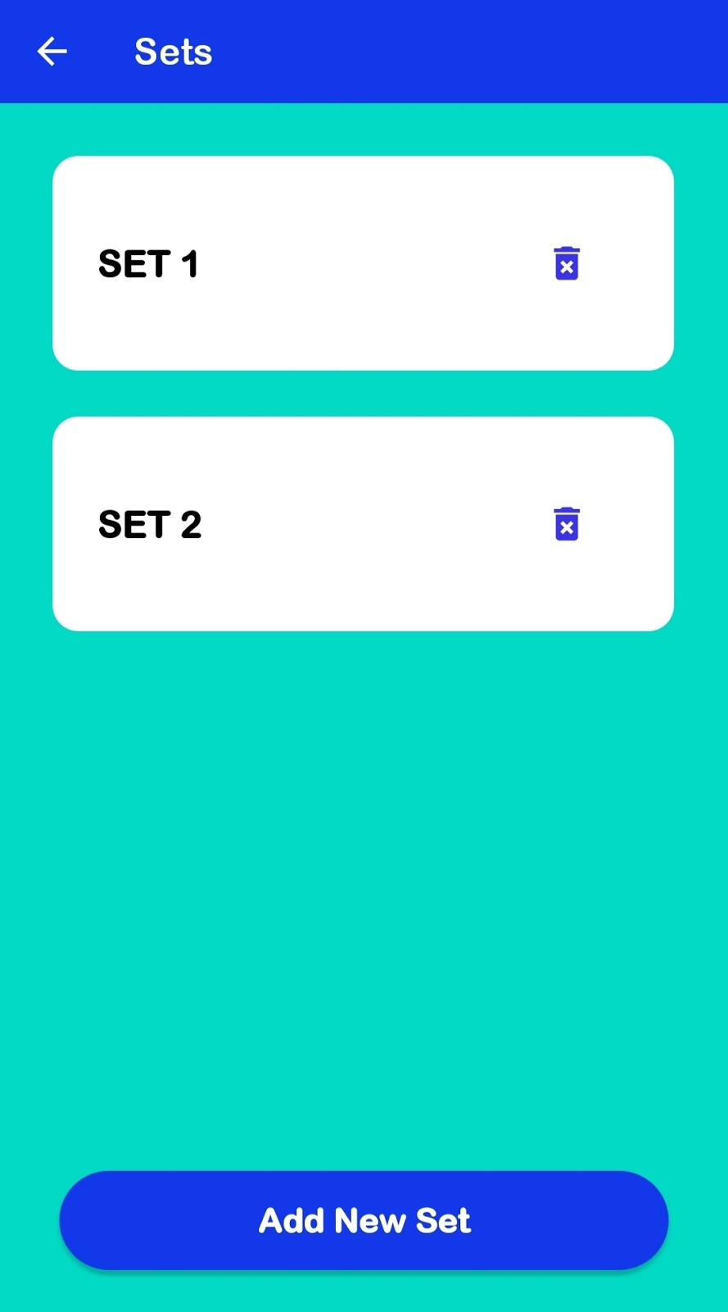
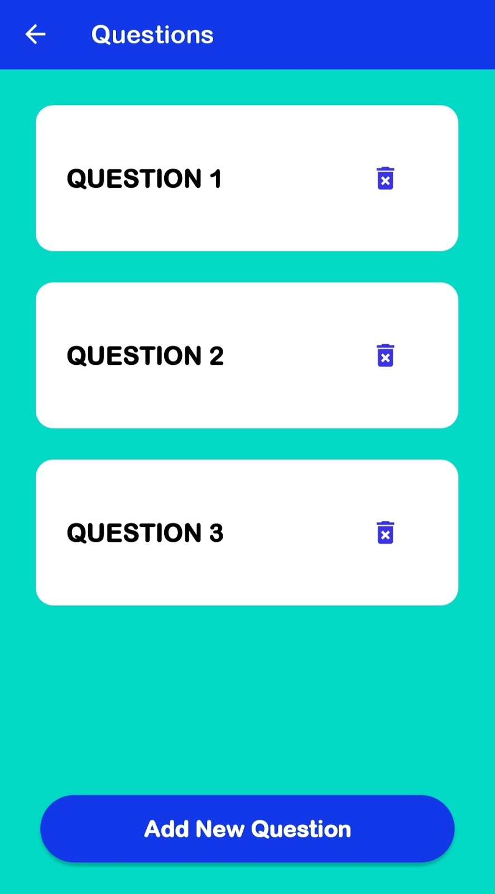

Slide 14
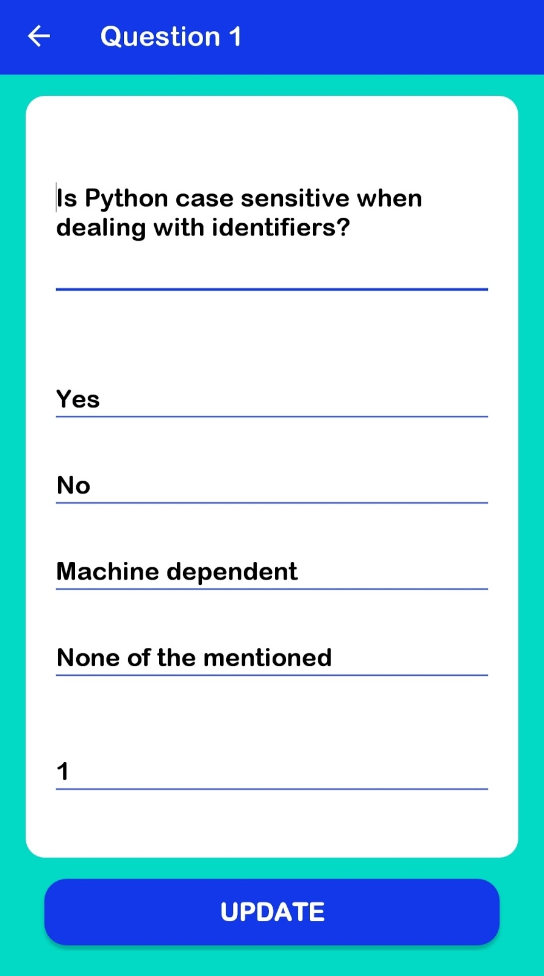

Slide 15
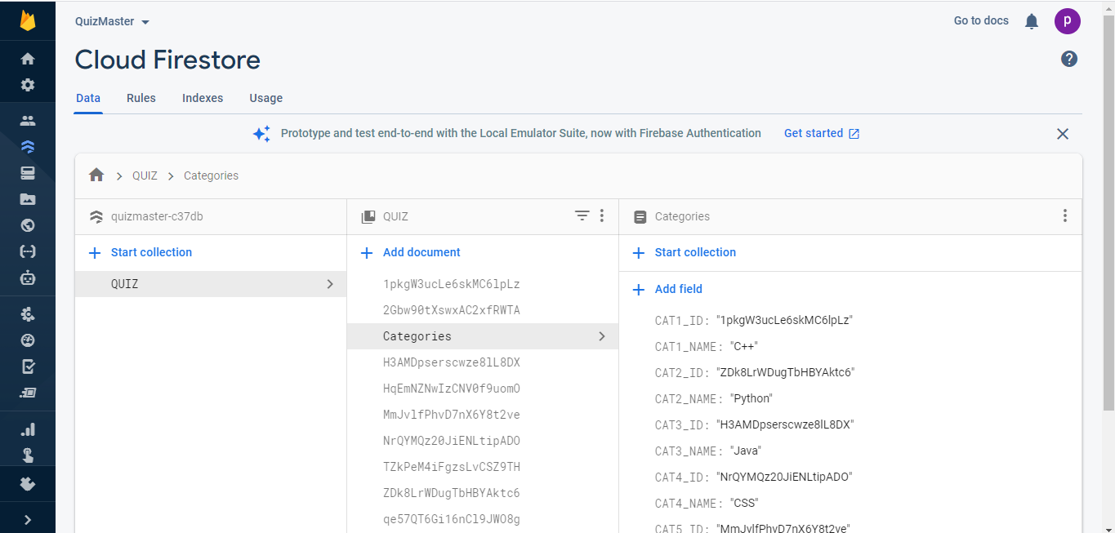
FIREBASE FIRESTORE INTEGRATION

Slide 16
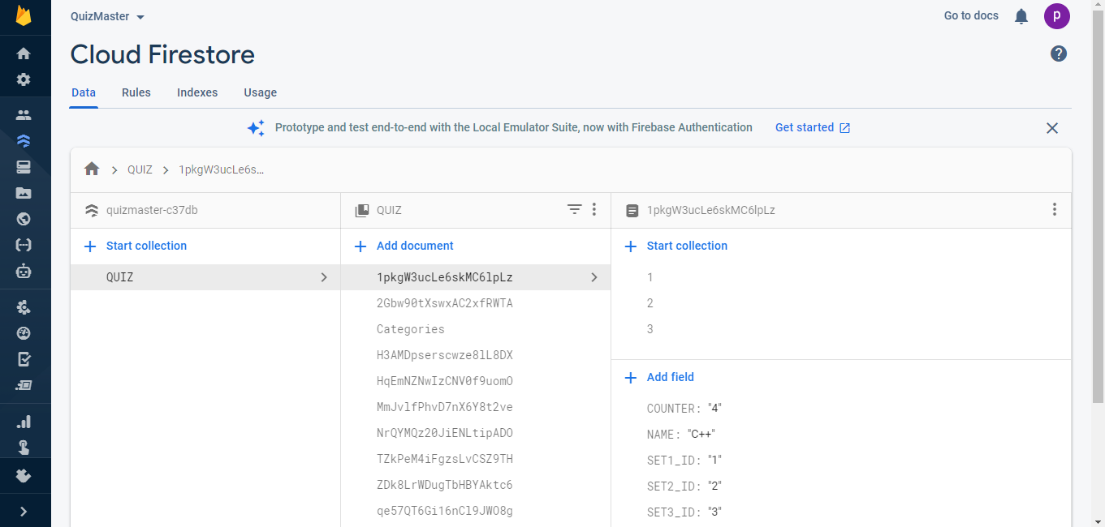

Slide 17
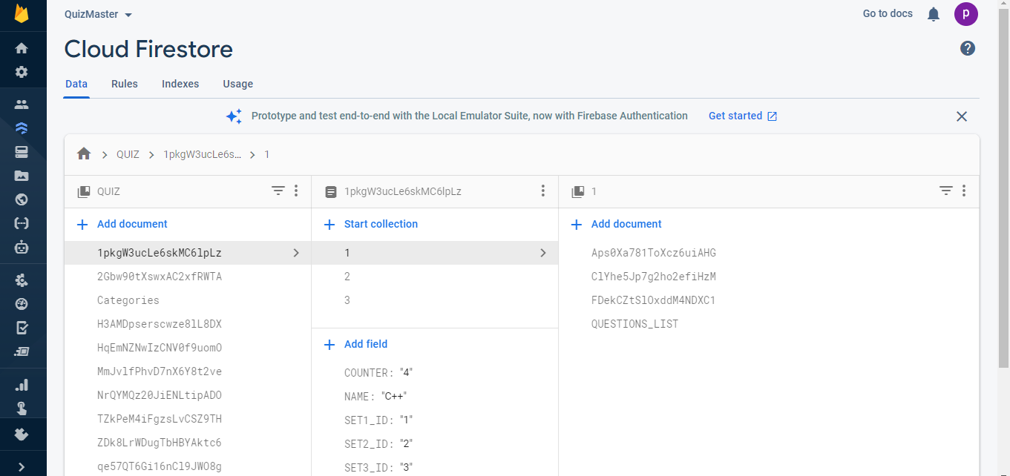

Slide 18
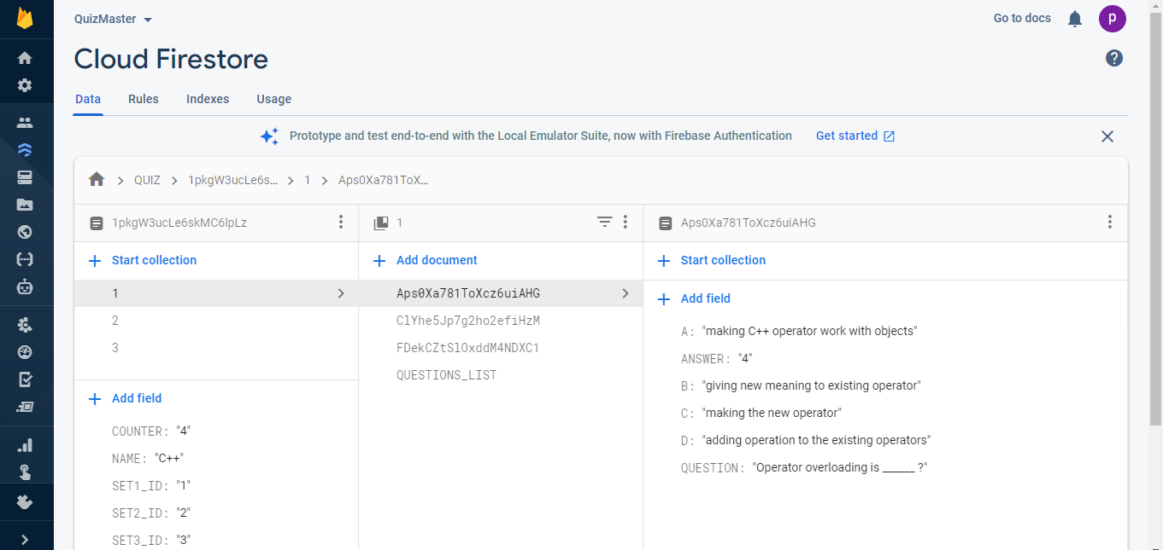

Slide 19
REFERENCES
https://developer.android.com/docs
https://docs.oracle.com/en/java/
https://www.youtube.com/
https://www.google.com/
https://firebase.google.com/docs
https://developer.android.com/guide/

