Slide 1
Gas Turbine Modeling for Behind the Meter Power Generation for Data Centers
Shashank Yellapantula, Deepthi Vaidhynathan & Kumaraguru Prabakar

Slide 2
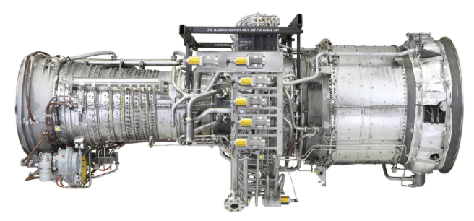
Aeroderivative Model
Developed a flexible framework in python to study various gas turbine cycles
  Model both simple and combined cycles with a heat-recovery steam cycle
  Can also be used as a dynamic dispatch model for a fleet of aeroderivatives
LM2500
LM2500 modeled as multi-shaft system with
HP gas-generator rotor: the high-speed compressor/turbine core
PT/generator rotor: the power turbine and electrical generator, tied to 60 Hz power at 3600 rpm.

Slide 3
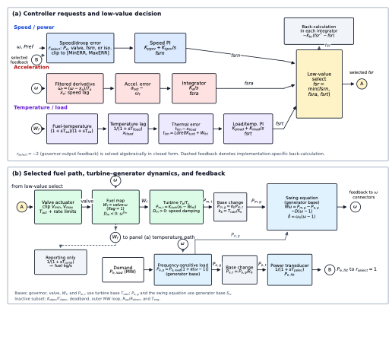
GGOV Governor Model
Governor model
Implementation based on the IEEE PES GGOV model
Include three competing controller with low-value select
  Speed/power governor
  Acceleration limiter
  Temperature limiter
Developed a unique capability allowing us to study various power generation & storage options to simulate the power demand from various data centers

Slide 4
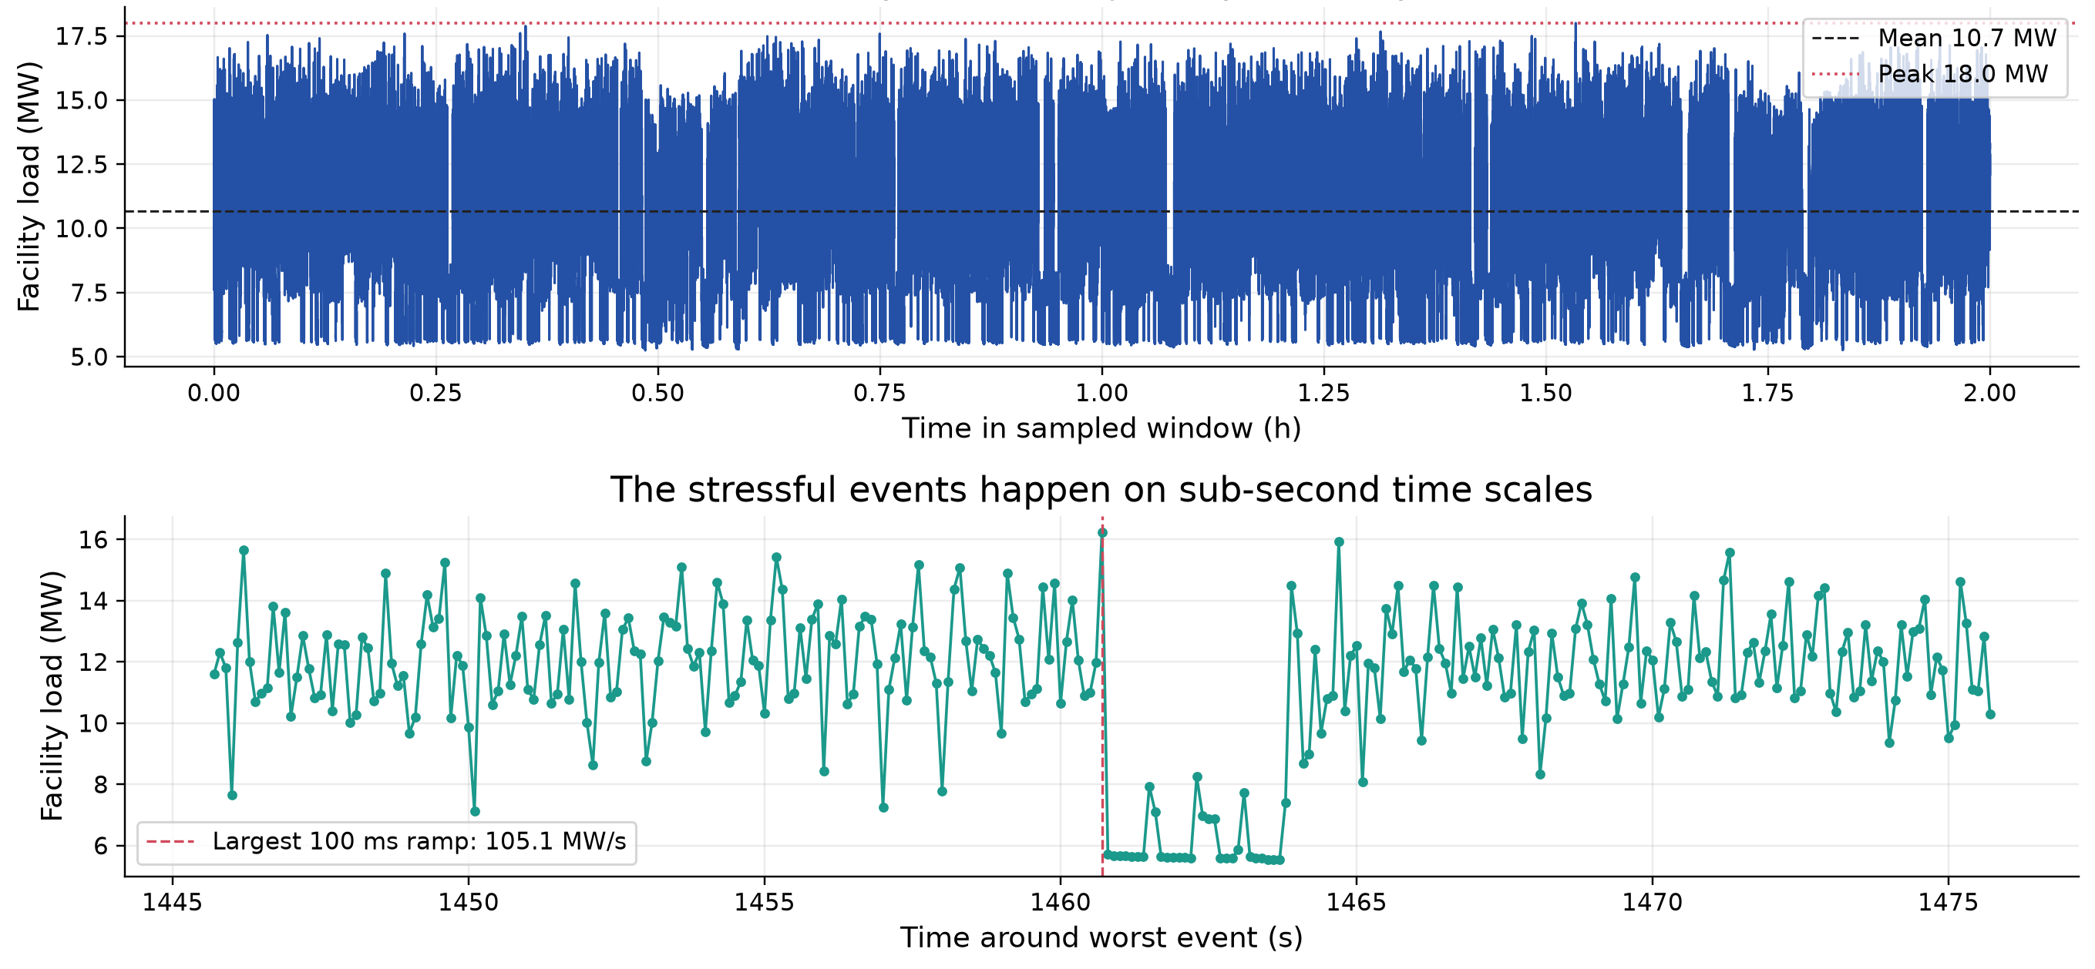
Data Center Load: Islanding Example
Data Center Load Profile
Per GPU telemetry recorded every 100ms
Used a 2h, 35 active GPU trace
Scaled it to match power demand of 18 MW
Worst case scenario of electrical load from a data center
Fleet with one (N=1) and two (N=2) LM2500s trip around these stressful events
N = 3 and N = 4 ride through these events

Slide 5
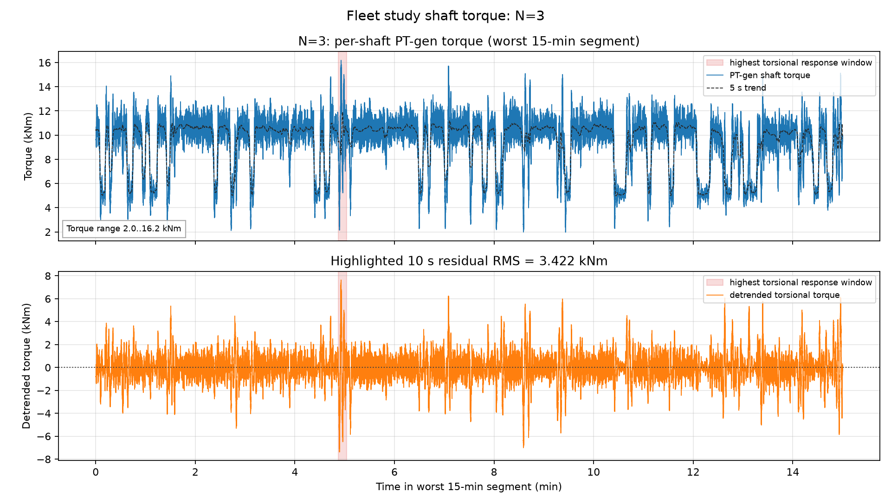
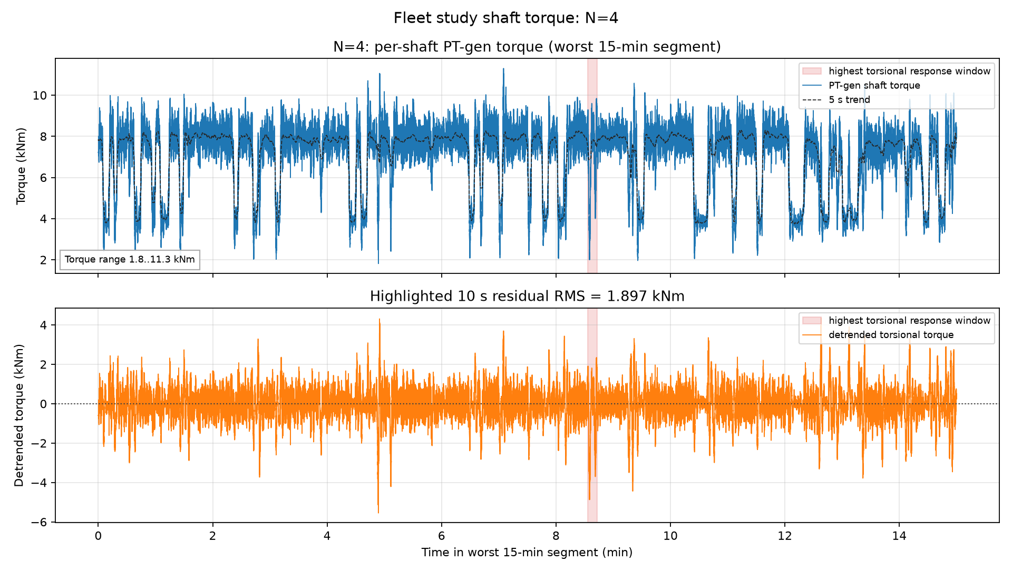
Fleet Modeling – Shaft Life
Shaft Torque can be used to investigate
  High Cycle Fatigue (HCF): fast ringing of the PT-generator shaft
  Low Cycle Fatigue (LCF): slow torque swings caused by turbine governor
Need exact shaft design and material properties from vendor to calculate impact on life.
Between N=3/4 we observe
  D_{HCF} damage reduction N=3 -> N=4: 49.9x
  D_{LCF} damage reduction N=3 -> N=4: 3.7x

Slide 6
Fleet Modeling – Shaft Life
Shaft Torque can be used to investigate
  High Cycle Fatigue (HCF): fast ringing of the PT-generator shaft
  Low Cycle Fatigue (LCF): slow torque swings caused by turbine governor
Need exact shaft design and material properties from vendor to calculate impact on life.
Between N=3/4 we observe
  D_{HCF} damage reduction N=3 -> N=4: 49.9x
  D_{LCF} damage reduction N=3 -> N=4: 3.7x
Repeated heating and cooling can shorten the life of hot-gas-path components through thermal and thermomechanical fatigue

Slide 7
Thank You
www.nlr.gov

