Slide 1
Gas Turbine Electrical Generator Model Coupled to Data Center Load

Slide 2
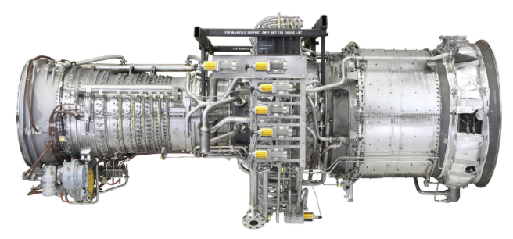
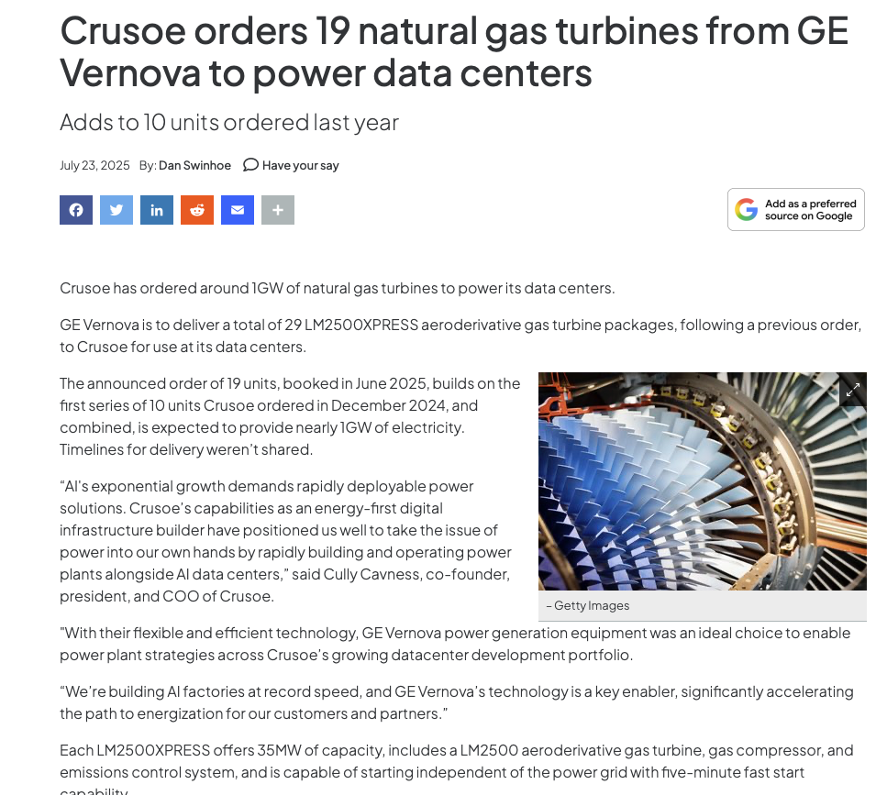
LM2500 - Aeroderivative
CF6 aircraft engine combustor
Very popular with data center developers

Slide 3
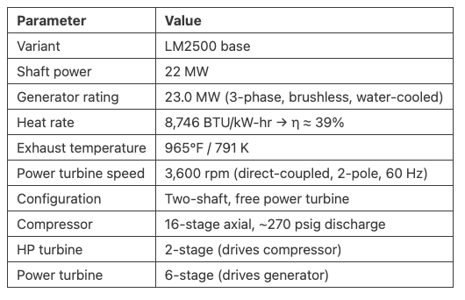
LM2500 - Aeroderivative
CF6 aircraft engine combustor
2-pole synchronous generator on 60Hz systems
120*60/2 = 3600 rpm
Free turbine = Speed not controlled by compressor speed but by the governor

Slide 4
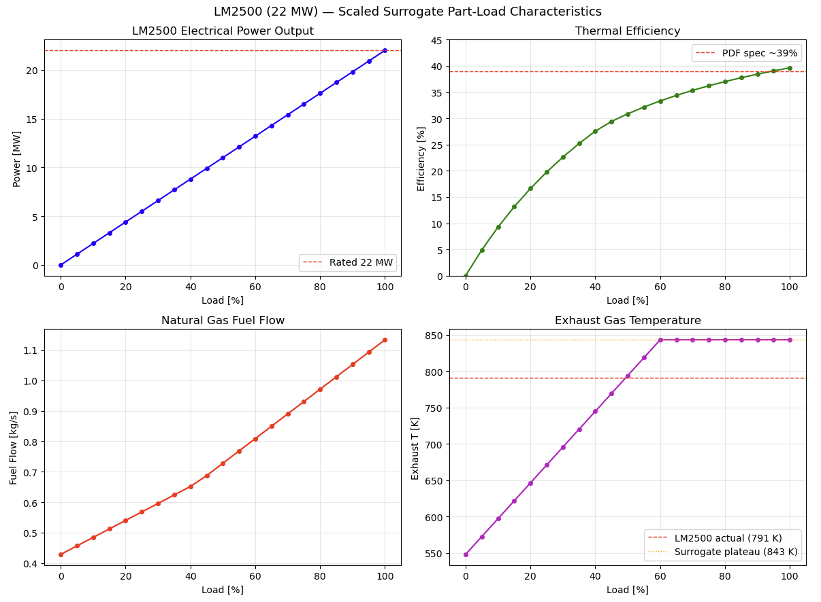
Thermopower surrogate – LM2500
Scaled the Thermopower library gas plant to match LM2500 output

Slide 5
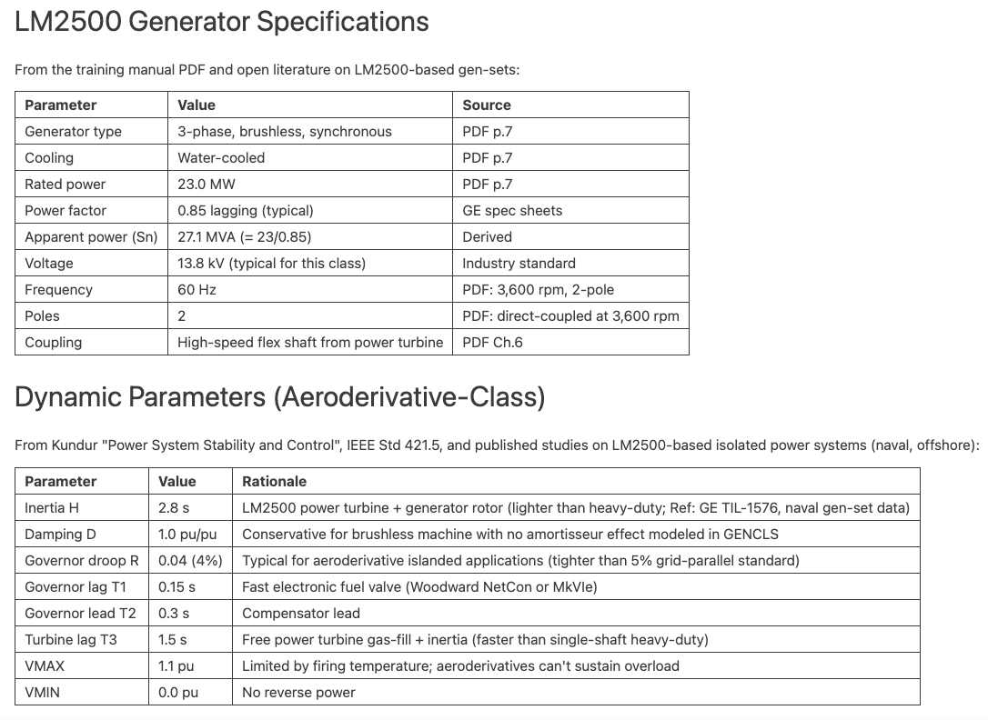
LM2500 – Generator details
Typically, LM2500 uses a Woodward-type electronic governor
LM2500 power turbine rotor is ~1200 kg with 0.35 m radius, moment of inertia of 150 kg m^2

Slide 17
Edit the red bracketed text as appropriate with the applicable DOE office(s) and program office(s) that sponsored the work and/or add other funding as needed. For non-CMEI funding, see https://thesource.nlr.gov/publishing/disclaimers.html
Insert the words “in part” if this work includes
non-NLR authors.
This work was authored [in part] by the National Laboratory of the Rockies for the U.S. Department of Energy (DOE), operated under Contract No. DE-AC36-08GO28308. Funding provided by [applicable Department of Energy office and program office, e.g., U.S. Department of Energy Office of Critical Minerals and Energy Innovation Solar Energy Technologies Office (spell out full office names; do not use initialisms/acronyms)]. The views expressed in the article do not necessarily represent the views of the DOE or the U.S. Government. The U.S. Government retains and the publisher, by accepting the article for publication, acknowledges that the U.S. Government retains a nonexclusive, paid-up, irrevocable, worldwide license to publish or reproduce the published form of this work, or allow others to do so, for U.S. Government purposes.

Slide 18
Insert the words “in part” if this work includes
non-NLR authors.
This work was authored [in part] by the National Laboratory of the Rockies for the U.S. Department of Energy (DOE), operated under Contract No. DE-AC36-08GO28308. Funding provided by [applicable Department of Energy office and program office, e.g., U.S. Department of Energy Office of Critical Minerals and Energy Innovation Solar Energy Technologies Office (spell out full office names; do not use initialisms/acronyms)]. The views expressed in the article do not necessarily represent the views of the DOE or the U.S. Government. The U.S. Government retains and the publisher, by accepting the article for publication, acknowledges that the U.S. Government retains a nonexclusive, paid-up, irrevocable, worldwide license to publish or reproduce the published form of this work, or allow others to do so, for U.S. Government purposes.
Edit the red bracketed text as appropriate with the applicable DOE office(s) and program office(s) that sponsored the work and/or add other funding as needed. For non-CMEI funding, see https://thesource.nlr.gov/publishing/disclaimers.html

