Slide 1
CLASS:-X
NAME:- HARSHITHA.S
SUBJECT:- MATHEMATICS
TOPIC:- STATISTICS
FORMATIVE ASSESSMENT:-III
ACTIVITY:-II
YEAR:- 2019-2020

Slide 2
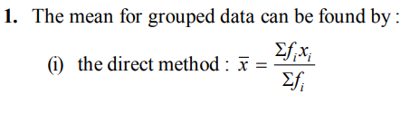
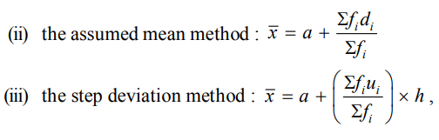
MEAN

Slide 3
MEAN OF GROUPED DATA
Example 1 : The marks obtained by 30 students of Class X of a certain school in a Mathematics paper consisting of 100 marks are presented in table below. Find the mean of the marks obtained by the students
Marks obtained (xi ) | 10 | 20 | 36 | 40 | 50 | 56 | 60 | 70 | 72 | 80 | 88 | 92 | 95
Number of students ( f i ) | 1 | 1 | 3 | 4 | 3 | 2 | 4 | 4 | 1 | 1 | 2 | 3 | 1
Solution:- we require the product of each xi with the corresponding frequency f i . So, let us put them in a column as shown in Table

Slide 4


Marks obtained (xi ) | Number of students ( f i ) | f ixi
10 20 36 40 50 56 60 70 72 80 88 92 95 | 1 1 3 4 3 2 4 4 1 1 2 3 1 | 10 20 108 160 150 112 240 280 72 80 176 276 95
TOTAL | ∑f i = 30 | ∑f i xi = 1779

Slide 5

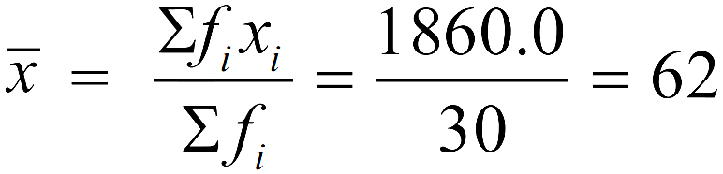
MEAN OF DIRECT METHOD
4 students who have obtained 40 marks would be considered in the class interval 40-55 and not in 25-40. With this convention in our mind, let us form a grouped frequency distribution table
Class interval | 10-25 | 25-40 | 40-55 | 55-70 | 70-85 | 85-100
Number of students | 2 | 3 | 7 | 6 | 6 | 6
Class interval | Number of students ( f i ) | Class mark (xi ) | f ixi
10-25 25-40 40-55 55-70 70-85 85-100 | 2 3 7 6 6 6 | 17.5 32.5 47.5 62.5 77.5 92.5 | 35.0 97.5 332.5 375.0 465.0 555.0
TOTAL | ∑f i = 30 |  | ∑f i xi = 1860.0

Slide 6
ASSUMED MEAN METHOD
4 students who have obtained 40 marks would be considered in the class interval 40-55 and not in 25-40. With this convention in our mind, let us form a grouped frequency distribution table
Class interval | 10-25 | 25-40 | 40-55 | 55-70 | 70-85 | 85-100
Number of students | 2 | 3 | 7 | 6 | 6 | 6
Class interval | Number of students ( f i ) | Class mark (xi ) | di = xi – 47.5 | f idi
10-25 25-40 40-55 55-70 70-85 85-100 | 2 3 7 6 6 6 | 17.5 32.5 47.5 62.5 77.5 92.5 | -30 -15 0 15 30 45 | -60 -45 0 90 180 270
TOTAL | ∑f i = 30 |  |  | ∑f idi = 435

Slide 7

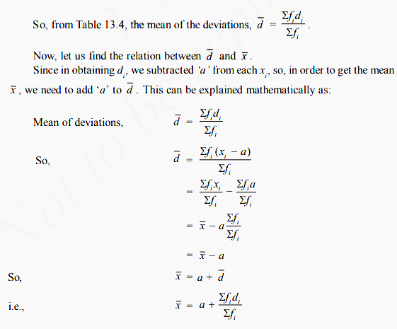

Slide 8

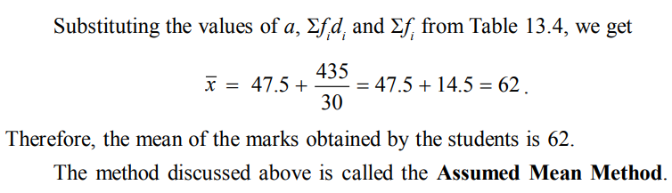

Slide 9
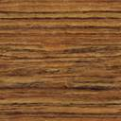
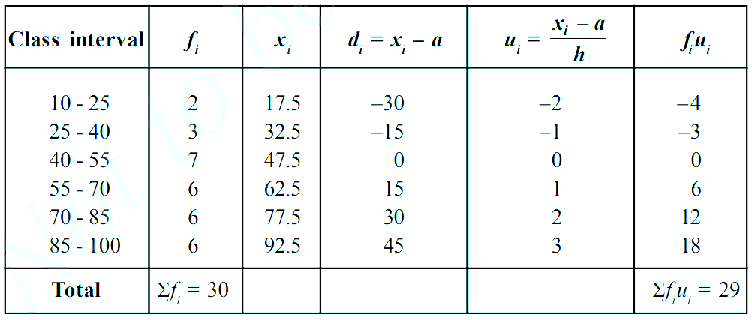
MEAN OF STEP DEVEATION METHOD
4 students who have obtained 40 marks would be considered in the class interval 40-55 and not in 25-40. With this convention in our mind, let us form a grouped frequency distribution table
Class interval | 10-25 | 25-40 | 40-55 | 55-70 | 70-85 | 85-100
Number of students | 2 | 3 | 7 | 6 | 6 | 6

Slide 10

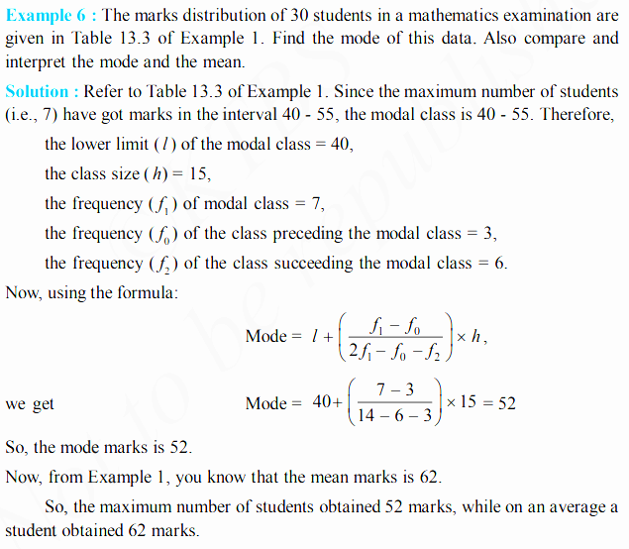
MODE OF GROUPED DATA

Slide 11

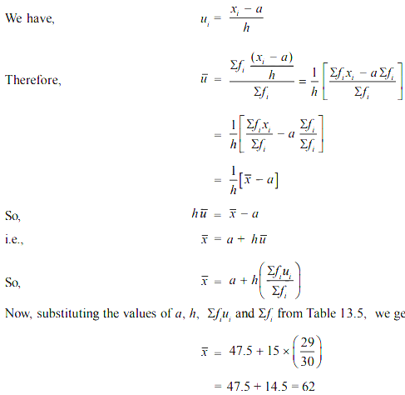

Slide 12
MEDIAN OF GROUPED DATA
Example 7 : A survey regarding the heights (in cm) of 51 girls of Class X of a school was conducted and the following data was obtained:
Height (in cm) | Number of girls
Less than 140 Less than 145 Less than 150 Less than 155 Less than 160 Less than 165 | 4 11 29 40 46 51
Find the median height.
Solution : To calculate the median height, we need to find the class intervals and their corresponding frequencies.
The given distribution being of the less than type, 140, 145, 150, . . ., 165 give the upper limits of the corresponding class intervals. So, the classes should be below 140, 140 - 145, 145 - 150, . . ., 160 - 165. Observe that from the given distribution, we find that there are 4 girls with height less than 140, i.e., the frequency of class interval below 140 is 4. Now, there are 11 girls with heights less than 145 and 4 girls with height less than 140. Therefore, the number of girls with height in the interval 140 - 145 is 11 – 4 = 7. Similarly, the frequency of 145 - 150 is 29 – 11 = 18, for 150 - 155, it is 40 – 29 = 11, and so on. So, our frequency distribution table with the given cumulative frequencies becomes:

Slide 13
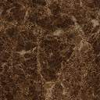
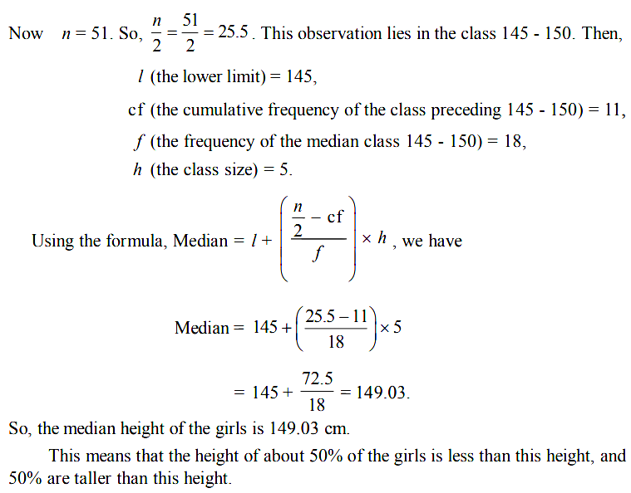
CLASS INTERVALS | FREQENCY | Cumulative frequency
BELOW 140 140-145 145-150 150-155 155-160 160-165 | 4 7 18 11 6 5 | 4 11 29 40 46 51

Slide 14
☺END☺

Slide 15
Thank you

