Slide 1
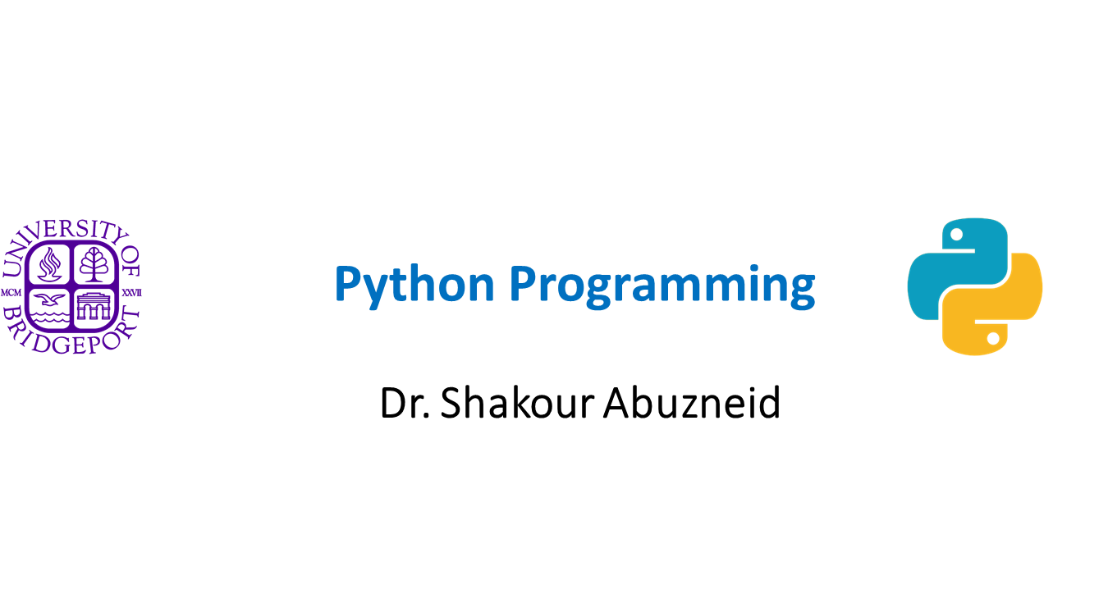

Slide 2
Python GUI – tkinter

Slide 3
Topics
Introduction to tkinter Window
Basic Widgets:
Label
Button
Entry
Canvas
Frame
Static drawing
Events Binding
Widget Variables More Widgets:
OptionMenu
Radiobutton
Checkbutton
Menu
Grid layout Dialogs

Slide 4
Introduction to tkinter
Python provides various options for developing graphical user interfaces (GUIs). In this course we will be using tkinter GUI module. tkinter is the Python interface (inter) to the Tk GUI toolkit shipped with Python. Tk offers native look and feel on all platforms.
tkinter consists of a number of modules. The Tk interface is provided by a binary extension module named _tkinter. This module contains the low-level interface to Tk, and should never be used directly by application programmers. The public interface is provided through a number of Python modules. The most important interface module is the tkinter module itself. To use tkinter, all you need to do is to import the tkinter module:
import tkinter Or more often: from tkinter import *
The tkinter module only exports widget classes and associated constants, so you can safely use the from-in form in most cases. If you prefer not to, but still want to save some typing, you can use import-as:
import tkinter as tk

Slide 5
Using tkinter
tkinter is a layered GUI, each component is creates a new layer in the window. tkinter is easy to use, the basic template to create a tkinter application is
Import the tkinter module
Create the GUI application main window
Add widgets and layers
Enter the main event loop to take action against each event triggered by the user

Slide 6
Window
The first component in tkinter is the window object.
All other components are added to the window object.
The window object also provides the main loop mechanism that keeps the application alive and listens to all events.
Sample Code:
import tkinter
window = tkinter.Tk() window.title("Hello, world") window.geometry("450x300") window.mainloop()

Slide 7
Window
We start by importing the tkinter module.
It contains all classes, functions and other things needed to work with the Tk toolkit:
import tkinter
To initialize tkinter, we have to create a Tk window widget.
This is an ordinary window, with a title bar and other decoration provided by your window manager.
You should only create one root widget for each program, and it must be created before any other widgets.
window = tkinter.Tk()

Slide 8
Window
The window wont appear until we’ve entered the tkinter event loop:
window.mainloop()
The program will stay in the event loop until we close the window. The event loop handles:
events from the user (such as mouse clicks and key presses)
events from the windowing system (such as redraw events and window configuration messages)
operations queued by tkinter itself (like geometry management and display updates)

Slide 9
Widgets
tkinter provides various controls to be used in GUI applications, such as buttons, labels and text boxes. These controls are commonly called widgets. All widgets inherits from the class widget.
Widgets can be directly added to the window, where the window serves as the master parent for those widgets. Widgets can be added to the master window using one of the three geometry managers.
There are currently many types of widgets in tkinter, in this course we will be using: Label, Button, Entry, Canvas, Frame, OptionMenu, Radiobutton, Checkbutton, and Menu. However, there are more widgets like: Listbox, Menubutton, Message, Scale, Scrollbar, Text, Toplevel, Spinbox, PanedWindow, and LabelFrame.

Slide 10
Geometry Management
Geometry manager (also know as layout manager) is responsible for organizing widgets throughout the parent widget area. tkinter has three geometry managers: Pack, Grid, and Place.
Pack: Pack is the easiest to use of the three geometry managers. Instead of having to declare precisely where a widget should appear on the display screen, the positions of widgets is declared relative to each other. Pack organizes widgets in blocks before placing them in the parent widget.
Grid: Grid was introduced in 1996 as an alternative to pack. The Grid geometry manager places the widgets in a 2-dimensional table, which consists of a number of rows and columns. The position of a widget is defined by a row and a column number
Place: Place allows explicitly setting the position and size of a widget, either in absolute terms, or relative to another widget.

Slide 11
Widgets Packing
All widgets inherit from the widget class, which implements the pack method. The pack methods calls the pack geometry manager to size the widget and to place it in a relative location.
The pack method accepts three parameters:
expand: When set to True, widget expands to fill any space not otherwise used in widget's parent.
fill: Determines whether widget fills any extra space allocated to it by the packer, or keeps its own minimal dimensions: NONE (default), X (fill only horizontally), Y (fill only vertically), or BOTH (fill both horizontally and vertically).
side: Determines which side of the parent widget packs against: TOP (default), BOTTOM, LEFT, or
RIGHT.

Slide 12
Widgets
Widget | Description
Label | The Label widget is used to provide a single-line caption for other widgets. It can also contain images.
Button | The Button widget is used to display buttons in your application.
Entry | The Entry widget is used to display a single-line text field for accepting values from a user.
Canvas | The Canvas widget is used to draw shapes, such as lines, ovals, polygons and rectangles, in your application.
Frame | The Frame widget is used as a container widget to organize other widgets.
OptionMenu | The option menu is similar to the combo box control commonly used on Windows.
Radiobutton | The Radiobutton widget is used to display a number of options as radio buttons. The user can select only one option at a time.
Checkbutton | The Checkbutton widget is used to display a number of options as checkboxes. The user can select multiple options at a time.
Menu | The Menu widget is used to provide various commands to a user. These commands are contained inside Menubutton.

Slide 13
Widgets: Label
The Label widget implements a display box where you can replace text or images.
Usually it’s used to provide a single-line caption for other widgets. The text displayed by this widget can be updated at any time you want.
lbl = Label ( master, option, ... )
The master is the container where we want to add the label, it can be the root window or any other container. Other parameters are usually passed and accessed as keyword parameters. For example, to change the label text, at any point just call:
lbl["text"] = "some text"

Slide 14
Widgets: Button
The Button widget is a standard tkinter widget used to implement various kinds of buttons. Buttons can contain text or images, and you can associate a Python function or method with each button. When the button is pressed, tkinter automatically calls that function or method.
btn1 = Button(master, text="OK", command=callback, image=None)
Where master is the parent container, text is the button text, and command is a function that will be called when a button is clicked.

Slide 15
Widgets: Entry
The Entry widget is a standard tkinter widget used to enter or display a single line of text. The entry widget is used to enter text strings. This widget allows the user to enter one line of text, in a single font. To enter multiple lines of text, use the Text widget.
ent1 = Entry(master)
To add entry text to the entry widget, use the insert method. To replace the current text, you can call delete before you insert the new text.
ent1.delete(0, END) ent1.insert(0, "a default value")
To get the current entry text, use the get method:
s = ent1.get()

Slide 16
Widgets: Canvas
The Canvas is a rectangular area intended for drawing or other complex layouts. You can place graphics, text, widgets, or frames on a Canvas.
The canvas is a general purpose widget, which is typically used to display and edit graphs and other drawings.
Another common use for this widget is to implement various kinds of custom widgets. For example, you can use a canvas as a completion bar, by drawing and updating a rectangle on the canvas.
Syntax: cnvs1 = Canvas(master, width, height)
To draw things in the canvas, use the create methods to add new items.

Slide 17
Widgets: Frame
The Frame widget is very important for the process of grouping and organizing other widgets in a somehow friendly way. It works like a container, which is responsible for arranging the position of other widgets.
It uses rectangular areas in the screen to organize the layout and to provide padding of these widgets. A frame can also be used as a foundation class to implement complex widgets.
Syntax: w = Frame ( master, option, ... )

Slide 18
Widgets: Static Drawing
We can draw shapes directly to a canvas widget. The canvas widget supports the following standard shapes:
arc . Creates an arc item.
coord = 10, 50, 240, 210
arc = canvas.create_arc(coord, start=0, extent=150, fill="blue")
image . Creates an image item, which can be an instance of either the BitmapImage or the PhotoImage classes. filename = PhotoImage(file = "sunshine.gif")
image = canvas.create_image(50, 50, anchor=NE, image=filename)
line . Creates a line item.
line = canvas.create_line(x0, y0, x1, y1, ..., xn, yn, options)
oval . Creates a circle or an ellipse at the given coordinates. oval = canvas.create_oval(x0, y0, x1, y1, options)
polygon . Creates a polygon item that must have at least three vertices.
poly = canvas.create_polygon(x0, y0, xs1, y1,...xn, yn, options)

Slide 19
Widgets: Events Binding
As was mentioned earlier, a Tkinter application spends most of its time inside an event loop (entered via the mainloop method). Events can come from various sources, including key presses and mouse operations by the user, and redraw events from the window manager (indirectly caused by the user, in many cases).
Tkinter provides a powerful mechanism to let you deal with events yourself. For each widget, you can bind Python functions and methods to events.
widget.bind(event, handler)
If an event matching the event description occurs in the widget, the given handler is called with an object describing the event.

Slide 20
Widgets Events Binding : Event Attributes
widget: The widget which generated this event. This is a valid Tkinter widget instance, not a name. This attribute is set for all events.
x, y: The current mouse position, in pixels.
x_root, y_root: The current mouse position relative to the upper left corner of the screen, in pixels.
char: The character code (keyboard events only), as a string.
keysym: The key symbol (keyboard events only).
keycode: The key code (keyboard events only).
num: The button number (mouse button events only).
width, height: The new size of the widget, in pixels (Configure events only).
type: The event type.

Slide 21
Widget Variables
The current-value setting of some widgets (like text entry widgets) can be connected directly to application variables by using special options.
This connection works both ways: If variable changes for any reason, the widget it is connected , will be updated to reflect the new value.
The only kinds of variables for which this works are variables that are subclassed from a class called Variable, defined in tkinter.
There are many useful subclasses of Variable already defined: StringVar, IntVar, DoubleVar, and BooleanVar.
To read the current value of such a variable, call the get() method on it, and to change its value you call the set() method.
Widget variables can also be traced to capture change events. To observe the change on a widget variable, call the trace method as: trace(mode, call-back) where mode is:
r: capture read events
w: capture write events
u: the value is deleted

Slide 22
Option Menu
The option menu is similar to the combo box widgets commonly used on Windows.
To get the currently selected value from an option menu, you have to pass in a widget variable. The menu options are passed to the constructor as arbitrary arguments.
om1 = OptionMenu(master, strvar, optionɨ [, optionɩ, …])

Slide 23
Radio Button
The Radiobutton is a standard Tkinter widget used to implement one-of-many (single) selection. Radiobuttons can contain text or images, and you can associate a Python function or method with each button. When the button is pressed, Tkinter automatically calls that function or method.
Radiobutton can be associated with widget variables of the type IntVar. To create a Radiobutton group, all the Radiobuttons should be associated with the same widget variables.
Syntax: rb1 = Radiobutton(master [, options])
To select a specific Radiobutton, call the method select(). To remove the selection, use the method deselect().

Slide 24
Check Button
The Checkbutton is a standard Tkinter widget similar to the Radiobutton but is used to implement on-off multiple selections. Checkbuttons can contain text or images, and you can associate a Python function or method with each button. When the button is pressed, Tkinter automatically calls that function or method.
Checkbutton can be associated with widget variables of the type IntVar. Syntax: cb1 = Checkbutton(master [, options])
Important options: onvalue (default: 1), offvalue (default: 0)
To select a specific Radiobutton, call the method select(). To remove the selection, use the method deselect().

Slide 25
Menu
The Menu widget is used to implement top-level menus. Top-level menus are displayed directly under the title bar of the window (on Apple Mac, along the upper edge of the screen).
To create a top-level menu, create a new Menu instance, and use add_ methods to add
commands and other menu entries to it.
Submenus are created in a similar fashion. The main difference is that they are attached to a parent menu (using add_cascade ), instead of a toplevel window.
The menu provides the following add_ methods:
add_cascade
add_checkbutton
add_command
add_radiobutton
add_separator

Slide 26
Grid Layout
The Grid geometry manager puts the widgets in a 2-dimensional table. The master widget is
split into number of rows and columns and each cell in can hold a widget.
The grid manager is the more flexible than the pack manager and provides easier way to place widgets on the window. Instead of using lots of extra frames to get the packing to work, you can in most cases simply pour all the widgets into a single container widget, and use the grid manager to get them all where you want them.
Note that the widgets are centred in their cells. You can use the sticky option to change this;
this option takes one or more values from the set N, S, E, W.
Note that the column number defaults to 0 if not given.
Warning: Never mix grid and pack in the same window

Slide 27
Place Layout
The Place layout allows you explicitly set the position and size of a window, either in absolute terms, or relative to another window. You can access the place manager through
the place method which is available for all standard widgets.
It is usually not a good idea to use place for ordinary window and dialog layouts; its simply to much work to get things working as they should. Use the pack or grid managers for such purposes.
However, place has its uses in more specialized cases. Most importantly, it can be used by compound widget containers to implement various custom geometry managers. Another use is to position control buttons in dialogs.

Slide 28
Dialogs
Tkinter library provides a set of standard dialogs that can be used to display message boxes, and to select files and colors. In addition, Tkinter provides some simple dialogs allowing you to ask the user for integers, floating point values, and strings. Where possible, these standard dialogs use platform-specific mechanisms, to get the right look and feel.
The tkinter.messagebox module provides an interface to the message dialogs. The easiest way to use this module is to use one of the convenience functions:
showinfo, showwarning, showerror, askquestion, askokcancel, askyesno, or askretrycancel.
They all have the same syntax: messagebox.{function}(title, message [, options])

Slide 29
Custom Dialogs
Standard dialogs might be sufficient for many simple applications. However, some applications require more complicated dialogs. For example, Login dialog, or to set the application configuration parameters a more advanced dialog is required.
Custom dialogs are implemented using the TopLevel widget and called using wait_window
method from the window object.

