Slide 1

OpenMax IL in android

Slide 2
Indroduction
What is OpenMAX IL?
A standard API for multimedia processing.
Facilitates integration of hardware codecs in multimedia applications.
Why OpenMAX IL?
Cross-platform compatibility.
Efficient hardware acceleration.

Slide 3
Overview of MediaCodecInfo and MediaCodecList
MediaCodecInfo:
Describes individual codecs (encoders/decoders) available on the device.
Contains details like codec name, type (encoder or decoder), supported formats, and capabilities.
MediaCodecList:
Manages a list of all available codecs on the system.
Facilitates querying codec capabilities, filtering by MIME type, and checking support for specific media formats.

Slide 4
Flow
Application:
The component or app that initiates the request for media encoding/decoding.
Examples: A media player, video recorder, or streaming service.
MediaCodecList:
A registry of all available codecs on the device.
Handles filtering and selecting codecs based on the application's requirements.
MediaCodecInfo:
Represents individual codecs and provides detailed information about each codec’s capabilities.
OMX Core:
The OpenMAX IL core that acts as a mediator between the application and the hardware/software codecs.
Responsible for initializing and managing the codec components.
Hardware Codec:
The actual hardware-accelerated implementation of the codec, which performs the encoding/decoding tasks.

Slide 5
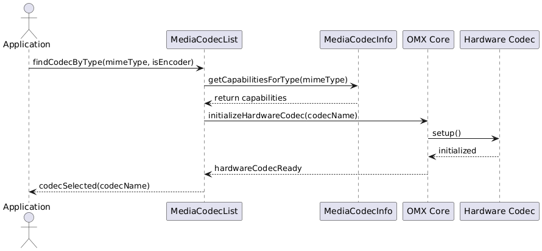
Sequence Diagram

Slide 6
Audio-Specific MIME Types:
For audio codecs, the MIME types are different. Examples include:
audio/mp4a-latm for AAC (Advanced Audio Codec).
audio/amr-wb for AMR-WB (Adaptive Multi-Rate Wideband).
audio/vorbis, audio/opus, etc.
Audio Codec Capabilities:
MediaCodecInfo will be queried for audio-specific capabilities, such as:
Supported sample rates (e.g., 44.1 kHz, 48 kHz).
Bit depths (e.g., 16-bit, 24-bit).
Channel configurations (mono, stereo, 5.1 surround, etc.).
Bitrate ranges (e.g., 64 kbps to 320 kbps).
Audio-Specific Prioritization:
Hardware audio codecs are prioritized for tasks like:
High-performance audio playback or recording.
Low-latency audio processing for real-time communication (e.g., VoIP).
Software codecs are fallback options for unsupported formats or capabilities.

Slide 7
mediacodecinfo.cpp:
getName():
Returns the name of the codec (e.g., OMX.vendor.codec).
Example:
std::string MediaCodecInfo::getName() const {
return mName;
}
isEncoder():
Checks if the codec is an encoder.
Example:
bool MediaCodecInfo::isEncoder() const {
return mIsEncoder;
}
getSupportedTypes():
Returns a list of MIME types supported by the codec.
Example:
std::vector<std::string> MediaCodecInfo::getSupportedTypes() const {
return mSupportedMIMETypes;
}
getCapabilitiesForType(const std::string &mimeType):
Retrieves codec capabilities for a specific MIME type, like max resolution, bit rate, etc.

Slide 8
mediaCodecList.cpp:
getCodecCount():
Returns the total number of available codecs.
size_t MediaCodecList::getCodecCount() const {
return mCodecInfos.size();
}
findCodecByType(const std::string &mimeType, bool isEncoder):
Searches for a codec that matches the MIME type and whether it’s an encoder.
const MediaCodecInfo* MediaCodecList::findCodecByType(const std::string &mimeType, bool isEncoder) const {
for (const auto& codec : mCodecInfos) {
if (codec.supportsType(mimeType) && codec.isEncoder() == isEncoder) {
return &codec;
}
}
return nullptr;
}
isSoftwareCodec(const std::string &codecName):
Determines if the codec is a software implementation.
bool MediaCodecList::isSoftwareCodec(const std::string &codecName) const {
return codecName.find("OMX.google.") == 0;
}
initialize():
Initializes the codec list by querying the system and populating MediaCodecInfo objects.

Slide 9
OpenMAX IL APIs for Audio Codec Initialization
Key APIs :
Query Codec Capabilities:
Retrieve supported audio formats and configurations.
OMX_COMPONENTTYPE *pComponent;
OMX_AUDIO_PARAM_PORTFORMATTYPE audioFormat;
OMX_GetParameter(pComponent, OMX_IndexParamAudioPortFormat, &audioFormat);
Set Codec Parameters:
Configure specific codec settings, such as profiles, sample rates, and bitrate.
OMX_SetParameter(handle, OMX_IndexParamAudioPcm, &pcmParams);
Initialize Codec:
Transition the codec state to Executing to start processing.
OMX_SendCommand(handle, OMX_CommandStateSet, OMX_StateExecuting, NULL);

Slide 10
Hardware audio codec intialization
OMX_HANDLETYPE handle;
OMX_BUFFERHEADERTYPE* pBuffer[4];
OMX_PARAM_PORTDEFINITIONTYPE portDef;
// Configure port
OMX_INIT_STRUCT(&portDef, OMX_PARAM_PORTDEFINITIONTYPE);
portDef.nPortIndex = 0; // Input port
OMX_GetParameter(handle, OMX_IndexParamPortDefinition, &portDef);
// Allocate buffers
for (int i = 0; i < portDef.nBufferCountActual; i++) {
OMX_AllocateBuffer(handle, &pBuffer[i], portDef.nPortIndex, NULL, portDef.nBufferSize);
}
// Enable port
OMX_SendCommand(handle, OMX_CommandPortEnable, portDef.nPortIndex, NULL);

Slide 11
Thank You

